Slide 1


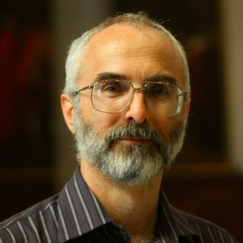

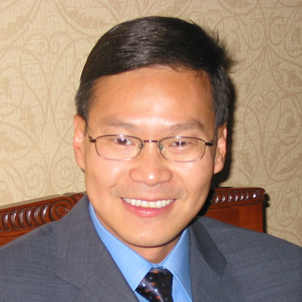















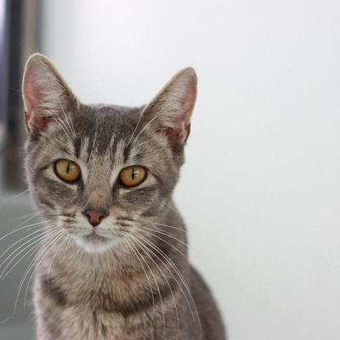
cppcon 2017
Attended eighteen talks
Saw twenty-one speakers

Slide 2

cppcon 2017
Some were boring

Slide 3
cppcon 2017
Here are the talks I liked

Slide 4


From security to performance to GPU programming: exploring modern allocators
Sergey Zubkov
Allocators allow you to do magic in legacy situations
Memory pools can prevent fragmentation

Slide 5
dynamic_cast From Scratch
Arthur O'Dwyer
Inheritance is cuckoo bananas
Informative talk. Takeaway:
If you want to understand your objects, use neither multiple nor virtual inheritance

Slide 6


Using Functional Programming Patterns to build a clean and simple HTTP routing API
Jeremy Demeule, Quentin Duval
Use expression templates to define declarative domain specific languages in your API
auto router = RequestRouter(
GET(Uri(“stocks”)/“current”/Int(“id”)), LastPrice(),
GET(Uri(“stocks”)/Ticker(“ticker”)), History(),
GET(Uri(“status”)/Regex(“(exchange|security)[0-9]+”), Status());
std::cout << typeid(router).name() << ‘\n’; // something insane

Slide 7
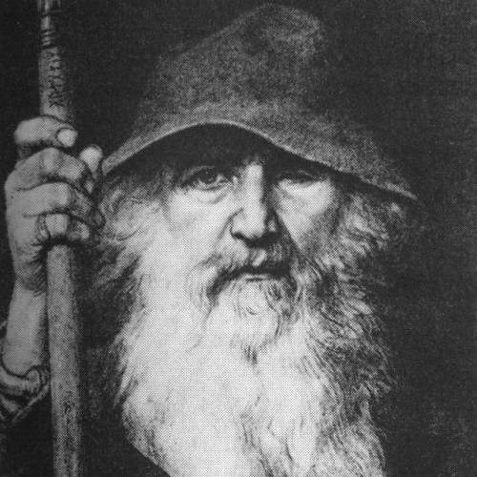
Agent based class design,
C++ with a robot glue gun
Odin Holmes
Odin is a C++ wizard
I don’t understand what Odin is doing
Something about assembling capabilities of electronic components at compile time in a modular fashion
Let the C++ compiler write your device code for you?

Slide 8

Meta: Thoughts on generative C++
(define-syntax define-record-type
(syntax-rules ()
((define-record-type type
(constructor constructor-tag ...)
predicate
(field-tag accessor . more) ...)
(begin
(define type
(make-record-type 'type '(field-tag ...)))
(define constructor
(record-constructor type '(constructor-tag ...)))
(define predicate
(record-predicate type))
(define-record-field type field-tag accessor . more)
...))))
Herb Sutter
Proposed an idea of what “meta-classes” might look like
I’m not turning C++ into Lisp, I promise!
I’m just simplifying what we already do, honest!

Slide 9
Reader-Writer Lock versus Mutex –
Understanding a Lost Bet
Jeffrey Mendelsohn
Just use a mutex
Always label your axes
Measure benchmarks in isolation

Slide 10
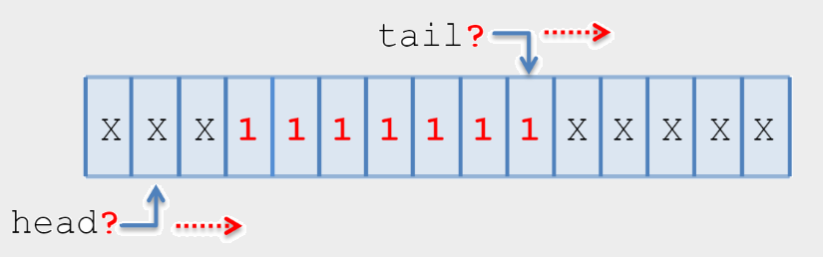
An Interesting Lock-free Queue –
Part 2 of N
Tony Van Eerd
Lock-free queues are interesting
Subtle
Fun to think about
You should never use one

Slide 11



Objects, Lifetimes, and References
oh my: the C++ Object Model, and Why it Matters to You
Nicole Mazzuca
Rebind reference members when assigning to object
Value/object relationship
Object
Value

Slide 12

So, you inherited a large code base...
David Sankel
How to improve BAS
Migration paths
Mnemonics, automated refactoring

Slide 13
Going Nowhere Faster
Chandler Carruth
X86 code is compiled (in the chip) into microcode
Microcode is pipelined, scheduled, reordered
Code does not do what you think

Slide 14
Unbolting the Compiler's Lid: What Has My Compiler Done for Me Lately?
Matt Godbolt
godbolt.org is cool
Matt is cool
The -O3 optimization setting is cool

Slide 15
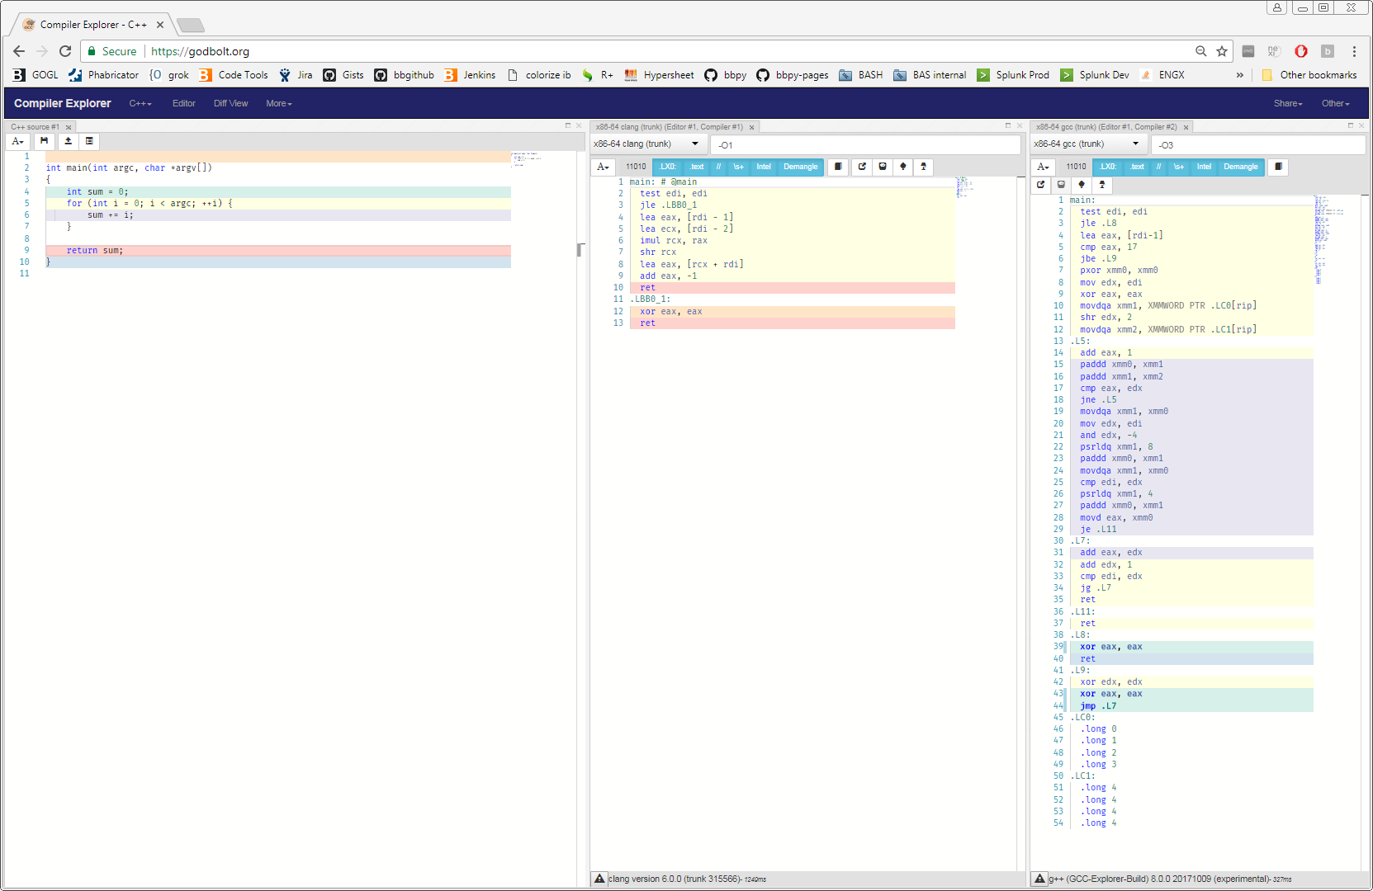
Unbolting the Compiler's Lid: What Has My Compiler Done for Me Lately?

Slide 16
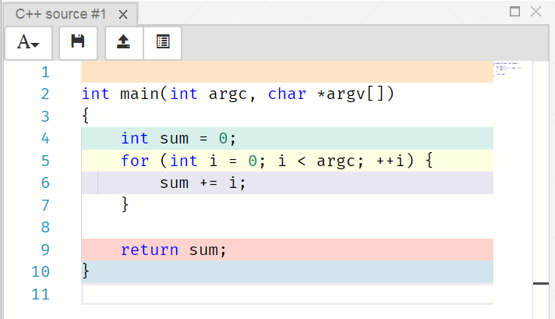
Unbolting the Compiler's Lid: What Has My Compiler Done for Me Lately?

Slide 17
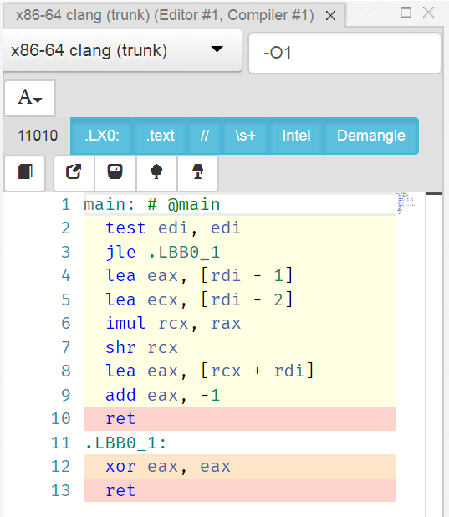
Unbolting the Compiler's Lid: What Has My Compiler Done for Me Lately?

Slide 18
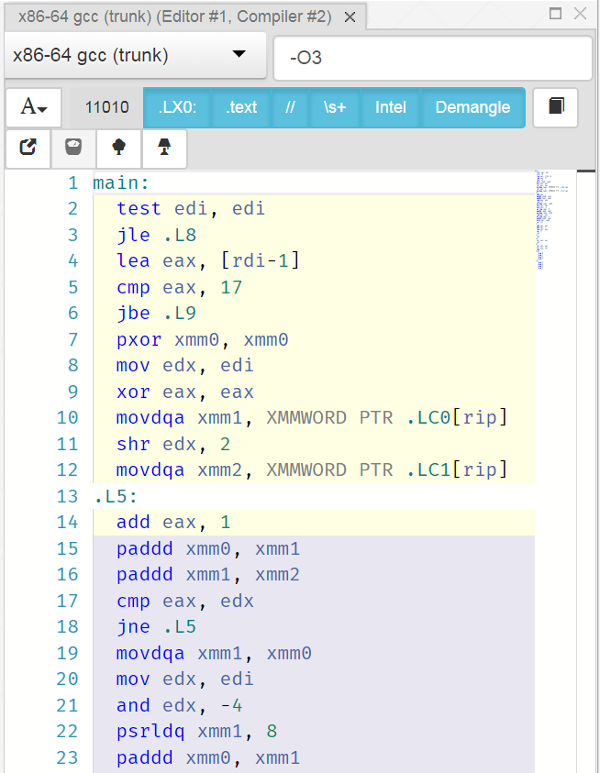
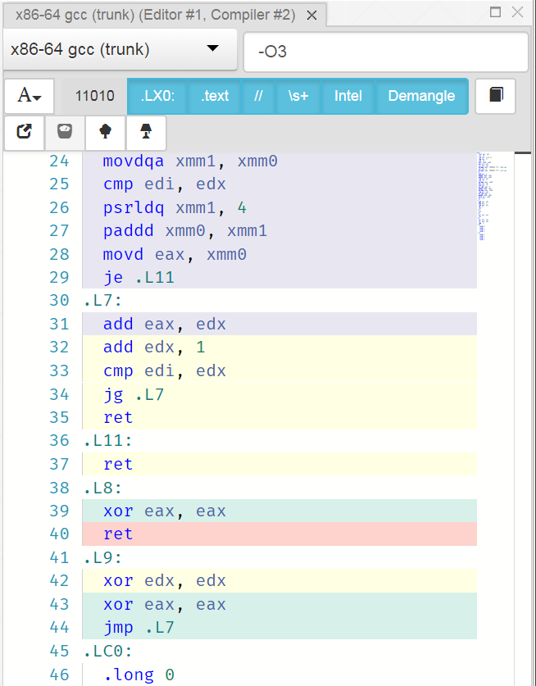
Unbolting the Compiler's Lid: What Has My Compiler Done for Me Lately?

Slide 19
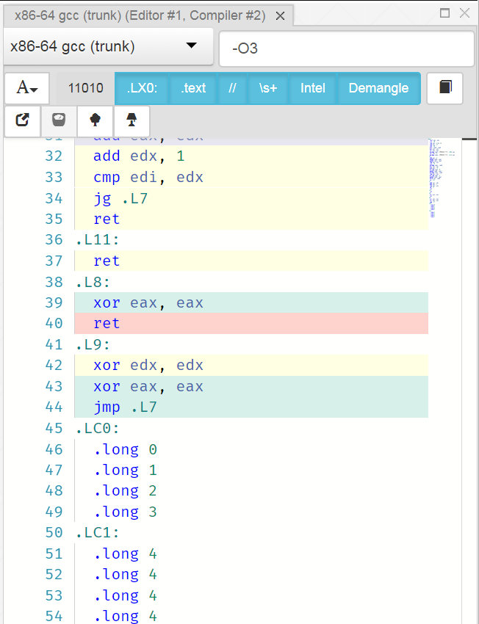
Unbolting the Compiler's Lid: What Has My Compiler Done for Me Lately?

Slide 20
cppcon 2017
That’s it for the talks I liked

Slide 21
Overall Impression of the Conference
Reflection/generation as language features
  What we’re going towards is hygienic macros
  But not, since C++ isn’t (and shouldn’t be) homoiconic
Meta-programming to build domain-tailored APIs
  Templates, SFINAE, constexpr, traits, constexpr if…
Make everything go faster
  Measurement is assumed but how often overlooked?
Concurrency still treated as a niche
  No more free lunch, blah blah, co-routines, blah blah

Slide 22
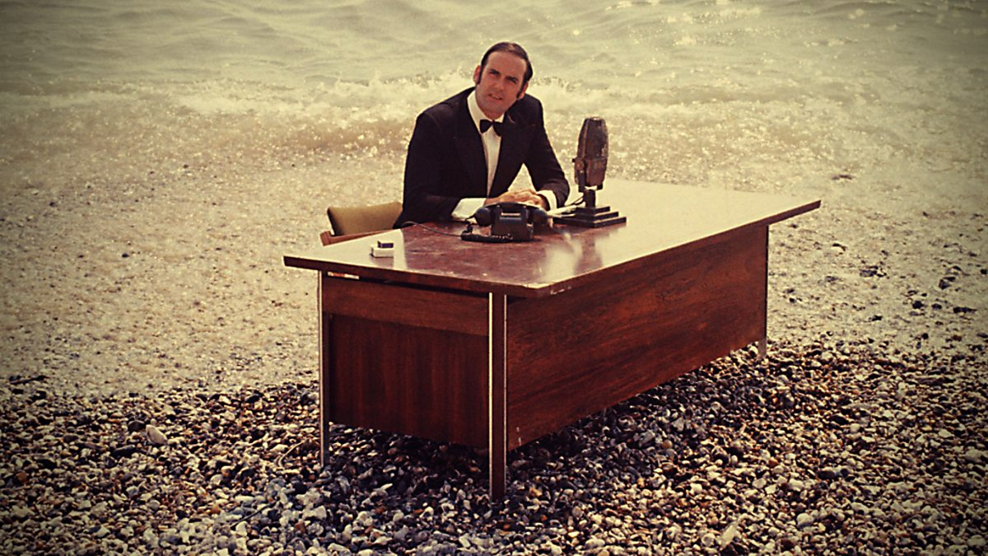

Slide 23
#define

Slide 24
I aspire to a more perfect enum

Slide 25
enum Color { e_RED, e_GREEN, e_PURPLE };
Color favorite = e_PURPLE;
cout << "I like " << favorite;
Color boring = Color::e_RED;
“I like 2”
“Error: WTF is Color::e_RED?”

Slide 26
enum class Color { e_RED, e_GREEN, e_PURPLE };
Color favorite = Color::e_PURPLE;
cout << "I like " << favorite;
“I like 2”

Slide 27
struct Color {
enum Value { e_RED, e_GREEN, e_PURPLE };
};
Color favorite = Color::e_PURPLE;
Color::Value best = Color::e_PURPLE;
cout << "I like " << best;
Error: No conversion
“I like 2”

Slide 28
bas_codegen.pl

Slide 29
/home/dgoffred/git/bas-codegen ! $ \
> git ls-files '*.*' | \
> sed 's/.*\.\([^.]\+\)$/\1/' | \
> sort | \
> uniq -c | \
> sort -r
90 pm
58 t
57 mk
57 mem
57 dep
57 cap
52 xml
19 opts
18 gitignore
10 xsd
10 sh
10 cpp
8 dd
6 pl
6 h
6 d
5 sundev1
5 defs
2 md
1 pod
1 ini
1 depends

Slide 30
/home/dgoffred/git/bas-codegen ! $ cat \
> <(git ls-files '*.pl') \
> <(git ls-files '*.pm') \
> <(git ls-files '*.t') | \
> xargs wc -l | \
> tail -1
68761 total

Slide 31
<?xml version="1.0" encoding="UTF-8"?>
<xs:schema
xmlns:xs="http://www.w3.org/2001/XMLSchema"
xmlns:bdem="http://bloomberg.com/schemas/bdem">
<xs:simpleType name="Color">
<xs:restriction base="xs:string">
<xs:enumeration value="RED" bdem:id="0" />
<xs:enumeration value="GREEN" bdem:id="1" />
<xs:enumeration value="PURPLE" bdem:id="2" />
</xs:restriction>
</xs:simpleType>
</xs:schema>

Slide 32
$ bas_codegen.pl \
> --mode msg \
> --msgExpand \
> --noAggregateConversion \
> --noExternalization \
> --package msgs \
> color.xsd
The schema is valid
Generating ./msgs_color.cpp
Generating ./msgs_color.h

Slide 33
$ wc -l msgs_color.{h,cpp}
167 msgs_color.h
119 msgs_color.cpp
286 total

Slide 34
$ less msgs_color.{h,cpp}
// msgs_color.h *DO NOT EDIT* @generated -*-C++-*-
#ifndef INCLUDED_MSGS_COLOR
#define INCLUDED_MSGS_COLOR
#ifndef INCLUDED_BDES_IDENT
#include <bdes_ident.h>
#endif
BDES_IDENT_RCSID(msgs_color_h, "$Id$ $CSID$")
BDES_IDENT_PRAGMA_ONCE
//@PURPOSE: Provide value-semantic attribute classes
//
//@AUTHOR: David GOFFREDO (dgoffredo@bloomberg.net)
#ifndef INCLUDED_BSLALG_TYPETRAITS
#include <bslalg_typetraits.h>
#endif
#ifndef INCLUDED_BDEAT_ATTRIBUTEINFO
#include <bdeat_attributeinfo.h>
#endif
#ifndef INCLUDED_BDEAT_ENUMERATORINFO
#include <bdeat_enumeratorinfo.h>
#endif

Slide 35
$ less msgs_color.{h,cpp}
#ifndef INCLUDED_BDEAT_TYPETRAITS
#include <bdeat_typetraits.h>
#endif
#ifndef INCLUDED_BSLS_ASSERT
#include <bsls_assert.h>
#endif
#ifndef INCLUDED_BSL_IOSFWD
#include <bsl_iosfwd.h>
#endif
#ifndef INCLUDED_BSL_OSTREAM
#include <bsl_ostream.h>
#endif
#ifndef INCLUDED_BSL_STRING
#include <bsl_string.h>
#endif

Slide 36
$ less msgs_color.{h,cpp}
namespace BloombergLP {
namespace msgs {
// ===========
// class Color
// ===========
struct Color {
public:
// TYPES
enum Value {
RED = 0
, GREEN = 1
, PURPLE = 2
};
enum {
NUM_ENUMERATORS = 3
};
// CONSTANTS
static const char CLASS_NAME[];
static const bdeat_EnumeratorInfo ENUMERATOR_INFO_ARRAY[];

Slide 37
$ less msgs_color.{h,cpp}
// CLASS METHODS
static const char *toString(Value value);
// Return the string representation exactly matching the enumerator
// name corresponding to the specified enumeration 'value'.
static int fromString(Value *result,
const char *string,
int stringLength);
// Load into the specified 'result' the enumerator matching the
// specified 'string' of the specified 'stringLength'. Return 0 on
// success, and a non-zero value with no effect on 'result' otherwise
// (i.e., 'string' does not match any enumerator).
static int fromString(Value *result,
const bsl::string& string);
// Load into the specified 'result' the enumerator matching the
// specified 'string'. Return 0 on success, and a non-zero value with
// no effect on 'result' otherwise (i.e., 'string' does not match any
// enumerator).
static int fromInt(Value *result, int number);
// Load into the specified 'result' the enumerator matching the
// specified 'number'. Return 0 on success, and a non-zero value with
// no effect on 'result' otherwise (i.e., 'number' does not match any
// enumerator).

Slide 38
$ less msgs_color.{h,cpp}
static bsl::ostream& print(bsl::ostream& stream, Value value);
// Write to the specified 'stream' the string representation of
// the specified enumeration 'value'. Return a reference to
// the modifiable 'stream'.
};
// FREE OPERATORS
inline
bsl::ostream& operator<<(bsl::ostream& stream, Color::Value rhs);
// Format the specified 'rhs' to the specified output 'stream' and
// return a reference to the modifiable 'stream'.
} // close package namespace
// TRAITS
BDEAT_DECL_ENUMERATION_TRAITS(msgs::Color)
// ============================================================================
// INLINE FUNCTION DEFINITIONS
// ============================================================================

Slide 39
$ less msgs_color.{h,cpp}
namespace msgs {
// -----------
// class Color
// -----------
// CLASS METHODS
inline
int Color::fromString(Value *result, const bsl::string& string)
{
return fromString(result,
string.c_str(),
static_cast<int>(string.length()));
}
inline
bsl::ostream& Color::print(bsl::ostream& stream,
Color::Value value)
{
return stream << toString(value);
}
} // close package namespace

Slide 40
$ less msgs_color.{h,cpp}
// FREE FUNCTIONS
inline
bsl::ostream& msgs::operator<<(
bsl::ostream& stream,
msgs::Color::Value rhs)
{
return msgs::Color::print(stream, rhs);
}
} // close enterprise namespace
#endif
// GENERATED BY BLP_BAS_CODEGEN_3.8.26 Fri Oct 13 21:00:46 2017
// USING bas_codegen.pl --mode msg --msgExpand –noAggregateConversion --noExternalization --package msgs generated.xsd
// ----------------------------------------------------------------------------
// NOTICE:
// Copyright (C) Bloomberg L.P., 2017
// All Rights Reserved.
// Property of Bloomberg L.P. (BLP)
// This software is made available solely pursuant to the
// terms of a BLP license agreement which governs its use.
// ------------------------------ END-OF-FILE ---------------------------------

Slide 41
$ less msgs_color.{h,cpp}
// msgs_color.cpp *DO NOT EDIT* @generated -*-C++-*-
#include <bdes_ident.h>
BDES_IDENT_RCSID(msgs_color_cpp,"$Id$ $CSID$")
#include <msgs_color.h>
#include <bdeat_formattingmode.h>
#include <bdeat_valuetypefunctions.h>
#include <bdeu_print.h>
#include <bdeu_printmethods.h>
#include <bdeu_string.h>
#include <bdlb_print.h>
#include <bslim_printer.h>
#include <bsls_assert.h>
#include <bsl_iomanip.h>
#include <bsl_limits.h>
#include <bsl_ostream.h>
namespace BloombergLP {
namespace msgs {

Slide 42
$ less msgs_color.{h,cpp}
// -----------
// class Color
// -----------
// CONSTANTS
const char Color::CLASS_NAME[] = "Color";
const bdeat_EnumeratorInfo Color::ENUMERATOR_INFO_ARRAY[] = {
{
Color::RED,
"RED",
sizeof("RED") - 1,
""
},
{
Color::GREEN,
"GREEN",
sizeof("GREEN") - 1,
""
},
{
Color::PURPLE,
"PURPLE",
sizeof("PURPLE") - 1,
""
}
};

Slide 43
$ less msgs_color.{h,cpp}
// CLASS METHODS
int Color::fromInt(Color::Value *result, int number)
{
switch (number) {
case Color::RED:
case Color::GREEN:
case Color::PURPLE:
*result = (Color::Value)number;
return 0;
default:
return -1;
}
}

Slide 44
$ less msgs_color.{h,cpp}
int Color::fromString(
Color::Value *result,
const char *string,
int stringLength)
{
for (int i = 0; i < 3; ++i) {
const bdeat_EnumeratorInfo& enumeratorInfo =
Color::ENUMERATOR_INFO_ARRAY[i];
if (stringLength == enumeratorInfo.d_nameLength
&& 0 == bsl::memcmp(enumeratorInfo.d_name_p, string, stringLength))
{
*result = (Color::Value)enumeratorInfo.d_value;
return 0;
}
}
return -1;
}

Slide 45
$ less msgs_color.{h,cpp}
const char *Color::toString(Color::Value value)
{
switch (value) {
case RED: {
return "RED";
} break;
case GREEN: {
return "GREEN";
} break;
case PURPLE: {
return "PURPLE";
} break;
}
BSLS_ASSERT(!"invalid enumerator");
return 0;
}
} // close package namespace
} // close enterprise namespace

Slide 46
$ less msgs_color.{h,cpp}
// GENERATED BY BLP_BAS_CODEGEN_3.8.26 Fri Oct 13 21:00:46 2017
// USING bas_codegen.pl --mode msg --msgExpand --noAggregateConversion --package msgs generated.xsd
// ----------------------------------------------------------------------------
// NOTICE:
// Copyright (C) Bloomberg L.P., 2017
// All Rights Reserved.
// Property of Bloomberg L.P. (BLP)
// This software is made available solely pursuant to the
// terms of a BLP license agreement which governs its use.
// ------------------------------ END-OF-FILE ---------------------------------

Slide 47
#include <msgs_color.h>
Color::Value favorite = Color::PURPLE;
cout << "I like " << favorite;
“I like PURPLE”

Slide 48
// ... insert magic here ...
Color favorite;
cin >> favorite;
if (!cin) {
cerr << "That's not a color.";
return 1;
}
if (favorite == Color::e_PURPLE) {
cout << "Good choice.";
}
else {
cout << favorite << " is in poor taste.";
}
“RED is in poor taste”

Slide 49
bslmc::enumeration Color { RED, GREEN, PURPLE };
Color favorite;
cin >> favorite;
if (!cin) {
cerr << "That's not a color.";
return 1;
}
if (favorite == Color::e_PURPLE) {
cout << "Good choice.";
}
else {
cout << favorite << " is in poor taste.";
}
“RED is in poor taste”

Slide 50
DEFINE_ENUM(Color, RED, GREEN, PURPLE);
Color favorite;
cin >> favorite;
if (!cin) {
cerr << "That's not a color.";
return 1;
}
if (favorite == Color::e_PURPLE) {
cout << "Good choice.";
}
else {
cout << favorite << " is in poor taste.";
}
“RED is in poor taste”

Slide 51
DEFINE_ENUM(NAME, ...);
Journey to the Center of the C++

Slide 52
When I type this:
DEFINE_ENUM(Color, RED, GREEN, PURPLE);

Slide 53
I want it to expand to this:
class Color {
public:
enum Value { e_RED, e_GREEN, e_PURPLE };
enum { k_NUM_VALUES = 3 };
static const StringRef(&names())[k_NUM_VALUES] // { ... }
private:
Value d_value;
public:
Color() // { .. }
Color(Value) // { ... }
operator Value() const // { ... }
StringRef toString() const // { ... }
friend ostream& operator<<(ostream&, const Color&) // { ... }
int fromString(const StringRef&) // { ... }
friend ostream& operator>>(ostream&, Color&) // { ... }
};
constants with the e_

Slide 54
where the strings are in the names() like this:
static const StringRef(&names())[k_NUM_VALUES]
{
static const StringRef(*dataPtr)[k_NUM_VALUES] = 0;
BSLMT_ONCE_DO
{
static const StringRef data[] = {
"RED", "GREEN", "PURPLE"
};
dataPtr = &data;
}
return *dataPtr;
}
each of the arguments “quoted”

Slide 55


Slide 56
Say you want to overload a macro on arity, so that:
MY_MACRO(arg1);
MY_MACRO(arg1, arg2);
MY_MACRO(arg1, arg2, arg3);
invoke three totally different macro definitions.
Can that be done?

Slide 57
YES
but you’re not going to like it

Slide 58
A macro that expands to how many arguments were passed to it:
NUM_ARGS(foo, bar) → 2
#define NUM_ARGS(...) // ... ?
How can such a macro be defined?

Slide 59
For any finite maximum supported arity (say, 3):
#define NUM_ARGS_HELPER(A3, A2, A1, N, ...) \
N
#define NUM_ARGS(...) \
NUM_ARGS_HELPER(__VA_ARGS__, 3, 2, 1)
Then the expansion of
NUM_ARGS(foo, bar)
is 2, because:
NUM_ARGS_HELPER(foo, bar, 3, 2, 1)
// NUM_ARGS_HELPER(A3, A2, A1, N, ...) N

Slide 60
Then you can have:
#define MY_MACRO_1(A1) "one"
#define MY_MACRO_2(A1, A2) "two"
#define MY_MACRO_3(A1, A2, A3) "three"
#define MY_MACRO_HELPER(N, ...) \
MY_MACRO_##N(__VA_ARGS__)
#define MY_MACRO(...) \
MY_MACRO_HELPER(NUM_ARGS(__VA_ARGS__), \
__VA_ARGS__)
and so
cout << MY_MACRO(foo, bar);
expands to
cout << "two";

Slide 61


Slide 62
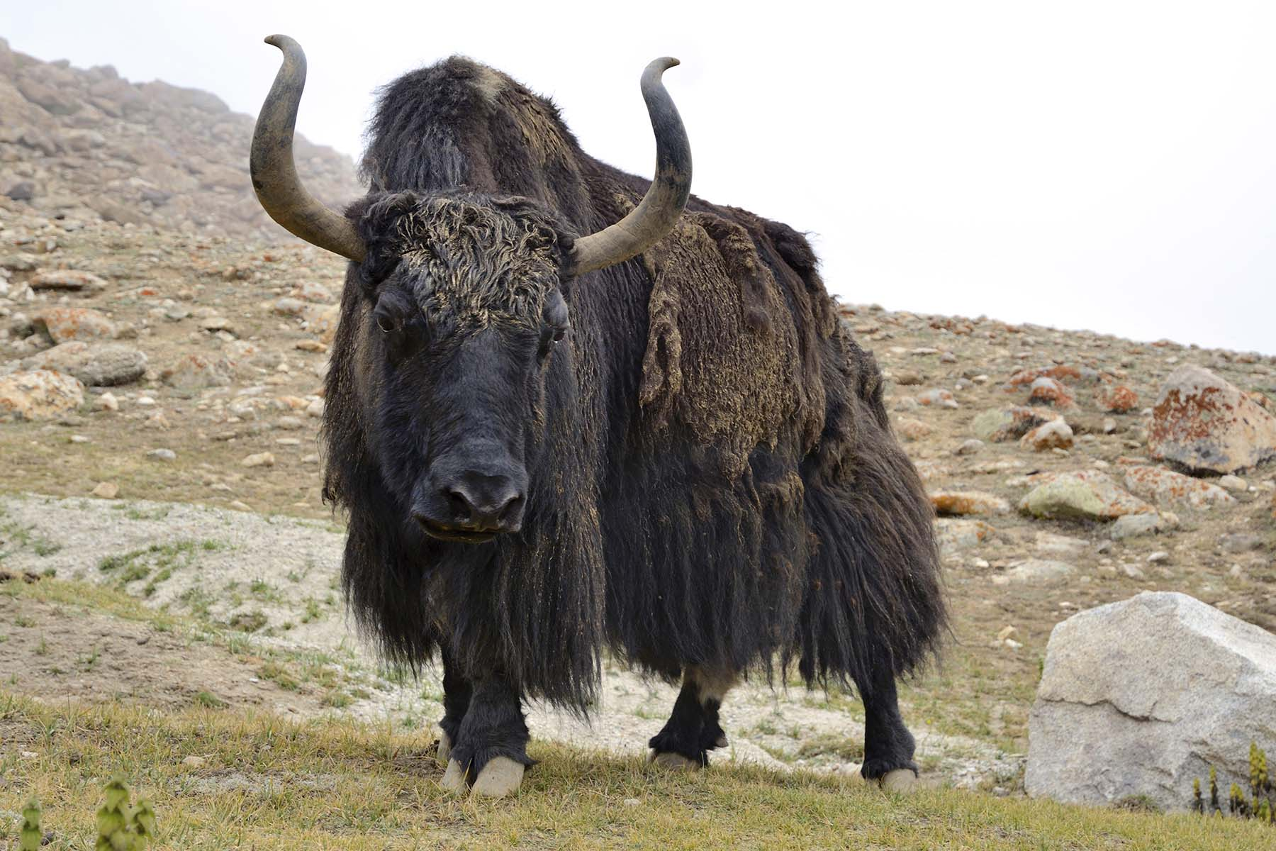

Slide 63
bdlat enumerations
A type Enum is a bdlat enumeration if:
overloads of the bdlat_enumfunctions exist for Enum and are accessible via argument dependent lookup, and
the IsEnumeration trait is specialized for Enum in the bdlat_EnumFunctions namespace.

Slide 64
bdlat enumerations
These are the functions to overload:
int bdlat_enumFromInt(Enum *result,
int number);
int bdlat_enumFromString(Enum *result,
const char *string,
int stringLength);
void bdlat_enumToInt(int *result,
const Enum& value);
void bdlat_enumToString(string *result,
const Enum& value);

Slide 65
bdlat enumerations
This trait is to be specialized for TYPE=Enum:
namespace BloombergLP {
namespace bdlat_EnumFunctions {
template <typename TYPE>
struct IsEnumeration;
}}

Slide 66
bdlat enumerations
Like this:
namespace BloombergLP {
namespace bdlat_EnumFunctions {
template <>
struct IsEnumeration<Enum>
{
enum { VALUE = 1 };
};
}}

Slide 67
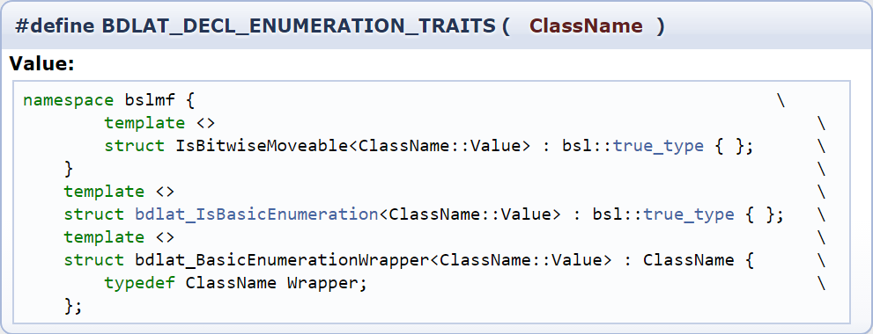
bdlat enumerations
This is how bas_codegen.pl handles the trait:
There’s that macro from the generated code

Slide 68
bdlat enumerations
But bas_codegen.pl can pick its namespace
and DEFINE_ENUM cannot,
so we’ll have to do something else.

Slide 69
bdlat enumerations
Let’s go back to the functions
int bdlat_enumFromInt(Enum *result,
int number);
int bdlat_enumFromString(Enum *result,
const char *string,
int stringLength);
void bdlat_enumToInt(int *result,
const Enum& value);
void bdlat_enumToString(string *result,
const Enum& value);

Slide 70
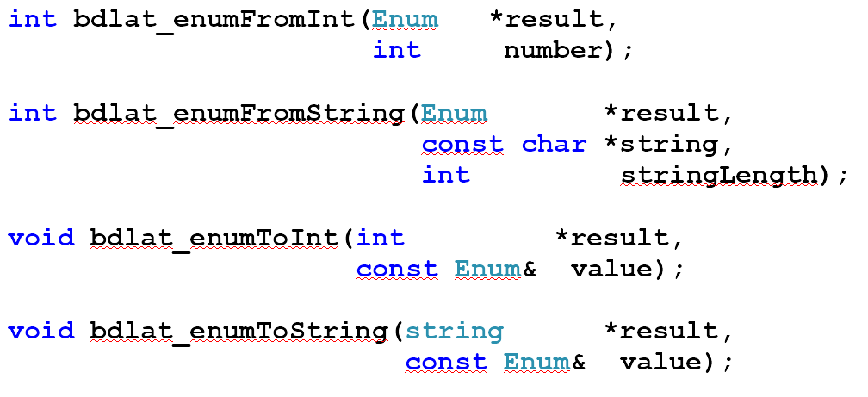
bdlat enumerations
We can’t include these in the macro,
because they could end up in a class scope.
Instead, how do we define these functions
for all types created by DEFINE_ENUM?

Slide 71
INHERITANCE
let’s try it

Slide 72
bdlat enumerations
Say each class created by DEFINE_ENUM
had a common base class EnumBase:
#define DEFINE_ENUM(NAME, ...) \
class NAME : public EnumBase { \
...

Slide 73
bdlat enumerations
Then we could generally define these functions:
int bdlat_enumFromInt(EnumBase *result,
int number);
int bdlat_enumFromString(EnumBase *result,
const char *string,
int stringLength);
void bdlat_enumToInt(int *result,
const EnumBase& value);
void bdlat_enumToString(string *result,
const EnumBase& value);

Slide 74
bdlat enumerations
and...
the functions would know nothing about the actual enumerations

Slide 75


Slide 76
bdlat enumerations
The base class needs knowledge of the derived class
Can it be done?

Slide 77
The Curiously Recurring Template Pattern
let’s try it

Slide 78
bdlat enumerations
Each class Enum created by DEFINE_ENUM
has a common base class EnumBase<Enum>:
#define DEFINE_ENUM(NAME, ...) \
class NAME : public EnumBase<NAME> { \
...

Slide 79
bdlat enumerations
Then we could generally define these functions:
template <typename ENUM>
int bdlat_enumFromInt(EnumBase<ENUM> *result,
int number);
...

Slide 80
bdlat enumerations
Then we could generally define these functions:
template <typename ENUM>
int bdlat_enumFromInt(EnumBase<ENUM> *result,
int number)
{
if (number < 0 || number >= ENUM::k_NUM_VALUES)
return -1;
ENUM& derived = static_cast<ENUM&>(*result);
derived = ENUM::Value(number);
return 0;
}

Slide 81
SUCCESS
Now what about that trait...

Slide 82
bdlat enumerations
How can we specialize this trait
for all classes derived from EnumBase<T>?
namespace BloombergLP {
namespace bdlat_EnumFunctions {
template <typename TYPE>
struct IsEnumeration;
}}

Slide 83
bdlat enumerations
Does the compiler accept this?
namespace BloombergLP {
namespace bdlat_EnumFunctions {
template <
typename T,
typename=enable_if<
has_enum_base<T>::value>::type>
struct IsEnumeration<T> {
...

Slide 84
NO
Error: IsEnumeration previously defined with one template parameter, but here is defined with two

Slide 85


Slide 86
The Curiously Recurring Template Pattern
not going to work

Slide 87
bdlat enumerations
What are we going to do about this trait?
namespace BloombergLP {
namespace bdlat_EnumFunctions {
template <typename TYPE>
struct IsEnumeration;
}}

Slide 88
bdlat enumerations
What if each type generated by DEFINE_ENUM were an instantiation of some template, BasicEnum?
template <typename UTIL>
class BasicEnum {
typename UTIL::Value d_value;
public:
BasicEnum(typename UTIL::Value)
...
};

Slide 89
bdlat enumerations
Then we could have this:
#define DEFINE_ENUM(NAME, ...) \
class NAME ## _Util { \
... \
}; \
\
typedef BasicEnum<NAME ## _Util> NAME

Slide 90
bdlat enumerations
For example, this:
DEFINE_ENUM(Color, RED, GREEN, PURPLE);
would expand to this:
class Color_Util {
...
};
typedef BasicEnum<Color_Util> Color;

Slide 91
bdlat enumerations
Then the trait is just a partial specialization
namespace BloombergLP {
namespace bdlat_EnumFunctions {
template <typename UTIL>
struct IsEnumeration<BasicEnum<UTIL> >
{
enum { VALUE = 1 };
};
}}

Slide 92
bdlat enumerations
The functions are similar to before:
template <typename UTIL>
int bdlat_enumFromInt(BasicEnum<UTIL> *result,
int number);
...

Slide 93
bdlat enumerations
The functions are similar to before:
template <typename UTIL>
int bdlat_enumFromInt(BasicEnum<UTIL> *result,
int number);
{
if (number < 0 || number >= UTIL::k_NUM_VALUES)
return -1;
*result = typename UTIL::Value(number);
return 0;
}

Slide 94
IT WORKS

Slide 95
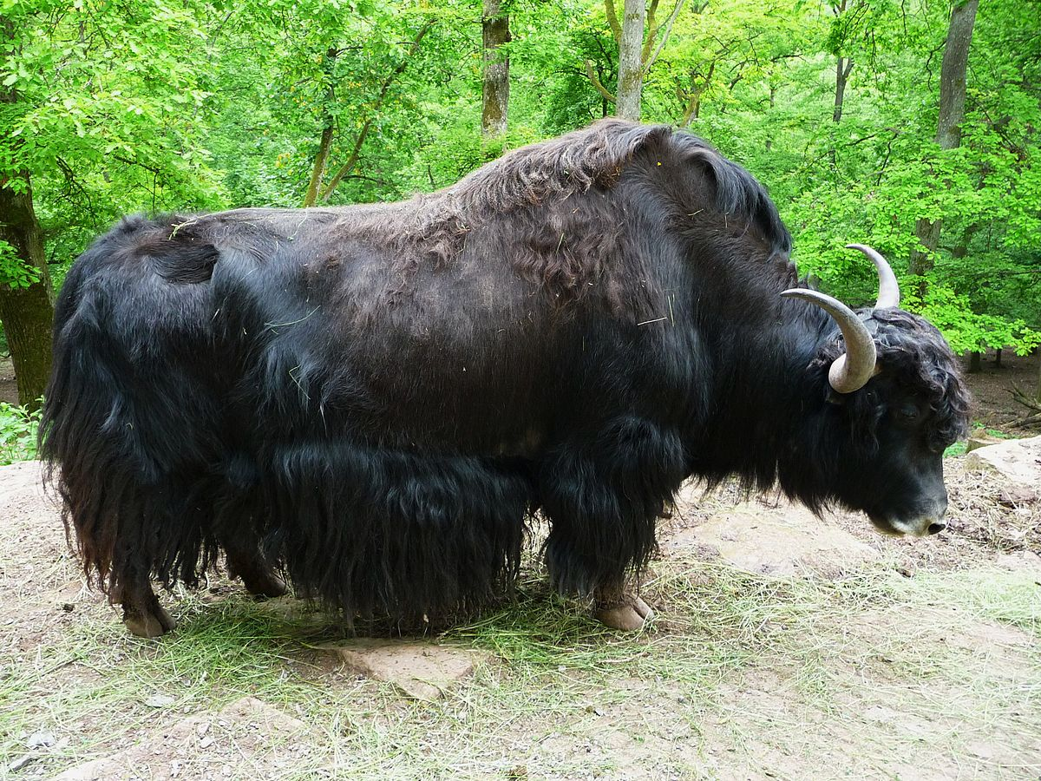

Slide 96
But wouldn’t have this been easier?
bslmc::enumeration Color {
RED,
GREEN,
PURPLE
};

Slide 97
fin

