Slide 1
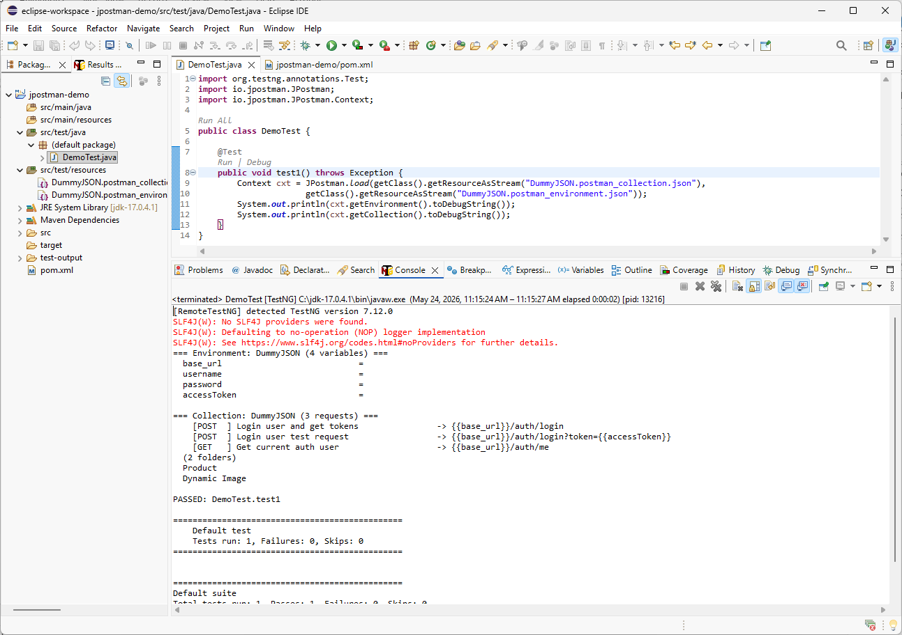

In the previous tutorial, we configured the Java Maven project with jpostman-core and loaded the exported Postman collection and environment files. The link to that video is available in the description. In this tutorial, we will use those settings to execute REST API requests from Java.

Slide 2
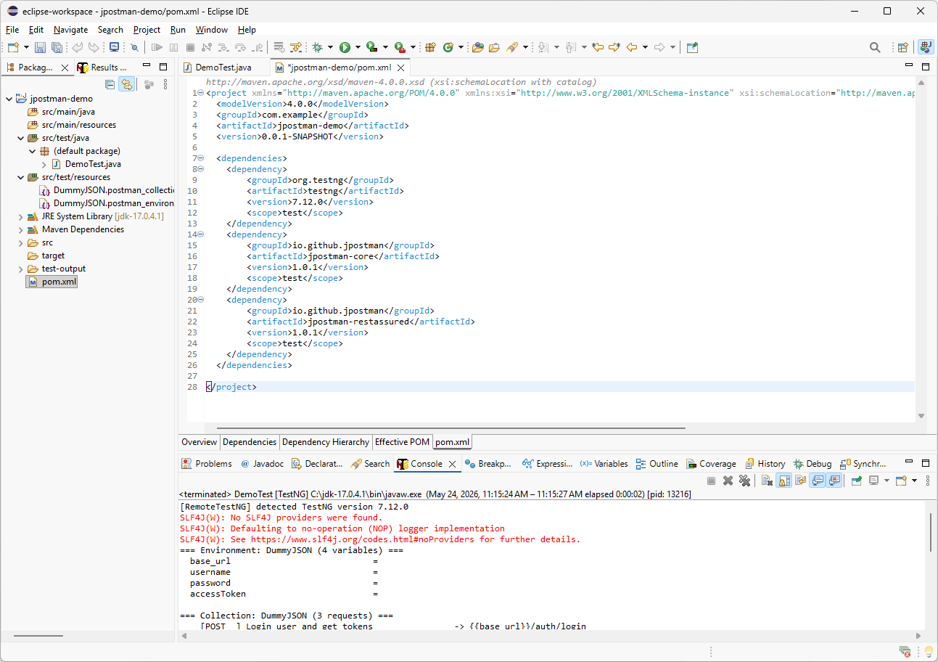
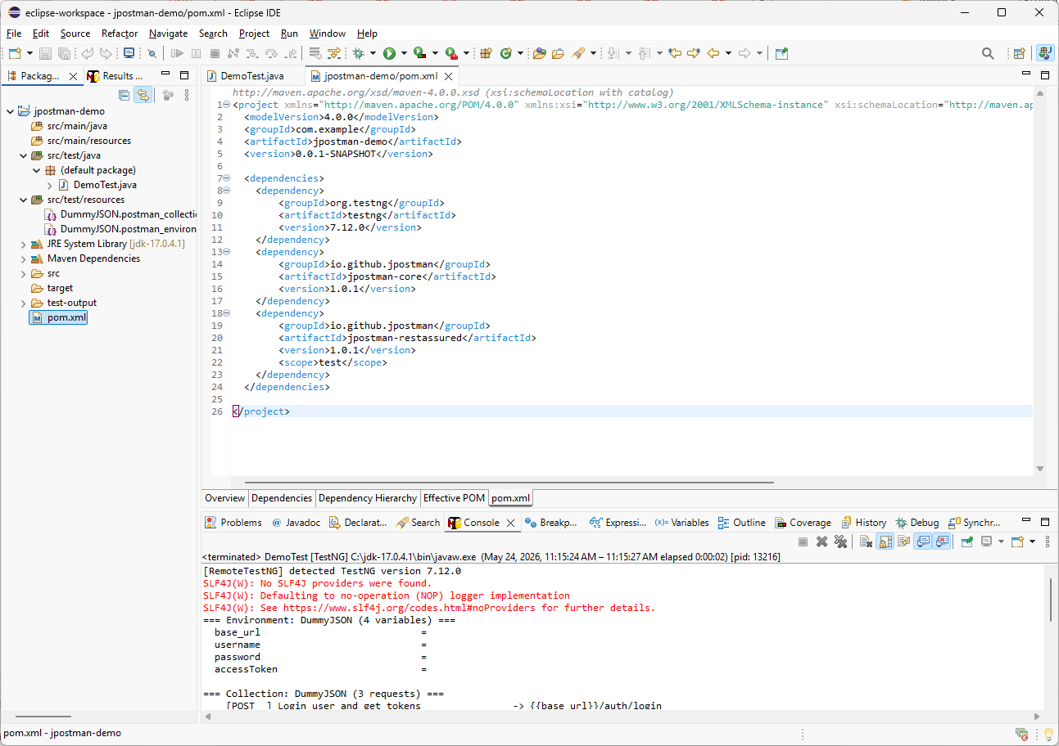
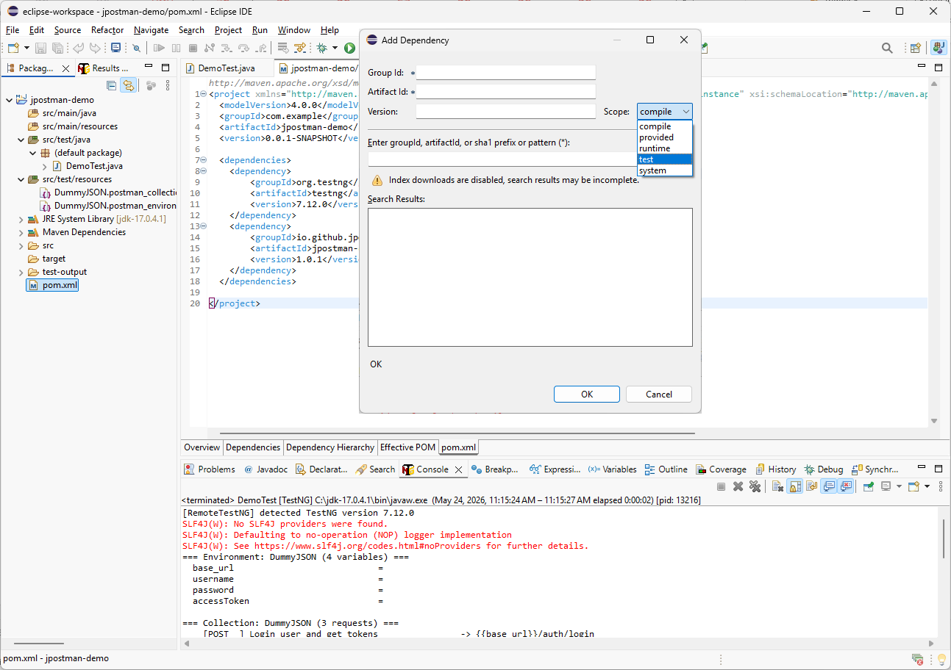
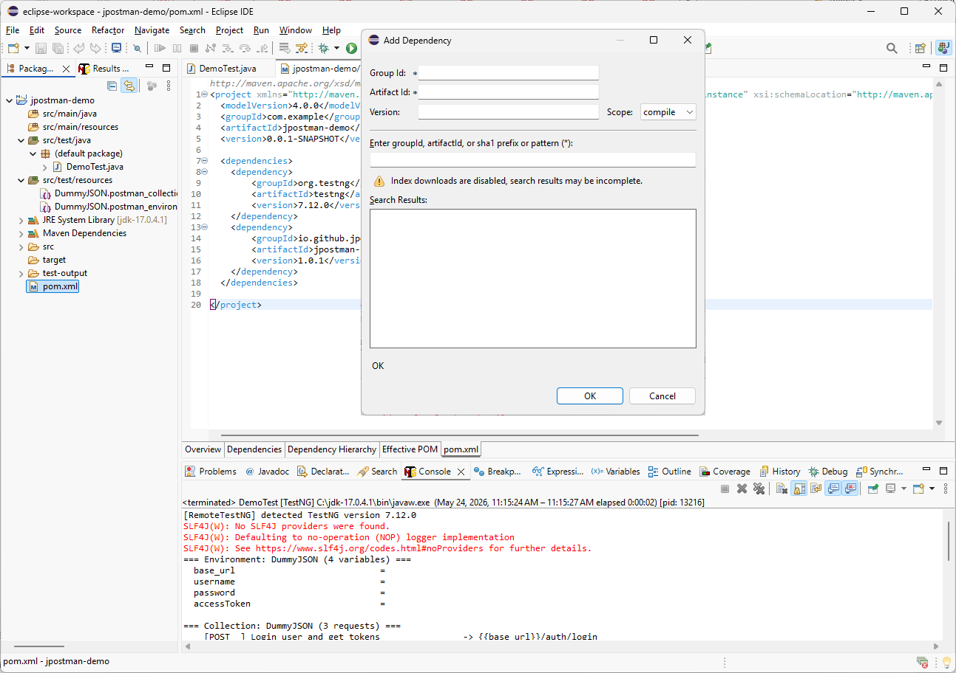
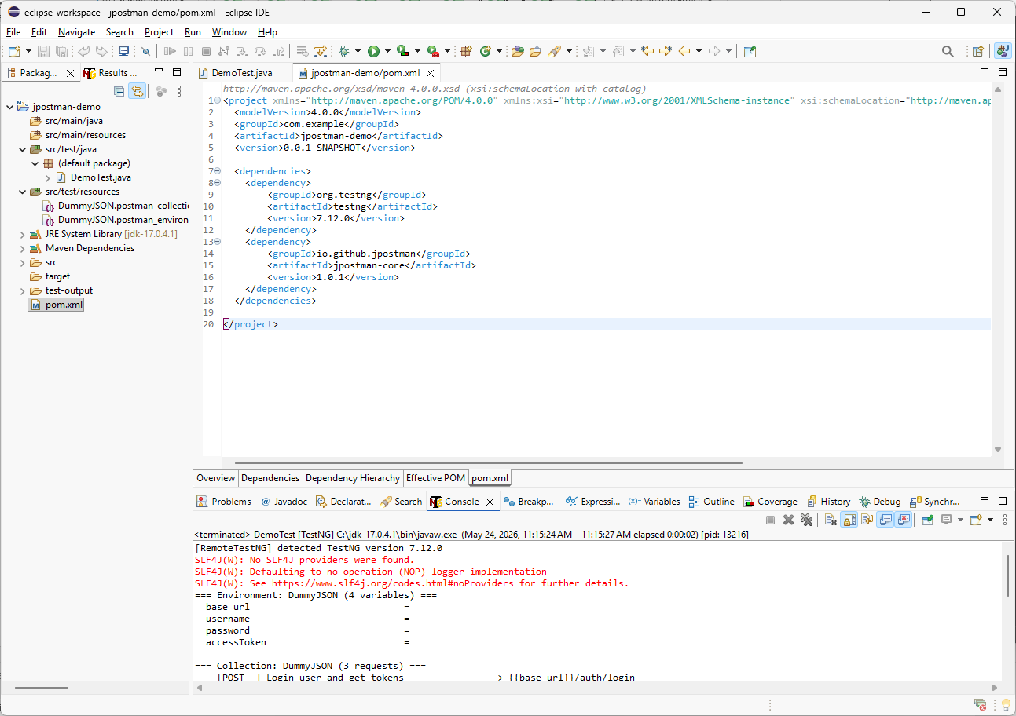
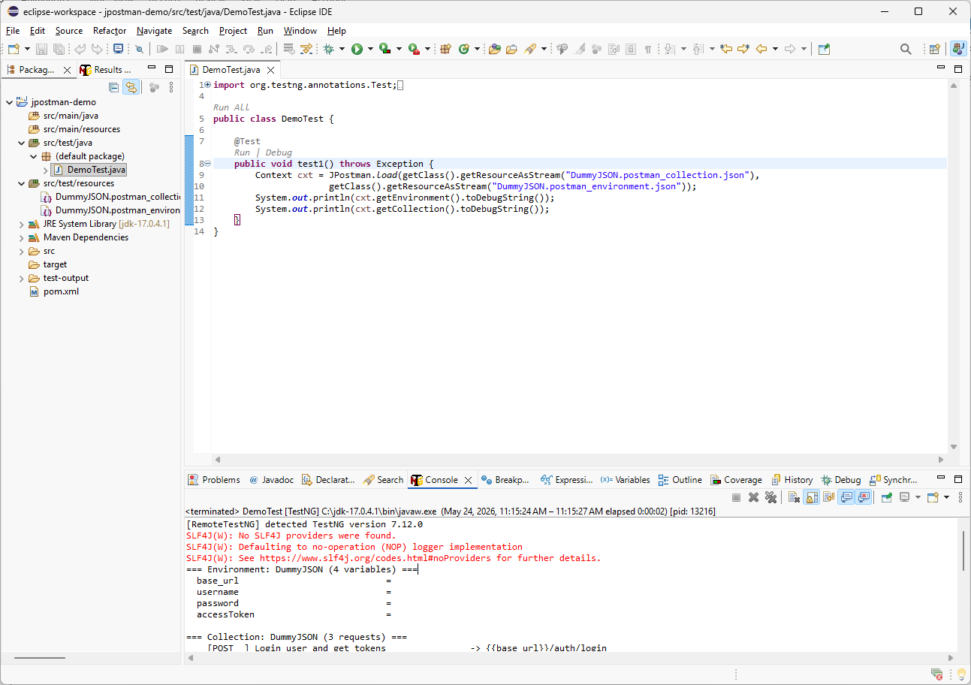
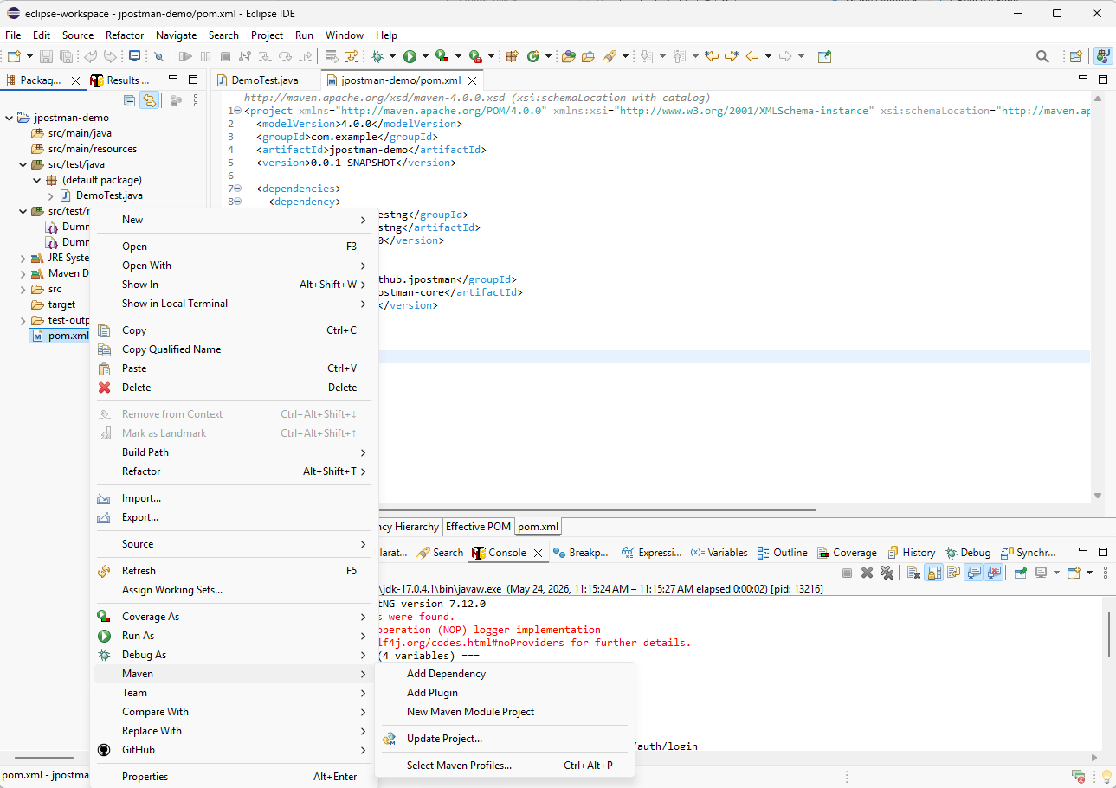
io.github.jpostman
jpostman-restassured
1.0.1
First, let’s review the current pom.xml file by double-clicking it in the Eclipse project tree. Then right-click the file, go to Maven, and select Add Dependency.
In the Add Dependency window, enter the JPostman Assured REST API executor dependency. Optionally, set the scope to test, then click OK.
As a best practice, use the test scope for testing-related libraries.

Slide 3
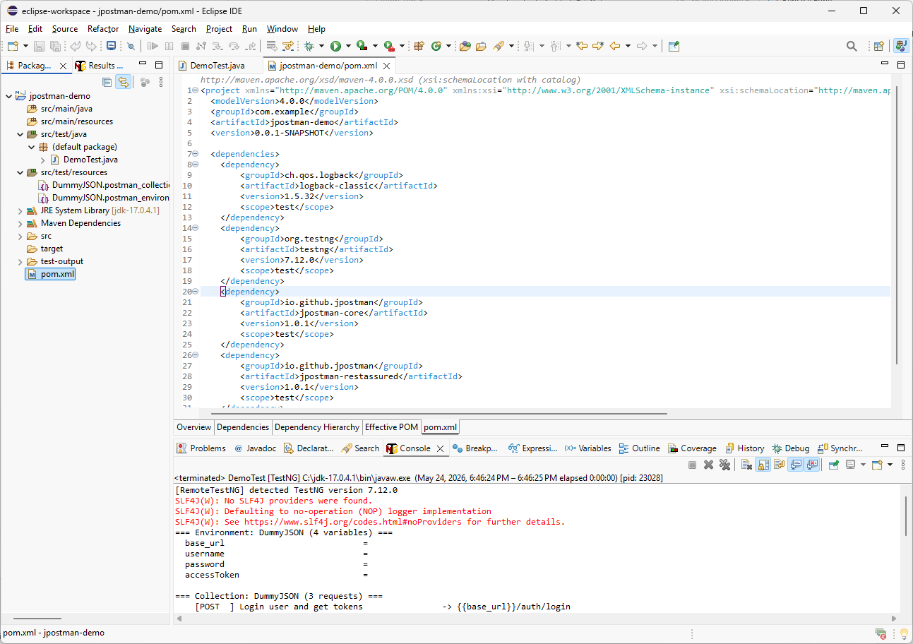
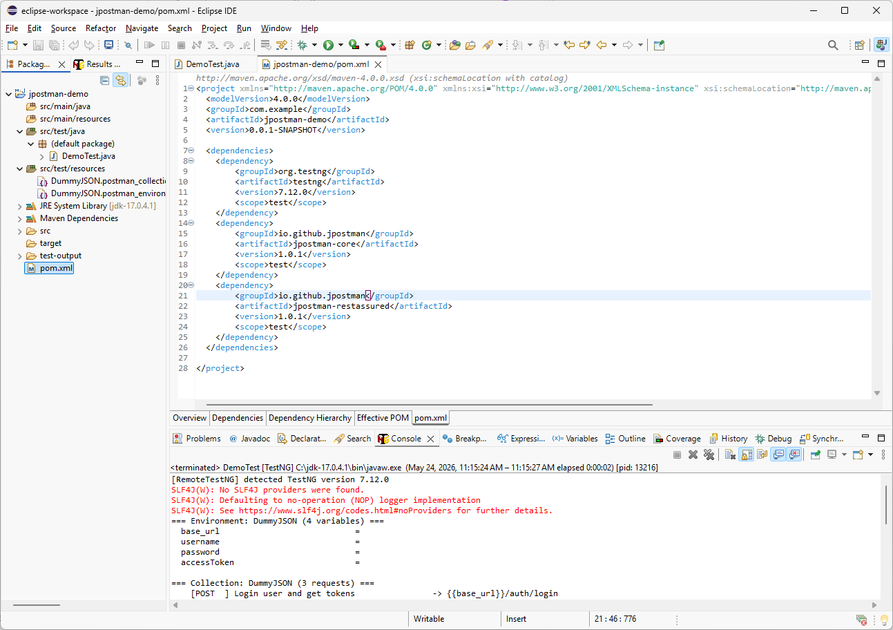
To resolve the SLF4J warning in the console, I will add logback-classic as a dependency. You can find the latest version from the link below or in the video description. Copy the dependency from the website and paste it into pom.xml, then set the scope to test.
https://central.sonatype.com/artifact/ch.qos.logback/logback-classic

Slide 4
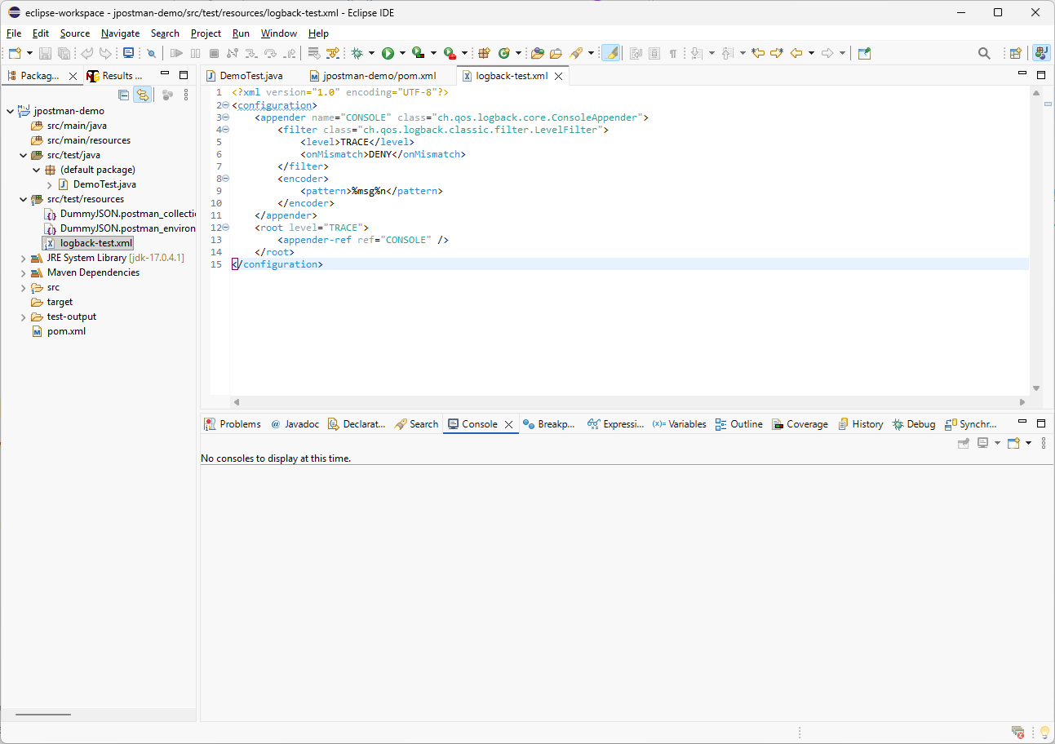
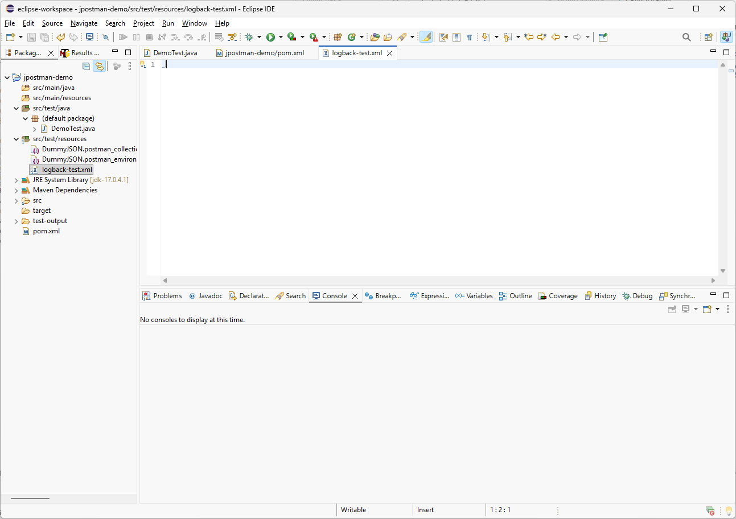
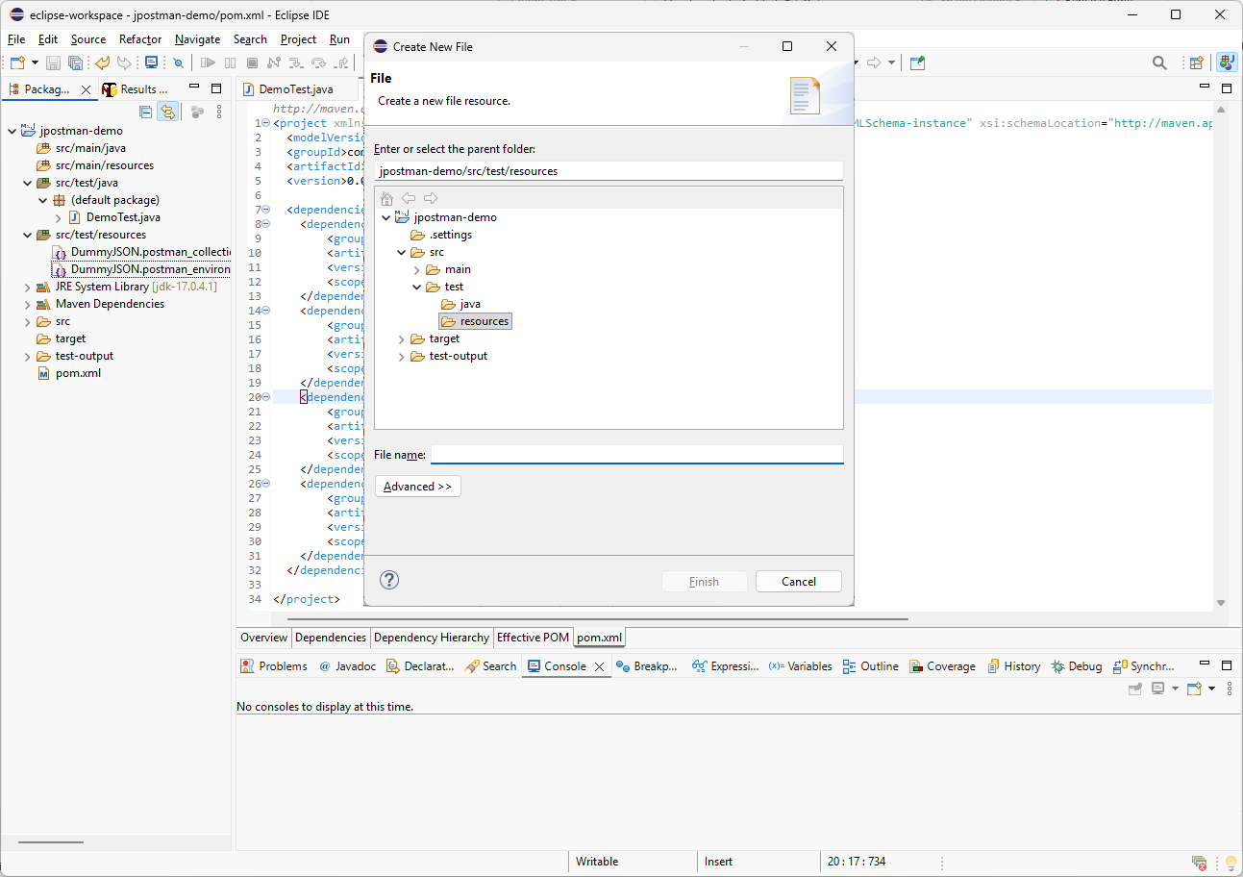
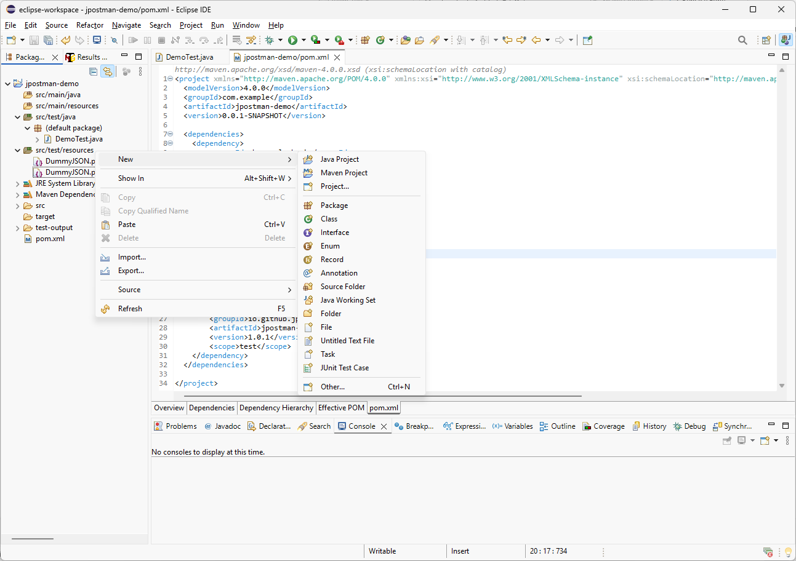
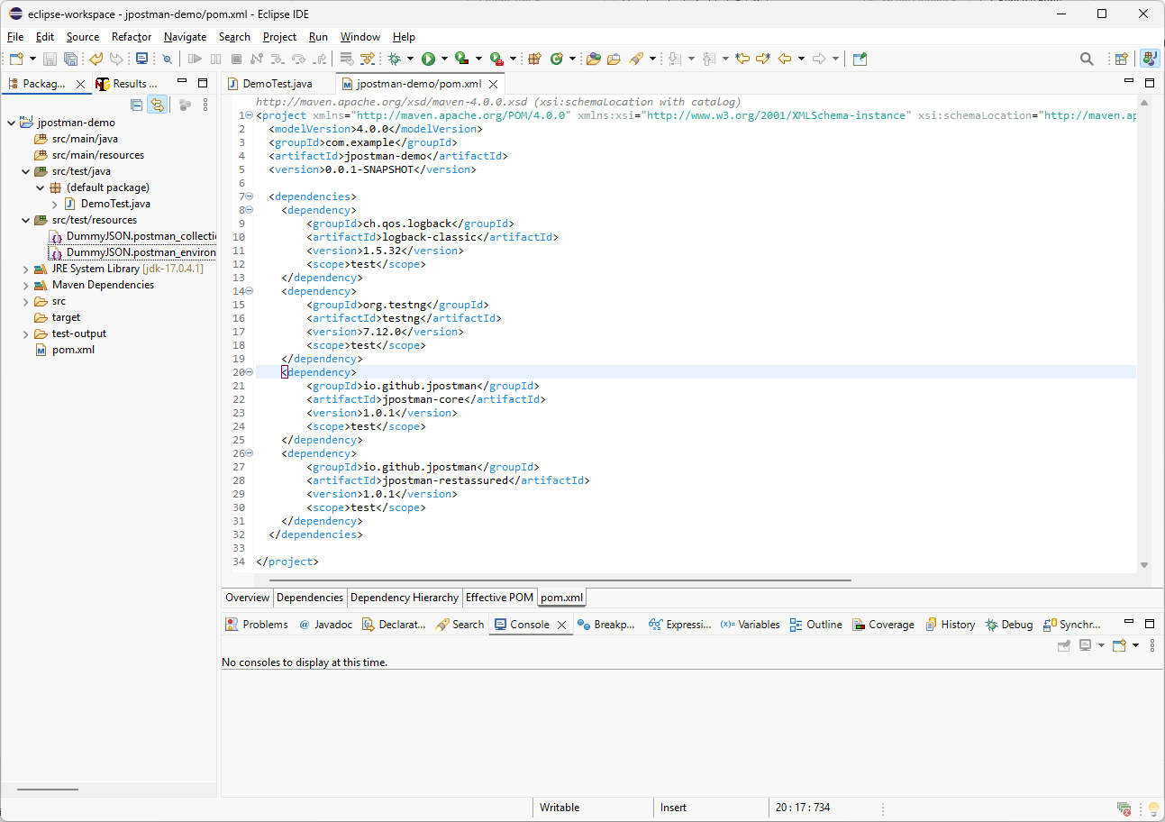
logback-test.xml
Before we test the log output, I need to create a Logback configuration file. I will right-click the src/test/resources directory, choose New, then File. I will name the file logback-test.xml and click Finish. After that, I will add a simple configuration to print log messages to the console using the TRACE level.

Slide 5
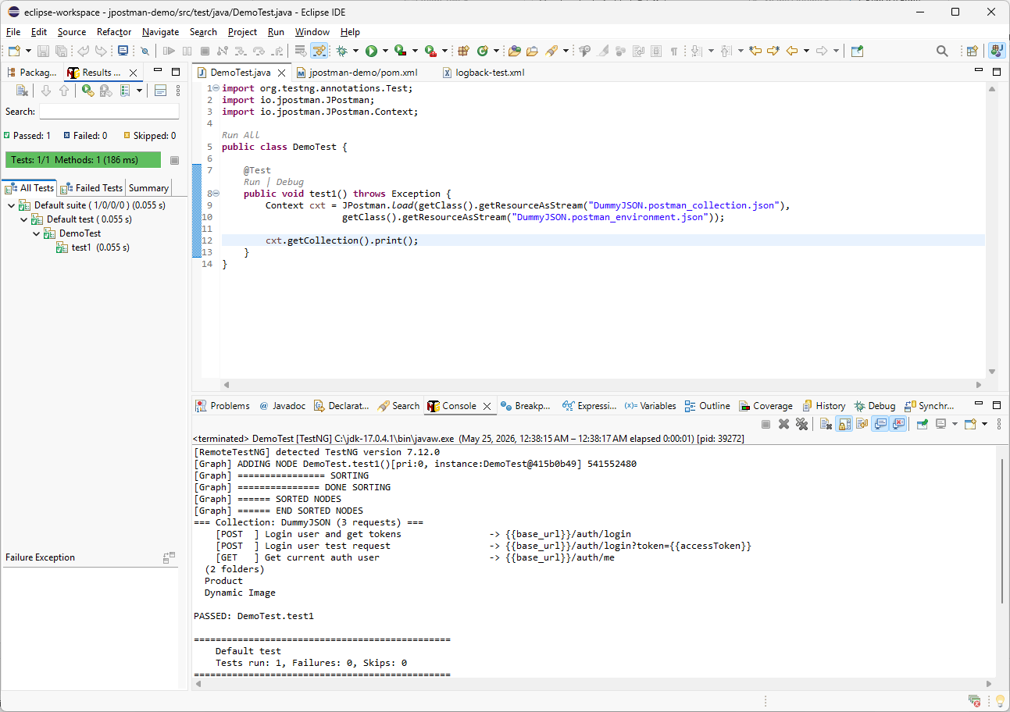
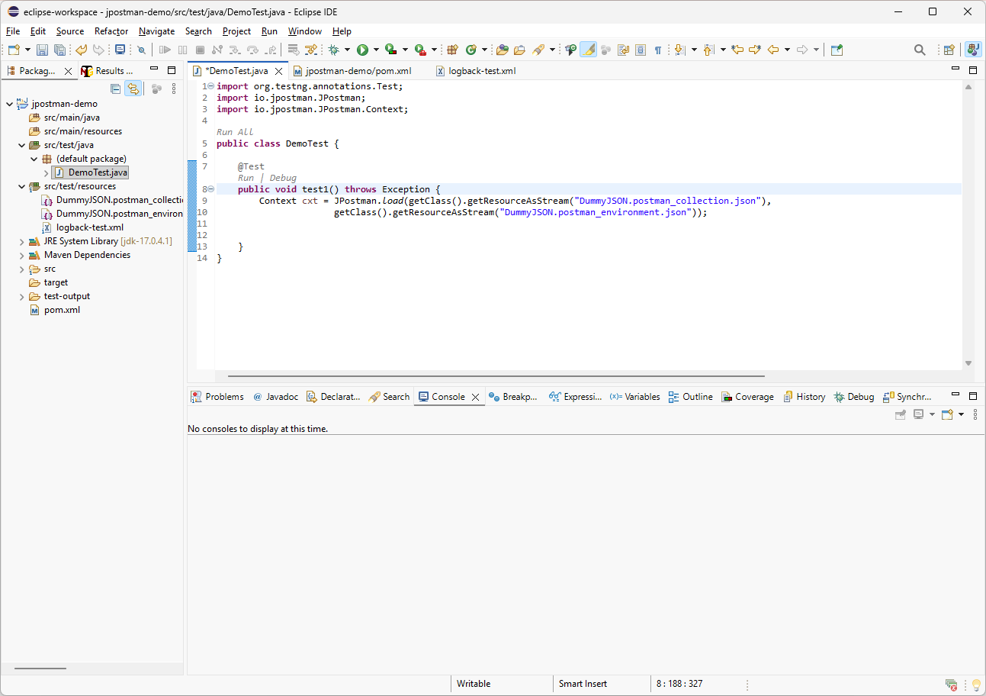
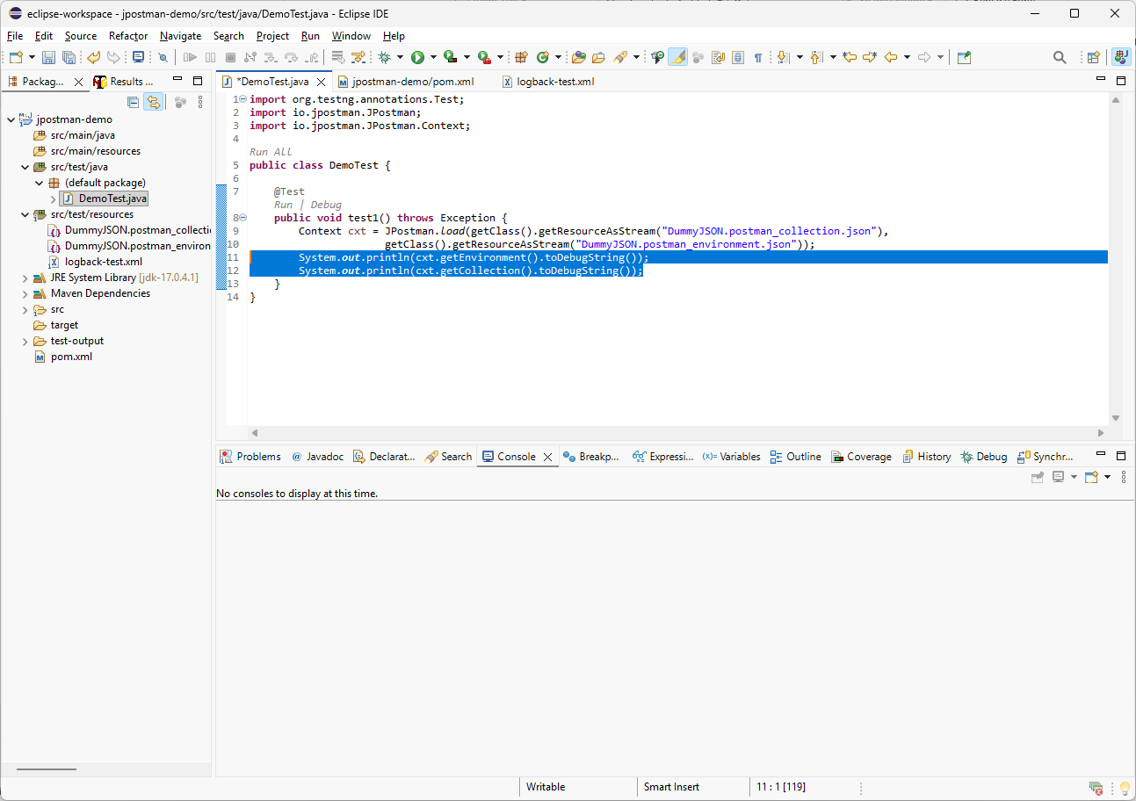
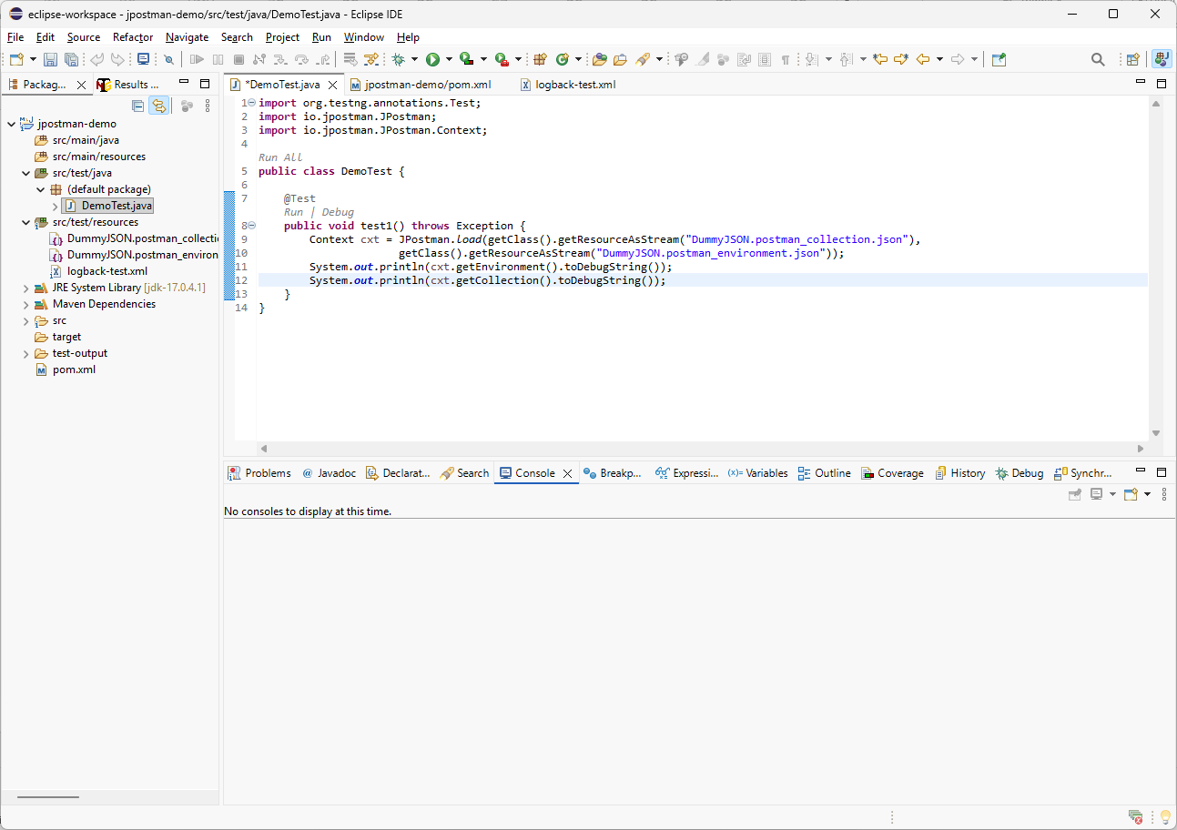
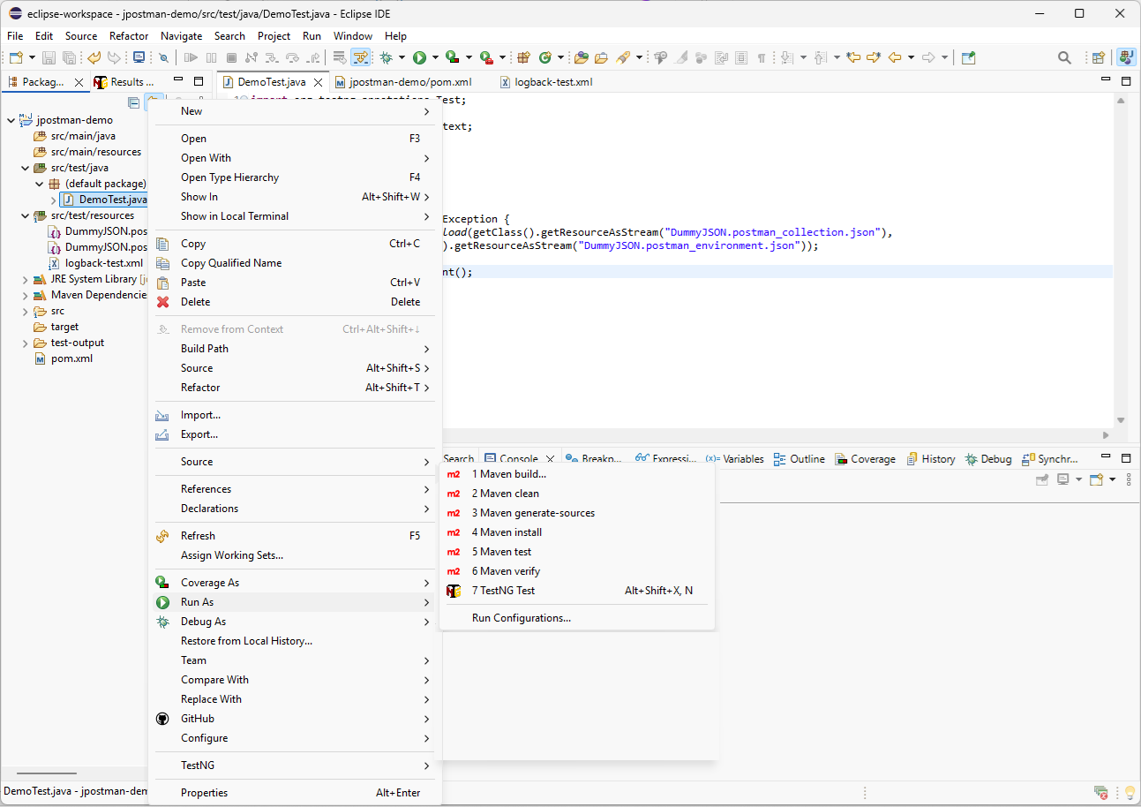
cxt.getCollection().print();
To test the log output, I will remove the two System.out.println lines and replace them with the collection print() statement. Then I will save the file, right-click and run it as a TestNG Test.
In the console output, we can see now the collection requests and folders under the root level.

Slide 6
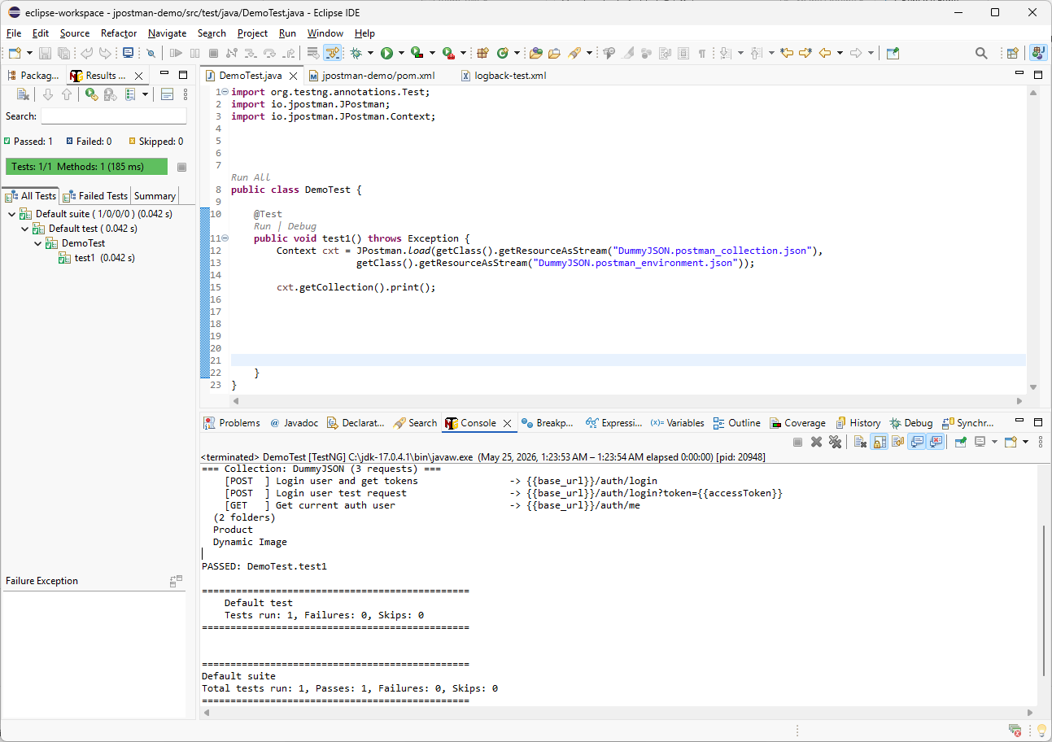
import io.jpostman.Request;
Request req = cxt.getCollection().getRequest(
To inspect the request details, I will create a local Request variable. We will reuse this request later with the RestAssuredExecutor. First, I will add the JPostman Request import, then call getRequest() from the loaded collection.

Slide 7
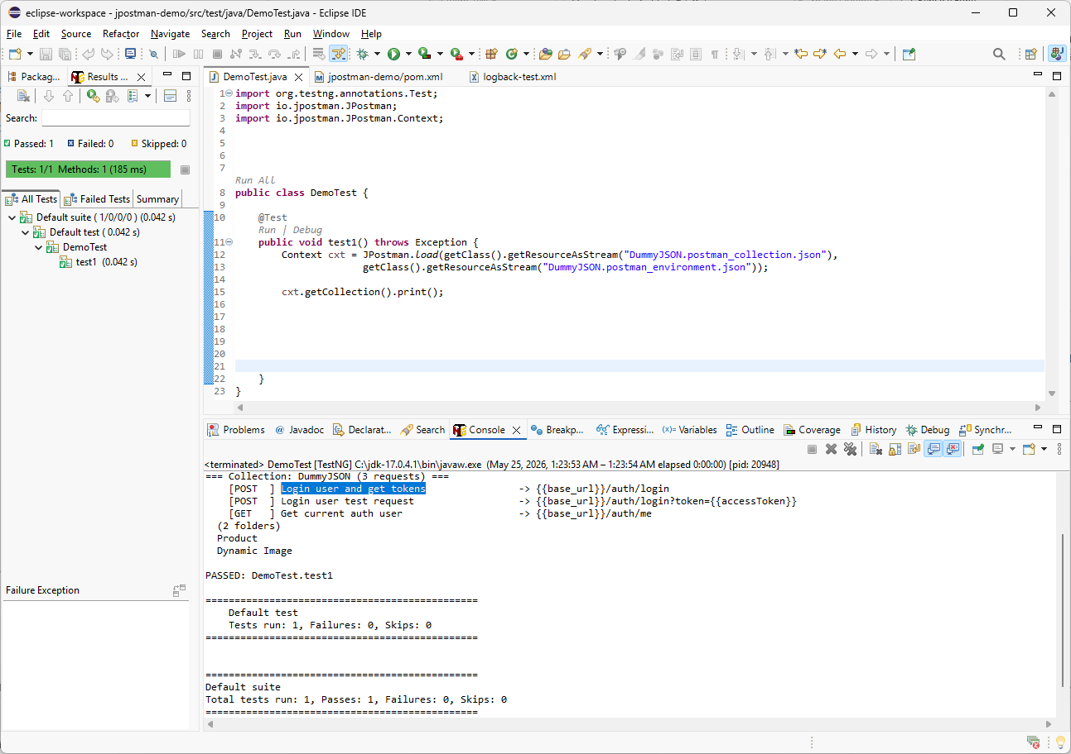
import io.jpostman.Request;
"Login user and get tokens");
req.print();
Request req = cxt.getCollection().getRequest(
For the first POST request, I will use the request name shown in the console: Login user and get tokens.
I will copy that name, paste it into the getRequest method, and then call print() to display the request debug information.

Slide 8
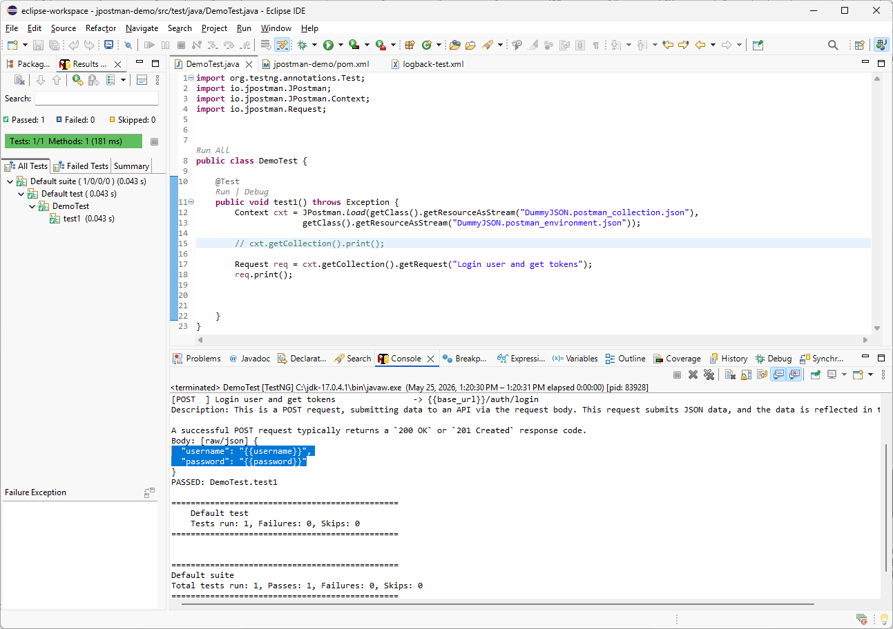
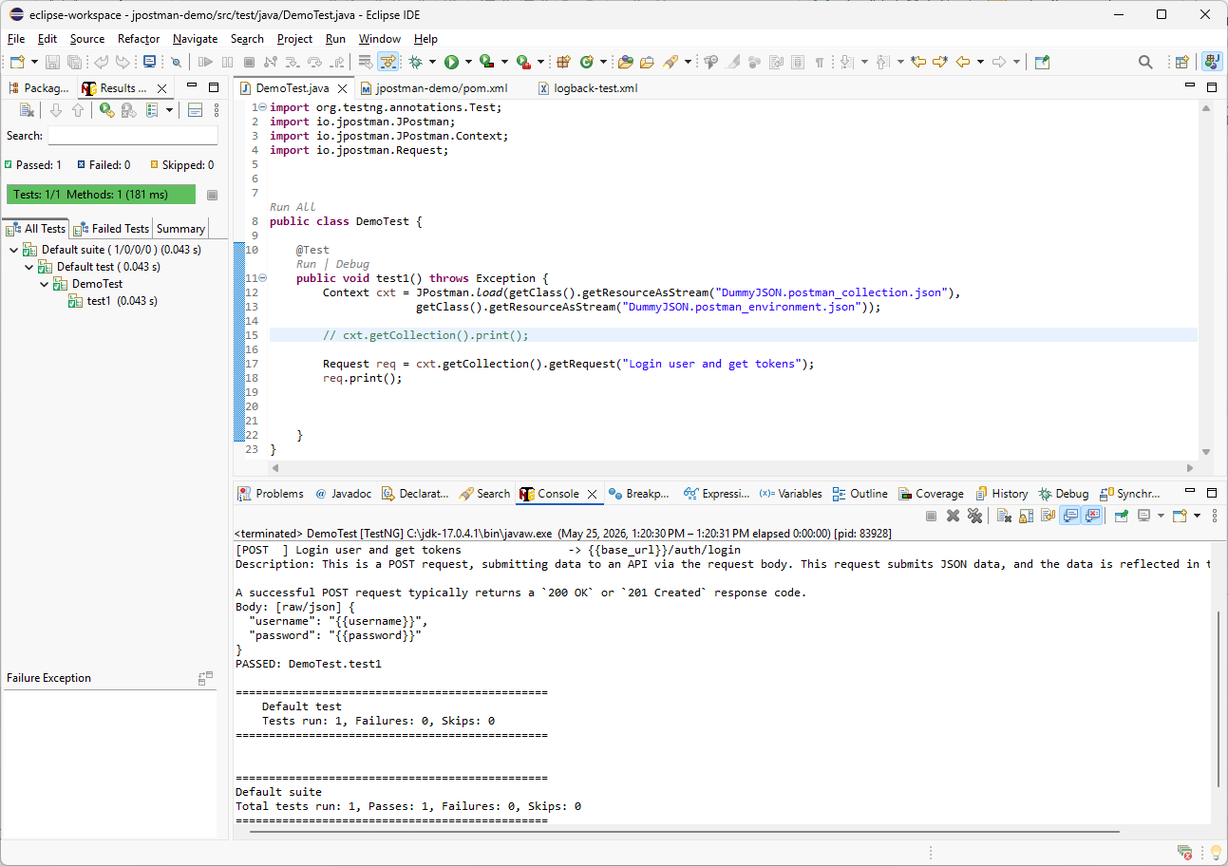
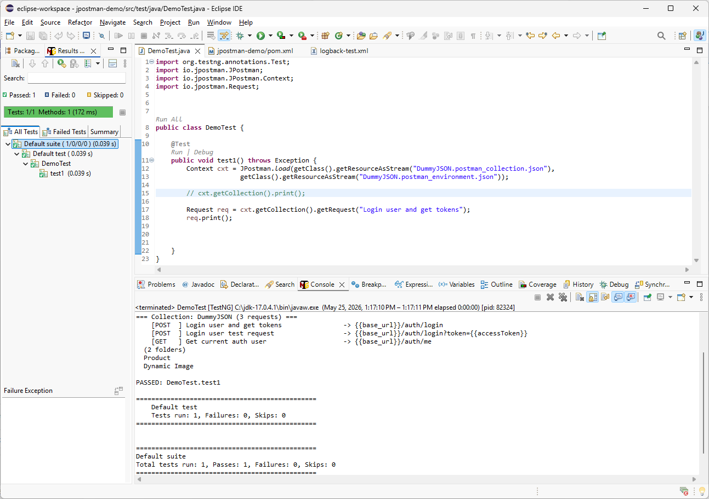
Before running the test, I will comment out the previous collection debug output so the console shows only the selected request details. Then I will use Ctrl + F11 to run the last TestNG Test again. As a result, we can see the request description and body with unresolved placeholders.

Slide 9
import io.jpostman.Environment;
Environment env = cxt.getEnvironment();
env.print();
Instead of hardcoding values in Java, we will read them from the exported Postman environment JSON file. This helps avoid code changes when the API changes in Postman. I will add the Environment import, define an environment variable, and print the environment details to inspect the available variables.

Slide 10
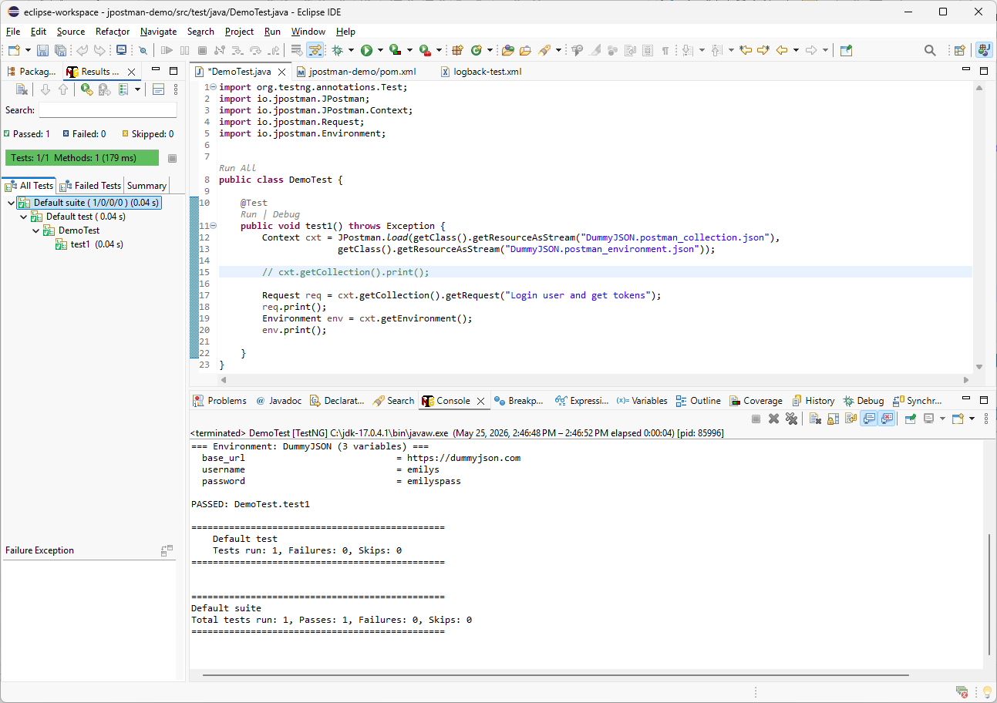
import io.jpostman.restassured.RestAssuredExecutor;
RestAssuredExecutor.execute(req.builder().build(env)).print();
After running the test with Ctrl + F11, we can see the environment values that will replace the placeholders in the request. Next, I will import the RestAssuredExecutor class, pass the environment object into the build() method, execute the request, and call print() to display the output.

Slide 11
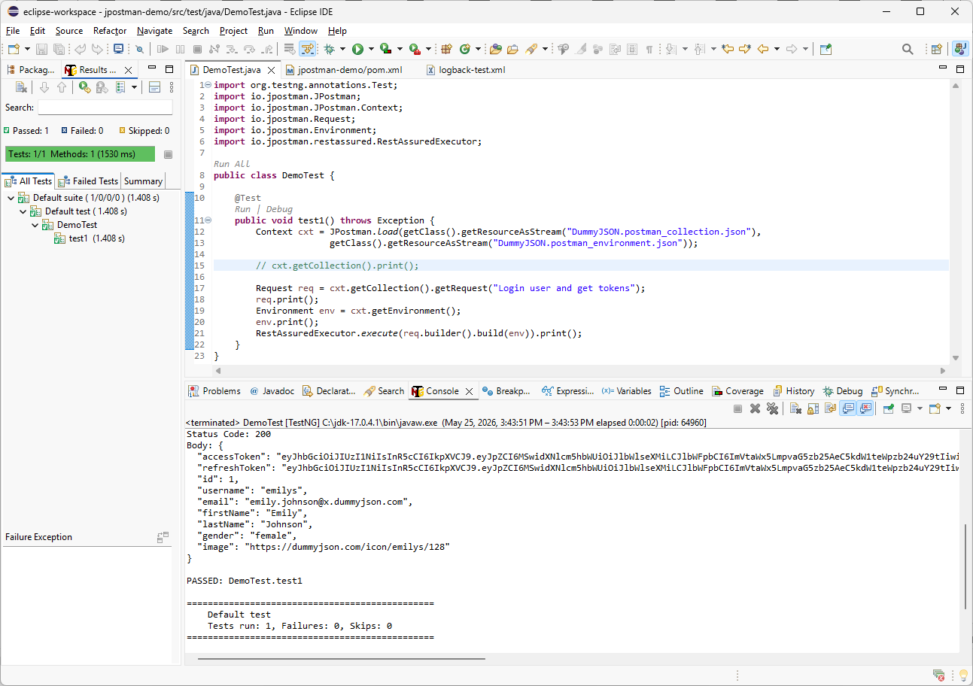
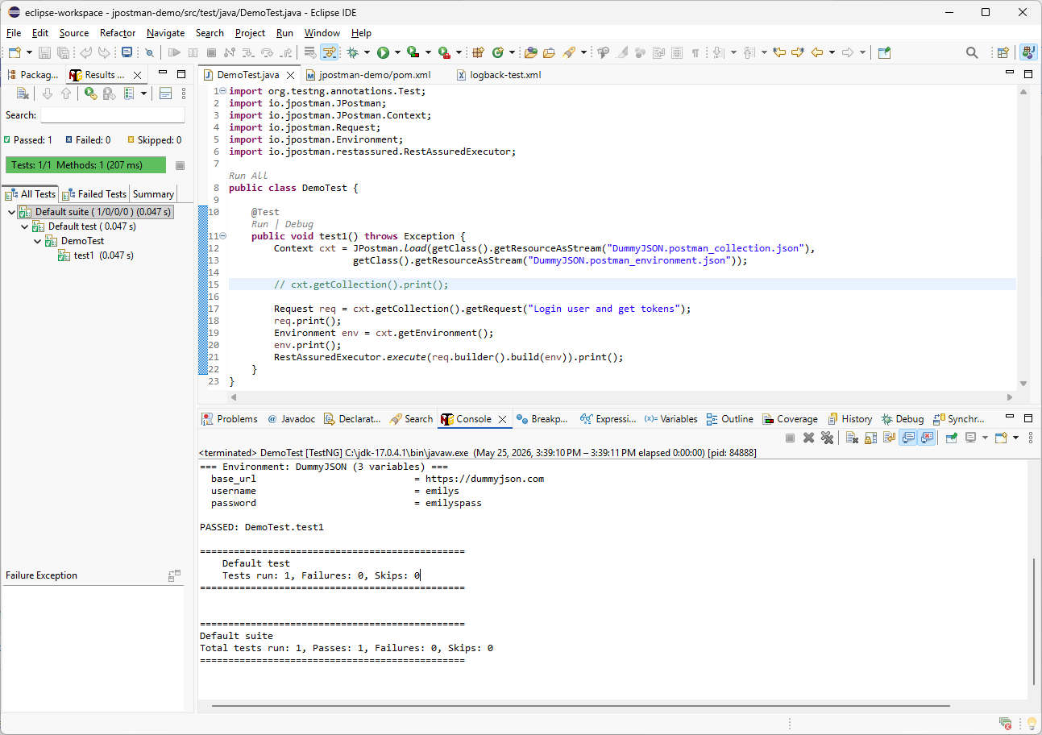
Excellent - we successfully executed our first REST API call and received a response from the server. In the next video, we will review chained requests.
Press Ctrl + S to save the file, then press Ctrl + F11 to run the last TestNG Test again.

Slide 12
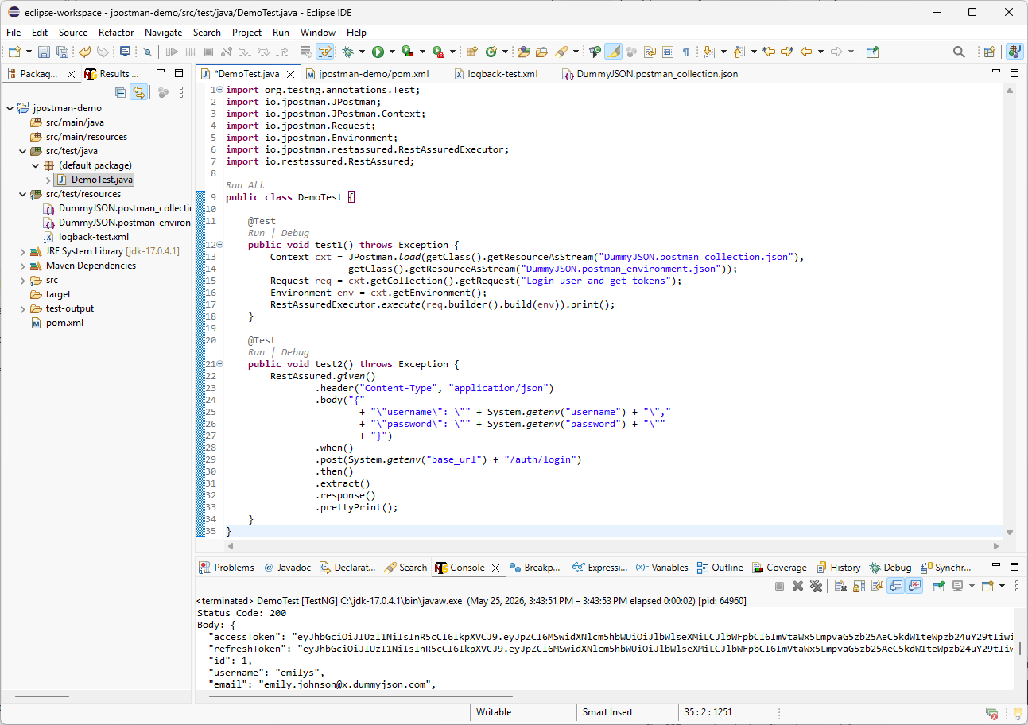
Let’s compare the same request using JPostman and manual RestAssured code.
In the next tutorial, we will continue exploring more JPostman features.
Thank you for watching, and I’ll see you in the next tutorial.

