Slide 1
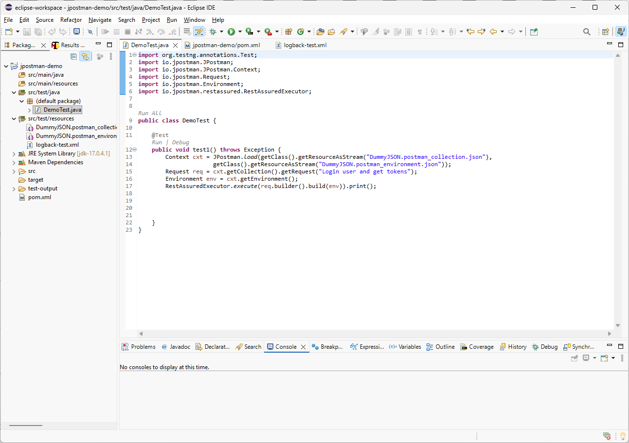

In this part, we will go deeper into JPostman and explore some important features. We will start with the Request object, which is immutable, meaning the original request loaded from the Postman collection cannot be changed directly.

Slide 2
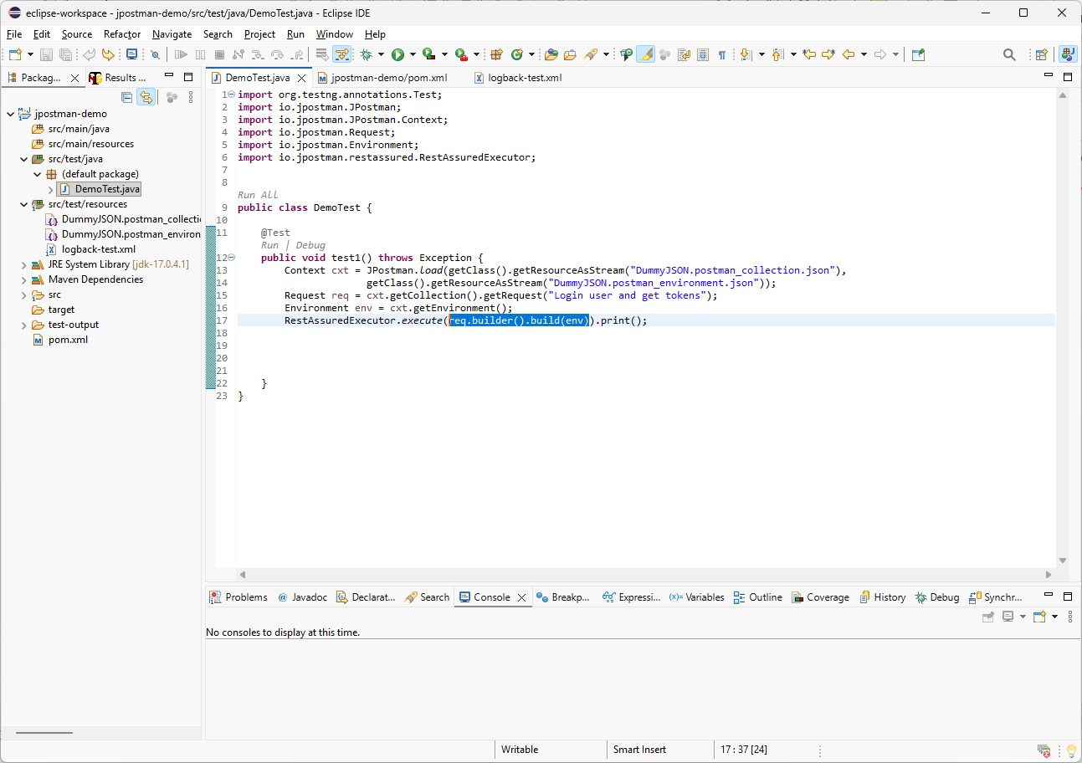
Here we are using req.builder().build(env). JPostman uses this builder call to create a resolved request with environment values applied. I will move this expression into a local variable so it is easier to inspect and debug.

Slide 3
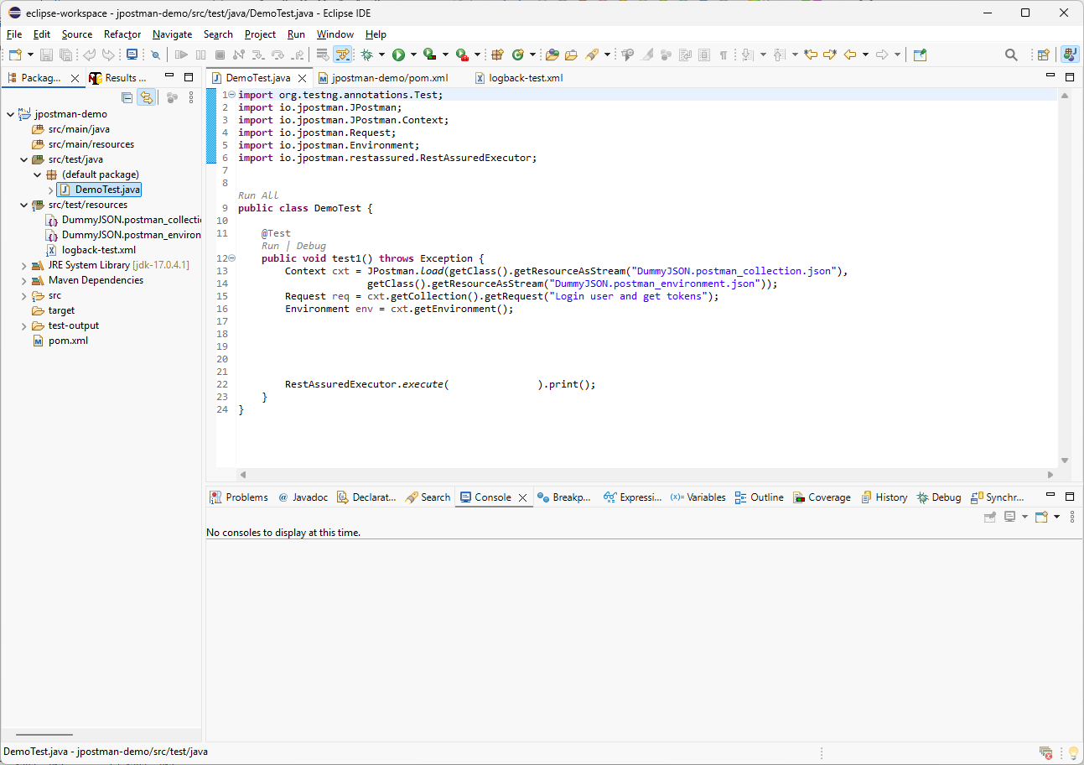
Request resolvedRequest = req.builder().build(env);
req.print();
resolvedRequest.print();
resolvedRequest
First, I will update the executor call to use a new argument. Instead of resolving the request inline, I will define a local variable named resolvedRequest. Then I will print both the original request and the resolved request so we can compare the body before and after placeholder resolution.

Slide 4
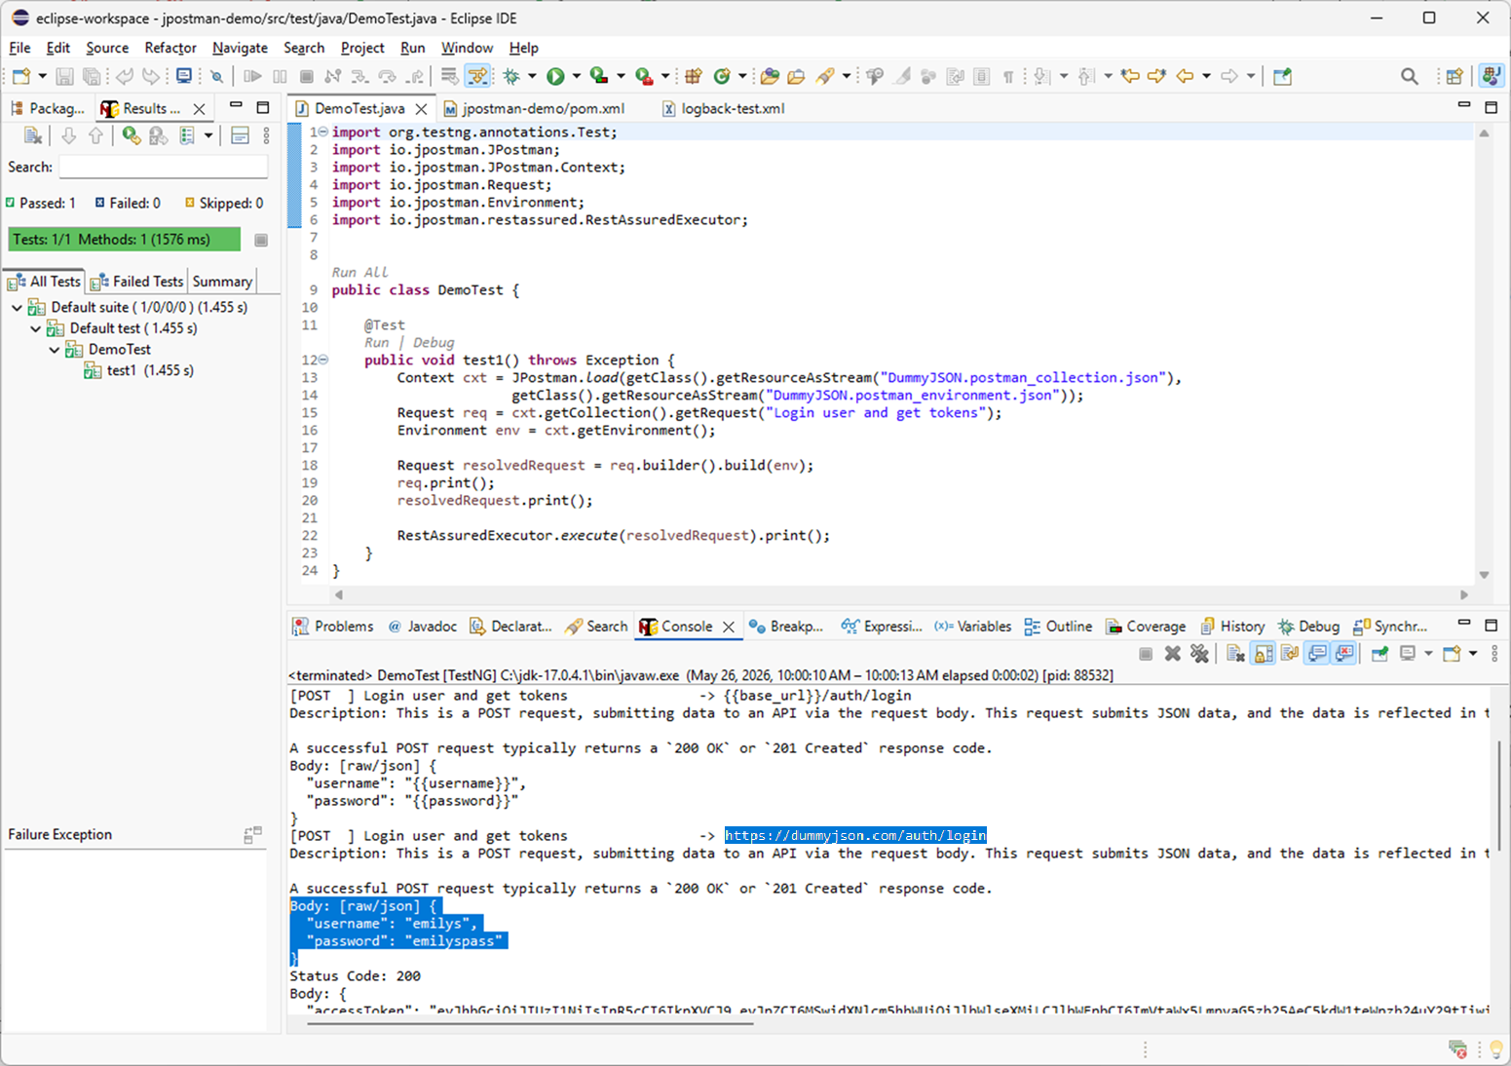
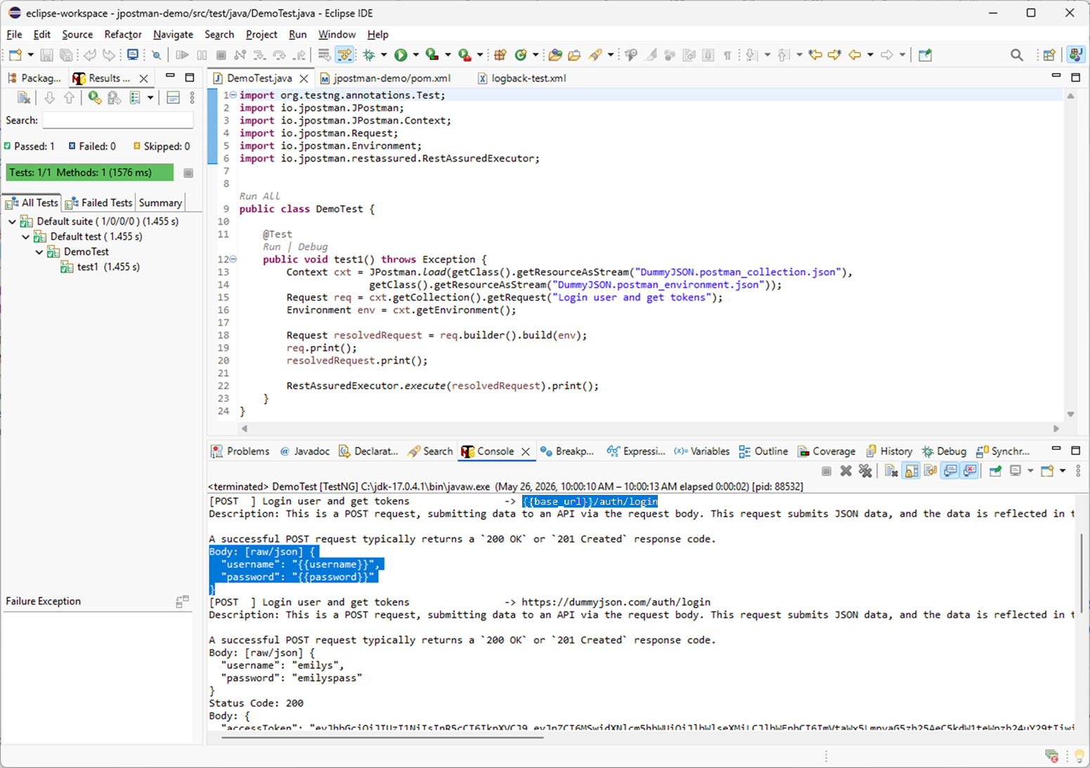
Now let’s run the code using Ctrl + F11. In the console output, we can see that the original request body remains unchanged and still contains unresolved placeholders. The resolved request, created with build(env), replaces those placeholders with values from the Postman environment JSON file.

Slide 5
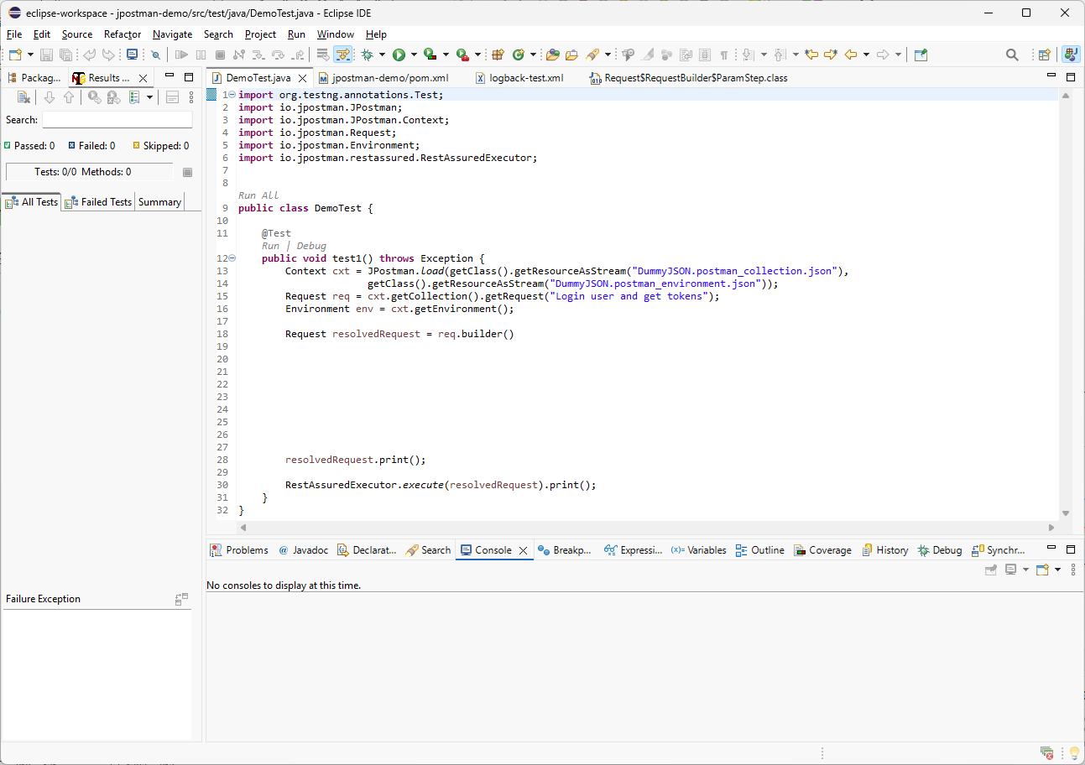
.url()
.add("q", "hello+world") // Add q as a URL query parameter
.map("base_url", "https://example.com") // Replace {{base_url}} in the request URL
.body()
.set("username", "sam") // Replace the existing username field in the request body
.add("age", 21) // Add a new age field to the request body
.end(env.getParams()) // Resolve any remaining body placeholders from the environment
.build(); // Create the resolved Request object
Let’s review other Request builder methods. We can manually customize the url(), headers(), auth() and body(). For each parameter step, we can use methods such as add, set, map, or json and end resolvers. Finally, we call build() to create a new resolved Request object with all changes applied.

Slide 6
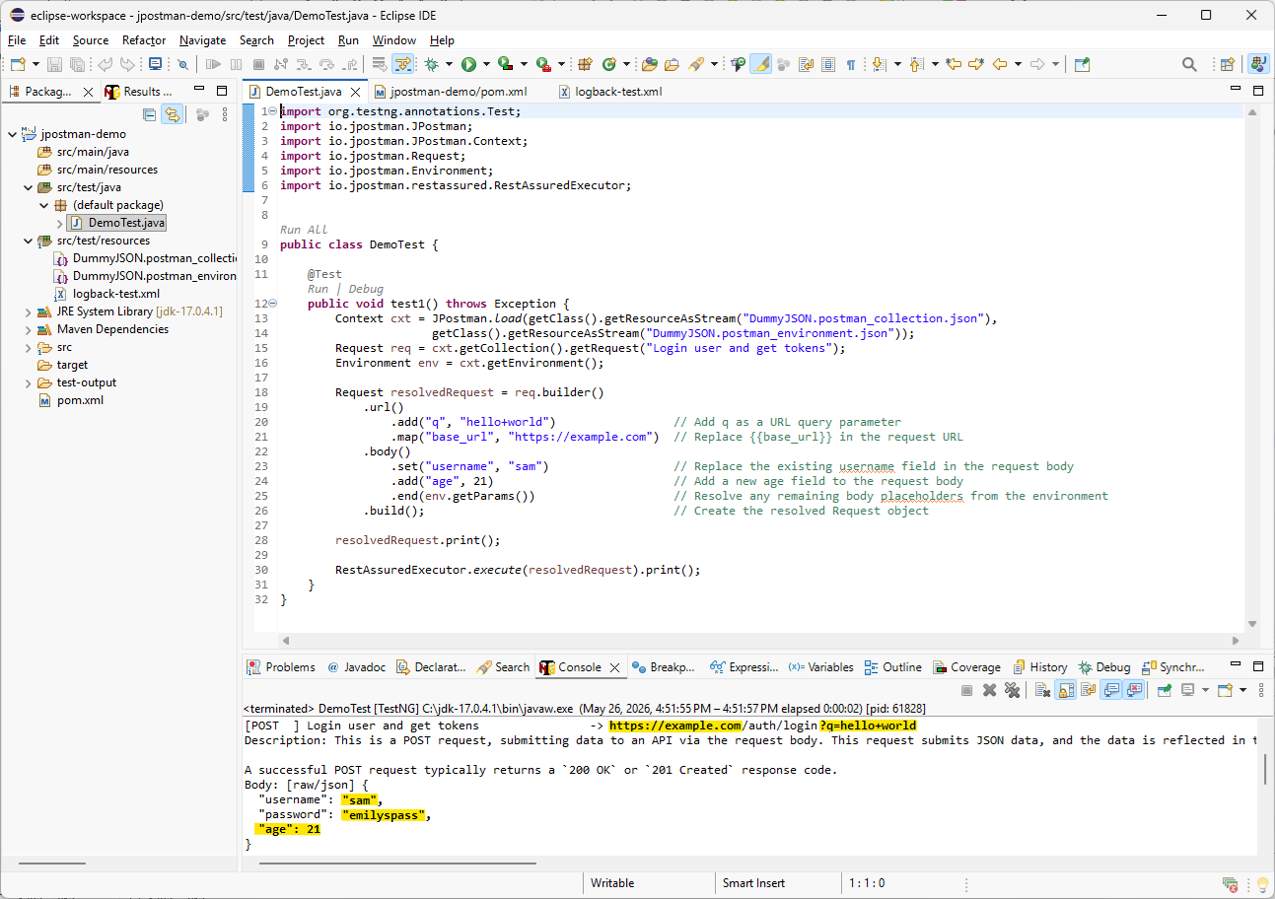
As a result of the execution, we can see that the request values were updated. The URL now uses the mapped base_url placeholder, the query parameter was added, the username value was replaced, and the new age field was applied. The password placeholder was replaced with the value from the environment JSON file.

Slide 7
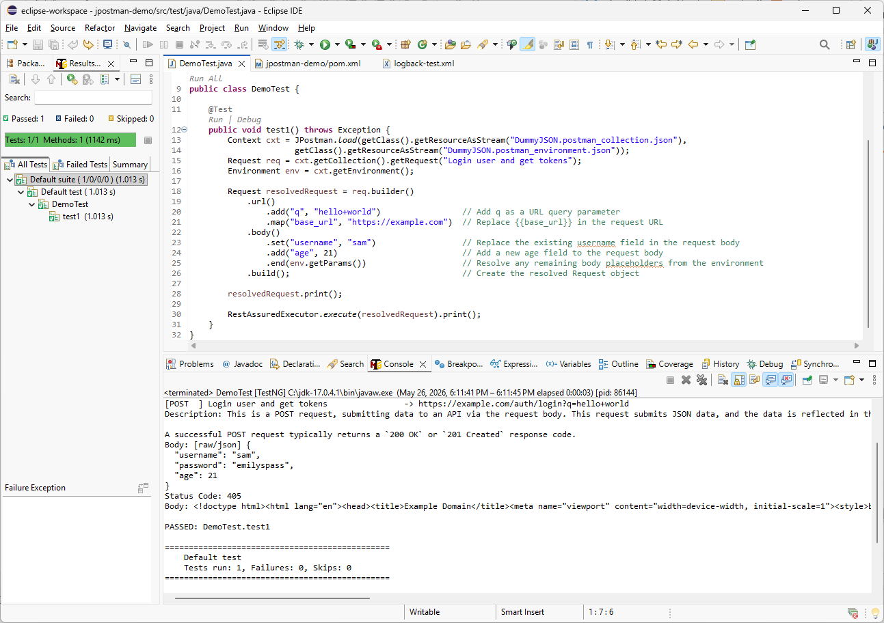
Even though TestNG shows the test as passed, the API response returned status code 405, which means HTTP Method Not Allowed. To properly validate the API result, we need to add an assertion that verifies the expected status code.

Slide 8
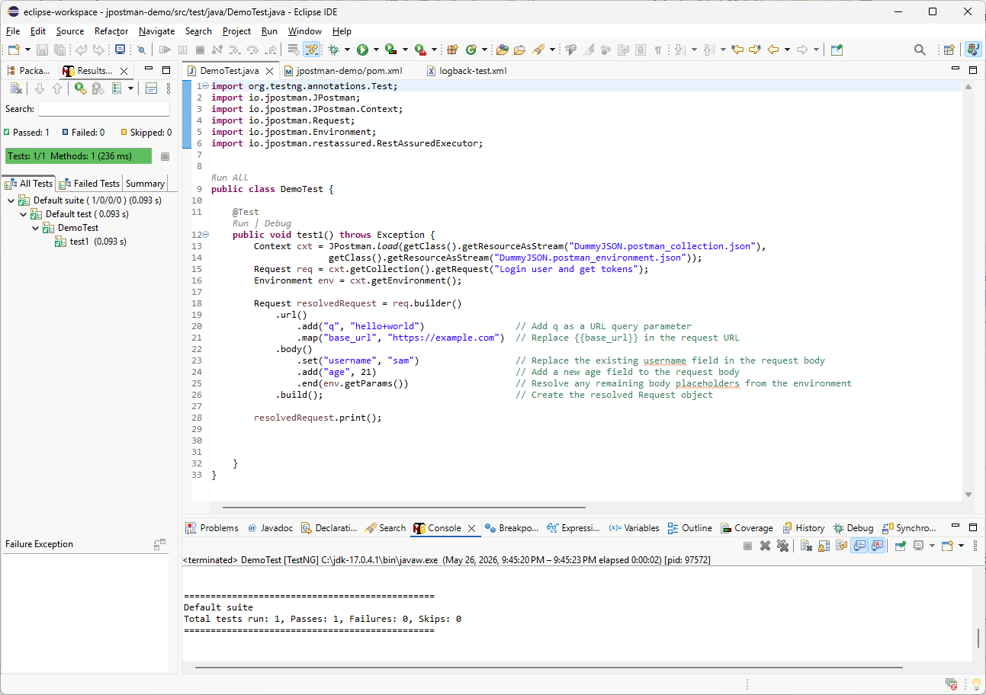
import io.jpostman.ApiResponse;
import static org.testng.Assert.assertEquals;
.print();
ApiResponse res =
RestAssuredExecutor.execute(resolvedRequest);
assertEquals(res.statusCode(), 200, "Body Result: " + res.pretty() + "\n");
I will remove the inline print() call and store the execution result in a local response variable. Then I will import ApiResponse from JPostman and add a static import for TestNG assertEquals. Finally, I will assert that the response status code is 200.

Slide 9
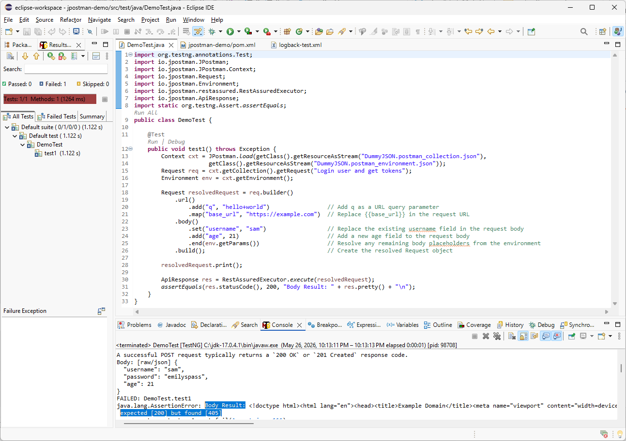
The test now fails correctly when the status code is wrong, and the assertion message includes the server response for debugging.

Slide 10
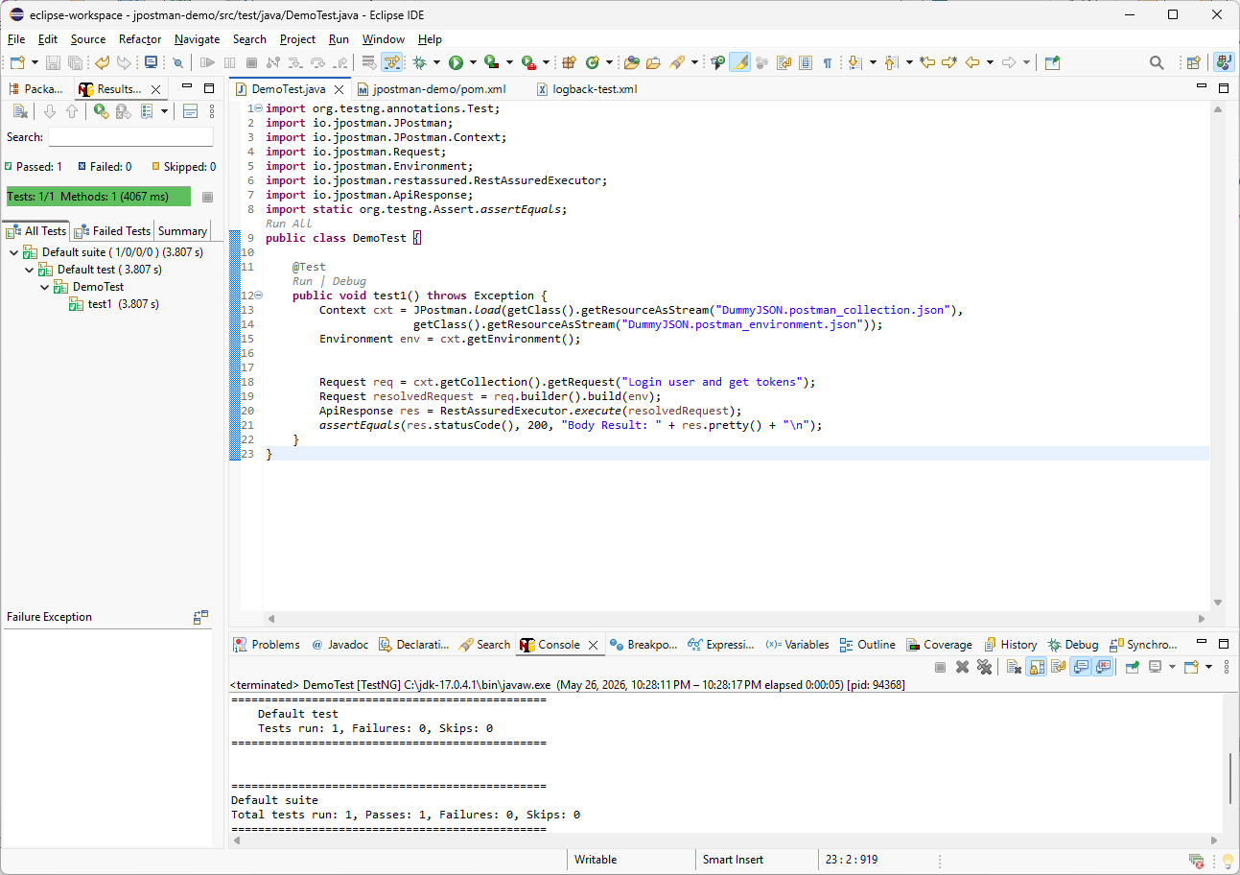
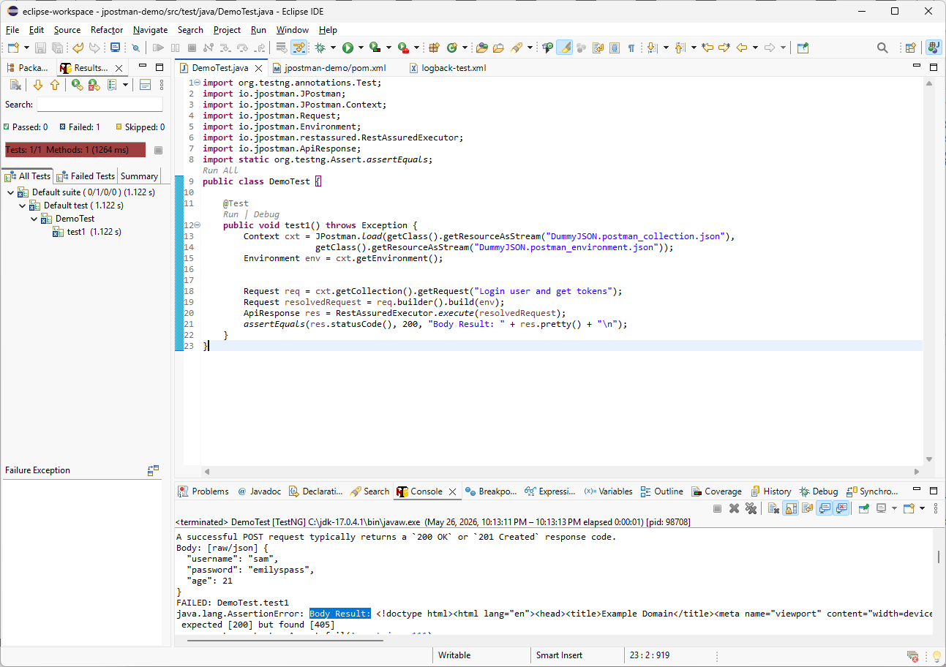
I removed the hardcoded request customizations and cleaned up the code. Now let’s run the test one more time. The TestNG result is passed, which confirms that the REST API server returned status code 200 as expected.

Slide 11
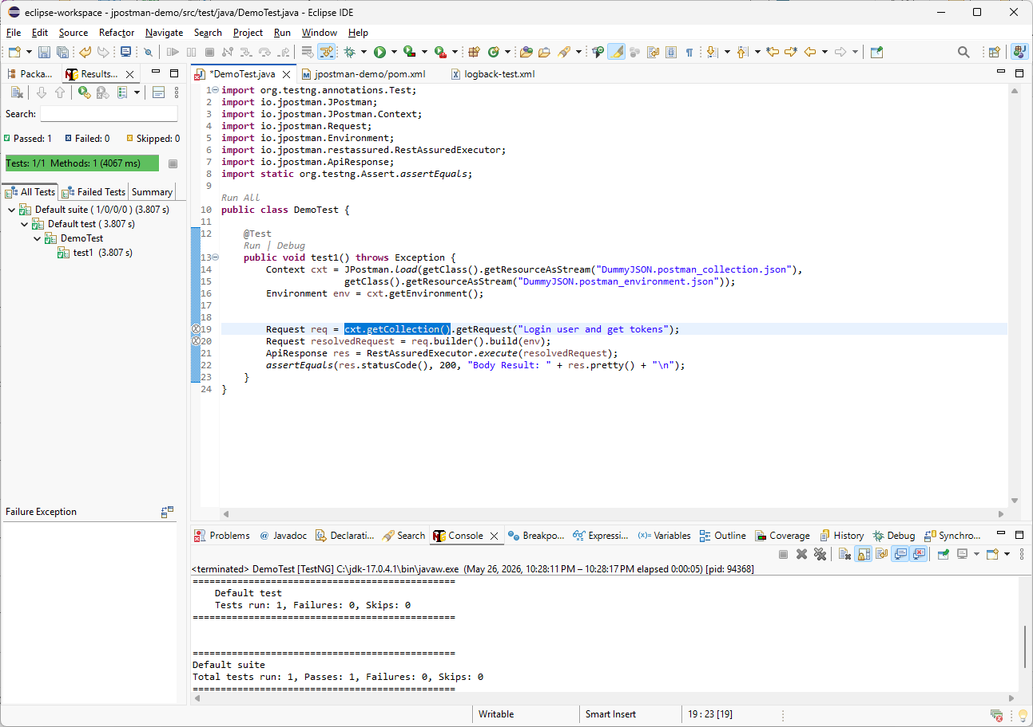
Before selecting another request, I will create a local reference to the Postman collection. This makes the code cleaner because I can reuse the same Collection variable for multiple getRequest() calls.

Slide 12
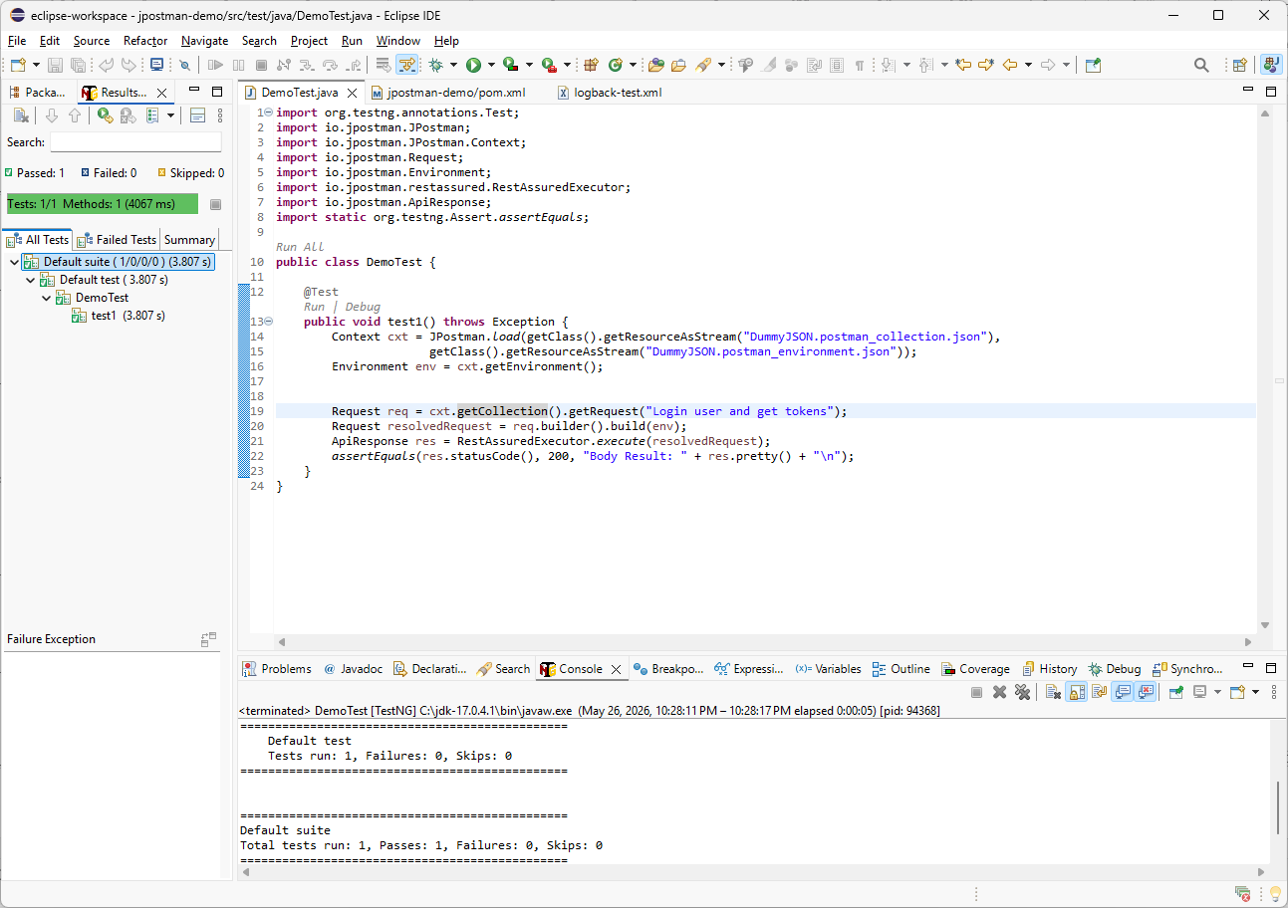
import io.jpostman.Collection;
Collection col = cxt.getCollection();
I will import the JPostman Collection class and create a local variable named col. This gives us a direct reference to the Postman collection loaded from the JSON file.

Slide 13
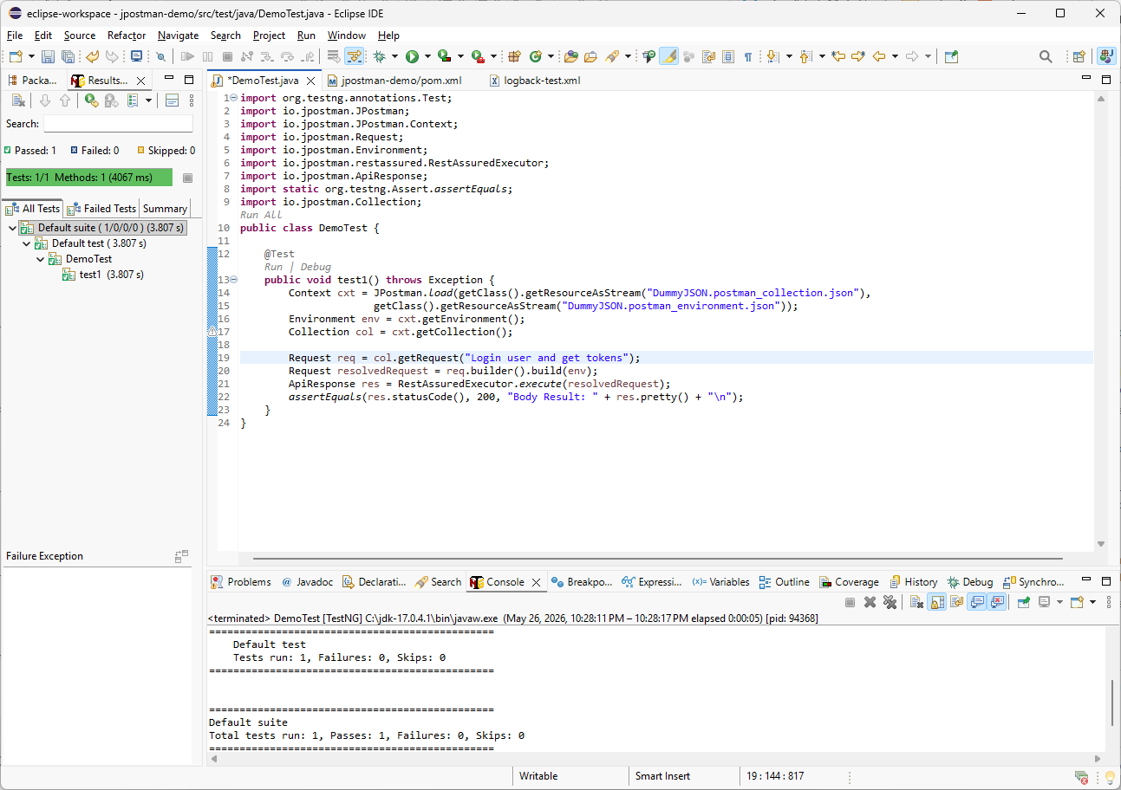
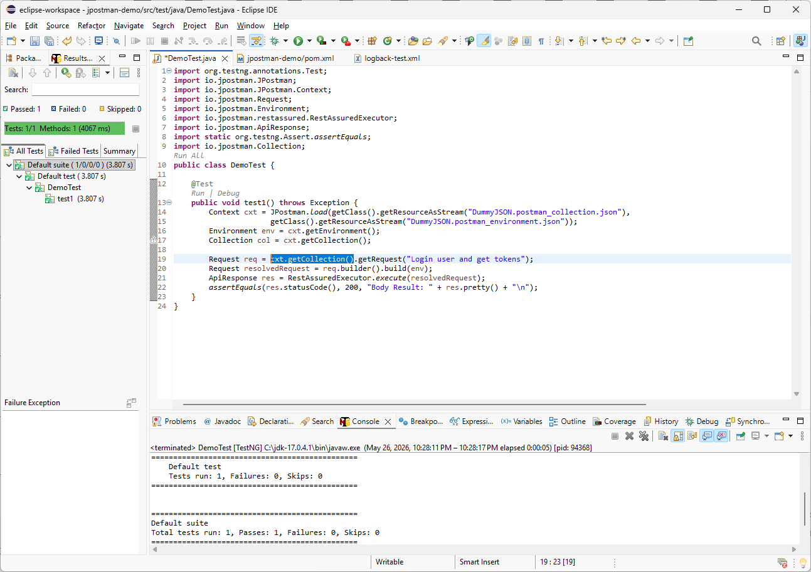
Next, I will replace the direct ctx.getCollection() call with the new col variable to make the code cleaner.

Slide 14
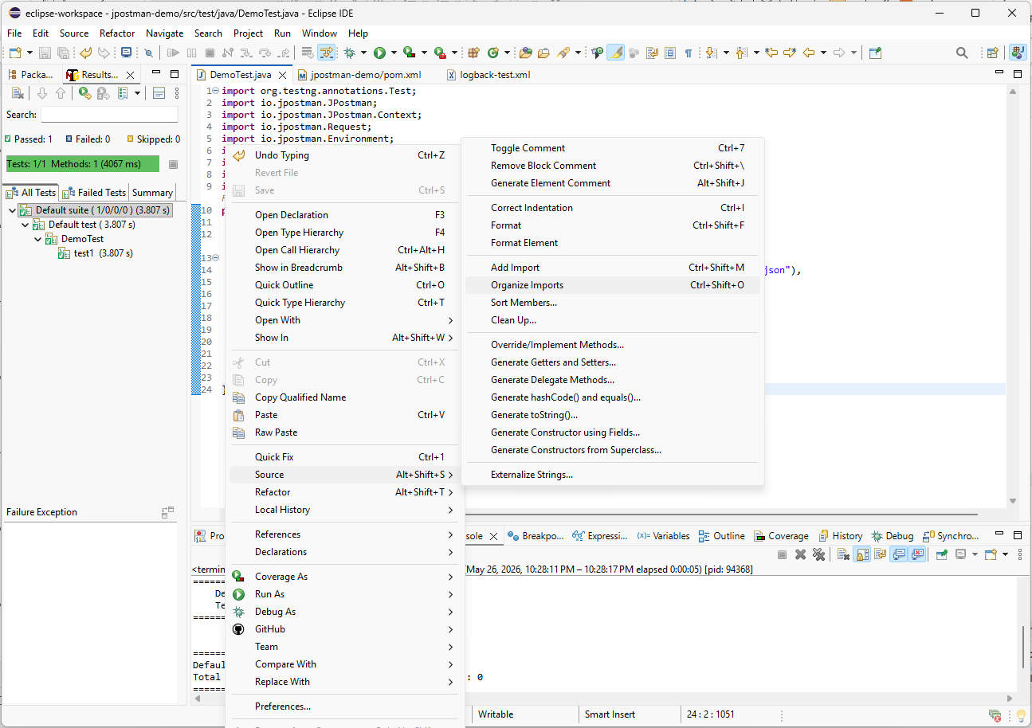
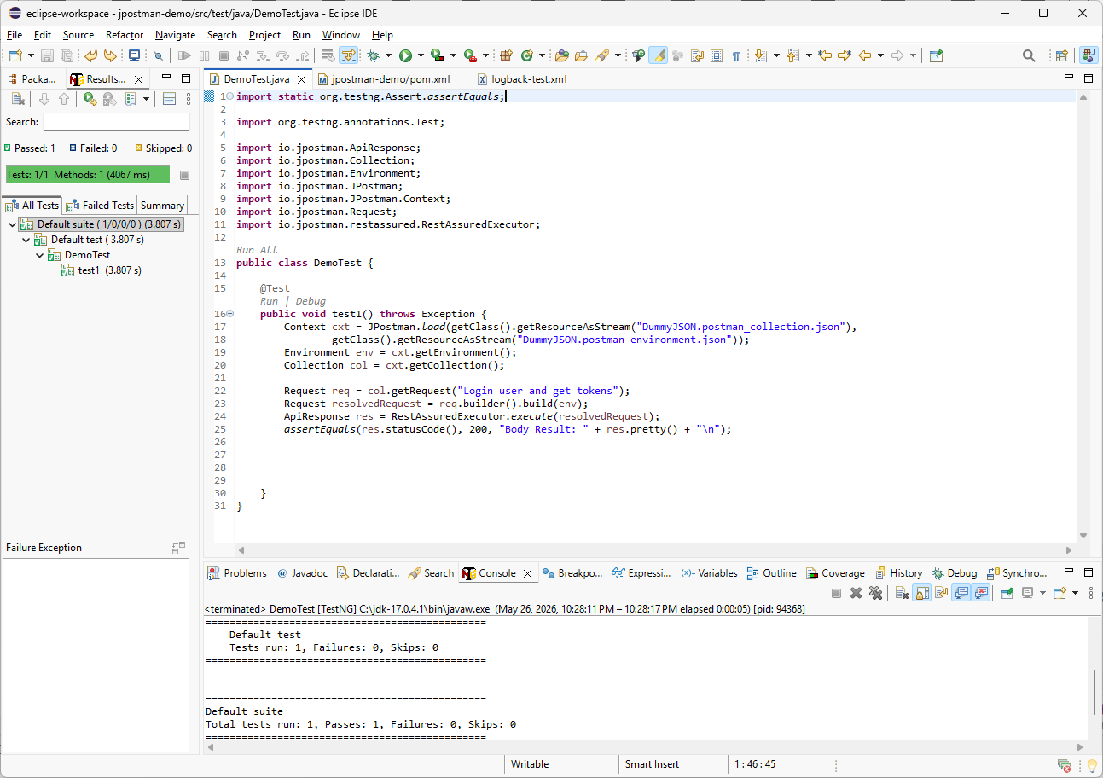
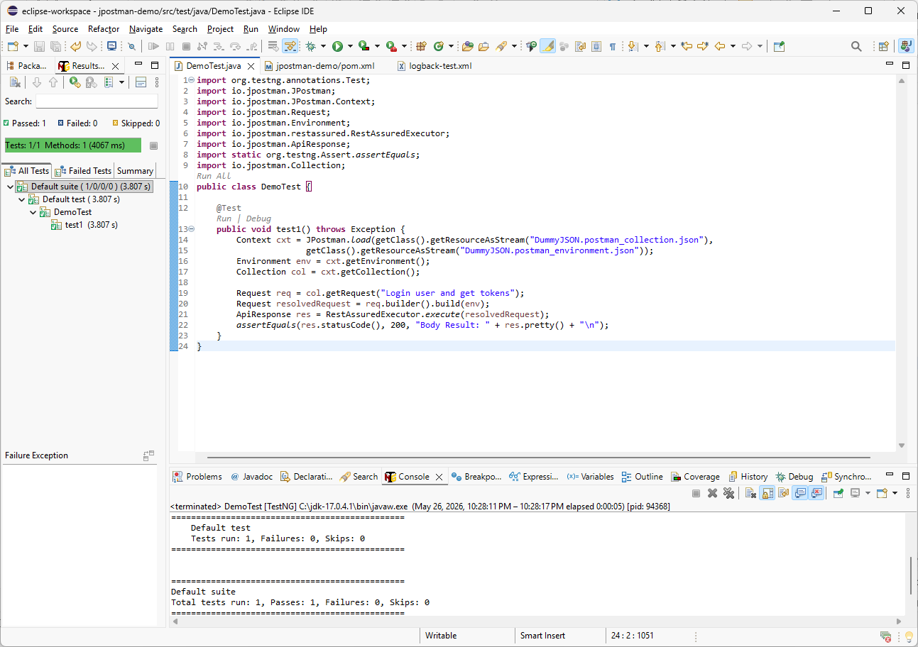
At this point, I will let Eclipse clean up the source code. I will right-click anywhere in the editor, go to Source, and select Organize Imports. Then I will apply Formatting. Now the imports are organized, and the code is easier to read.

Slide 15
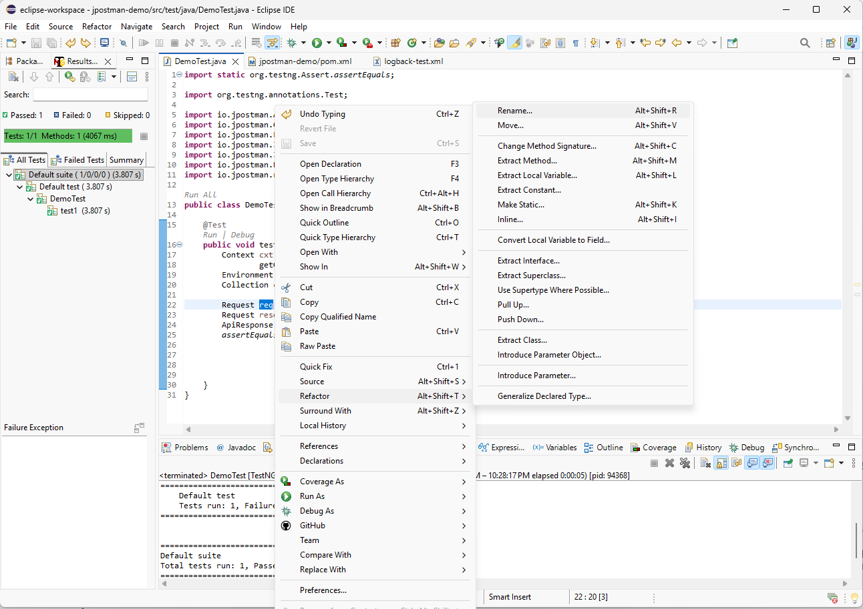
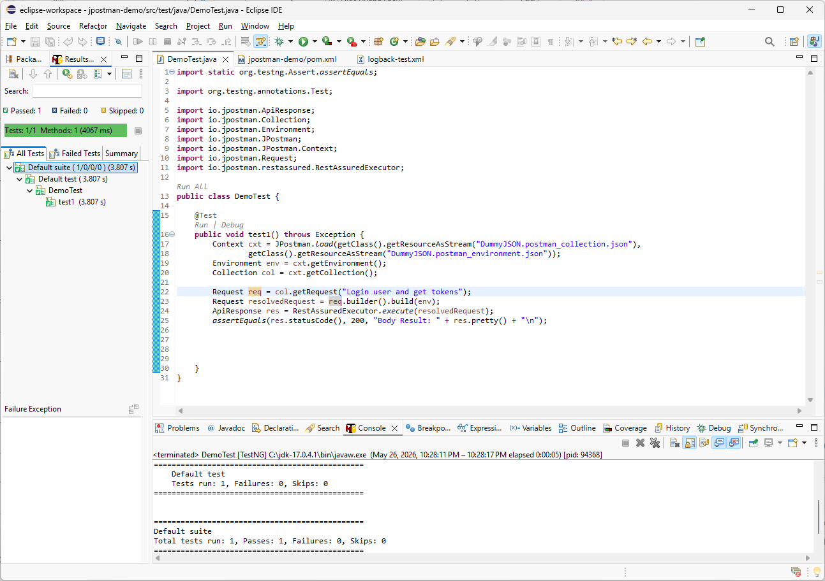
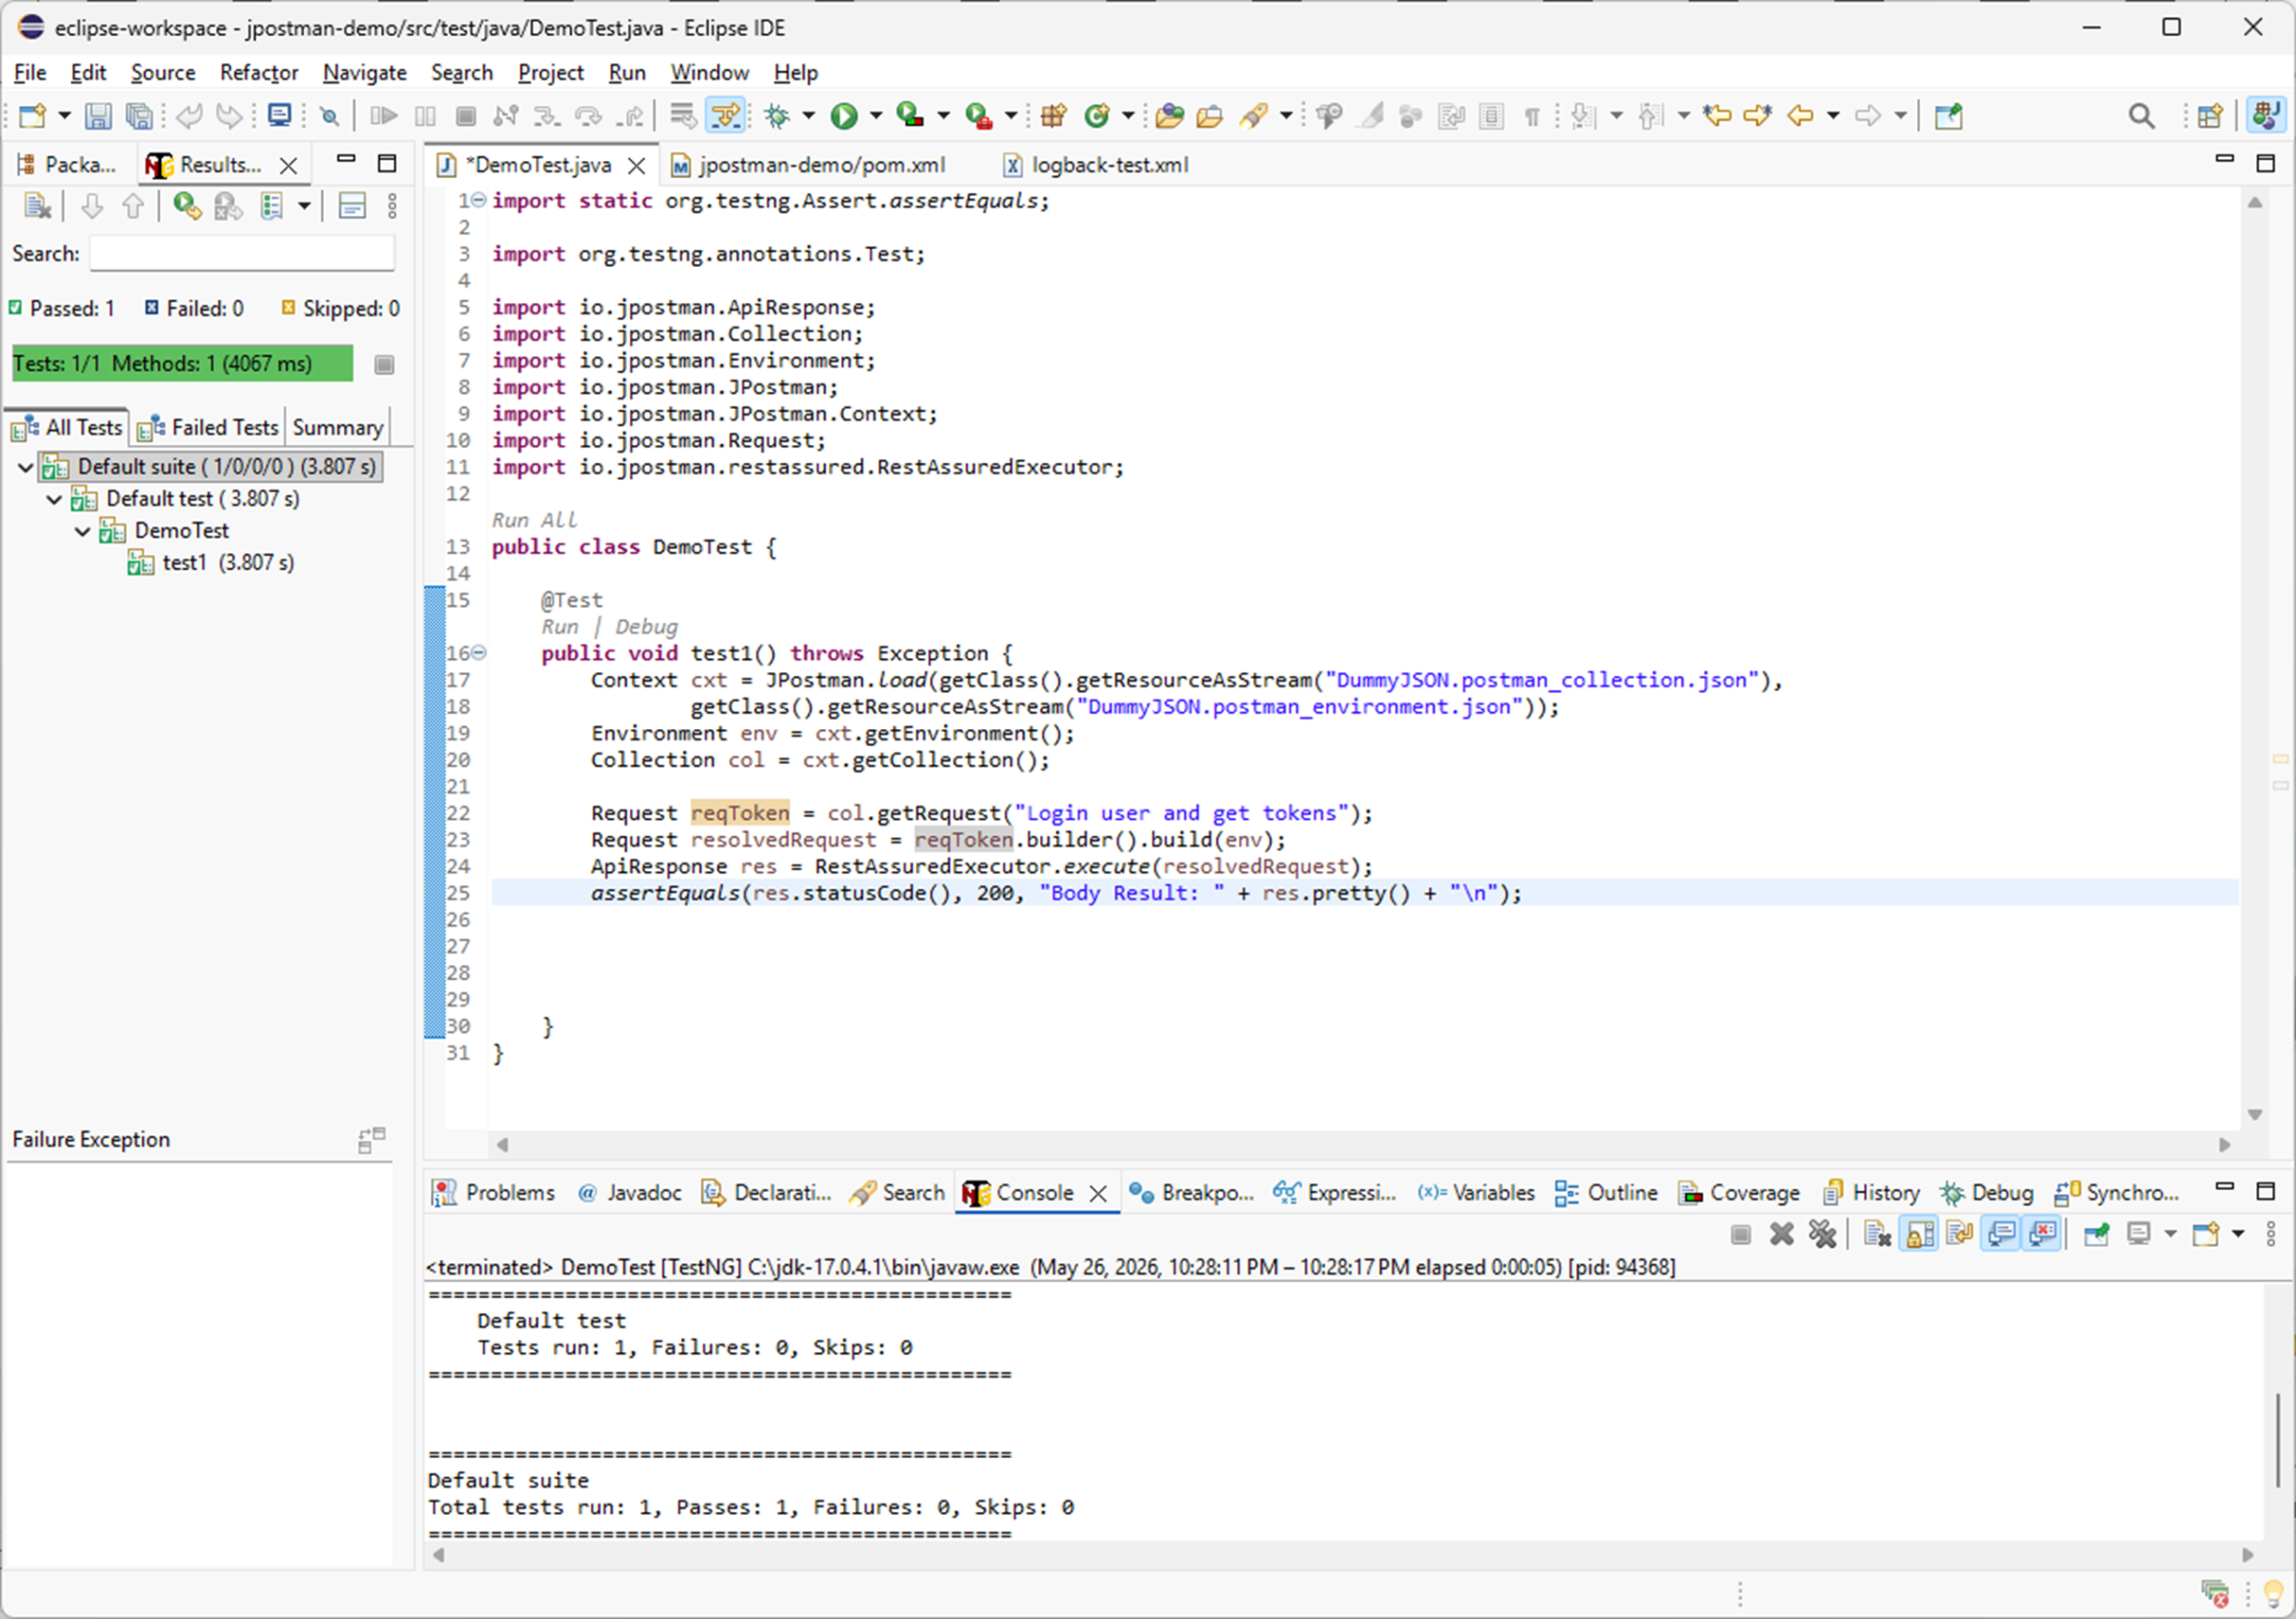
I will also give the variable a better name. Since this request is used to get the token, I will rename req to reqToken. I will right-click the variable, choose Refactor → Rename, and enter the new name.

Slide 16
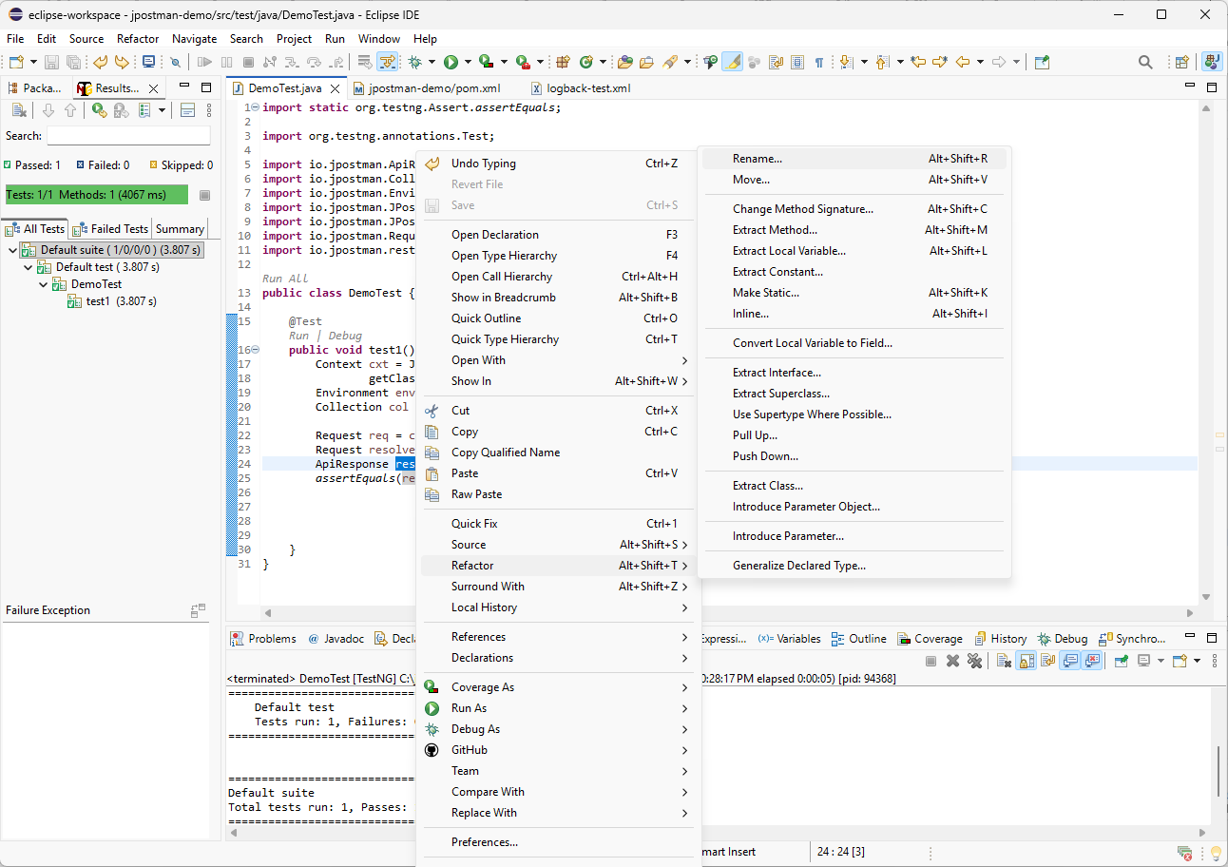
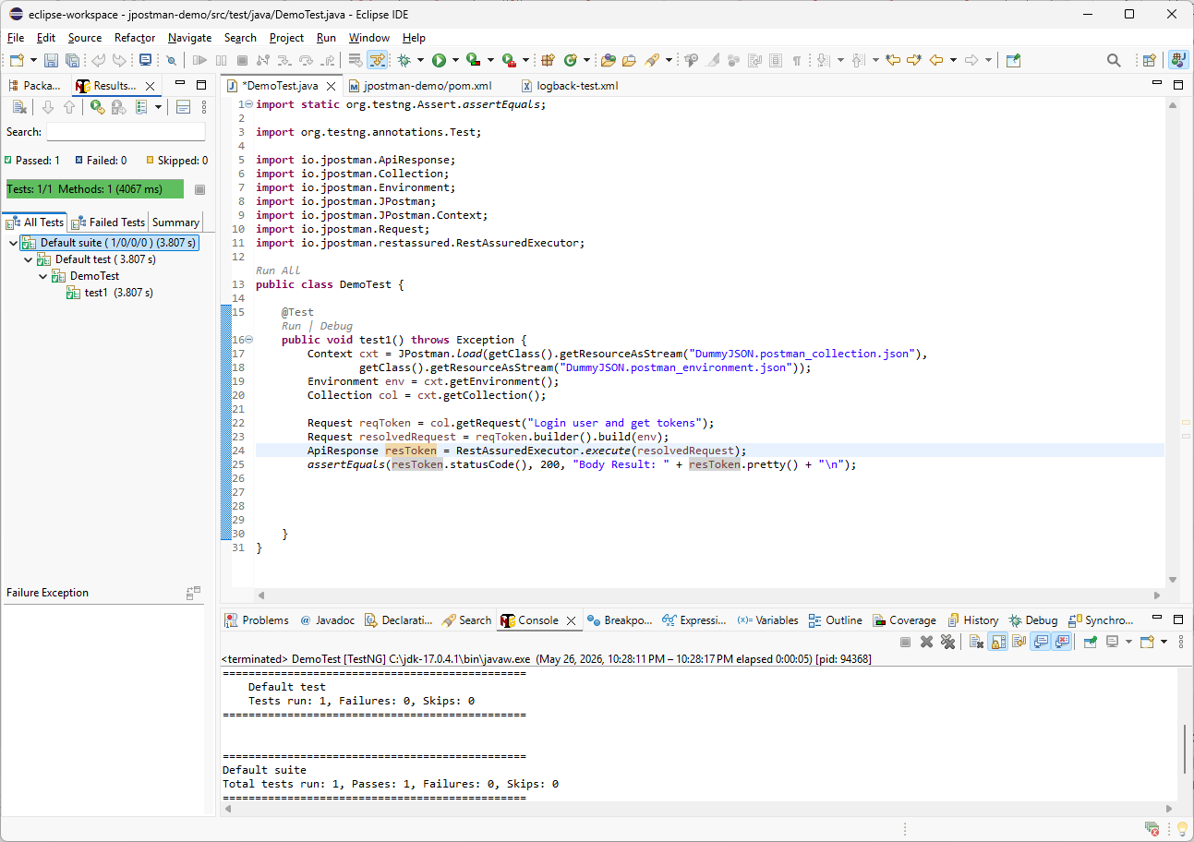
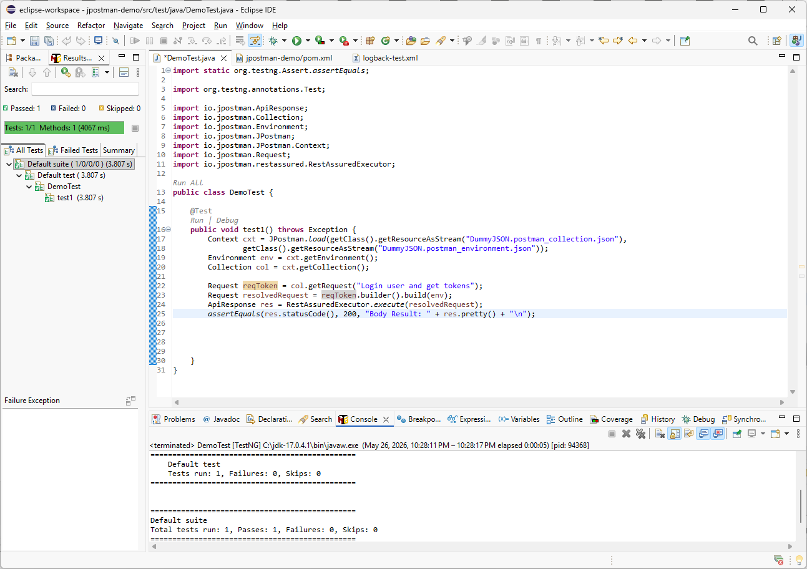
I will also apply the same refactoring step to the response variable. Since this response belongs to the token request, I will rename res to resToken.

Slide 17
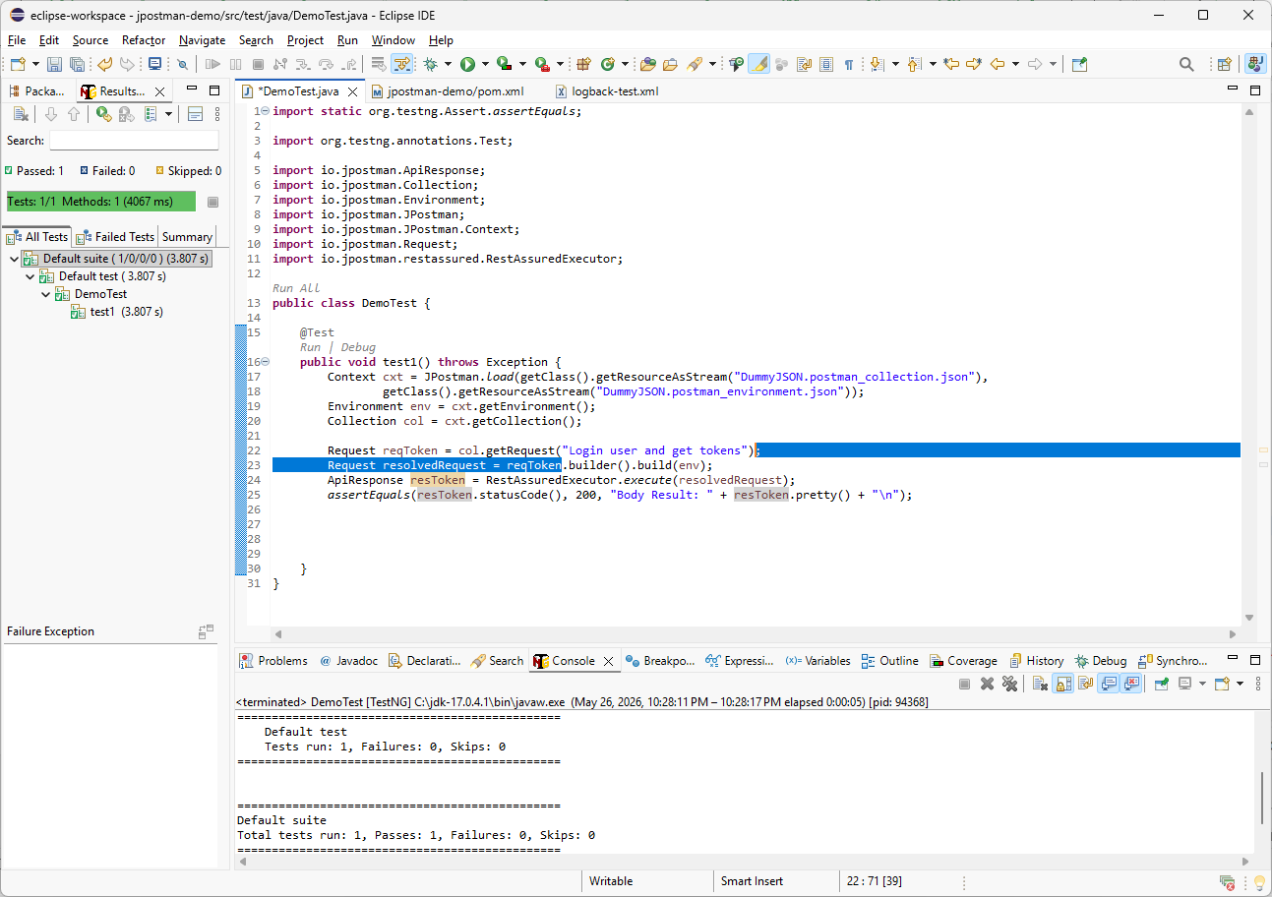
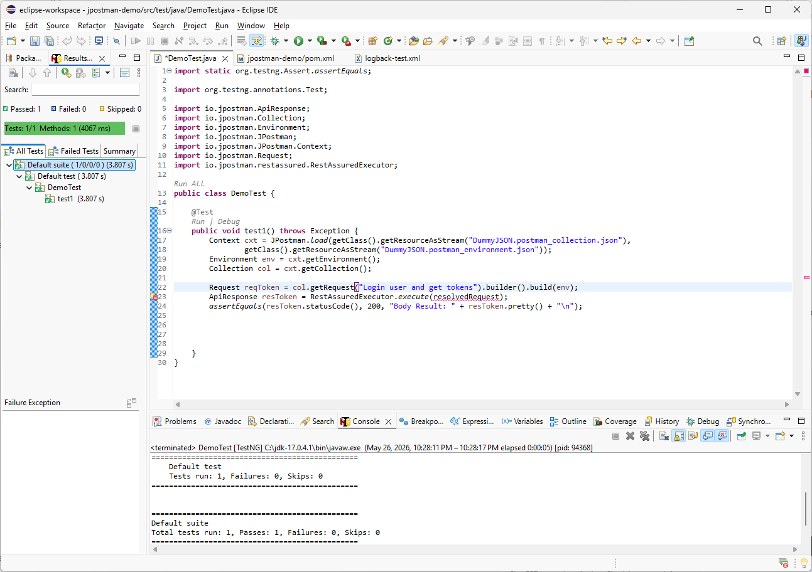
Finally, I will simplify the code by removing the separate resolvedRequest variable. I will move the .builder().build(env) call to the end of the reqToken line, then press Delete to remove the extra line.

Slide 18
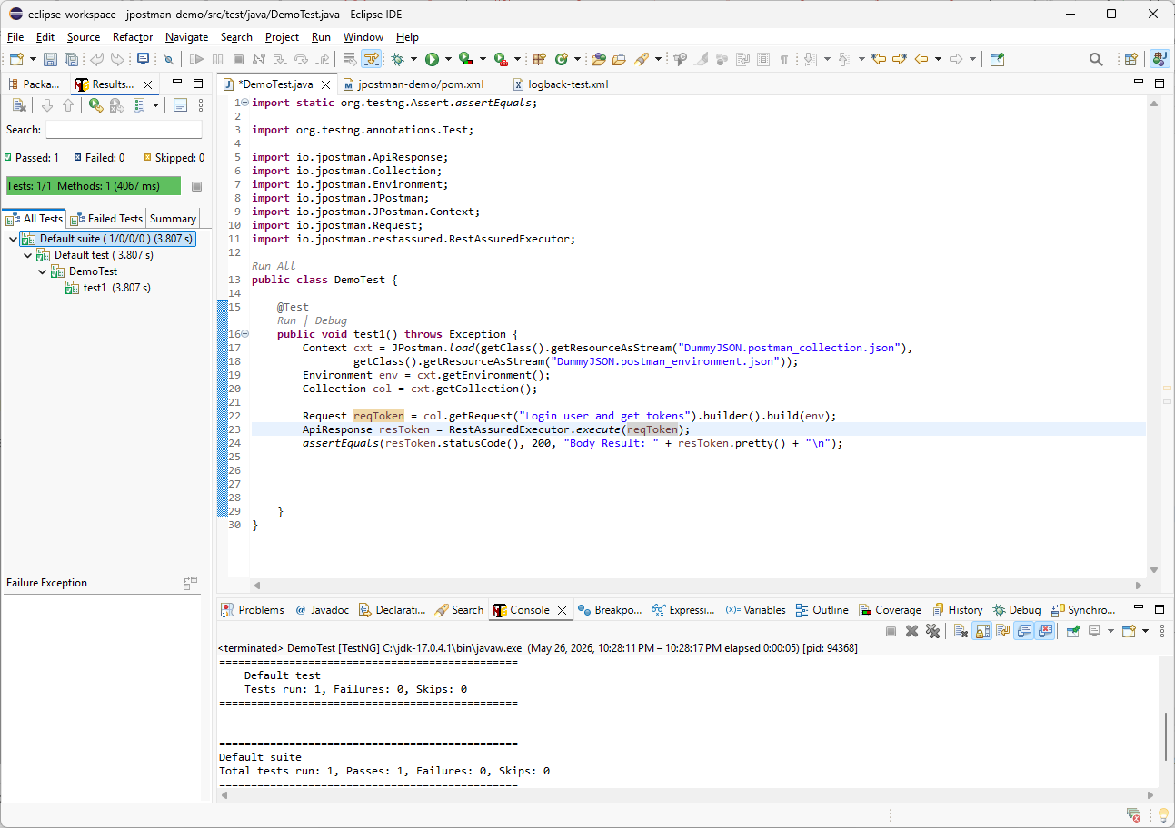
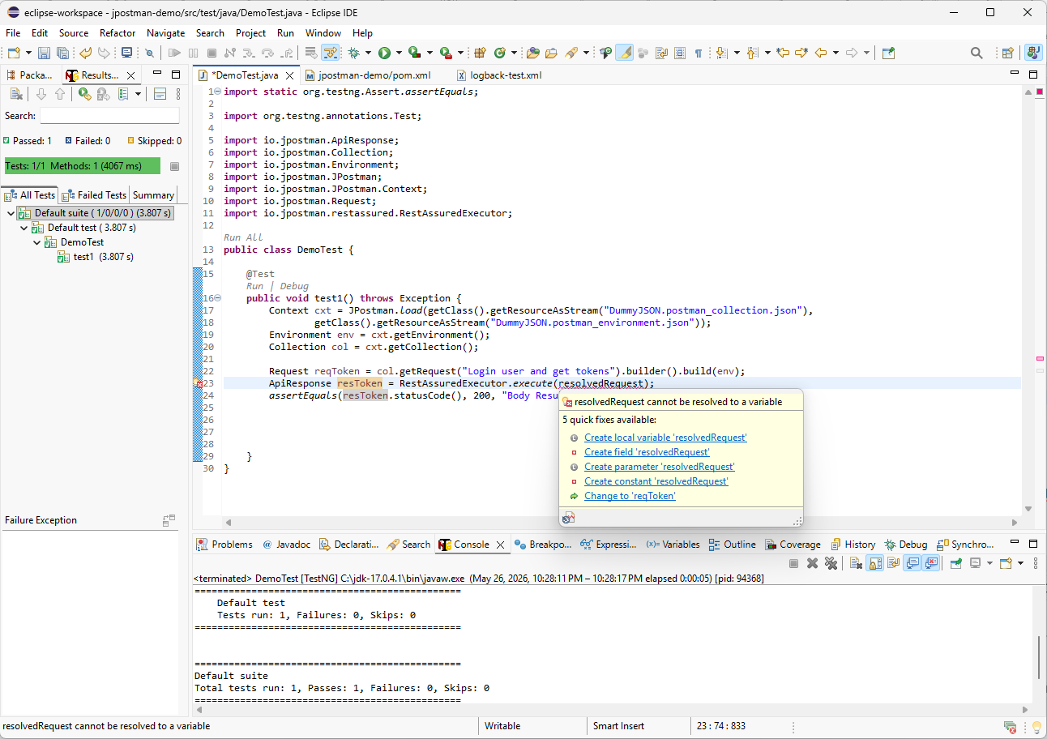
Since we removed the resolvedRequest variable, Eclipse shows an error. Hover over resolvedRequest and select Change to 'reqToken' from the quick-fix menu.

Slide 19
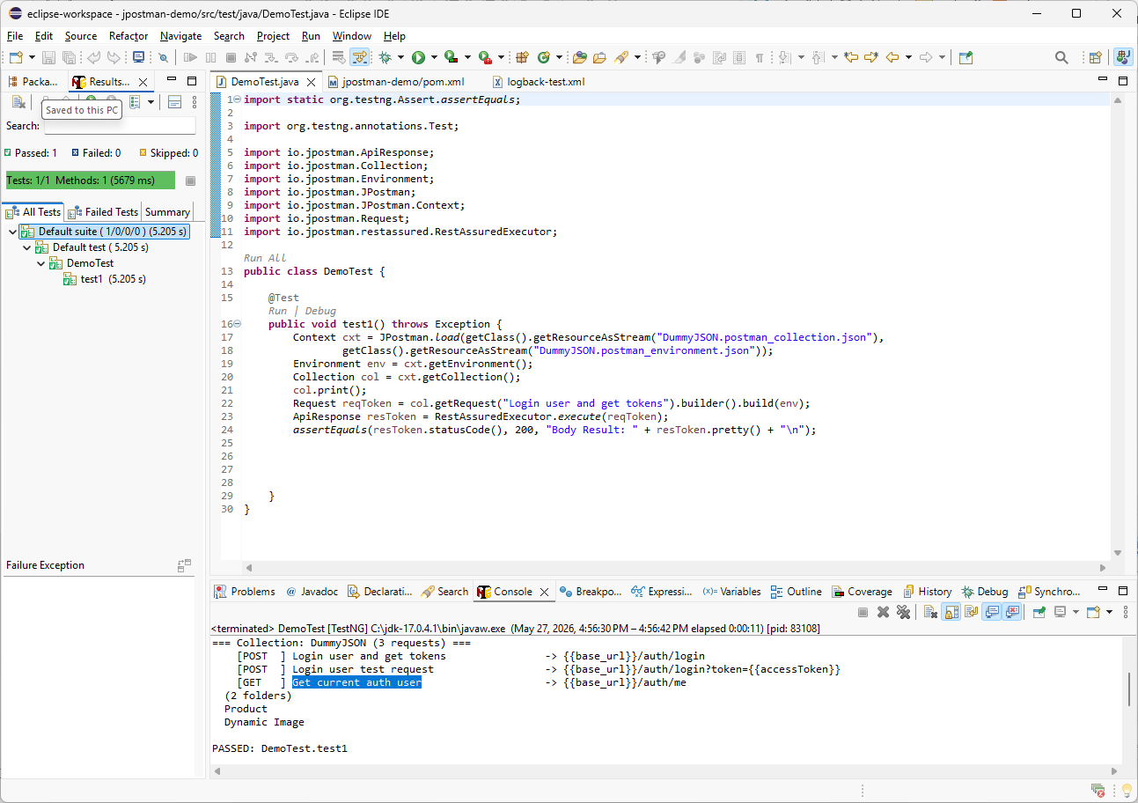
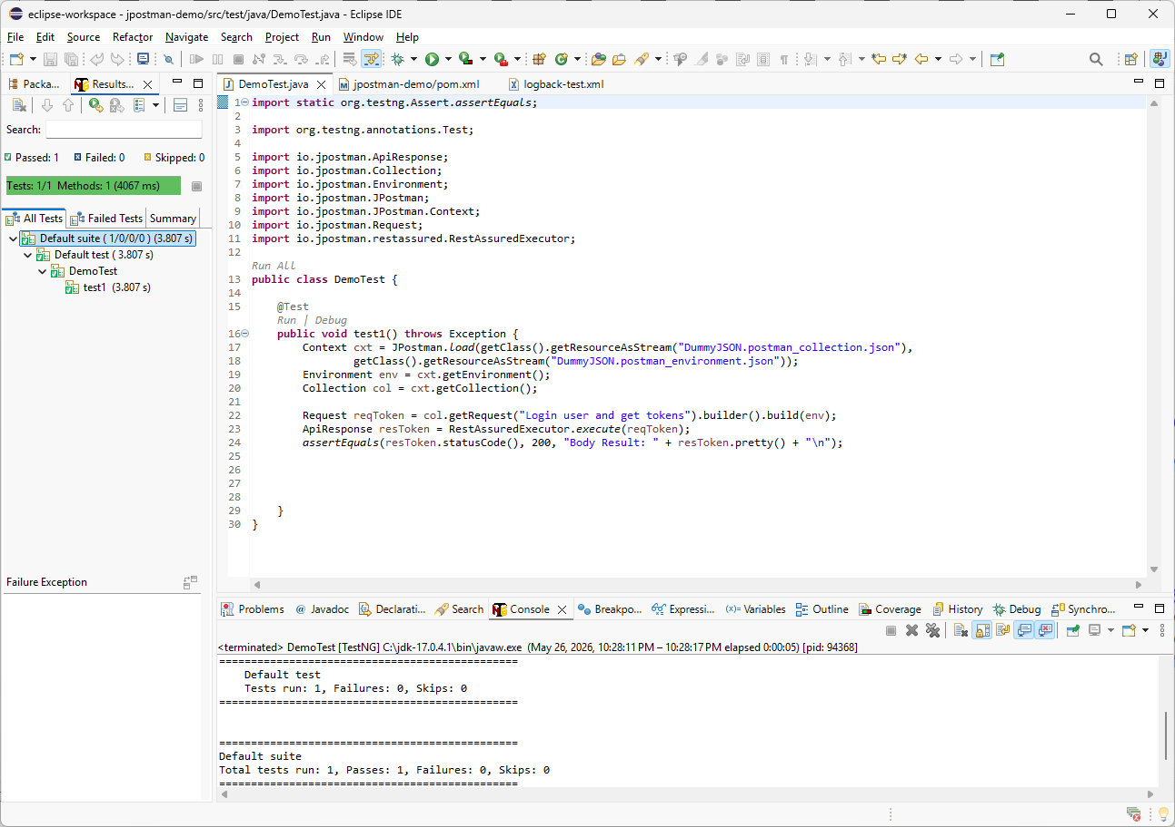
col.print();
Let’s call col.print() to display all available requests under the root collection again. Then press Ctrl + F11 to run the test. For the next API call, we will use the Get current auth user.

Slide 20
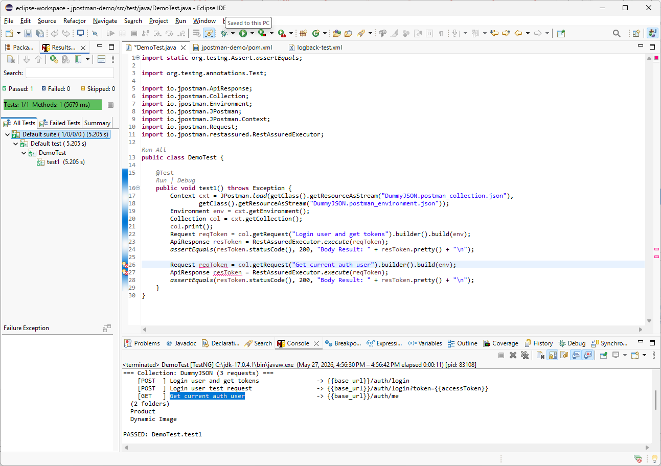
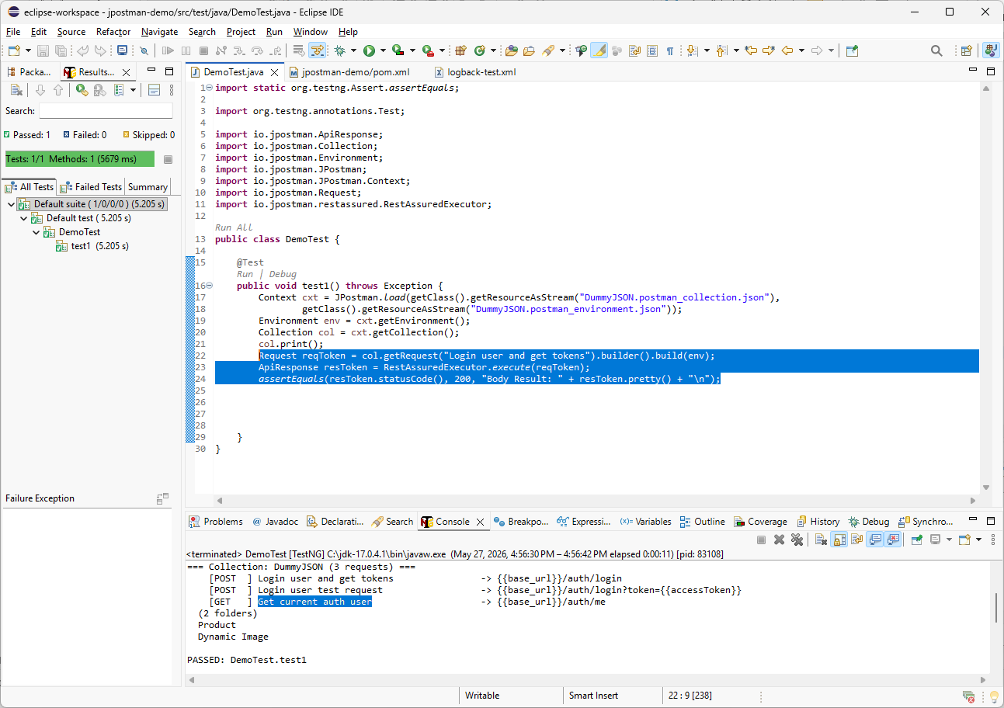

To save time, I will reuse the same three lines from the token request implementation. I will copy and paste them below the existing code, then replace the request name with Get current auth user from the console output.

Slide 21
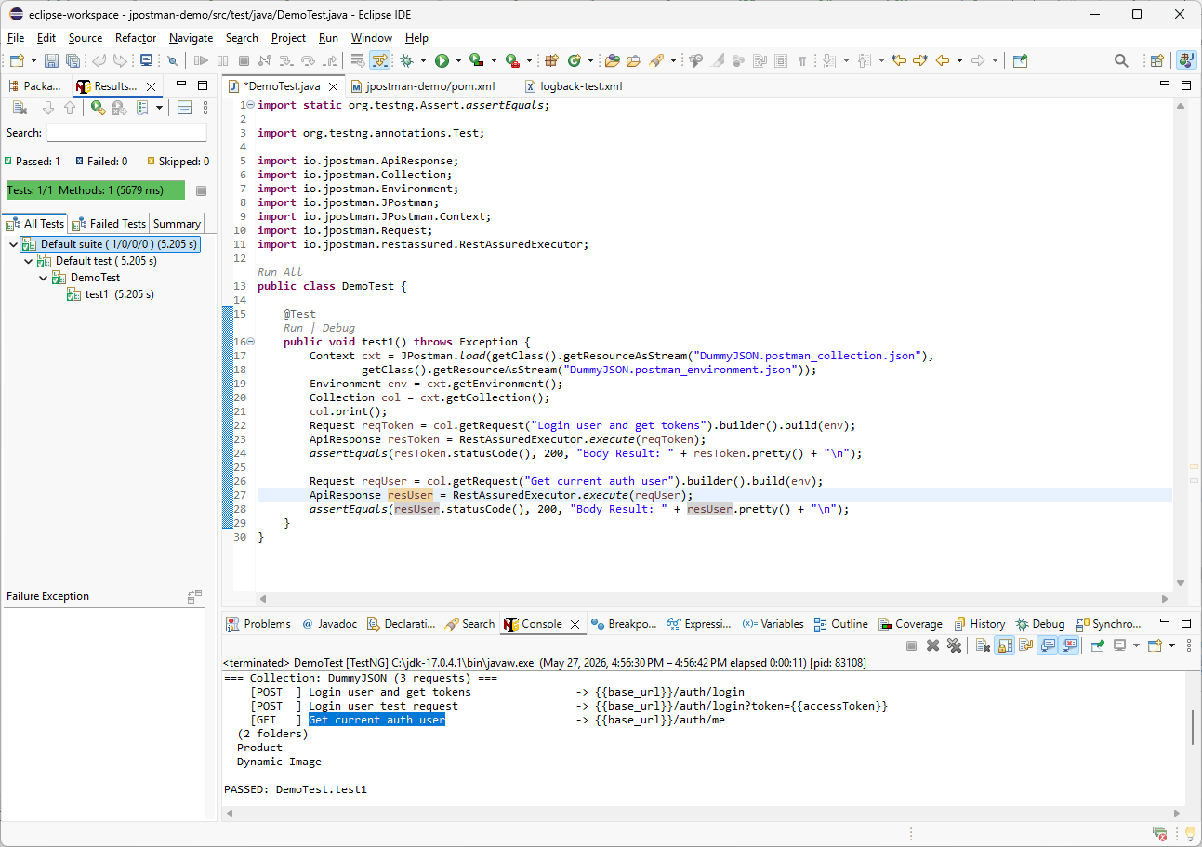



For the second request, I will rename the variable reqToken to reqUser, and I will change the response object from resToken to resUser.

Slide 22
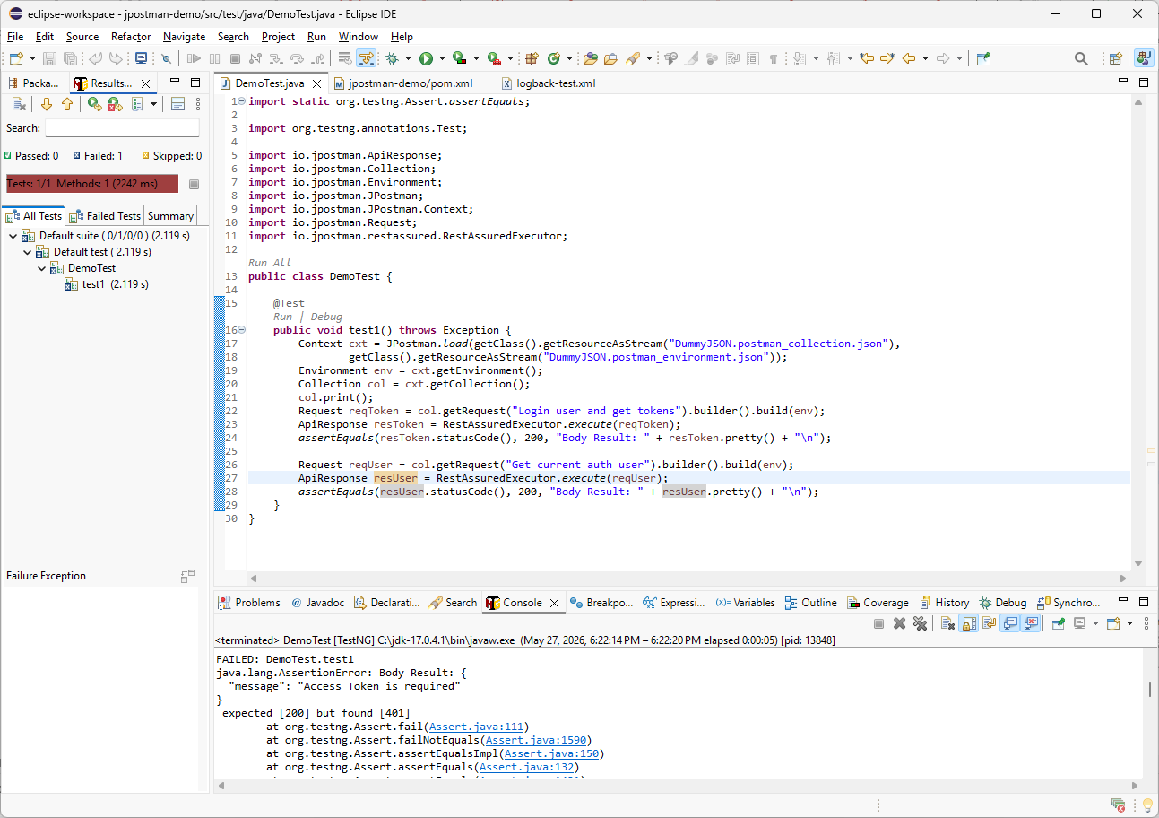
The first request passed, but the second request returned status code 401 with the message Access Token is required. This means the request is missing an authorization value. The easiest way to debug this is to print the second request details, including the URL, headers, and body.

Slide 23
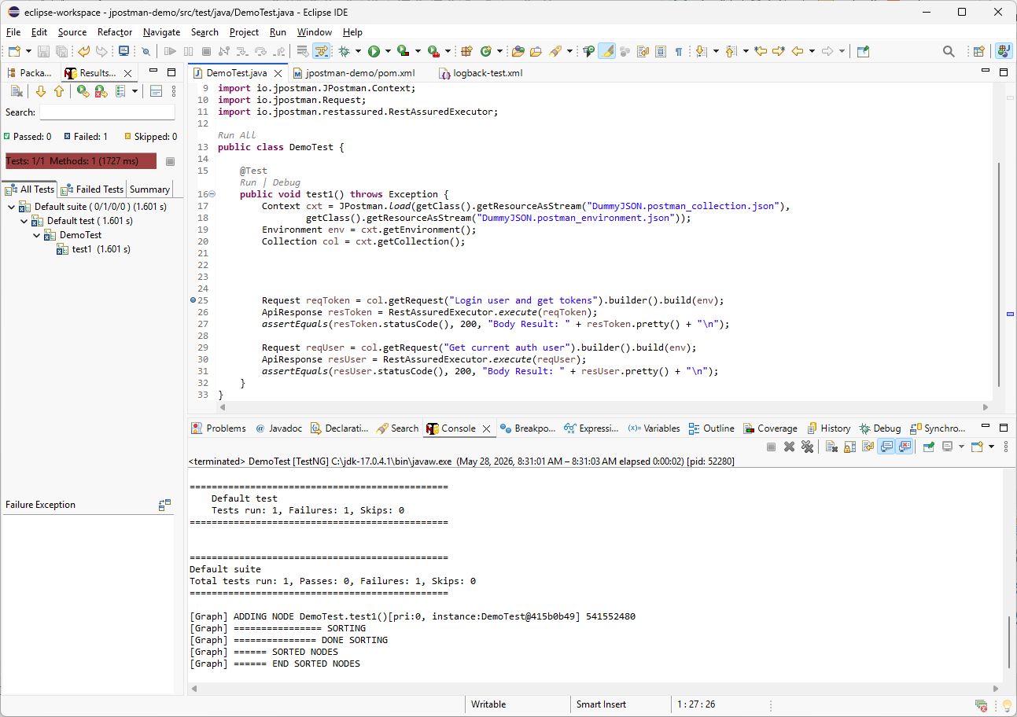

col.print();
col.getRequest("Get current auth user").print();
col.getRequest("Get current auth user").builder().build(env).print();
For debugging, I will replace the collection print line with two print statements: one for the unresolved request and one for the resolved request. I want to execute the code only up to these lines, so I will set a breakpoint and run the test in Debug mode from Eclipse.

Slide 24
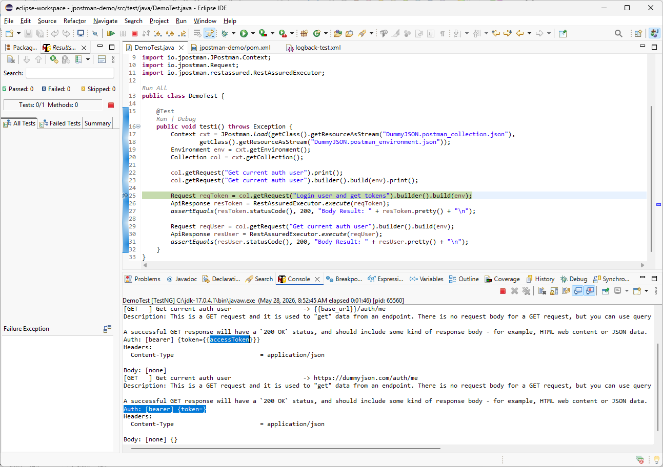
From the console output, we can see that the unresolved request expects the accessToken value. After resolving the request, this value is empty. To fix this, we have two options: update the Environment object so the value is available for all requests, or call the auth method only for this specific request.

Slide 25
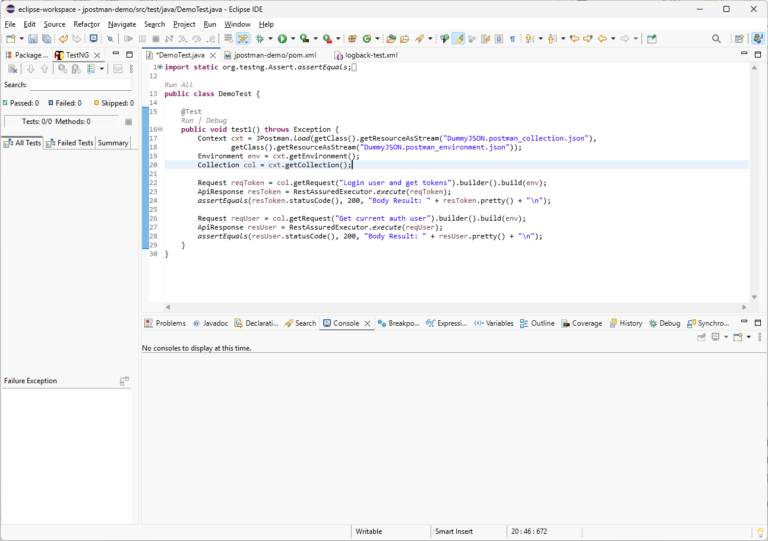
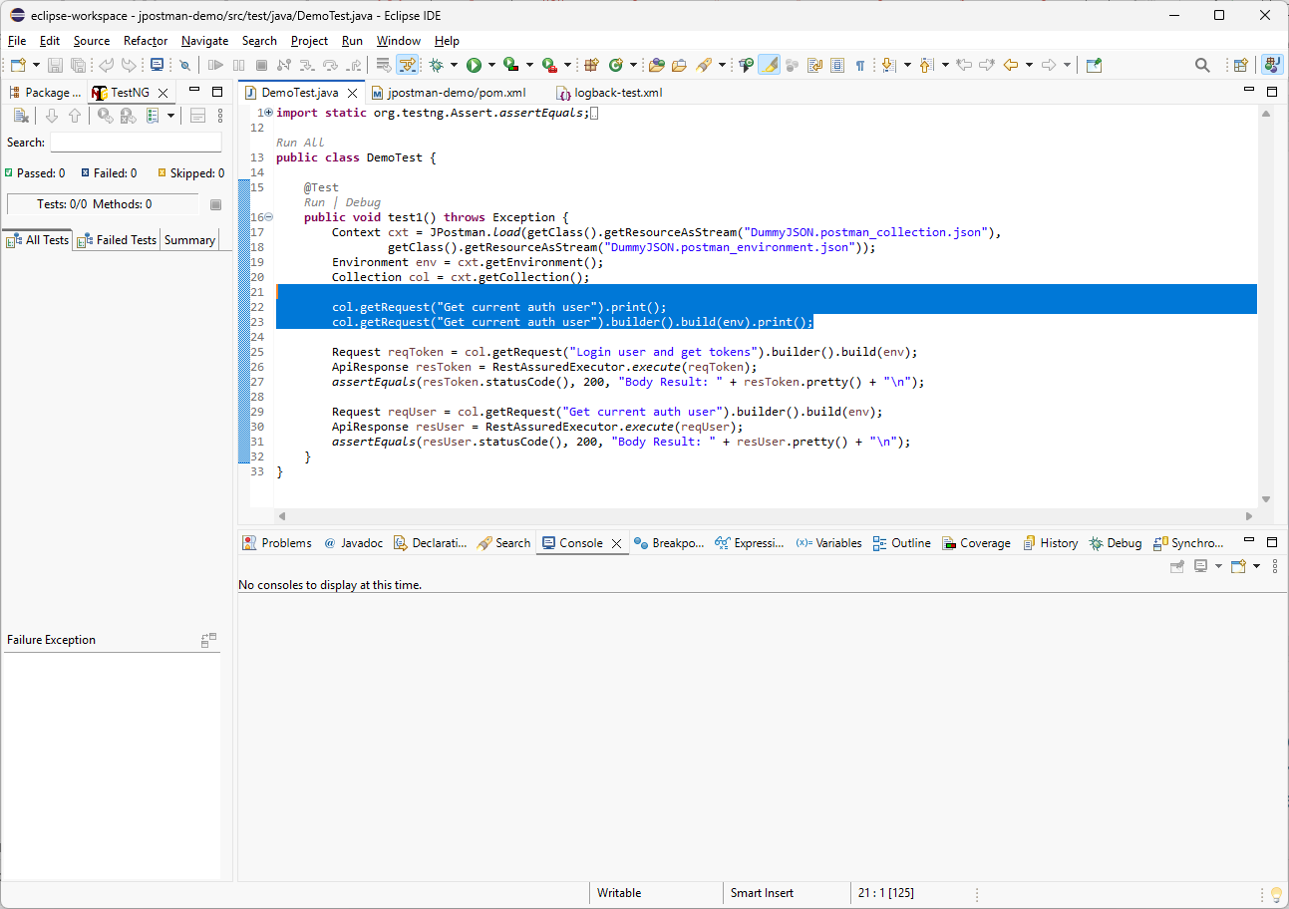
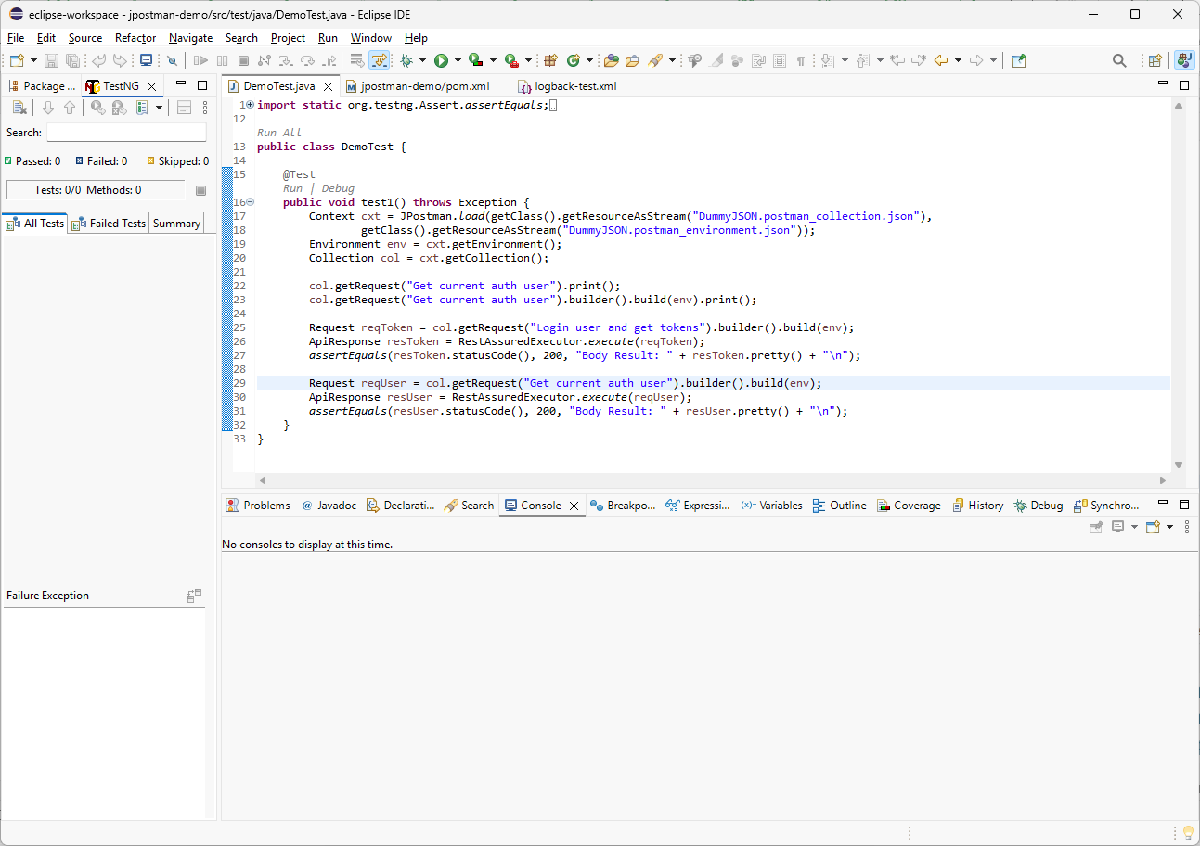
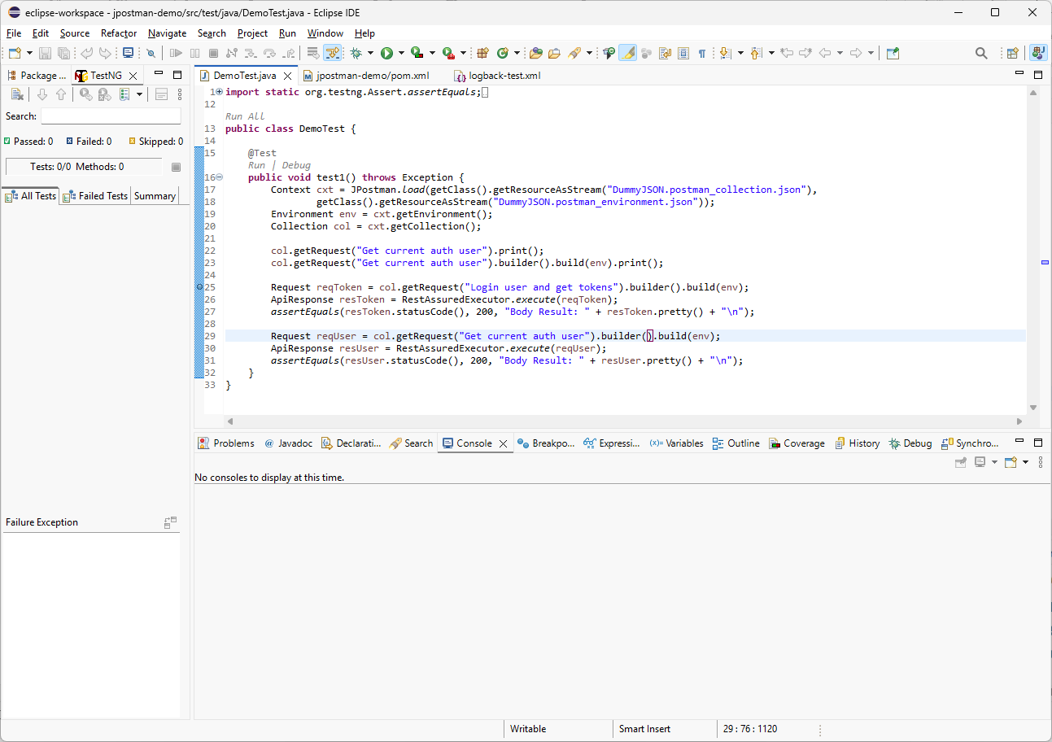
resToken.print();
Now I will remove the last breakpoint and clean up the temporary debug code. I will delete the temporary request print statements, then add resToken.print() so we can review the token response output one more time.

Slide 26
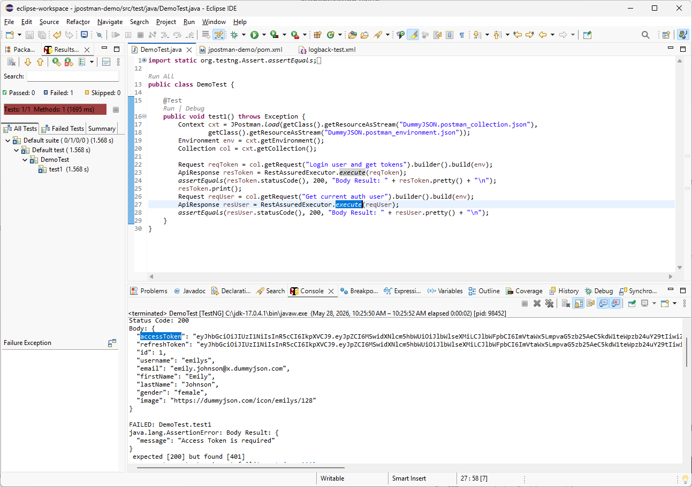
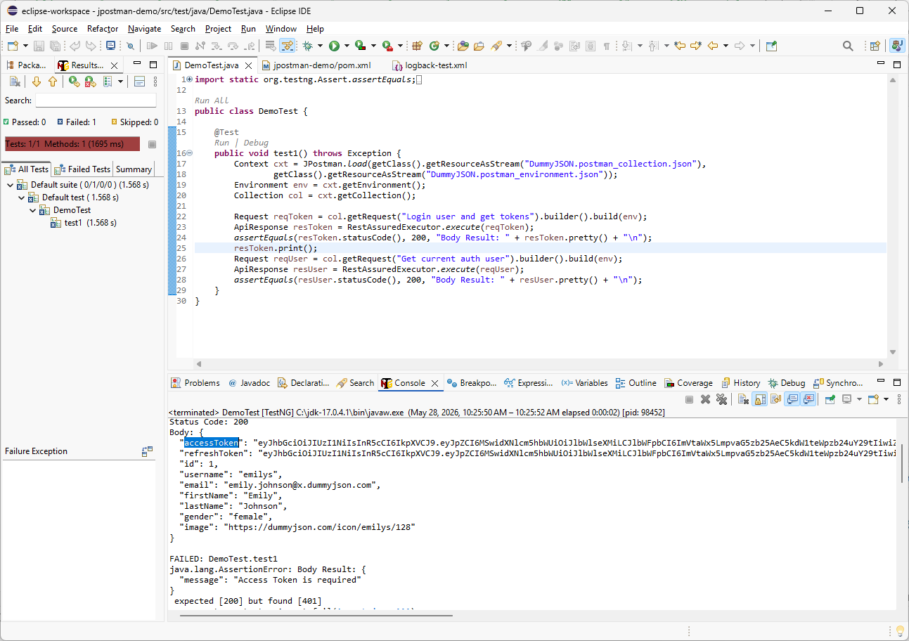
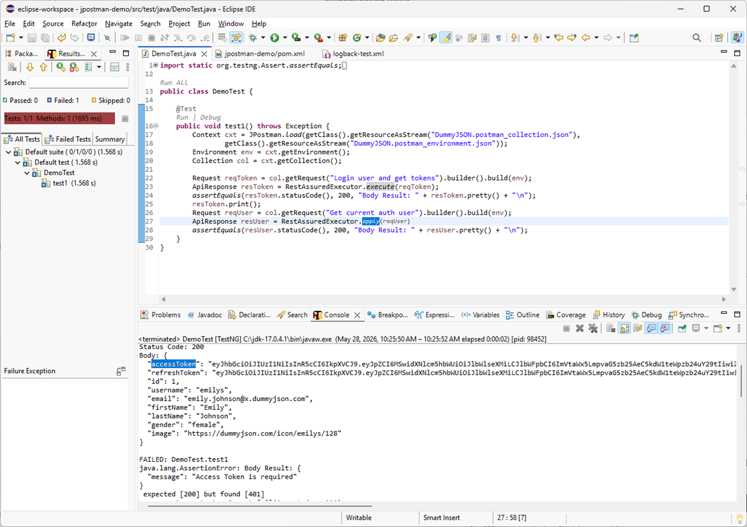
.auth().oauth2(resToken.path("accessToken")).response();
The request returns an accessToken in the response body. We will use this token in the next request to build a chained request flow. I will replace execute() with apply() so we can configure the executor before sending the request. Then I will use auth().oauth2() and pass the accessToken from the token response.

Slide 27
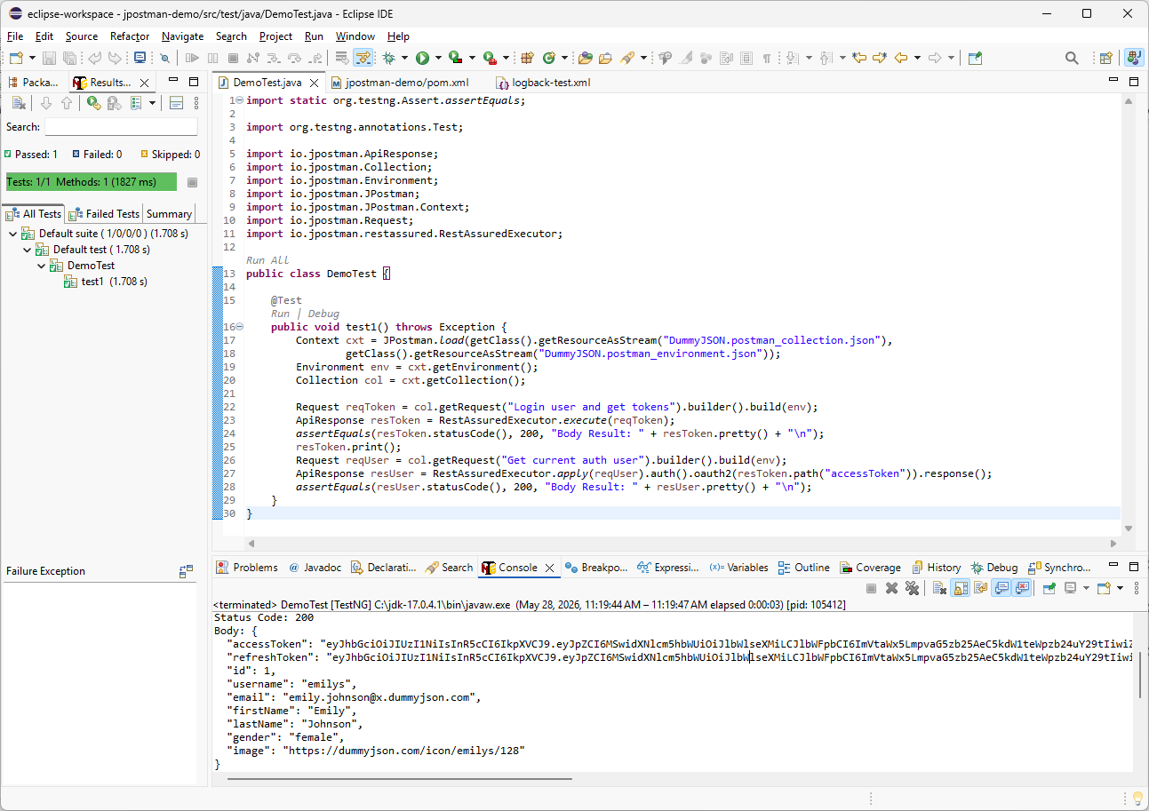
Both requests returned status code 200. In the next video, we will review best practices for organizing multiple requests in TestNG. Thank you for watching, and I’ll see you in the next tutorial.

