Slide 1
Distributed Systems and Cloud Computing
Creating and Connecting to an AWS EC2 AMI Instance

Slide 2
Creating EC2 Instance
Creating EC2 instance has 4 prerequisites.
Creating an IAM User
Amazon’s comment on IAM User: We don't recommend that you access AWS using the credentials for your AWS account; we recommend that you use AWS Identity and Access Management (IAM) instead.
Creating a Key Pair
AWS uses public-key cryptography to secure the login information for your instance. A Linux instance has no password; you use a key pair to log in to your instance securely. You specify the name of the key pair when you launch your instance, then provide the private key when you log in using SSH.
Create a Virtual Private Cloud
Amazon VPC enables you to launch AWS resources into a virtual network that you've defined, known as a virtual private cloud (VPC). The newer EC2 instance types require that you launch your instances in a VPC.
Create a Security Group
Security groups act as a firewall for associated instances, controlling both inbound and outbound traffic at the instance level. You must add rules to a security group that enable you to connect to your instance from your IP address using SSH. You can also add rules that allow inbound and outbound HTTP and HTTPS access from anywhere.
Related guide for prerequisites can be found here: https://docs.aws.amazon.com/en_us/AWSEC2/latest/UserGuide/get-set-up-for-amazon-ec2.html

Slide 3
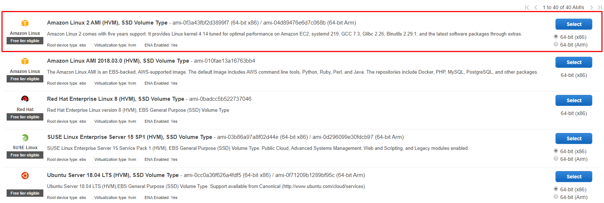
Creating EC2 Instance (2)
After completing prerequisities you can now create your EC2 instance.
Open EC2 console at: https://console.aws.amazon.com/ec2/
Then, select launch instance on the dashboard.
It will direct you to the first step. Select EC2 AMI instance in the picture.

Slide 4
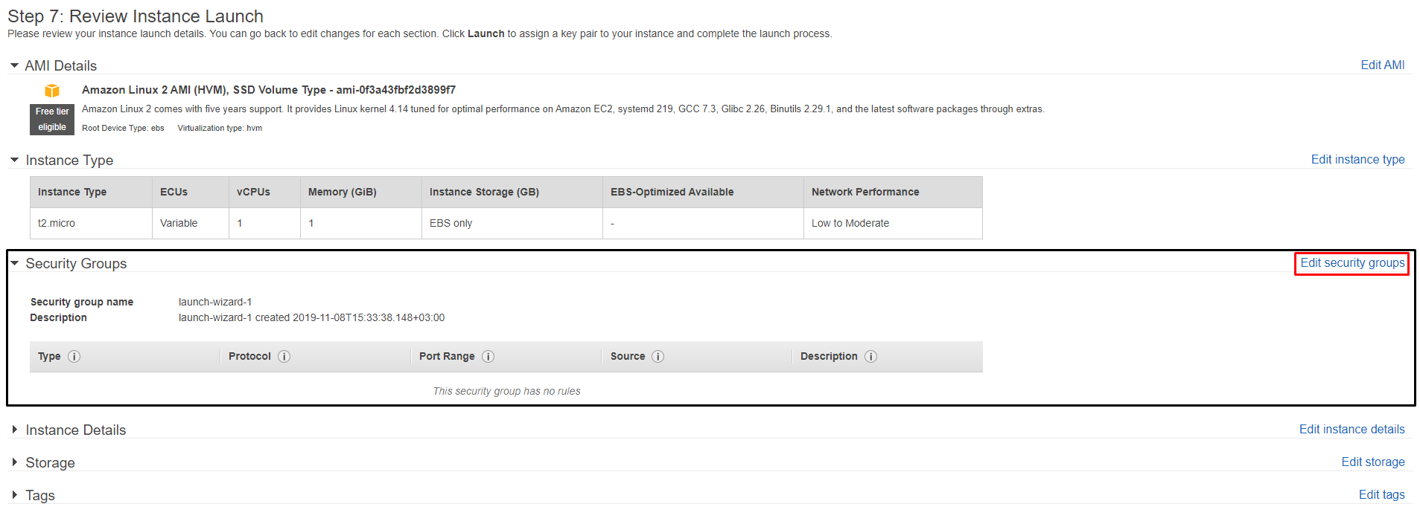
Creating EC2 Instance (3)
You do not need to change instance type on step 2. Click Review and Launch (Blue button, bottom right) on this step.
It will direct you to the Step 7: Review Instance Launch. On this step make sure you have edit the security groups and select group that you have created as prerequisite. After that click review and launch button again.

Slide 5
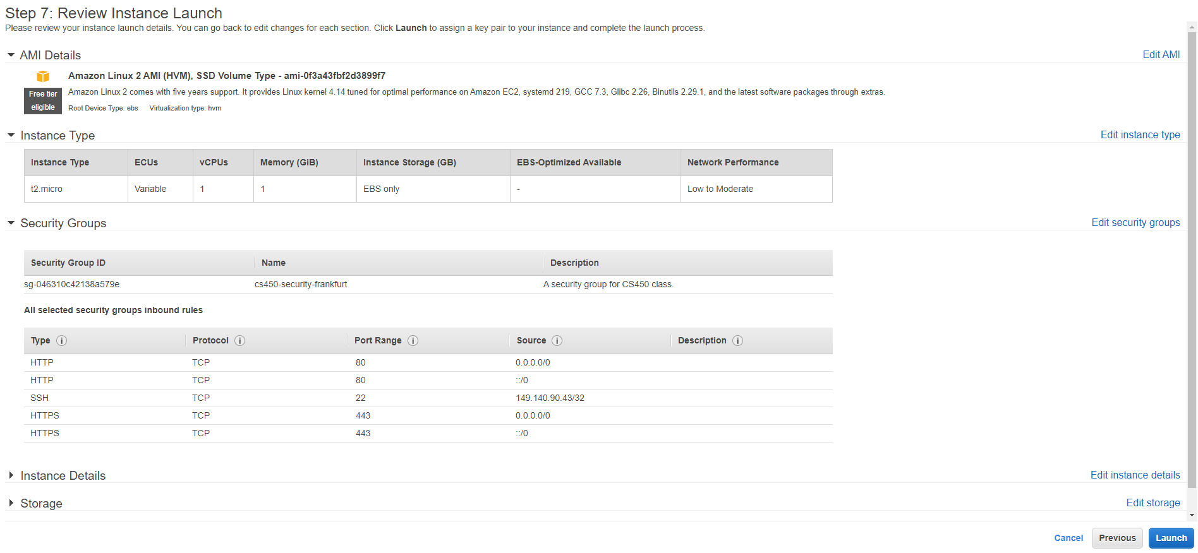
Creating EC2 Instance (4)
After setting security groups, select Launch button. Your page before the launch should be similar to this.

Slide 6
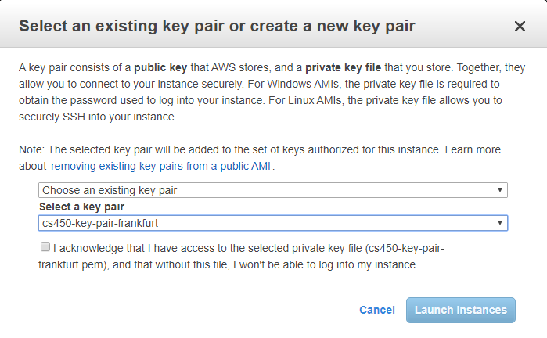
Creating EC2 Instance (5)
When prompted for a key pair, select Choose an existing key pair, then select the key pair that you created when getting set up.
Never select the Proceed without a key pair option. If you launch your instance without a key pair, then you can’t connect to it.

Slide 7
Creating EC2 Instance (6)
A confirmation page lets you know that your instance is launching. Choose View Instances (Blue button, bottom right) to close the confirmation page and return to the console.
On the Instances screen, you can view the status of the launch. It takes a short time for an instance to launch. When you launch an instance, its initial state if pending.
After the instance starts, its state changes to running and it receives a public DNS name.
It can take a few minutes for the instance to be ready so that you can connect to it. Check that your instance has passed its status checks; you can view this information in the Status Checks column.
If you see instance state is running and status checks are completed, you are ready to connect to your instance.

Slide 8
Connecting to EC2 Instance
There are different ways to connect to your EC2 instance.
All information about connecting to your EC2 instance for different Operating Systems can be found below:
https://docs.aws.amazon.com/en_us/AWSEC2/latest/UserGuide/AccessingInstances.html

Slide 9
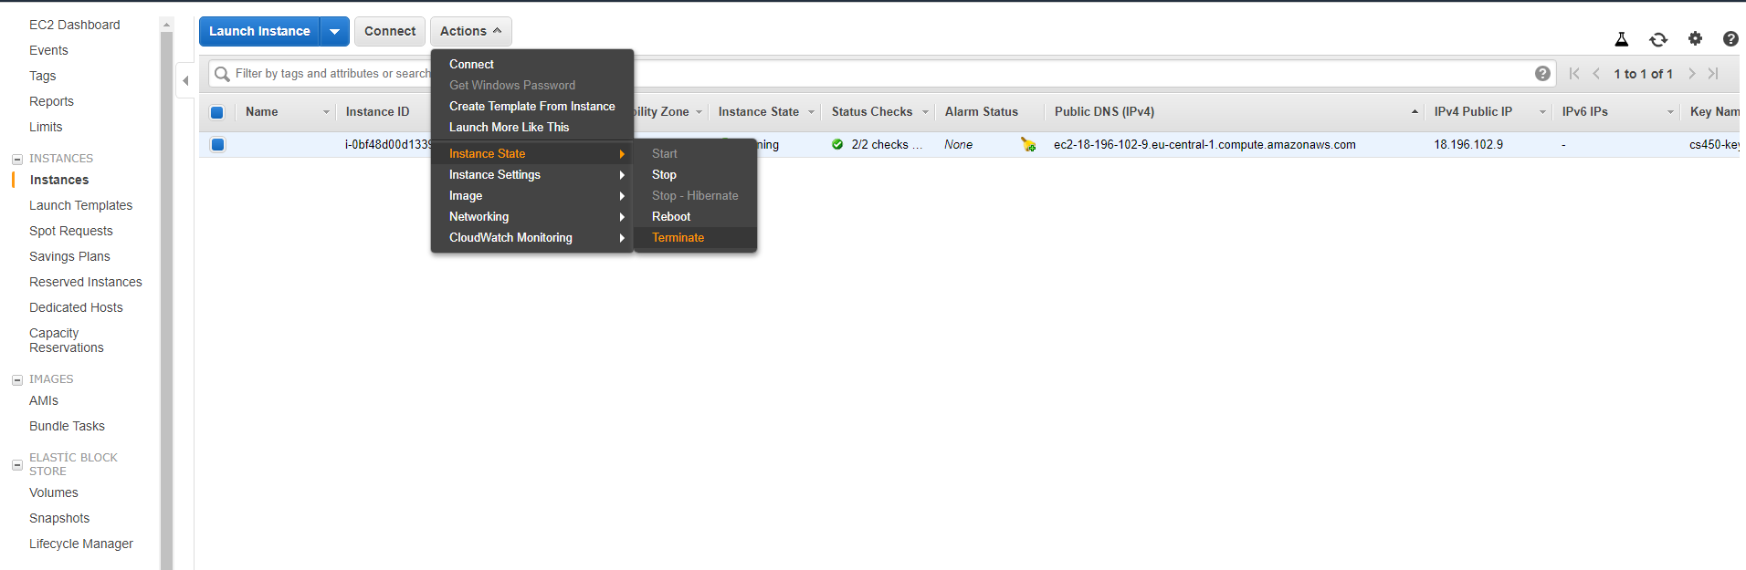
Terminating your EC2 Instance
After you've finished with the instance that you created for this homework, you should clean up by terminating the instance.
To terminate your instance
In the navigation pane, choose Instances. In the list of instances, select the instance.
Choose Actions, Instance State, Terminate.
Choose Yes, Terminate when prompted for confirmation.
Amazon EC2 shuts down and terminates your instance. After your instance is terminated, it remains visible on the console for a short while, and then the entry is deleted.

Slide 10
Related material
Prerequisities: https://docs.aws.amazon.com/en_us/AWSEC2/latest/UserGuide/get-set-up-for-amazon-ec2.html
Creating, connecting and terminating your EC2 instance: https://docs.aws.amazon.com/en_us/AWSEC2/latest/UserGuide/EC2_GetStarted.html
If you have any questions, do not hesitate to email.
umut.cakan@ozu.edu.tr

