Slide 1
Distributed Systems and Cloud Computing
Creating, Uploading and Invoking AWS Lambda Function on Eclipse IDE.

Slide 2
Getting Started
There are 2 prerequiries before creating and deploying your Lambda function to AWS.
Set up the Toolkit (Eclipse IDE)
Java 1.8
Eclipse IDE for Java Developers 4.2 or later
Amazon’s comment on Eclipse IDE selection: Eclipse provides a number of different downloads. We recommend installing the Eclipse IDE for Enterprise Java Developers. If you install another version of Eclipse, make sure that you have (or that you install, using the provided links) support for these features.
Set up AWS Credentials
To access Amazon Web Services with the AWS Toolkit for Eclipse, you must configure the AWS Toolkit for Eclipse with AWS account credentials.
Access keys consist of an access key ID and secret access key, which are used to sign programmatic requests that you make to AWS.
We recommend that you use IAM access keys instead of AWS root account access keys.

Slide 3
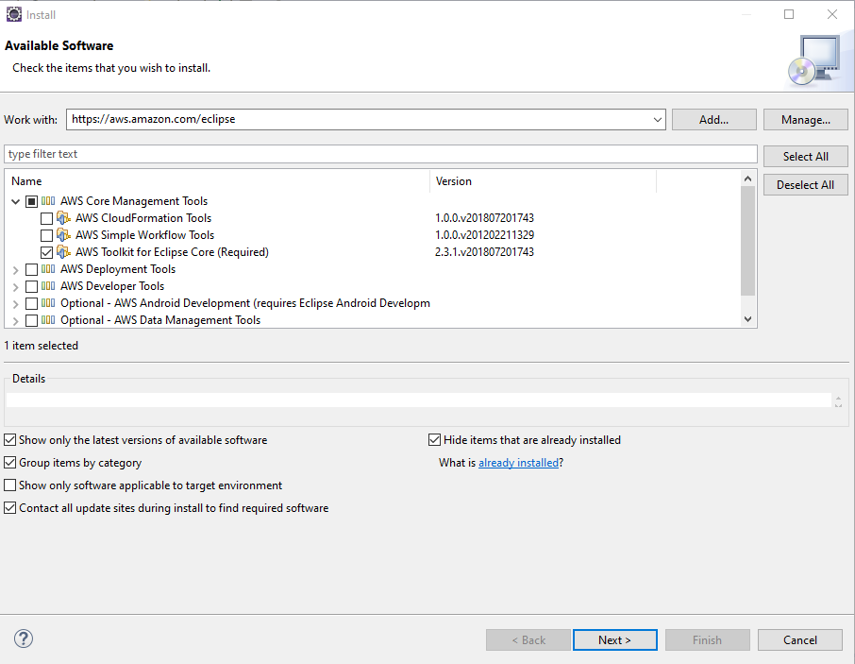
Setting up Eclipse IDE
To install the AWS Toolkit for Eclipse
Within Eclipse, click Help and then click Install New Software.
In the Work with box, type https://aws.amazon.com/eclipse and press Enter.
Select AWS Toolkit for Eclipse Core, it is required and select AWS Lambda Plugin from AWS Deployment Tools. Other components are optional.
Click Next or Finish to complete installation.

Slide 4
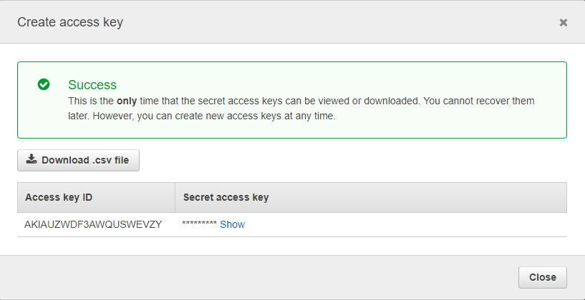
Setting up AWS Credentials
To get your access key ID and secret access key
Open the IAM Console: https://console.aws.amazon.com/iam/home
On the navigation menu, choose Users.
Choose your IAM user name (do not check the box, click on the name).
Open the Security credentials tab, and then choose Create access key.
To see the new access key, choose Show. Your credentials resemble the following:
To download the key pair, choose Download .csv file. Store the keys

Slide 5
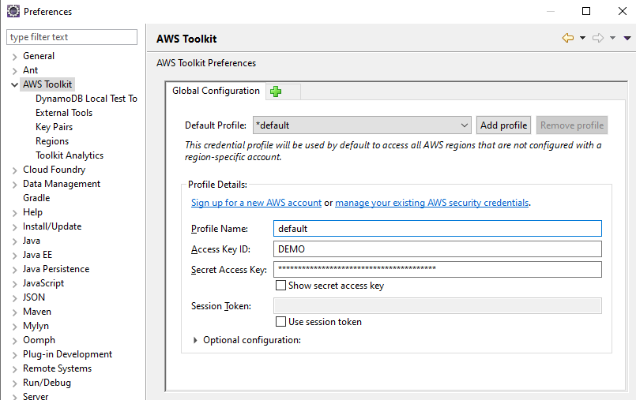
Setting up AWS Credentials (2)
To add your access keys to the AWS Toolkit for Eclipse
Open Eclipse’s Window > Preferences dialog box and click AWS Toolkit in the sidebar.
Type or paste your AWS access key ID in the Access Key ID box.
Type or paste your AWS secret access key in the Secret Access Key box.
Click Apply or OK to store your access key information.

Slide 6
Creating an AWS Lambda Project
The Amazon’s Guide has created a guide that allows you to create your first Project on Eclipse IDE and deploy it to the S3 Bucket.
Link: https://docs.aws.amazon.com/en_us/toolkit-for-eclipse/v1/user-guide/lambda-tutorial.html

Slide 7
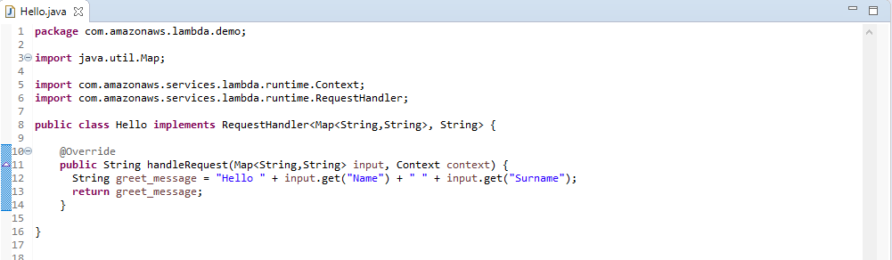
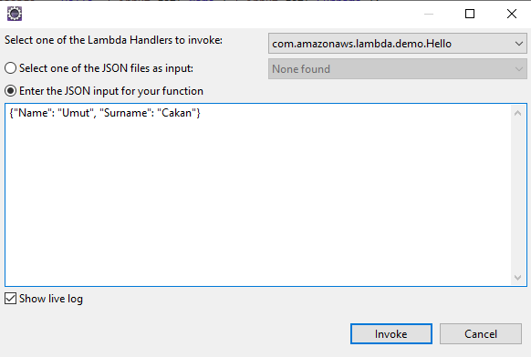
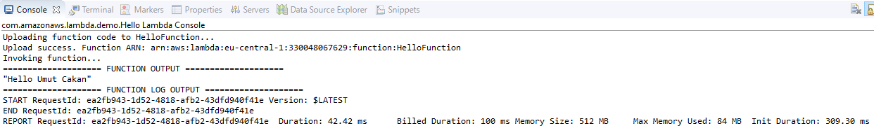
Important notes on Guide
After creating the Lambda Java Project, you need to make following changes to RequestHandler and handleRequest methods to be able to send multiple inputs.
And your input and output while invoking your code is like the following:

Slide 8
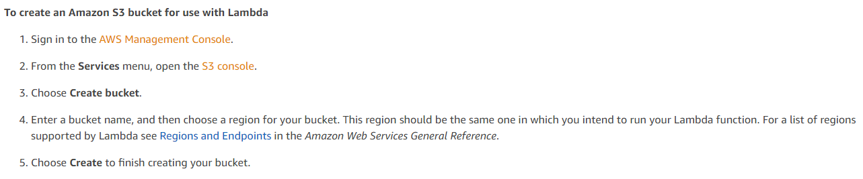
Important notes on Guide (2)
On the guide, you can create an Amazon S3 bucket in two ways, either through the AWS Management Console or by using the AWS Toolkit for Eclipse.
If you create your bucket choosing either of one way, you do not need to create bucket for the second time. Following option includes the console and after completing this, you do not need to create S3 bucket second time while deploying your function.

Slide 9
Related Material
Setting up Eclipse IDE (Prerequisite): https://docs.aws.amazon.com/en_us/toolkit-for-eclipse/v1/user-guide/setup-install.html
Setting up AWS Credentials (Prerequisite): https://docs.aws.amazon.com/en_us/toolkit-for-eclipse/v1/user-guide/setup-credentials.html
Create, Upload, and Invoke an AWS Lambda Function: https://docs.aws.amazon.com/en_us/toolkit-for-eclipse/v1/user-guide/lambda-tutorial.html
If you have any questions, do not hesitate to email.
umut.cakan@ozu.edu.tr

