Slide 1
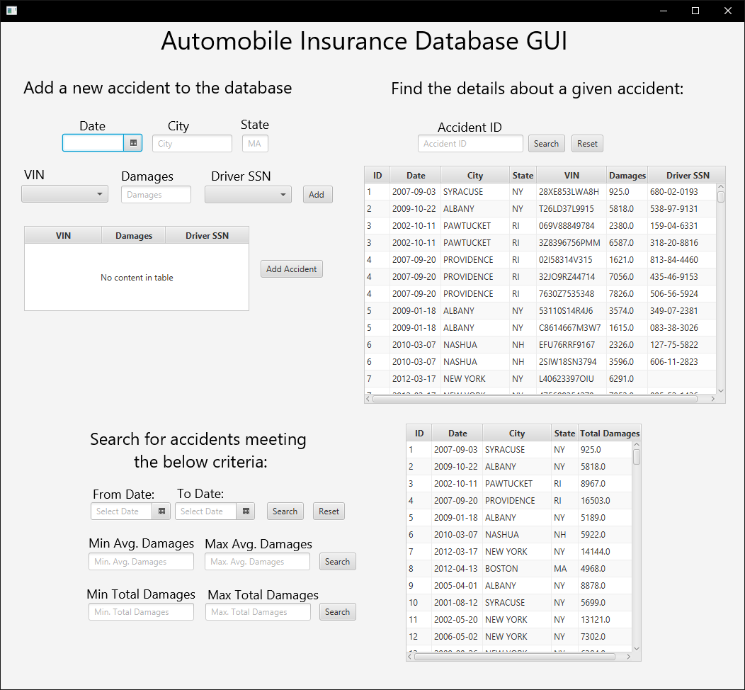
Automobile Insurance Database GUI
by: Daniel Gomes
This application used Java SE Development Kit 8 and might require it installed
https://www.oracle.com/technetwork/java/javase/downloads/jdk8-downloads-2133151.html
This application was developed using Apache Netbeans IDE 11.2
https://netbeans.apache.org/download/index.html

Slide 2
Table of Contents
Slide 3 - 4: How to install and run the application
Slide 5 - 7: How to use the application
Slide 8: How the code was structured. Answers: Where are the SQL queries located?

Slide 3
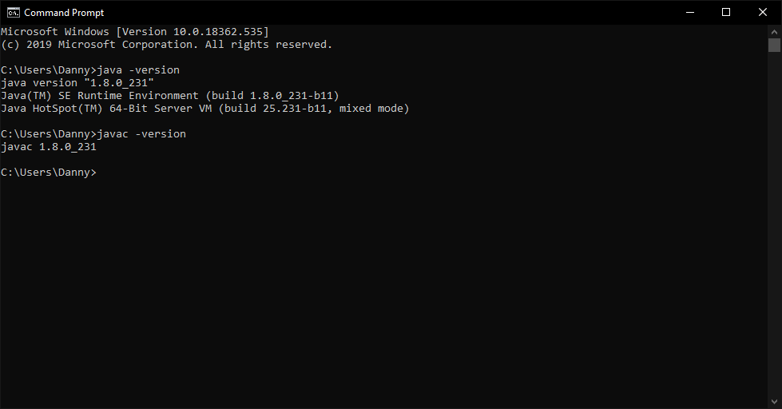
How to run it
This project was created using the latest version of JDK 8 (1.8.0_231) and Apache Netbeans IDE 11.2
If this project doesn’t run with other JDKs, i’d recommend installing JDK 8

Slide 4
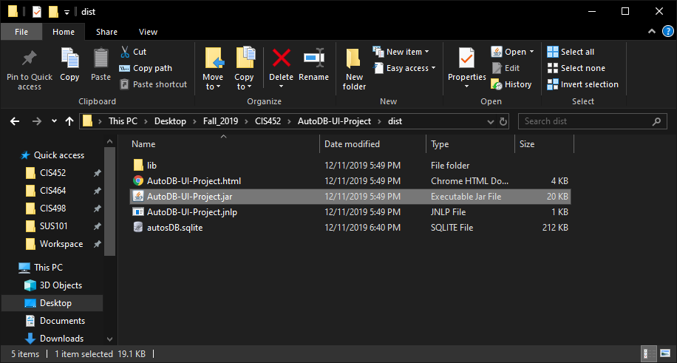
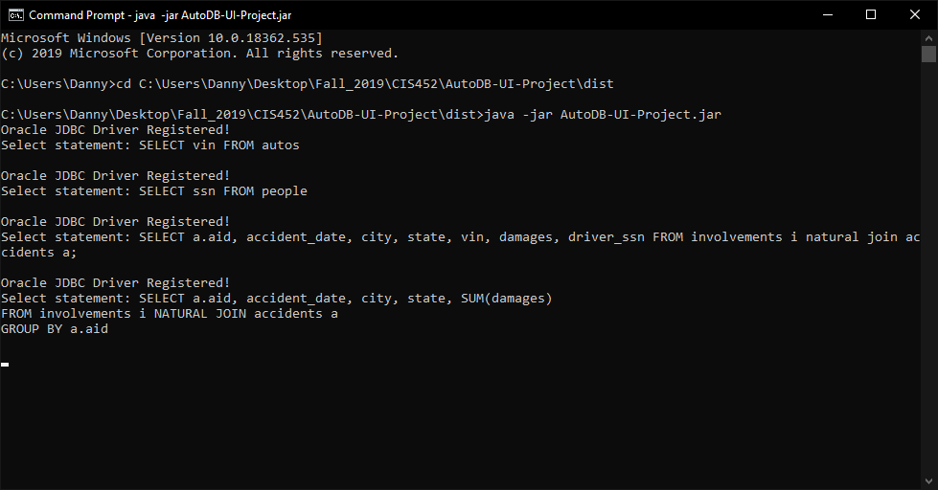
How to run it continued
After extracting the folder...
There are two ways you can run the application (besides running it with Apache Netbeans IDE 11.2):
Go to and double click: AutoDB-UI-Project/dist/AutoDB-UI-Project.jar
Run it through the command line. You will be able to see all SQL queries I performed.
Ensure that you are in AutoDB-Project\dist before executing:
java -jar AutoDB-UI-Project.jar

Slide 5
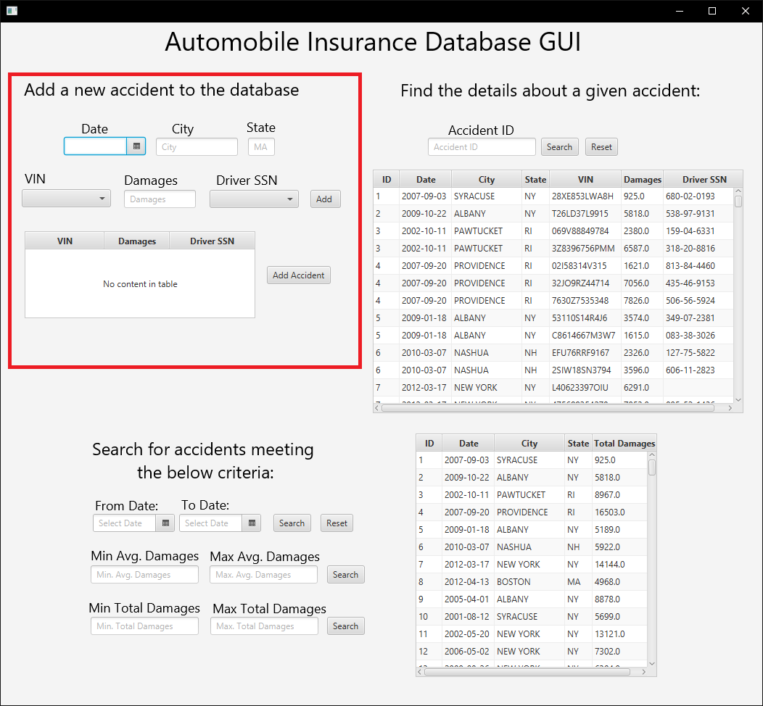
Adding a new accident
Select a date in the date field
Enter city and state in respected fields
VIN dropdown, damages textfield, and driver ssn dropdown
Hit add to add the vehicle/person/damages to the specific accident (multi entry)
Hit add accident to add accident and vehicles involved into db

Slide 6
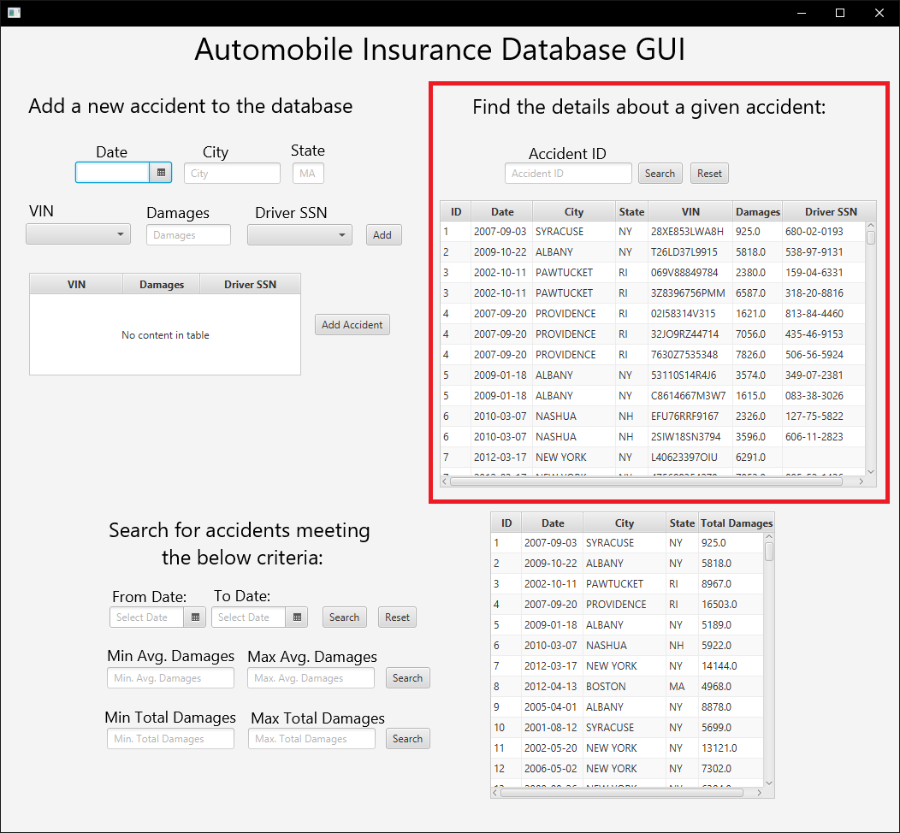
Searching by accident id
Type in an aid in the accident id textfield
Hit Search button
Hit Reset reset/re-populate table

Slide 7
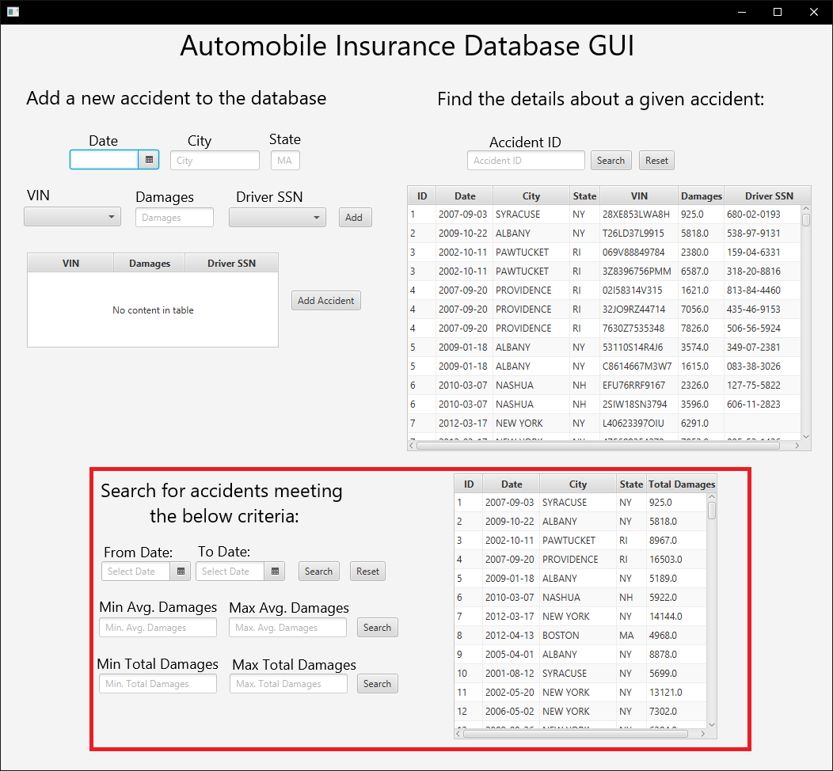
Searching for accidents using date and damages
To search for a range of dates
Enter starting date in from date field
Enter ending date in to date field
Hit search
Hit Reset to reset/re-populate table
To search for range of avg damages of an accident
Follow similar structure to above
To search for total damages of an accident
Follow similar structure to above

Slide 8
My Code Structure
Packages:
com.danny.main - contains MainApp.java, responsible for launching AccidentsView.fxml
com.danny.controller - contains AccidentsController.java and AccidentsView.fxml. AccidentsController.java contains the code for the functionality of AccidentsView.fxml
com.danny.model - contains AccidentsDetails.java and AccidentsCriteria.java. This contains the model classes for the two different types of data i will be accessing. Also contains AccidentsDetailsDAO.java and AccidentsCriteriaDAO.java where all SQL queries are located
com.danny.util - contains DBUtil.java which is responsible for providing basic connection to the AutoDB.

