Slide 1



DISCOUNTED CASH FLOW
Daniel Gómez-Lechón
CALCULATOR

Slide 2





METODOLOGÍAS:
OBJETIVO
MÉTODOS DE VALORACIÓN
ANÁLISIS FUNDAMENTAL
ANÁLISIS TÉCNICO
VALUE INVESTING
TRADING COMPS
EFFICIENT MARKET HYPOTHESYS
DEAL COMPS
INTRINSIC VALUE
DCF METHOD
MARGIN OF SAFETY
LBO
BREAK-UP ANALYSIS
OBJETIVO
FIN. STATEMENTS
DFC VALUATION
CALCULATOR
ASSET VALUATION
LIQUIDATION
RESTRUCTURING
Notes:
Technical analysis looks at the price movement of a security and uses this data to attempt to predict future price movements. Fundamental analysis instead looks at economic and financial factors that influence a business.
Value investors don't believe in the efficient-market hypothesis, which says that stock prices already take all information about a company into account, so their price always reflects their value. Instead, value investors believe that stocks may be over- or underpriced for a variety of reasons.

Slide 3
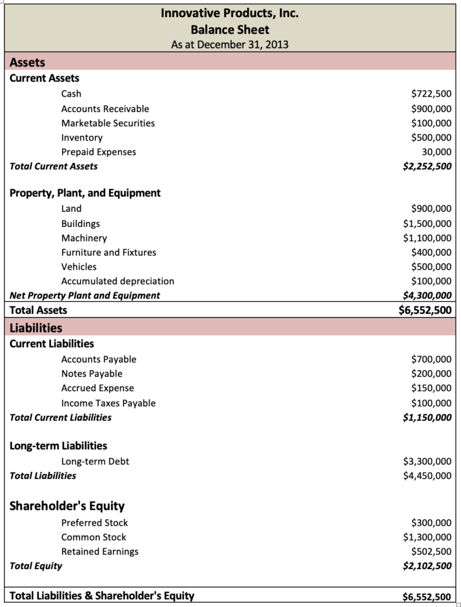
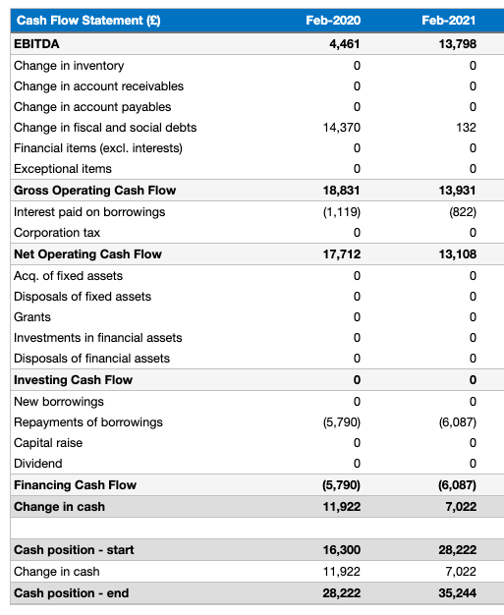

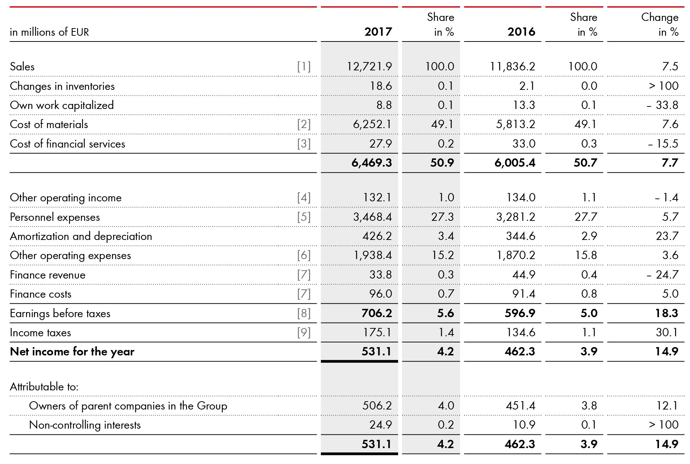
FINANCIAL STATEMENTS
CUENTAS FINANCIERAS Y COMO SE RELACIONAN
OBJETIVO
FIN. STATEMENTS
DFC VALUATION
CALCULATOR

Slide 4
DCF VALUATION
PROCESO Y CALCULOS PARA VALORACIÓN
3)
VALOR PRESENTE DE CF
1)
SELECCIÓN DE PARÁMETROS
4)
VALORACIÓN DE LA EMPRESA
2)
PROYECCIÓN DE CASH FLOWS
OBJETIVO
FIN. STATEMENTS
DFC VALUATION
CALCULATOR

Slide 5
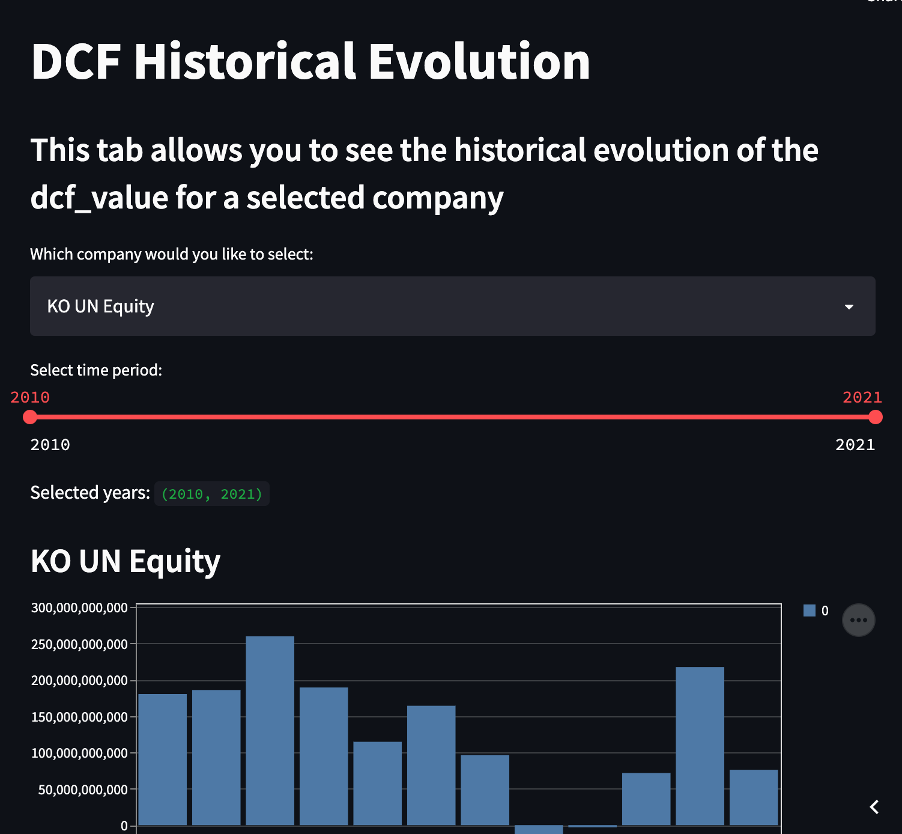


DCF CALCULATOR
DISCOUNTED CASH FLOW
DCF_VALUE
DCF_EVOLUTION
INVESTING STRATEGY
CALCULATOR
OBJETIVO
FIN. STATEMENTS
DFC VALUATION
CALCULATOR

Slide 6
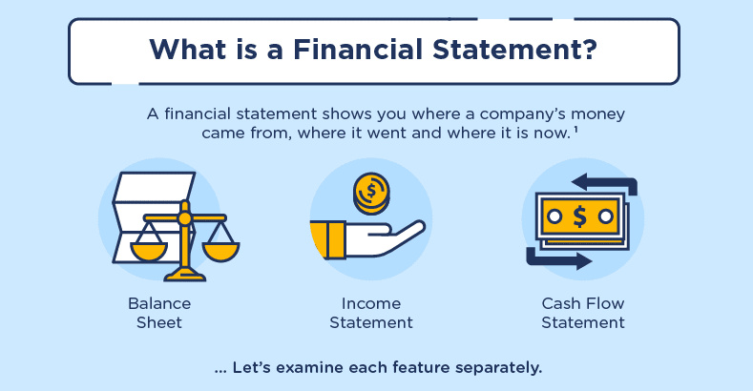
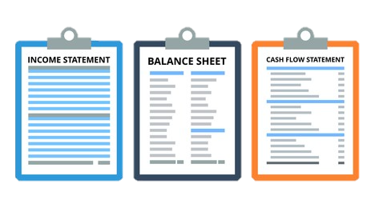


FINANCIAL STATEMENTS
CUENTAS FINANCIERAS Y COMO SE RELACIONAN
OBJETIVO
FIN. STATEMENTS
DFC VALUATION
CALCULATOR

