Slide 1

Visualization and Analysis –
Tutorial Presentation for Feedback
Date:
Group Id: A184 Name of Student Presenting: Durga Sai Gonnuri

Slide 2
Part 1: VISUALISATION of DS – 238
Summary of our dataset: Bank Customer Churn (DS238)
This dataset contains information about 10,000 bank customers, including demographic details, financial indicators, and whether the customer exited the bank. It is meaningful because it allows us to analyze churn behavior and understand which financial factors may influence a customer’s decision to leave the bank.
Research Question
Is there a statistically significant difference in the mean account balance (measured in euros) between customers who exited the bank and those who remained?

Slide 3
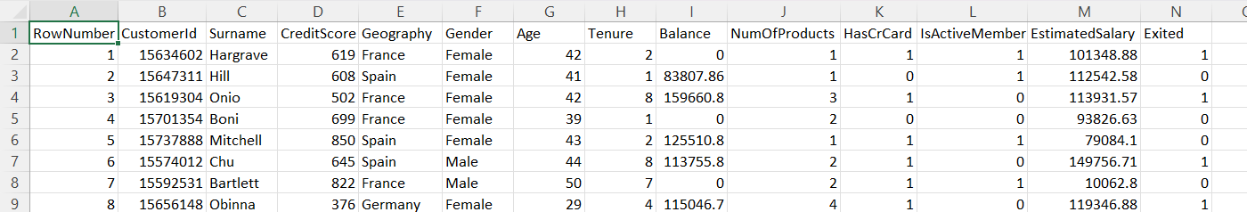
The column/ variable name which we are including in our Research Question :
1. Balance – Dependent variable
Type: Interval/Ratio (numeric),
Meaning: Customer’s account balance in euros
Role: This is what you are comparing between the two groups
2. Exited – Independent Variable
Type: Nominal (0 = No, 1 = Yes)
Meaning: Whether the customer left the bank
Role: This variable creates the two groups being compared
Our Dataset has Total 14 Columns and 10,000 Rows in total

Slide 4
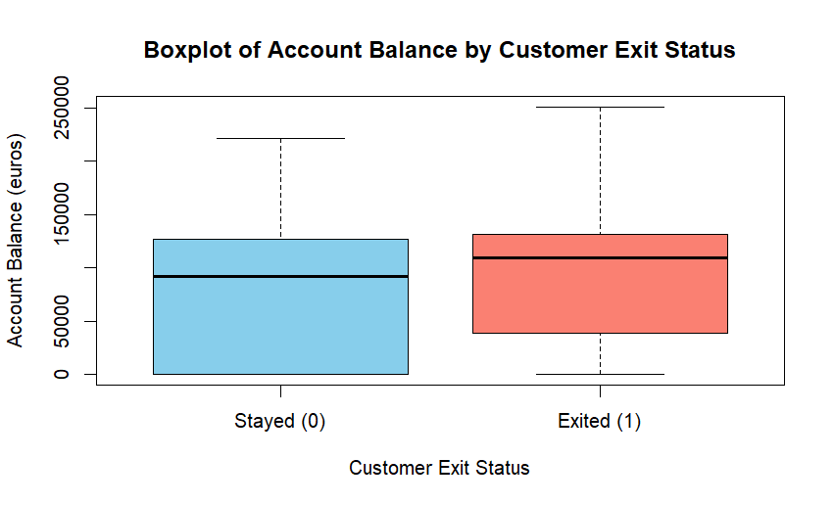
1. Boxplot of Account Balance (euros) by customer exit status – Dependent variable Balance, Independent variable Exited.
Y axis Label - Balance (euros)
X axis label – Customer exit status (0 = Remained, 1 = Exited)
Our RQ Includes Comparison of means

Slide 5
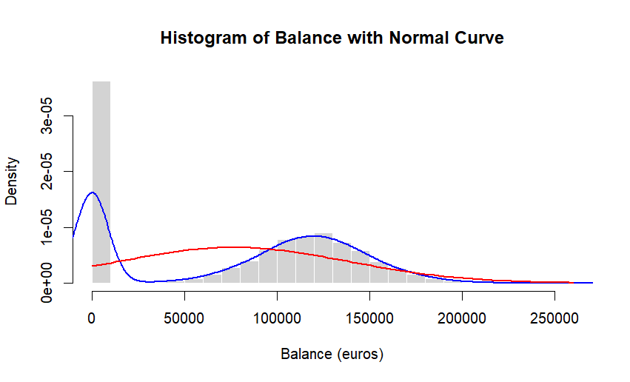
2. Histogram of Balance (euros) with Normal Curve – Dependent variable Balance.
X axis label - Balance(euros)
Y axis label - Density
Our RQ Includes Comparison of means

Slide 6
Choosing Test & Rationale
Normality Check
Histogram shows strong skewness
Large number of zero balances
Distribution does not follow a normal curve
Conclusion about test selection
“Because the normal curve does not follow the data, the Wilcoxon rank-sum test is more appropriate.
However, we also ran the Welch t-test to compare results, since the sample size is large (n = 10,000), making the t-test robust.”

Slide 7
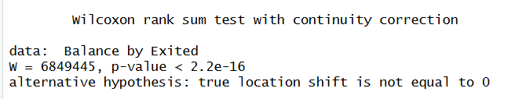
Statistical Tests & Results
WILCOXON TEST (Final, correct test)
Interpretation : The Wilcoxon test also shows p < 0.001, confirming that the two groups differ significantly in balance, even when using a non-parametric method.
R Code : > wilcox_result <- wilcox.test(Balance ~ Exited)
> wilcox_result

Slide 8
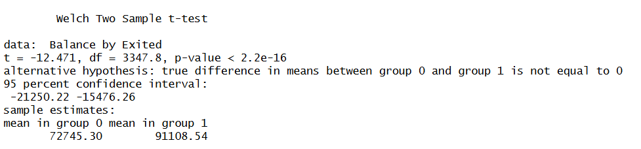
Statistical Tests & Results
T-TEST (Welch Two Sample t-test)
Interpretation : “Because p < 0.001, we reject the null hypothesis.
There is a statistically significant difference in mean account balance between customers who exited and those who remained.
R Code : > t_test_result <- t.test(Balance ~ Exited)
> t_test_result

Slide 9
Conclusion
Both the Wilcoxon test and the Welch t-test indicate p < 0.001, therefore we reject the null hypothesis and conclude that customers who exited the bank have significantly different account balances compared to those who remained.

