Slide 1
Git’n Pro with HTML/CSS
Day 2
January 19th, 2017

Slide 2
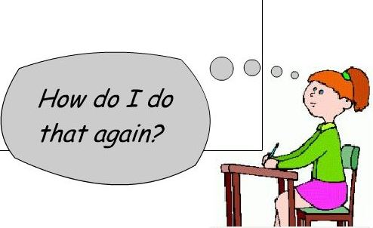
It’s Okay!

Slide 3
Admin Items

Slide 4
Where to Get Help
Practice, Practice, Practice: Work Individually or in Groups
Review In Class Material (Exercises and Slides): Our REPO is
https://github.com/UCF-Coding-Boot-Camp/01-17-LM-Class-Content
Re-Watch Class Videos: Links to class videos are on our REPO
In Class Office Hours: 45 minutes before class, 30 minutes after
One-on-One Sessions: By Announcement through SSM
Contact Student Success: Anytime!

Slide 5
Homework #1 - Assignment
Also, at this point everyone should have access to the homework repository in GitHub ALSO ON OUR REPO ☺
https://github.com/UCF-Coding-Boot-Camp/01-17-LM-Class-Content/tree/master/homework-assignments/01-html-css
Homework Assignment #1 is due next week
01-html-css homework submission due by 11:59pm on Wednesday the 25th of January, 2017.
Please do not use this as an excuse to stay up late – get it done early and get your rest.

Slide 6
Today’s Class!

Slide 7
Tonight’s mission, should you choose to accept it…
Understand the importance of Git Version Control and of how to use it.
Create GitHub Repositories, push code into them, and share with class.
Make more HTML documents.
Learn to properly use basic HTML tags.
Implement basic CSS styling to HTML documents.

Slide 8
Know Thyself
If you are a complete beginner to HTML/CSS and Coding:
Continue getting comfortable with HTML.
Be able to completely write a basic HTML document (like in last class).
Understand what CSS is, what it’s for, and how it works with HTML.
Be able to use Git and GitHub to upload code.
If you’ve had past exposure and felt comfortable with the last lesson:
Aim to build up your skills. Clear up any questions or confusions about HTML.
Become knowledgeable about a wider range of HTML and CSS tags.
Be able to selectively apply CSS to specific HTML elements.
Be able to use Git and GitHub to upload code.

Slide 9
What / Why Git?

Slide 10
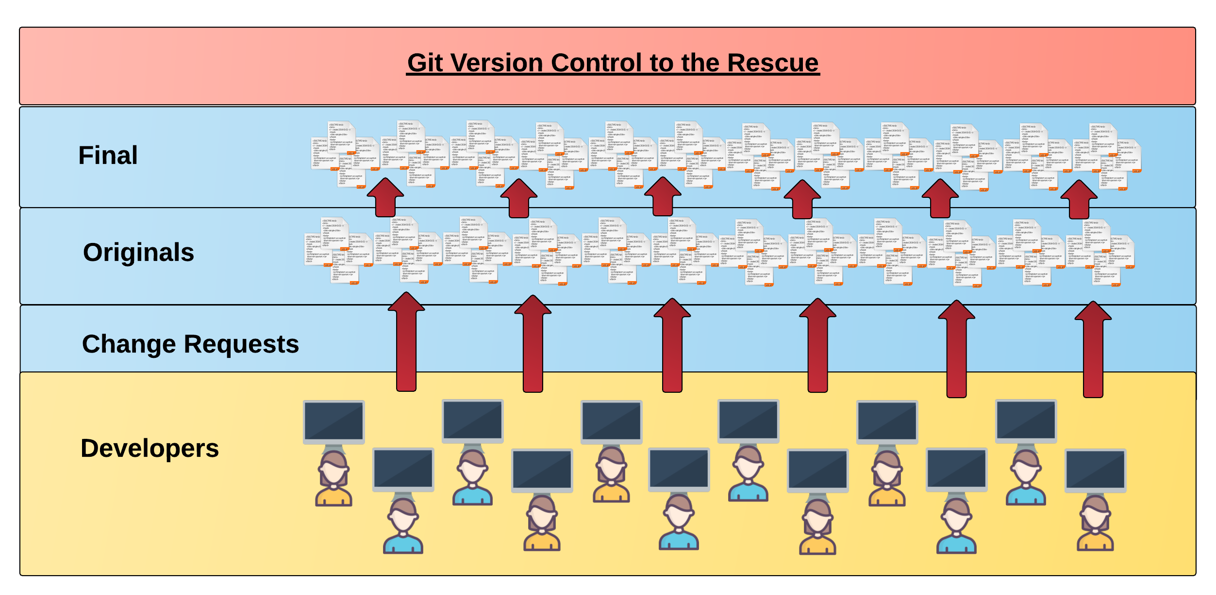
Collaborative Coding
Modern web development is highly collaborative.
Teams are often extremely large and separated across the country — or planet.
Apps sometimes comprise hundreds or even thousands of files.

Slide 11

The Group Project
I HAZ THE GREATEST HTML IDEA!!!!!
SpongeSite.com

Slide 12

The Group Project
Programming Away…

Slide 13

The Group Project
Programming Away…
SpongeBob's idea is dumb. We should call it…
KobezzzSite.com

Slide 14
The Group Project
Programming Away…
SpongeBob's Version
Programming Away…
Kobe’s Version

Slide 15
The Group Project
Programming Away…
Now they have two completely different versions.
Programming Away…

Slide 16
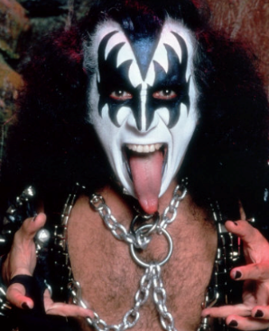
The Group Project
Programming Away…
Programming Away…

Slide 17
The Group Project
Programming Away…
Hai guyz!!!
How R Kan help??
Programming Away…

Slide 18
The Group Project – Tragedy #2
Programming Away…
OK.
Delete. Delete. Delete. Delete.
Delete. Delete
Programming Away…

Slide 19
The Group Project
Lesson:
You should use Version Control.
….And be wary of group members.

Slide 20
Version Control
Git Version Control: Provides a organized system for managing code for when multiple developers work on a project
at the same time.
The Benefits of Git:
A strict system for resolving conflicts in code.
Version History.

Slide 21
The Group Project
Programming Away…
Now they have two completely different versions.
Programming Away…

Slide 22
The Group Project with Version Control
Main Branch (SpongeBob's)
SpongeBob continues programming
1
2
3
4
5
Kobe pushes (uploads) his code changes into the main branch.
Code conflicts are resolved before inclusion.
Kobe’s Branch

Slide 23
The Group Project – Tragedy 2 (Revisited)
Programming Away…
OK.
Delete. Delete. Delete. Delete.
Delete. Delete
Programming Away…

Slide 24
The Group Project with version control
Main Branch (SpongeBob's)
1
2
3
4
Kiss Dude pushes his (bad) code deletions.
Kiss Dude’s Branch

Slide 25
The Group Project with version control
Main Branch (SpongeBob's)
1
2
3
4
5
But this time, SpongeBob rolls back the code to an earlier version.
Kiss Dude’s Branch

Slide 26
The Group Project
Lesson:
You should use Version Control!
When you are working on your first project and you say ….

Slide 27
Quick Activity!
Suggested Time: 3 min
Turn to your neighbor, and have one of you explain to the other:
The concept of version control.
Then the other should explain:
Two of the key advantages to using a version control system.

Slide 28

So… What’s this GitHub?
GitHub is a Web-Based hosting service to store code online.
It allows developers to pull (download) code or push (upload) code to the same repository (directory).
It also allows developers to view histories of code changes and to track issues.

Slide 29




Pushing and Pulling to GitHub
1
2
3
4
GitHub Branch
Pull Code
Push Code
Pull Code
Pull Code
Push Code
Pull Code
Push Code

Slide 30
Get Started with Git

Slide 31
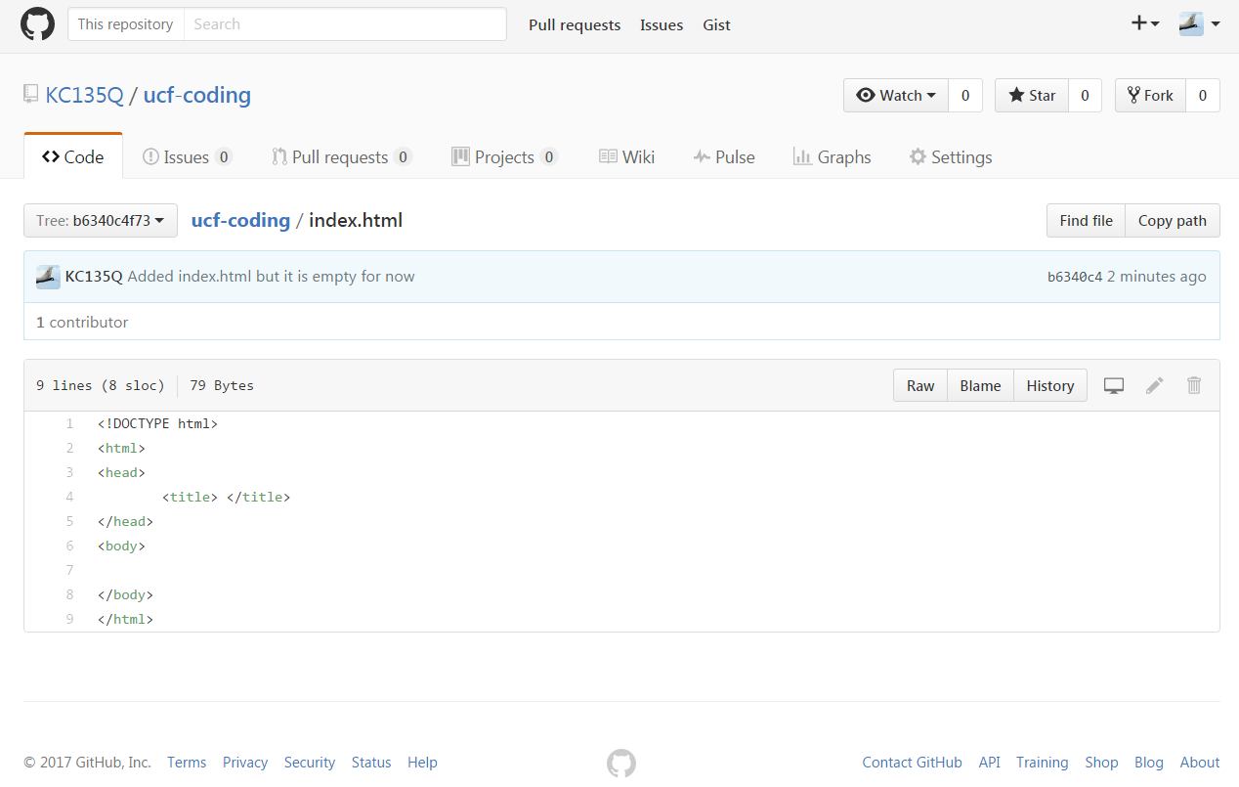
Instructor Git Demo!

Slide 32
Basic Git Commands
At its most basic, these are the five git commands to get started:
git clone
git add
git commit
git push
git pull

Slide 33
Basic Git Commands
At its most basic, these are the five git commands to get started:
git clone – copies an entire repo (to begin).
git add – adds a file for inclusion in Git.
git commit – notes a change to the local repo.
git push – sends changes to hosting service.
git pull – downloads freshest version of repo.
Daily MANTRA – pull, make changes, add, commit, push – REPEAT until project is COMPLETE ☺

Slide 34
> YOUR TURN!
Activity: Git Add, Commit, Push | Suggested Time: 20 min
Assignment:
Using GitHub and the Command Line:
Create a new public GitHub repository and name it whatever you like. Be sure to check the box for “initialize this repository with a README.”
Next, clone the repo to your local directory.
Then create an HTML file inside the local directory.
Add, Commit, and Push the code to GitHub.
Bonus:
Find a partner in class, and fork their repository to your own GitHub account. Clone this forked repository to your local directory.
Add, Commit, and Push the code back to your forked copy.
Finally, submit a pull request to send your changes to your partner’s repo.

Slide 35
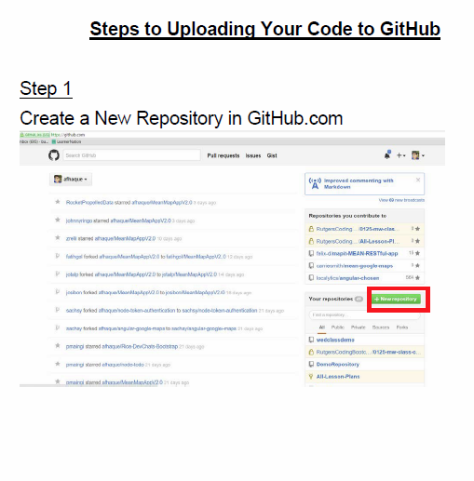
Still a Bit Lost? Never Worry!
Follow this handy Guide!
Practice a few times on your own before our next class.

Slide 36
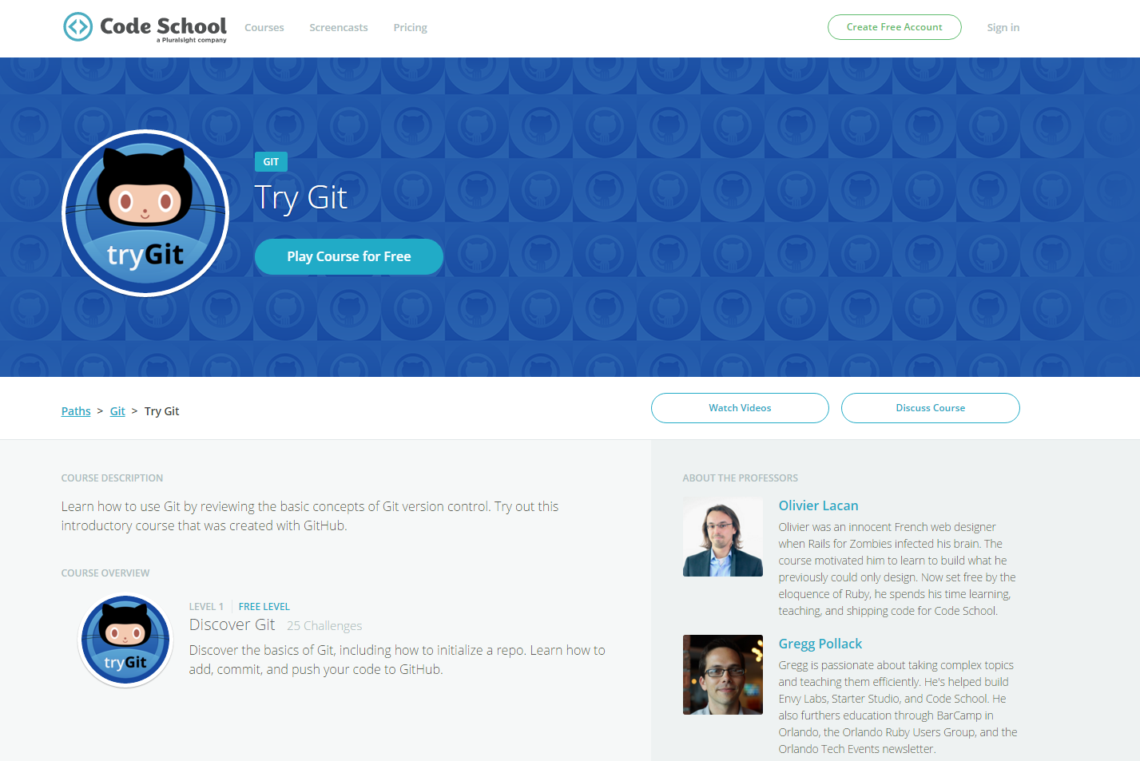
If You’re Still Lost… Here’s a (Free) Course
https://www.codeschool.com/courses/try-git

Slide 37
HTML Round 2

Slide 38
HTML Syntax (Basic)
Content
<h1>
This is Mah House
</h1>
Opening Tag
Closing Tag

Slide 39
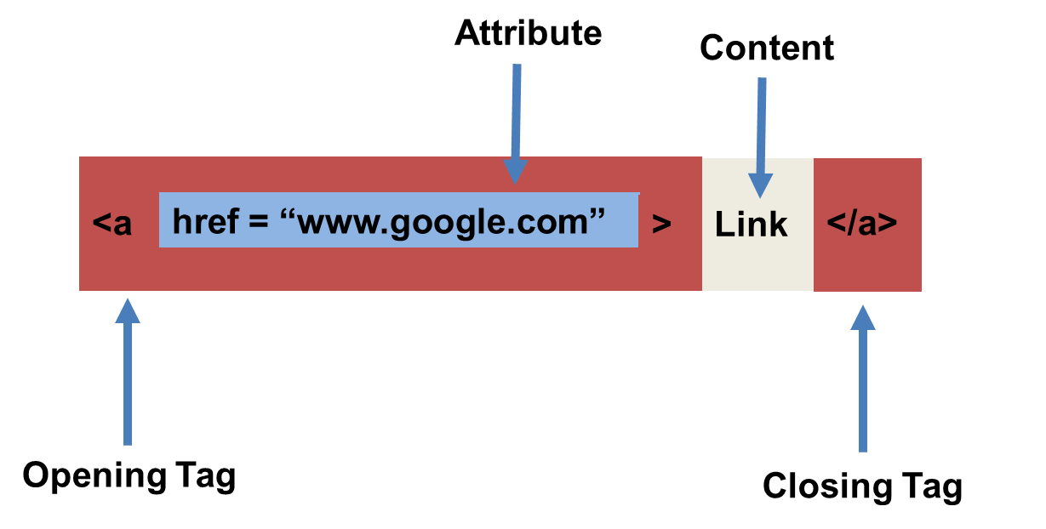
HTML Syntax (with Attribute)

Slide 40
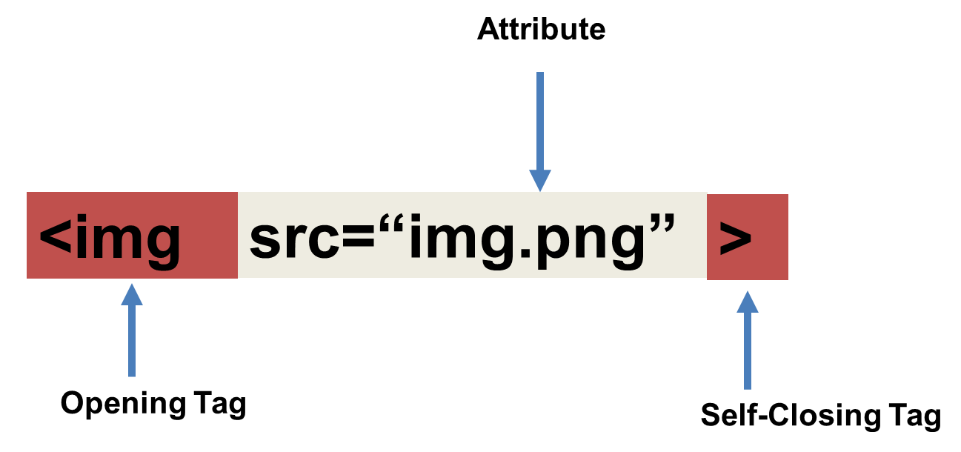
Tricky Tags (Self-Closing)

Slide 41
Important Common Tags
Headings:
<h1> </h1> - Heading 1 (Largest Heading)
<h2> </h2> - Heading 2 (Next Largest Heading)
<h3> </h3> - Heading 3
…
Containers:
<html> </html> - Wraps the entire page
<head> </head> - Wraps the header of the page
<body> </body> - Wraps the main content
<div> </div> - Logical Container ***
<p> </p> - Wraps individual Paragraphs
Others:
<strong> (bold), <em> (emphasis)
<img> (images), <a href> (links), <li> (list items) , <title> (title), <br> (line break), <table> (tables), <!-- --> (comments)

Slide 42
Less Common Tags
All HTML Tags are listed here: http://www.w3schools.com/tags/
Don’t try to memorize them! Simply refer back to documentation as needed.
Other tags:
<video> for Videos
<audio> for Audio files
<embed> for Embedded files
<code> for including computer code
<header> for headers
<nav> for navigation bars
<footer> for footers

Slide 43
HTML for Forms
Common UI (User Interface) Form Elements:
<form> - Creates a form section in HTML
<input> - Input boxes
<label> - Labels for boxes
<button> - Button
<textarea> - Large textbox

Slide 44
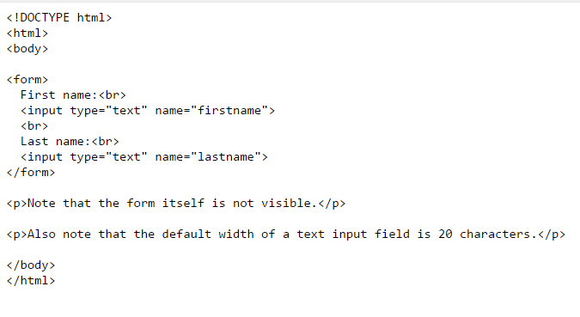
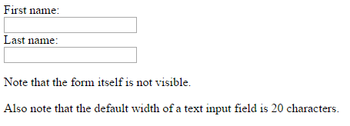
HTML for Forms

Slide 45
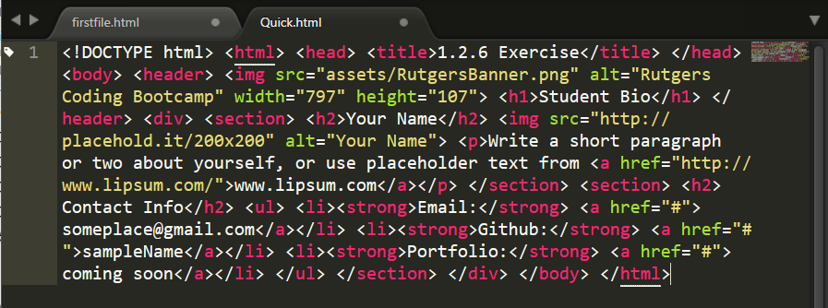
On Ugly HTML
Don’t do this… Use proper indentation and sectioning.
Readable code is easier to maintain.
Invest time to get better about this now. It will pay dividends!

Slide 46
> YOUR TURN!
Activity: 1-HTML_Git | Suggested Time: 20 min
Assignment
In this activity, you’ll create a student bio using HTML. You will then add, commit, and push your completed HTML to GitHub for the world to see.
Additional instructions, sent via Slack.

Slide 47
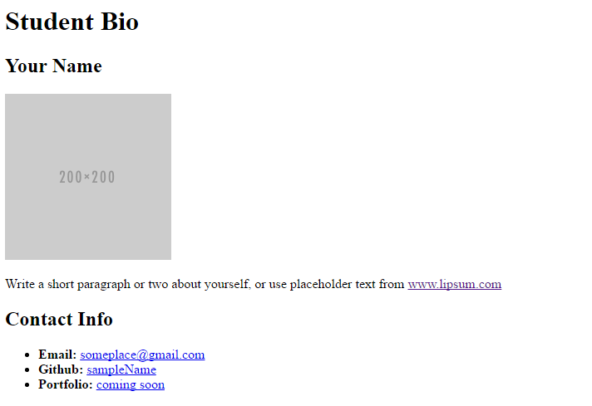
> YOUR TURN!

Slide 48
CSS Stylin’

Slide 49
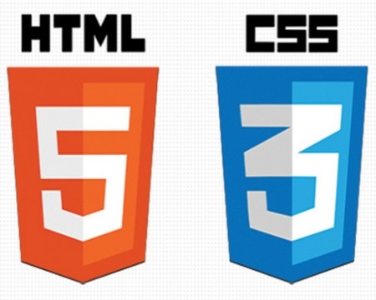

HTML / CSS Definitions (*yawn* unimportant)
HTML: Hypertext Markup Language – (Content)
CSS: Cascading Style Sheets – (Appearance)
HTML/CSS are the “languages of the web.” Together they define both the content and the aesthetics of a webpage – handling everything from the layouts, colors, fonts and content placement. (JavaScript is the third – handling logic, animation, etc.)

Slide 50


HTML / CSS Analogy
HTML Alone
Like writing papers in “Notepad.”
Can only write unformatted text.
HTML / CSS
Like writing papers in Microsoft Word.
Can format text, page settings, alignment, etc. based on “highlighting” and menu options.

Slide 51
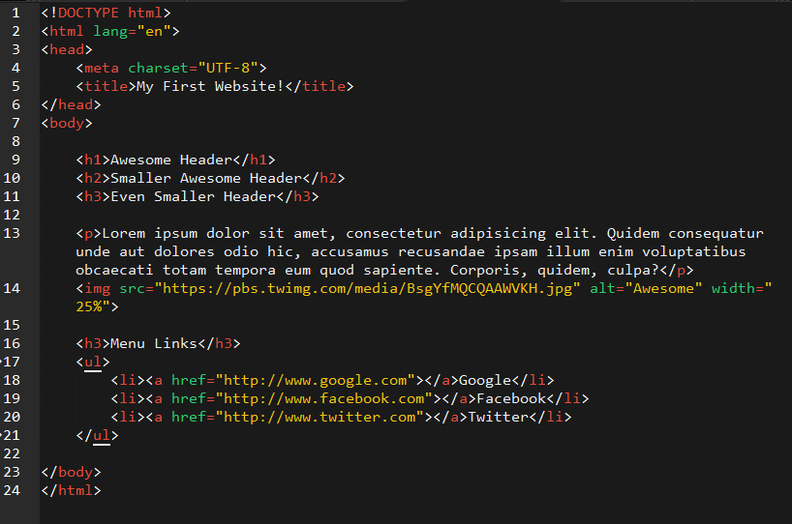
Basic HTML Page

Slide 52
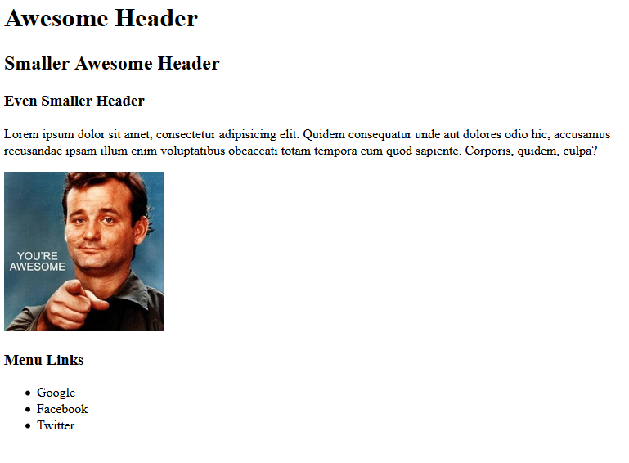
Basic HTML Page - Result

Slide 53
Basic HTML Page - Result
Can you say… BORING?

Slide 54
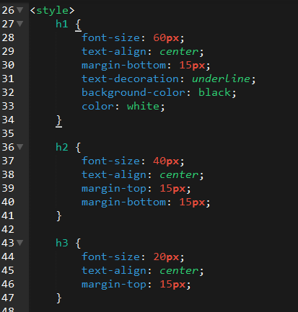
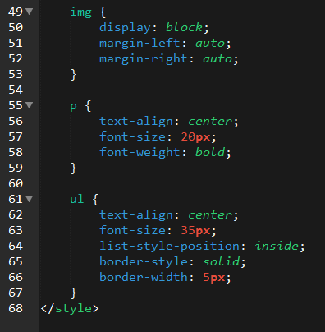
Enter CSS

Slide 55
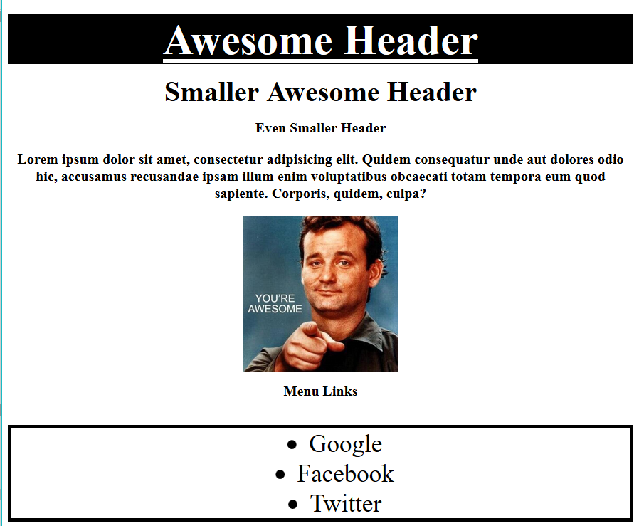
Enter CSS - Result

Slide 56
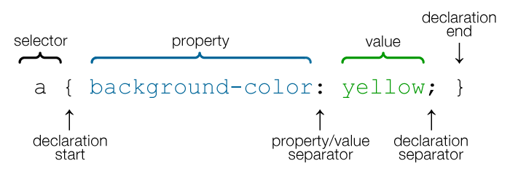
CSS Syntax
CSS works by hooking onto selectors added into HTML using classes and identifiers.
Once hooked, we apply styles to those HTML elements using CSS.

Slide 57
CSS Example
In the below example the “Header” would be turned blue and MUCH larger because of the CSS.
We can incorporate an element’s class or ID to apply a CSS style to a particular part of the document.
Just remember to include the necessary symbol before the CSS: “.” for class, “#” for ID.
Example (HTML):
<p class=“bigBlue”>Header</p>
Example (CSS):
.bigBlue
{
font-size: 100px;
color: blue;
}

Slide 58
Key CSS Attributes
Font / Color:
color: Sets color of text.
font-size: Sets size of the font.
font-style: Sets italics.
font-weight: Sets bold.
Alignment / Spacing:
Padding-top(bottom/left/right): Adds space between element and its own border.
margin-top (bottom/left/right): Adds space between element and surrounding elements.
float: Forces elements to the sides, centers, or tops.
Background:
background-color: sets background color.
background-image: sets background image.

Slide 59
Powerful Duo
Believe it or not, HTML / CSS is all you need
to develop a vivid, full-blown website.

Slide 60
INSTRUCTOR DEMO
Instructor: Demo
(quickexample_internalcss.html | 2-BasicCSS)

Slide 61
> YOUR TURN!
Activity: 3-HTML_CSS_Layout | Suggested Time: 20 min
Assignment
In this activity, you’ll upgrade your previous HTML bio-page using CSS style rules. Once you’re done, commit and push up your changes to GitHub.
We’ll send you additional instructions via Slack.

Slide 62
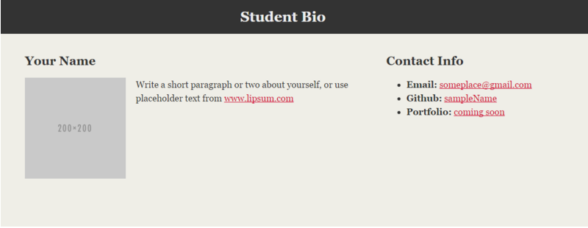
> YOUR TURN!

Slide 63
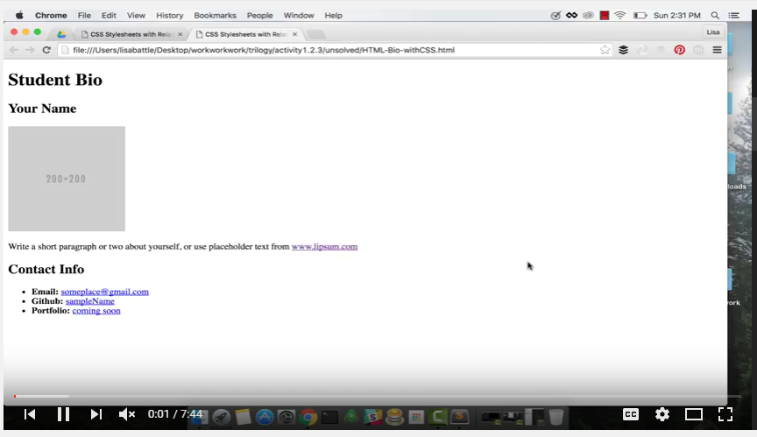
Video Walkthrough!!
https://www.youtube.com/watch?v=kMBinXTCrXI&list=PLgJ8UgkiorCnMLsUevoQRxH8t9bt7ne14&index=2

Slide 64
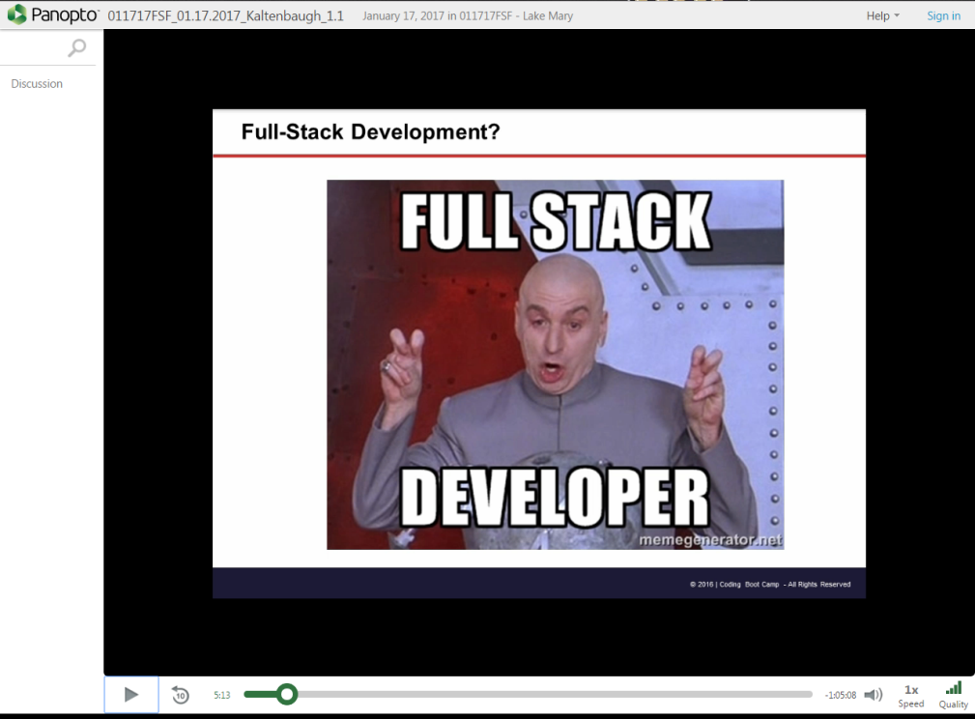
Still a Bit Confused?
Remember! We’ve got video guides for key activities like that last one.
If you feel like you are EVER falling behind, use those online walkthroughs to help catch back up. They are made to be easy to understand.
Still having trouble? Shoot your instructor or one of your TAs a message!
We are here to help you out in whatever way we can!

Slide 65
Recap + Questions

