Slide 1
JavaScript Juggernauts
Day 9
February 3rd, 2017

Slide 2

This will soon be you…
JavaScript Juggernauts.

Slide 3
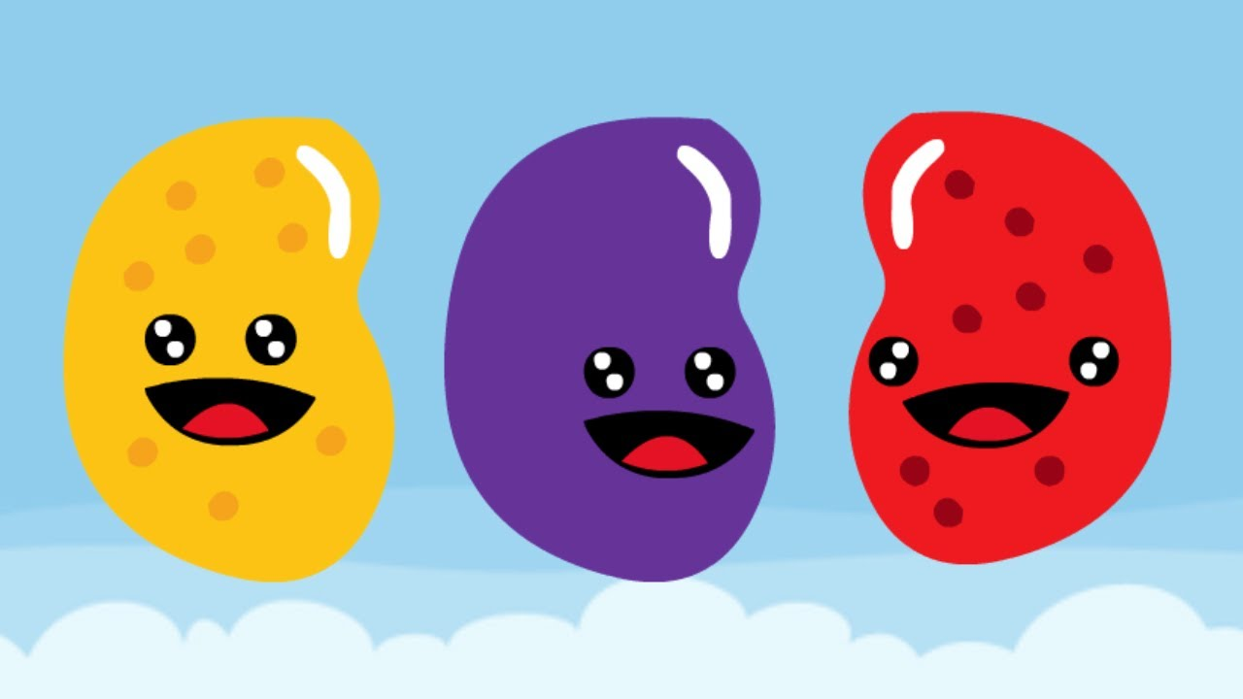
But right now…
Maybe feeling like
JavaScript Jellybeans.

Slide 4
Transformation to Come
HANG IN THERE!

Slide 5
Today’s Class

Slide 6
Objectives
In today’s class we’ll be covering:
JavaScript Functions
JavaScript Objects
Building Simple JavaScript Applications

Slide 7
Functions

Slide 8
> YOUR TURN!!
Activity: 1-LoopTV | Suggested Time: 10 min
01-Loop TV Partners – 10 Minutes
01-LoopTV/loop-tv-unsolved-html
*** Replace the ????s with comments that explain what the code does. The objective is to understand the code, not to create any yourself. ***

Slide 9
Demo Time
Instructor: Demo
(SuperHeroLogging_NoFunctions.html | 2-SuperHeroLogging)

Slide 10
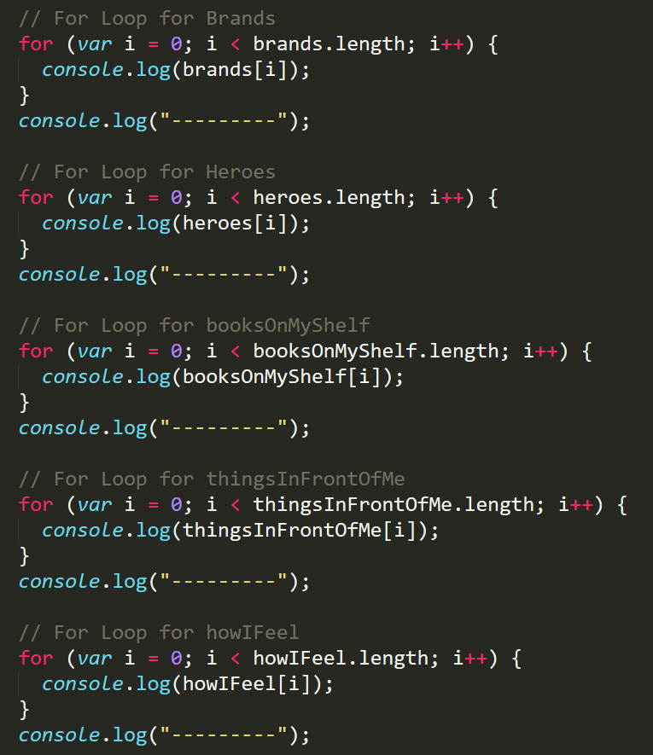
Mondo Repetitive…
Who wants to maintain this??
Hint: No one.

Slide 11
Demo Time
Instructor: Demo
(SuperHeroLogging_WithFunctions.html | 2-SuperHeroLogging)

Slide 12
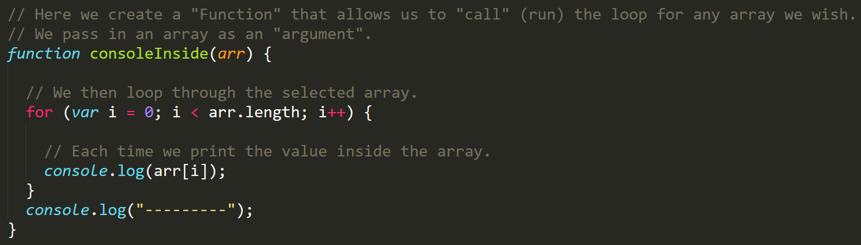
Much Better with Functions!
Squeaky Clean Code.
Minimal repetition

Slide 13
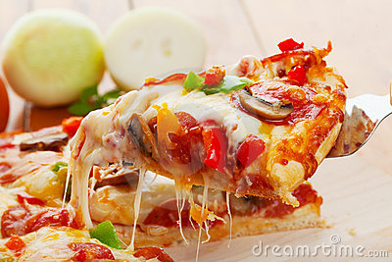
> YOUR TURN!!
Activity: 3-MyFirstFunctions | Suggested Time: 20 min
03 My First Functions – Partners – 20 Minutes
03-MyFirstFunctions/my-first-functions-unsolved.html
Instructor Do – Order Pizza…

Slide 14
Objects

Slide 15
Demo Time
Instructor: Demo
(GoodArray.html | 4-GoodArray)

Slide 16
Demo Time
Instructor: Demo
(JoanOfArcArrays.html | 5-JoanOfArcArrays)

Slide 17
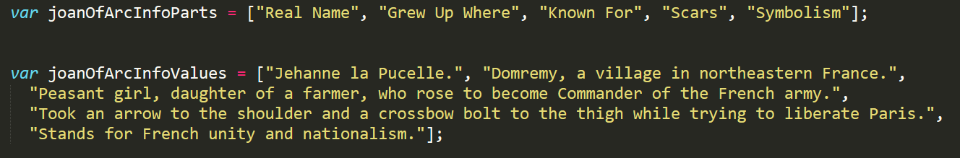
Associated Data ==/== Arrays
Relating two separate arrays is not fun.

Slide 18
Demo Time
Instructor: Demo
(JoanOfArcObjects.html | 6-JoanOfArcObjects)

Slide 19
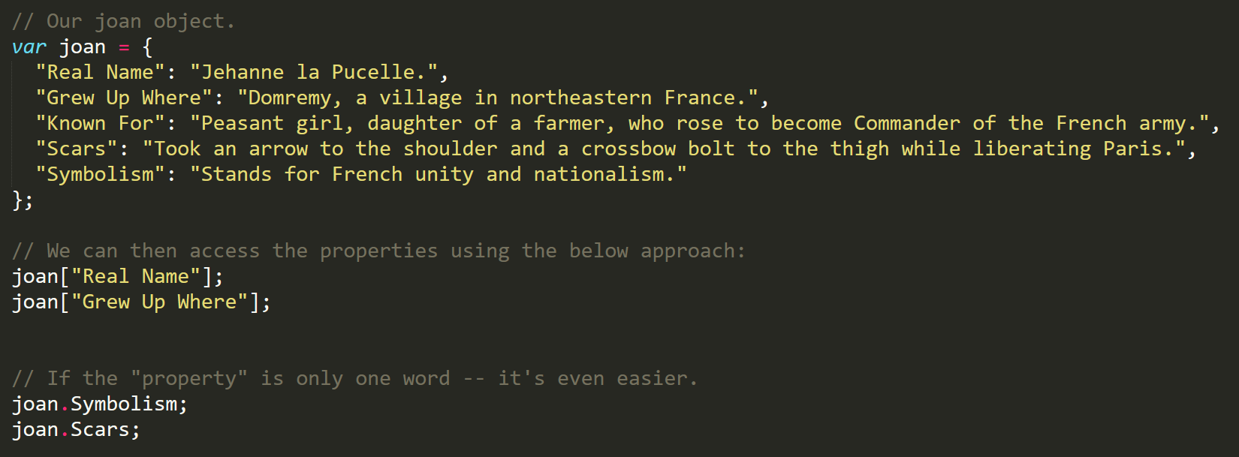
Joan of Arc – The Maid of Le’Objects
Joan’s “properties” and “values” are associated in object form, making it easy to recall specific data.

Slide 20
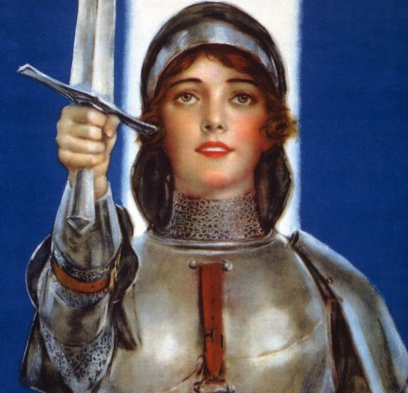
Objects Visualized
var joan
=
{
“Real Name”
:
“Jehanne La Pucelle”
,
“Scars”
:
“Took an arrow to shoulder…”
,
“Symbolism”
:
“Stands for French unity..”
}
This is Joan. According to code… Joan is an Object.

Slide 21
Objects Visualized
var joan
=
{
“Real Name”
:
“Jehanne La Pucelle”
,
“Scars”
:
“Took an arrow to shoulder…”
,
“Symbolism”
:
“Stands for French unity..”
}
These are Joan’s properties (like descriptors).

Slide 22
Objects Visualized
var joan
=
{
“Real Name”
:
“Jehanne La Pucelle”
,
“Scars”
:
“Took an arrow to shoulder…”
,
“Symbolism”
:
“Stands for French unity..”
}
These are the “values” of Joan’s Properties.

Slide 23
Objects Visualized
var joan
=
{
“Real Name”
:
“Jehanne La Pucelle”
,
“Scars”
:
“Took an arrow to shoulder…”
,
“Symbolism”
:
“Stands for French unity..”
}
Thus: Joan.Scars = “Took an arrow to shoulder…”

Slide 24
Demo Time
Instructor: Repeat Demo
(JoanOfArcObjects.html | 6-JoanOfArcObjects)

Slide 25
> YOUR TURN!!
Activity: 7-MyFirstObject | Suggested Time: 15 min
07 My First Object – Partners – 15 Minutes
07-MyFirstObject/car-object-unsolved.html
Instructions are in the file ☺

Slide 26
Demo Time
Instructor: Demo in Browser
(carGame_Solved.html | 8-CarGame)

Slide 27
> YOUR TURN!!
Activity: 8-CarGame | Suggested Time: 20-30 min
08-CarGame – Individual Effort – 30 Minutes
08-CarGame/Instructions.txt

Slide 28
Scope & Stuff
Everyone Do: Scope & Callbacks

Slide 29
> YOUR TURN!!
Activity: 9-TriviaGame | Suggested Time: 45 min
10 Question Game – Partner Activity – 45 minutes
10-QuestionGame/instructions.txt

Slide 30
Questions

