Slide 1
jQuery $(Begins)
Day 10
February 7th, 2017

Slide 2
Admin Items

Slide 3
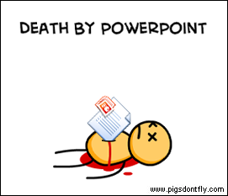
Not the Way to Learn Coding

Slide 4

True Way to Learn Coding

Slide 5
A New Era of Class
Be prepared to have classes that are increasingly “just code”
You will appreciate it in the long-run

Slide 6
Today’s Class

Slide 7
Objectives
In today’s class we’ll be covering:
DOM Manipulation using Plain Javascript
DOM Manipulation using jQuery
Responding to click events

Slide 8
DOM Manipulation

Slide 9
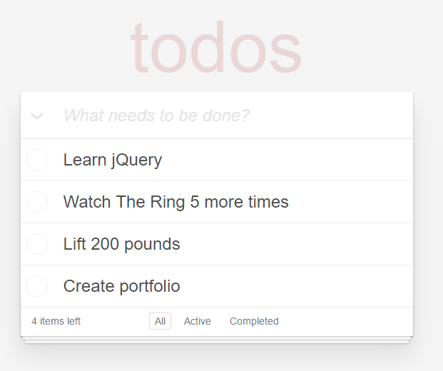
Understanding the “DOM”
Every HTML page begins as static content..
However, with Javascript / jQuery we can “modify the DOM” and change this static content in real-time.
This allows us to build dynamic sites.
Basic Example: http://todomvc.com/examples/jquery/#/all

Slide 10
Demo Time
Instructor: Demo
(1-5.html | 1-JSGenerators)

Slide 11
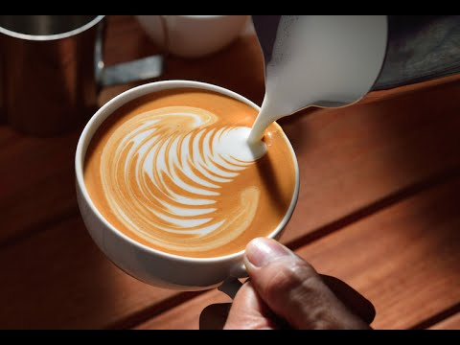
> YOUR TURN!!
Activity: 2-JSDrinkList | Suggested Time: 15 min
02 – JS Drink List – Individual Effort – 15 Minutes
02-JSDrinkList/drinklist-unsolved.html
Instructions are in the file…

Slide 12
Intro to jQuery

Slide 13
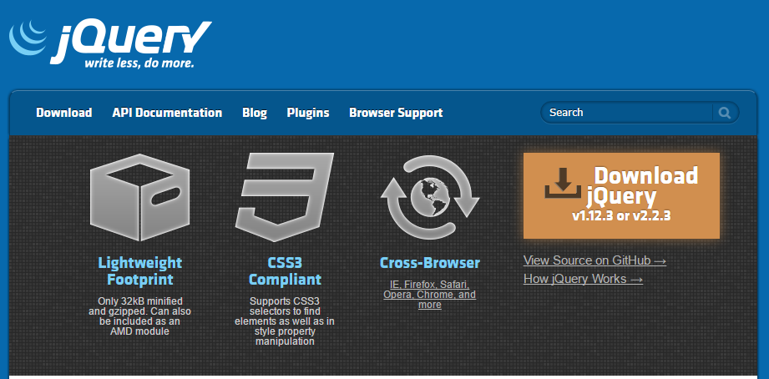
Intro to jQuery
https://jquery.com/
jQuery is a cross-platform Javascript library for easier of client-side HTML scripting.

Slide 14

jQuery Helper Library
jQuery can be useful for tasks like:
Dynamically Inserting, Updating, or Removing HTML
Registering click or other change events
Animating HTML elements
Download data from databases
And much more!

Slide 15


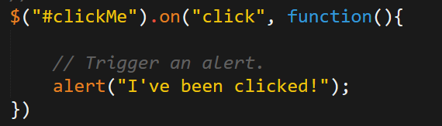
Working with jQuery involves…
SHOW ME THE….
LIBRARY!!!!!
1. Including a CDN Link to the jQuery script…
2. Utilizing the jQuery specific ($) selector…
3. Then applying jQuery methods on the selected elements.

Slide 16
Demo Time
Instructor: Demo
(1-3.html | 3-jQueryGenerators)

Slide 17
> YOUR TURN!!
Activity: 4-jQueryDrinkList | Suggested Time: 12 min
04 jQuery Drink List – Individual Effort – 12 Minutes
04-jQueryDrinkList/jquery-drinklist-unsolved.html
Instructions are in the file ☺

Slide 18
Demo Time
Instructor: Demo
(OnClick.html | 5-OnClickBasic)

Slide 19
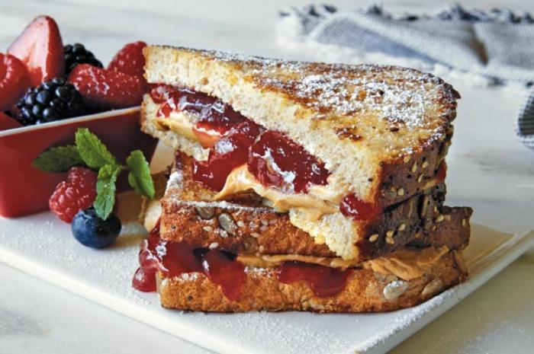
> YOUR TURN!!
Activity: 6-SandwichClick | Suggested Time: 20 min
06 Sandwich Click – Partners – 20 Minutes
06-SandwichClick/sandwich-click-unsolved.html
Instructions are in the file

Slide 20
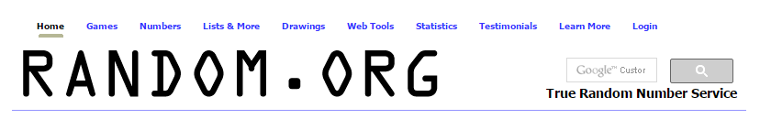
> YOUR TURN!!
Activity: 7-TriggerRandom | Suggested Time: 12 min
07 Trigger Random – Partner Activity – 12 Minutes
07-TriggerRandom/trigger-random-unsolved.html
Instructions are in the file
Maybe you can be the next…

Slide 21
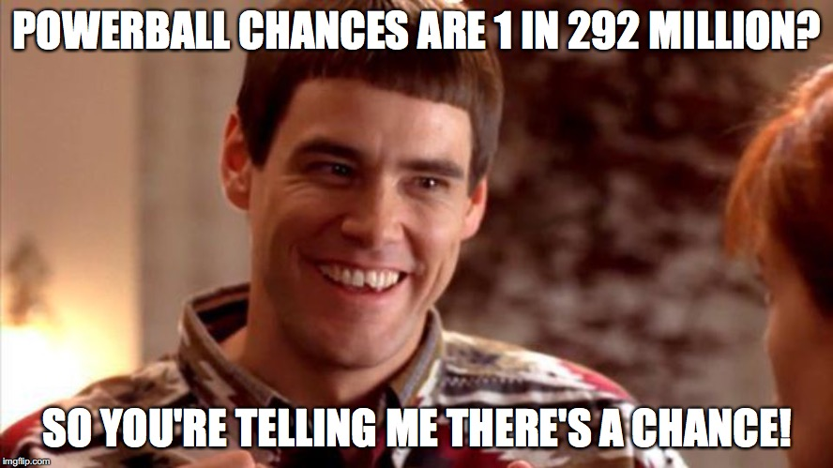
> YOUR TURN!!
Activity: 8-LotteryGenerator | Suggested Time: 20 min
08 Lottery Generator – Partner Activity – 20 Minutes
08-LotteryGenerator/lottery-generator-starting-point.html
Instructions are in the file.

Slide 22
Questions?

Slide 23
Extra!

Slide 24
> BONUS ROUND!!
Activity: 9-NumberChecker | Suggested Time: 20 min
09 Number Checker – Individual Effort – 20 Minutes
09-NumberChecker/number-checker.html
Instructions are in the file.

Slide 25
Questions

