Slide 1
JS and jQuery Jubilee
Day 11
February 9th, 2017

Slide 2
Remember this! -- You shouldn’t be freaking out as much as you have been ☺
“You can’t tell whether you’re learning something when you’re learning it—in fact, learning feels a lot more like frustration.”
“What I’ve learned is that during this period of frustration is actually when people improve the most, and their improvements are usually obvious to an outsider. If you feel frustrated while trying to understand new concepts, try to remember that it might not feel like it, but you’re probably rapidly expanding your knowledge.”
Jeff Dickey, Author of Write Modern Web Apps with the MEAN Stack: Mongo, Express, AngularJS, and Node.JS

Slide 3

Feedback #1 – Pace is Fast!!!
That said, as instructors / TAs we are here to help.
As we fall into a class rhythm, feel encouraged to schedule a 1-1 during office hours. {You guys are doing great at asking for this}
In addition to using the time to understand concepts… it’s a great way for us to identify weaknesses and outline steps to get on the right track.
These might be before / after class.

Slide 4
Today’s Class

Slide 5
Objectives
Play Captain Planet: The GAME!
Practice jQuery on Fridge
Pretend to learn scoping, and we aren’t talking about mouthwash…
Understand click events

Slide 6
Captain Planet!

Slide 7
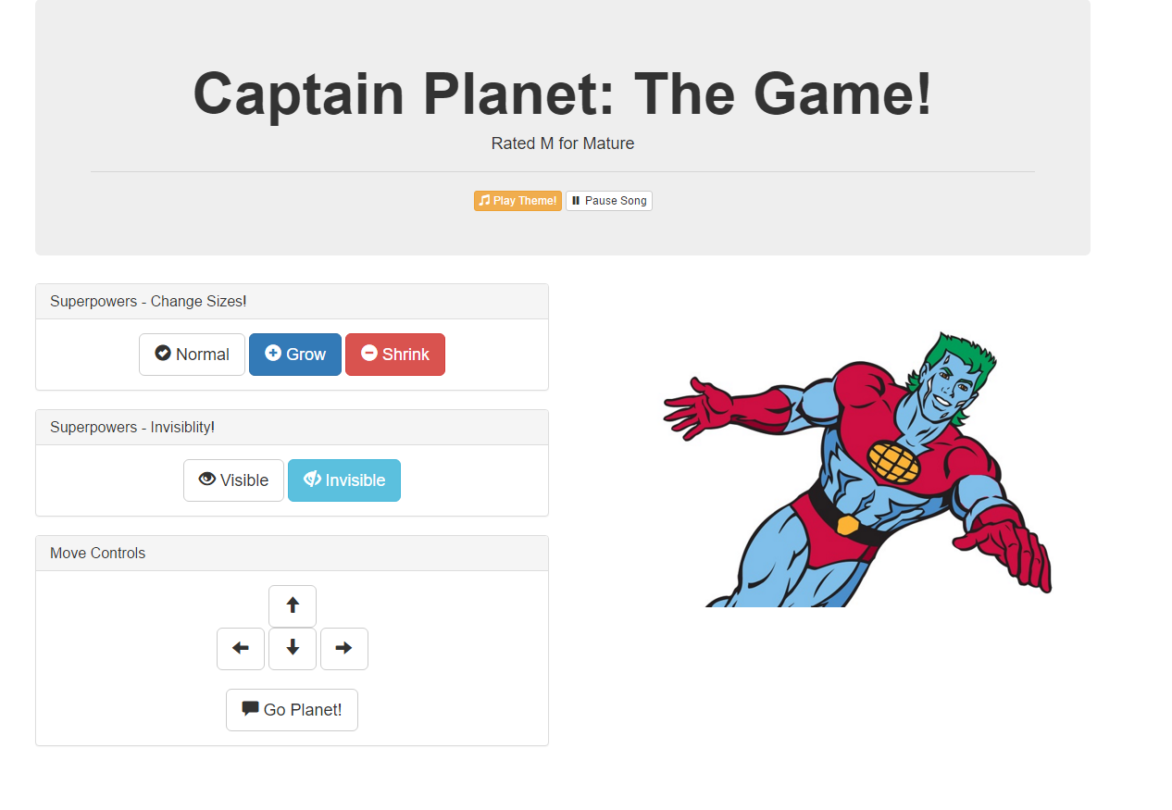

Slide 8
Demo Time
Instructor: Demo
(CaptainPlanet.html | 1-CaptainPlanet)

Slide 9
> YOUR TURN!!
Activity: 1-CaptainPlanet | Suggested Time: 7min
Code Dissection:
Examine the code for the Captain Planet Game
Class Repo: in-class-activities/01-CaptainPlanetGame/
captain-planet-game.html
Then, in groups, describe how this code works in 5 Steps.
1.
2.
3.
4.
5.

Slide 10
Pseudocoding – Captain Planet
Solution:
An initial HTML Layout was created using Bootstrap.
A reference to jQuery was added.
Key buttons and images were assigned unique class names
jQuery was used to capture when the corresponding buttons were clicked. This was done through the $( ) identifier with the class-name inside.
Code was created that changed the css of target classes in response to the click events.

Slide 11
> YOUR TURN!!
Activity: 1-CaptainPlanet | Suggested Time: 12 min
Look at the jQuery API Docs and add a button of your own that gives Captain Planet a new power.
(Still using in-class-activities/
01-CaptainPlanetGame/captain-planet-game.html)
Examples:
Click to… stretch Captain Planet
Click to… trigger a maniacal laugh
Click to… create clones of Captain Planet
Click to… create a shield (hint: border)
Click to… create fire or water (hint: images)
Slack out a screenshot of the working example

Slide 12
jQuery Recap

Slide 13

jQuery – In a Nutshell
Find some HTML.
Attach to an event.
Do something in response.

Slide 14
jQuery – In a Nutshell
We use the jQuery $( ) identifier to capture HTML elements.
$(“.classname”)
$(“elementname”)
$(“#idname”)
$(“etc”)
Then we tie the element to a jQuery method of our choosing to capture events and change that element (or a different element)
.on(“click”)
.ready( )
Finally, we tie the element to a jQuery method of our choosing to capture events and change that element (or a different element)
.append( )
.animate( )
.etc()

Slide 15
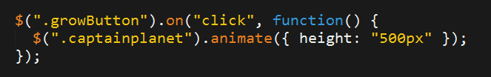
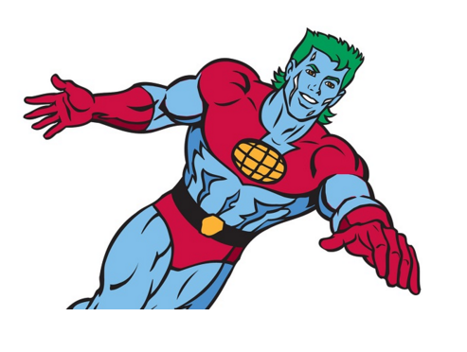
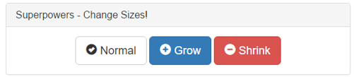

jQuery – Common Example
1. Click the Grow Button
2. Make Captain Planet Grow

Slide 16
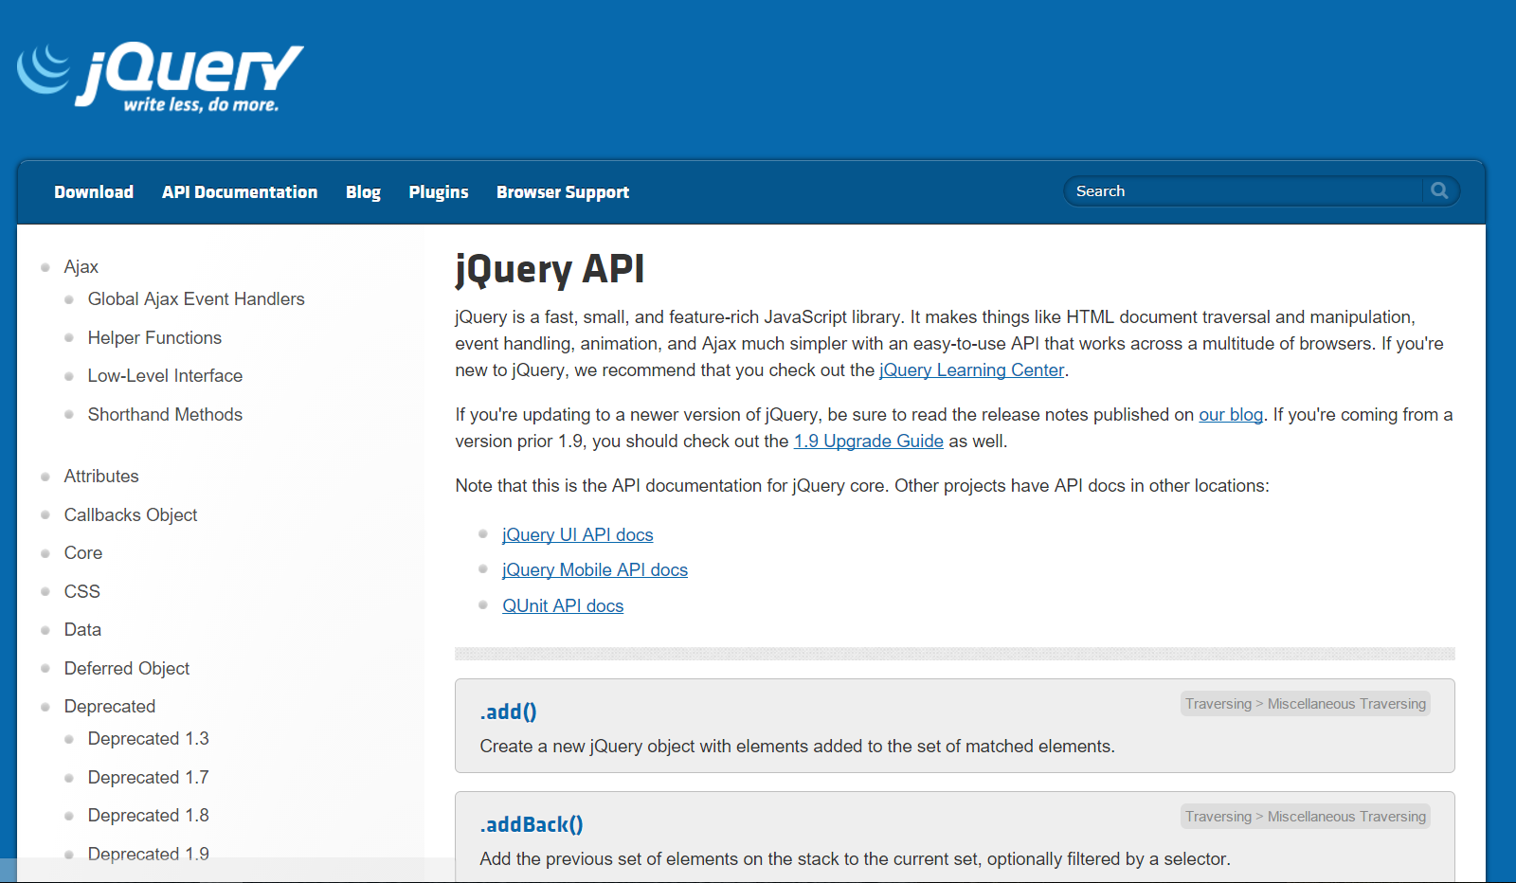
Use Documentation When Needed!

Slide 17
Fridge Game!

Slide 18
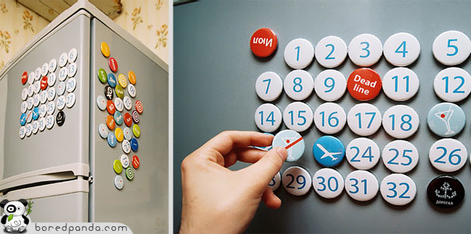
> YOUR TURN!!
Activity: 2-FridgeGame | Suggested Time: 35 min
02 Fridge Game
02-FridgeGame/fridge.html
Instructions are in the file

Slide 19
Crystal Collector!

Slide 20
Demo Time
Instructor: Demo
(1-12.html | 3-CrystalExample)

Slide 21
Lexical Scope

Slide 22
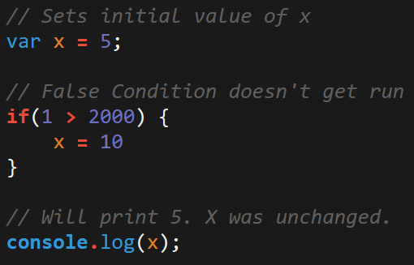
Javascript Scope
In Javascript curly brackets { } indicate blocks of code.
In order for the code inside the curly brackets to be executed, it must meet the condition or it must be called (example: functions).
These blocks of code have the power to affect variables outside the curly brackets if those variables were declared outside – so be careful!

Slide 23
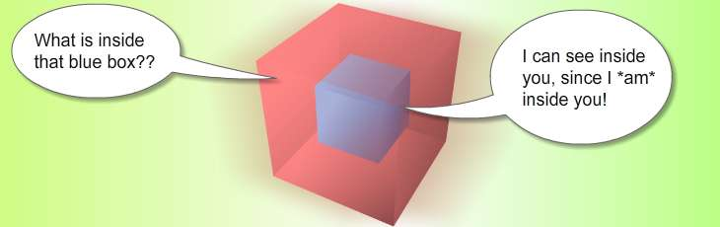
Scope = Boxes in Boxes
Scope impacts which variables can be accessed by which function.

Slide 24
Scope = Boxes in Boxes
function global()
function inner()
function evenInner()
function evenMoreInner()

Slide 25
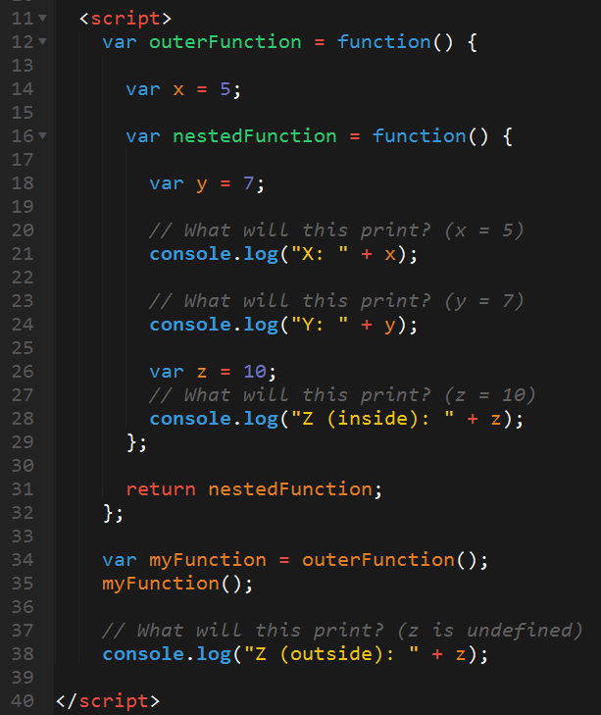
Javascript Scope Example (Tricky)
Here nested function is clearly able to access the variables of their parent function.
Whereas outer function has no idea what the variable z is because it was declared in a child function.

Slide 26
> YOUR TURN!!
Activity: 4-ScopeOne | Suggested Time: 5 min
04 Lexical Scope – Partner Activity – 5 Minutes
04-ScopeOne/lexical-scope1.html
Instructions are in the file

Slide 27
> YOUR TURN!!
Activity: 5-ScopeTwo | Suggested Time: 7 min
…and more scoping – 05 Scope Two – Individual Effort – 7Min
05-ScopeTwo/lexical-scope2.html
Instructions are in the file

Slide 28
> YOUR TURN!!
Activity: 6-ScopeThree | Suggested Time: 7 min
Last scope activity – promise!
06-ScopeThree/lexical-scope3.html
Instructions are in the file

Slide 29
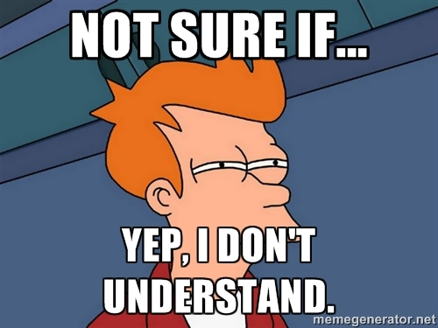
You Probably…

Slide 30
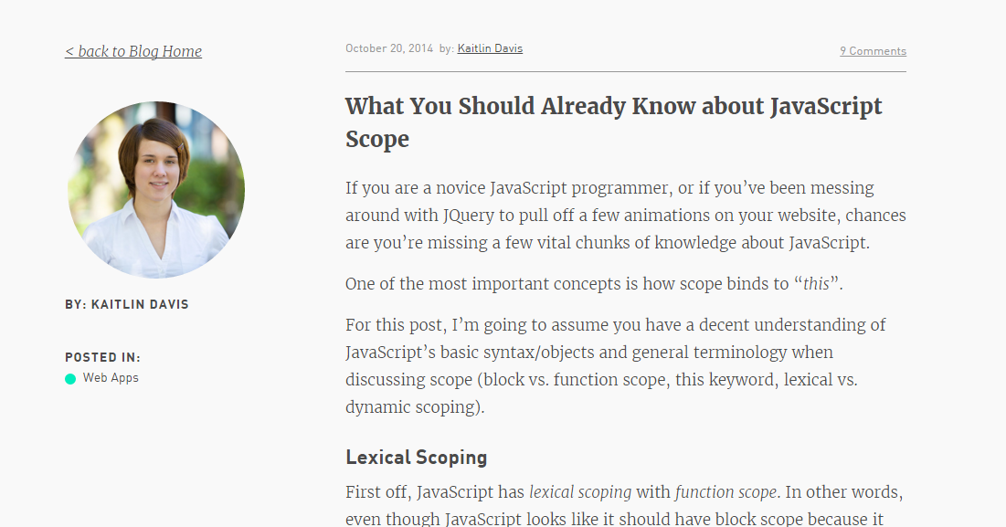
Helpful Article (If you’d like to learn more…)

Slide 31
Build a Brain Teaser
(Time Permitting)

Slide 32
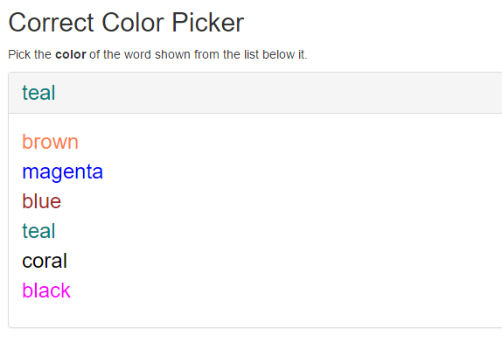
Color Picker – Brain Teaser

Slide 33
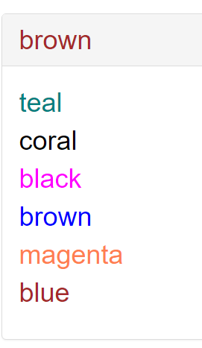
> YOUR TURN!!
Activity: 7-ColorCorrector | Suggested Time: 20 min
07-ColorCorrector/color-correct.html as a starting point, add the missing code such that the Color Corrector game works correctly.
To win, you should be picking the “word” that matches the color of the text at the top.
Ex:

Slide 34
Questions

