Slide 1

Sustainable Dundee
Group 6
Sprint Review

Slide 2

What will be covered
New features we have been working on
Discussion of our development Process
What we have planned for the future
Time for questions

Slide 3
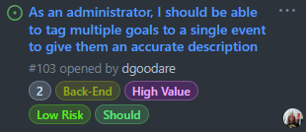
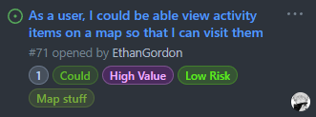
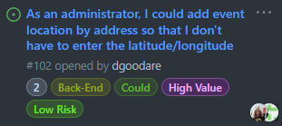
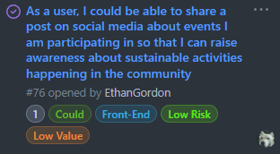
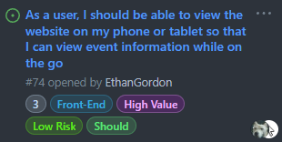
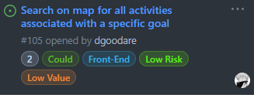
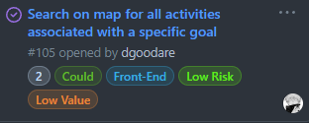
User Stories

Slide 4
Development Process
Problems we have faced

Slide 5
Future Plans
Fix problems with connection to database
Develop Goals page to be interactive
Get user’s location data to show nearby activities

Slide 6
Any Questions?

