Slide 1
how to make
end-to-end tests in java
more interesting?

Slide 2

David Sobreira Gouvea
Lead Software Engineer

Slide 3
Agenda
What is Definity Labs?
Why end-to-end tests are so painful?
What is flue2ent?
What is Screenshot Testing?
Q&A

Slide 4


Slide 5





Slide 6
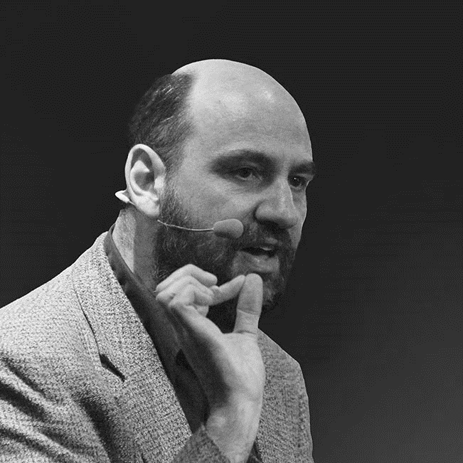
“In short, tests that run end-to-end through the UI are: brittle, expensive to write, and time consuming to run.”
Martin Fowler

Slide 7
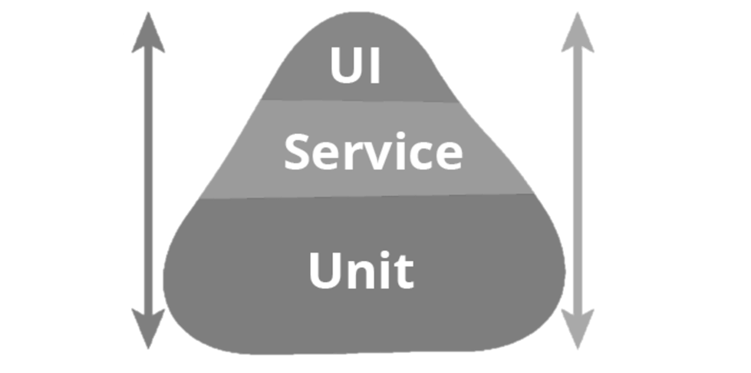



Slide 8
flue2ent
fluent
+
e2e

Slide 9
“The API is primarily designed to be readable and to flow. The price of this fluency is more effort, both in thinking and in the API construction itself.”
Martin Fowler

Slide 10

show me…

Slide 11


Slide 12
show me…

Slide 13





Slide 14
Useful links
http://definitylabs.org
http://definitylabs.org/#/products/flue2ent
http://content.definitylabs.org

Slide 15



