Slide 1
Operating Systems
Programming assignment 2. Minishell

Slide 2
Presentation
2
Introduction
Command processing.
Execution of a simple command.
Background execution.
I/O redirection.
Execution of command sequences.
Internal commands.

Slide 3
Introduction
Development of a minishell in UNIX/Linux in C language.
It must implement:
Execution of simple commands
ls, cp, mv, rm, […].
Execution of command sequences
ls | wc -l
ls | sort | wc -l
Execution of simple commands or sequences in background (&)‏
ls &
ls | sort | wc -l &
Execution of simple commands or sequences with input, output and error redirections.
ls > file
cat | more < file
ls | grep mio > my_entries
make install 2> error_output

Slide 4
Development process
An incremental development is recommended.
Support for simple commands: ls, cp, mv, […].
Support for simple commands in background (&).
Execution of simple commands with redirections.
Support for command sequences.
Support for command sequences in background (&).
Support for redirections in simple commands and sequences.
Internal command
mycalc, mycp

Slide 5
Material
For the development of the programming assignment, an initial code is provided. This code can be downloaded from AulaGlobal.
The files given are:
p2_minishell_19_20/
Makefile
libparser.so
msh.c
probador_ssoo_p2.sh
To compile simply execute make.
The student must only:
Modify msh.c to include the asked functionality

Slide 6
Command preprocessing
For obtaining the orders a sintactical analizer is used. It checks if the commands sequence has the correct structure and allows you to get the content through a function.
int read_command(char ***argvv, char **filev, int *in_background);
It returns
0 if EOF (CTRL + D)‏
-1 when an error happens
n Number of orders plus one
Examples:
ls | sort → Returns 3
ls | sort > fich → Returns 3
ls | sort & → Returns 3
cat < input_file → Returns 2

Slide 7
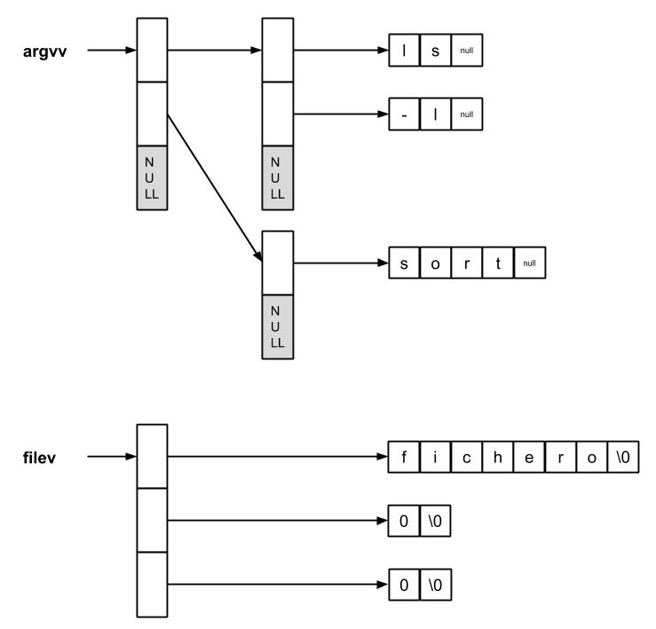
Getting Commands
The function read_command returns as first parameter:
char ***argvv
Which is a structure that contains the commands introduced by the user.
Example:
Print command X:
printf(“Command X: %s \n”, argvv[i][0]);
Print its first argument:
printf(“Arg 1 of X: %s \n”, argvv[i][1]);
ls -l | sort > fichero

Slide 8
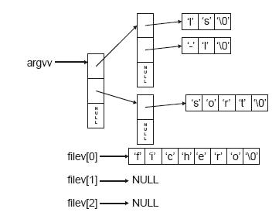
Getting Commands
The function read_command returns as second parameter:
char **filev
Which is a structure that contains the files used in the redirections.
filev[0]
String that contains the name of the file used for the input redirection (<).
filev[1]
String that contains the name of the file used for the output redirection (>).
filev[2]
String that contains the name of the file used for the error output redirection (>&).

Slide 9
Getting Commands
The function read_command returns as third parameter:
int *in_background
Which is a variable that indicates if the commands are executed in background.
Its values are :
in_background = 0 → If it is not executed in background
in_background = 1 → If it is executed in background (&)

Slide 10
Error control
When a system call fails, it returns -1. The error code is inside the global variable errno.
Inside the file errno.h you can find all the possible values that it can take.
To access to the error code there are two possibilities:
Use errno as an index to access to the chain sys_errlist[].
Use the library function perror(). See man 3 perror.
#include <stdio.h>
void perror(const char *s);
perror prints the received message as parameter and prints the message associated to the code of the last error ocurred during a system call.

Slide 11
Process identifiers
A process is a program in execution
All processes have a unique identifier. Two functions let you get that identifier:
pid_t getpid(void);
pid_t getppid(void);
An example:
#include <sys/types.h>
#include <stdio.h>
int main() {
printf(“Procces identifier: %s\n”, getpid());
printf(“Procces identifier of the parent process%s\n”, getppid());
return 0;
}

Slide 12
File descriptors of a process
In UNIX / Linux all processes have three opened file descriptors by default:
Standard input Value = 0 (STDIN_FILENO)‏
Standard ouput Value = 1 (STDOUT_FILENO)‏
Standard error Value = 2 (STDERR_FILENO)‏
They are in the file descriptor table of a process when it is created:
The commands executed in a shell are implemented to read and write from the standard input /ouput.
It is possible to redirect the standard input / output to read /write using other files, or to read / write in a pipe.
0 | STD_IN
1 | STD_OUT
2 | STD_ERR

Slide 13
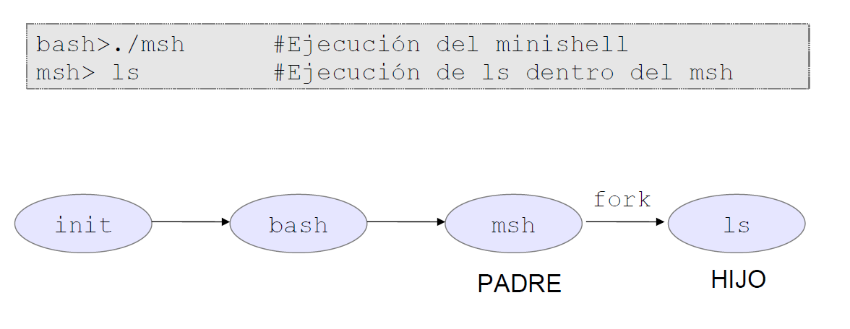
Needed processes in a shell
The minishell is the parent process of all the new processes generated from it.
Example of execution of the command ls.
FATHER
CHILD
Every new process created from the minishell (for example: ls) will be executed as its child process.

Slide 14
Creation of processes with fork()
It allows to generate a new process or child process that is an exact copy of the parent procress:
The child process inherites:
The values of signal manipulation.
The process class.
The segments of shared memory.
The masks of file creation, etc.
The child process differs in:
The child has a new ID (each process IS is unique).
It has a private copy of the files descriptors opened by the parent.
The pending signals of the child process is empty.
The child does not inherit the stablished locks of the parent.
It returns:
0 → If it is the children.
pid → If it is the parent.
pid_t fork()‏

Slide 15
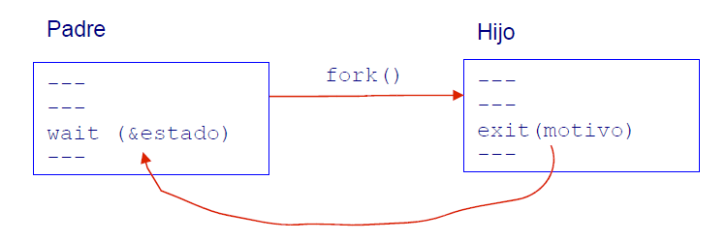
Example of creation of processes with fork()
#include <sys/type.h>
#include <unistd.h>
#include <stdio.h>
int main() {
int pid;
int estado;
pid = fork();
switch(pid) {
case -1: /* error */
perror (“Error in fork”);
return (-1);
case 0: /* hijo */
printf(“The process CHILD sleeps 10 seconds\n”);
sleep(10);
printf(“End of process CHILD\n”);
break;
default: /* padre */
if (wait(&estado) == -1) //the parent waits for the child
perror(“Error in the wait”);
printf(“End of process PARENT\n”);
}
exit(0);
}
Parent
Child

Slide 16
Process execution with execvp()
The function execvp replaces the process image with a new one. This new image corresponds to the command that you want to execute.
int execvp(const char *file, char *const argv[]);
Arguments:
file → Path of the file that contains the command to be executed . If there is not path, it searches inside the PATH.
argv[] → List of avalaible arguments for the new program. The first argument must point to the name of the file that is going to be executed.
Return:
If the function returns something it is because an error has happened.
It returns -1 and the error code is in the global variable errno.
The function never returns in a successful execution.

Slide 17
Example of process execution with execvp()
#include <sys/type.h>
#include <unistd.h>
#include <stdio.h>
int main() {
int pid;
char *arguments[3] = {“ls”, “ls -l”, “NULL”};
pid = fork();
switch(pid) {
case -1: /* error */
perror(“Error in fork”);
exit(-1);
case 0: /* child */
execvp(arguments[0], arguments);
perror(“Error in exec. If the execution is correct this would never be executed.”);
break;
default: /* parent */
printf(“I am the parent process\n”);
}
exit (0);
}

Slide 18
Finalization and waiting for processes
The finalization of a process can be executed with:
return status;
void exit(int status);
void abort (void); → Abnormal finalization of the process.
The processes can wait to the finalization of other processes.
pid_t waitpid(pid_t pid, int *status, int options);
Normally, parent processes always wait for its children to finalize.
pid_t wait(int *status);
If a process finalizes and its parent process have not waited for it, the procces goes to ZOMBIE state until the parent dies.
ps -axf → visualize all processes, including zombie processes.
kill -9 <pid> → kill (terminate) a process.

Slide 19
Example of finalization and process waiting
#include <sys/type.h>
#include <unistd.h>
#include <stdio.h>
#include <sys/wait.h>
int main() {
int pid;
int status;
char *argumentos[3] = {“ls”, “-l”, “NULL”};
pid = fork();
switch(pid) {
case -1: /* error */
perror(“Error infork”);
exit(-1);
case 0: /* child */
execvp(argumentos[0], argumentos);
perror(“Error in exec. If all is correct this should never be executed.”);
break;
default: /* parent */
while (wait(&status) != pid);
if (status == 0) printf(“Normal execution of the child\n”);
else printf(“Abnormal execution of the child \n”);
}
exit (0);
}

Slide 20
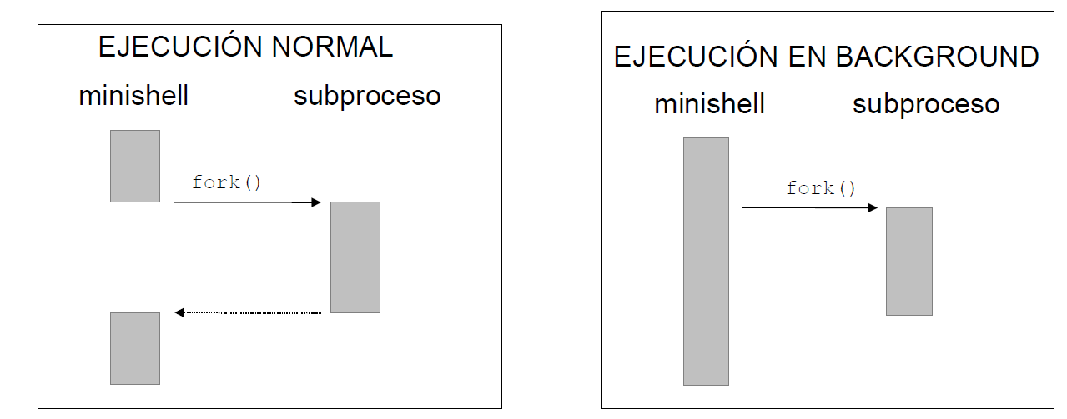
Background execution
A command can be executed in background from the command line using & at the end. For example:
sleep 10 &
In this case the parent process does not block, waiting for the finalization of the child process.
The command fg <job_id> let you get a process from background to foreground. It receives a job id, not a pid.
fg → It is not considered in this lab
NORMAL EXECUTION
BACKGROUND EXECUTION

Slide 21
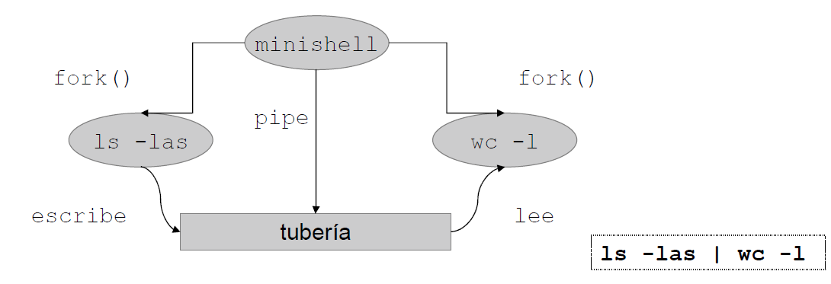
Command sequences with pipes
Command sequences are built using pipes: | . For example:
ls -las | wc -l
¿How does a pipe work?
The standard ouput of each command is connected to the standard input of the next one.
The first command reads from the standard input (keyboard) if there is not an input redirection.
The last command writes in the standard output (screen) if there is no output redirection.
reads
writes
pipe

Slide 22
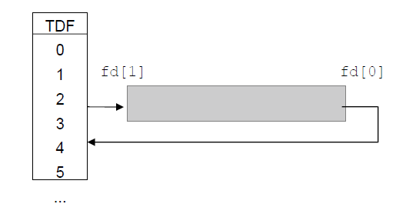
Creation of pipes with pipe()
For the creation of pipes without name you have to use the function pipe.
#include <unistd.h>
int pipe(int descf[2])
It receives an array with the file descriptor for input and ouput.
descf[0] → Input Descriptor (read).
descf[1] → Output descriptor (write).
It returns:
-1 → If there is an error.
0 → In any other case.

Slide 23
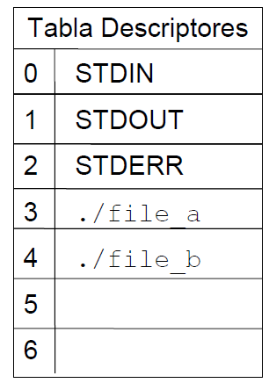
Functions dup and dup2
The functions dup y dup2 let you duplicate the file descriptors.
#include <unistd.h>
int dup(int oldfd);
int dup2(int oldfd, int newfd);
The function dup uses the first descriptor avalaible in the table when opening a file.
#include <unistd.h>
#include <stdio.h>
int main() {
int fd1, fd2, fd3;
fd1 = open(“./file_a”, O_READ);
fd2 = open(“./file_b”, O_READ);
fd3 = dup(fd2);
}

Slide 24
Use of pipe + dup
pipe
pipe(pipe)
close
close(STDOUT_FILENO)
dup
dup(pipe[1])
close
close(pipe[0])
close(pipe[1])
0 | STD_IN
1 | STD_OUT
2 | STD_ERR
0 | STD_IN
1 | STD_OUT
2 | STD_ERR
3 | PIPE[0]
4 | PIPE[1]
1
2
0 | STD_IN
1 | PIPE[1]
2 | STD_ERR
3 | PIPE[0]
4 | PIPE[1]
0 | STD_IN
1 | STD_OUT
2 | STD_ERR
3 | PIPE[0]
4 | PIPE[1]
3
4
0 | STD_IN
1 | PIPE[1]
2 | STD_ERR
3 | PIPE[0]
4 | PIPE[1]
0 | STD_IN
1 | PIPE[1]
2 | STD_ERR

Slide 25
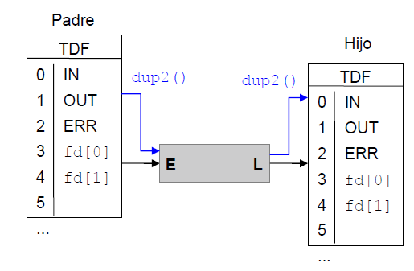
Example of pipe use
Example of pipe for the command : ls | more. The child executes the command more the parent executes the command ls.
int main (int argc, char *argv[]) {
int fd[2];
char *arguments1[2]={“more”, “NULL”};
char *arguments2[3]={“ls”, “NULL”};
pipe(fd);
if (fork() == 0) {
close(STDIN_FILENO);
dup(fd[0]);
close(fd[1]);
execvp(arguments1[0], arguments1);
}
else {
close(STDOUT_FILENO);
dup(fd[1]);
close(fd[0]);
execvp(arguments2[0], arguments2);
}
printf("ERROR: %d\n", errno);
}
Father
Child

Slide 26
Input, output and error redirections
It is possible to redirect the input / ouput to write/ read from other files
The input redirection (<) only affects the first command.
Opens a file in read mode and uses it as standard input.
close (STDIN_FILENO);
df = open(“./input_file”, O_RDONLY);
The output redirection (>) only redirects the last command.
opens a file in write mode and uses it as standard output.
close (STDOUT_FILENO);
df = open(“./output_file”, O_CREAT| O_WRONLY, 0666);
The redicrection of the standard error affects all commands (!>).
Opens a file in write mode and use it as standard error.
close (STERR_FILENO);
df = open(“./error_ouput”, O_CREAT| O_WRONLY, 0666);
System call open uses the first file descriptor available in the files table.
Redirection: Considers that before opening the file (./input_file) the STDIN_FILENO is closed

Slide 27
Internal commands
An internal command is a command that correspond to a system call or is a complement offered by the minishell.
Its function must be implemented inside the minishell.
The command input must be analyzed. ¡¡The parser does not do it!!
It must be executed inside the process minishell.

Slide 28
Internal commands: mycalc
28
The minishell must offer the following internal command mycalc whose syntax is:
mycalc <operand 1> <add/mod> <operand 2>
For this purpose:
Check that the syntax is correct.
Execute the selected operations: sum (add) or modulus (mod) .
Show the results on the screen.
msh> mycalc 3 add -8
[OK] 3 + -8 = -5; Acc -5
msh> mycalc 5 add 13
[OK] 5 + 13 = 18; Acc 13
msh> mycalc 10 mod 7
[OK] 10 % 7 = 7 * 1 + 3
msh> mycalc 10 % 7
[ERROR] The structure of the command is <operand 1> <add/mod> <operand 2>
msh> mycalc 8 mas
[ERROR] The structure of the command is <operand 1> <add/mod> <operand 2>

Slide 29
Internal commands: mycp
29
The minishell must offer the following internal command mycp whose syntax is:
mycp <origin file> <dest file>
For this purpose:
Check that the syntax is correct.
Check that the file exist and read its contents.
Create a new file (or truncate if it already exists) and write the contents of the first file.
Close the files.
msh> mycp msh.c msh.c_bak
[OK] Copy has been successful between msh.c and msh.c_bak
msh> mycp inexistente.c .
[ERROR] Error opening original file: No such file or directory
msh> mycp origen.txt
[ERROR] The structure of the command is mycp <original file> <output directory>

Slide 30
Delivery
30
Tuesday 28th March 2020(until 23:55h).
Zip compressed file with name ssoo_p2_AAA_BBB_CCC.zip that contains:
msh.c
Authors.txt
Report: Turnitin.
You must follow the rules included in the statement. Please read it carefully.

