Slide 2
Same Agent,
Two Architectures
When MCP Wins (And When It Doesn't)
Mariano Gomez Bent Chief Product & Technology Officer, Mekorma
Community Summit NA 2026 • Nashville, TN • October 11–15

Slide 3


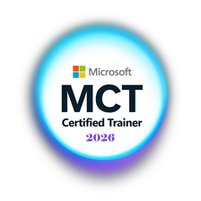

About the Speaker
Mariano Gomez Bent
Chief Product & Technology Officer
Former Microsoft Business Applications MVP (2008-2024)
Microsoft Certified Trainer
International Speaker
Building AI-First products with Microsoft Power Platform and Copilot Studio
Focused on practical AI architecture for real-world enterprise scenarios

Slide 4
Session Agenda
1
The setup
MCP will not replace your connectors
5 min
2
Meet Project Orion
The scenario, the data, and the dashboard
5 min
3
Three tools, three jobs
What actually changes with MCP
12 min
4
Demo 1: the connector agent
Where a connector wins, and its ceiling
15 min
5
Two architectures
Today's demo setup vs. what you'd ship
8 min
6
Demo 2: the MCP agent
The server changes, the agent follows
18 min
7
When to reach for MCP
The decision framework and the honest warning
12 min
8
Take it home
The lab, the repo, and Q&A
15 min

Slide 5
Learning Objectives
By the end of this session, you will be able to:
Explain what actually changes
1
Moving from a connector to an MCP server changes who owns the tools, not who decides to call them.
Decide when MCP earns its cost
2
Use two questions: how many agents share these tools, and how often do the tools change?
Build it yourself
3
A custom MCP server over SQL, GitHub's MCP server, a new tool rolled out without republishing the agent, and what changes for production.

Slide 6
“MCP will not replace your connectors.”
The right question is not which tool is better.
The right question is: what does my agent need to do?

Slide 7
Introducing Project Orion
An enterprise team building a customer-facing web app. Mid-release cycle. Under pressure.
Release Readiness
Sprint Completion
Critical Blockers
Velocity Trend
52
30%
3
↓
/100
open
Declining
Was 85 three sprints ago
Sprint 5, 14 of 46 pts done
Auth, dashboard, data sync
Peak 43pts, now 33pts
Data lives in two places: SQL Server (sprint metrics) and GitHub (issues).
The agent needs to reason across both.

Slide 8
Three Tools. Three Jobs.
Connector
REST API Tool
MCP Server
What it is:
What it is:
What it is:
A prebuilt or custom Power Platform connector. Its actions are added and described in each agent.
Point the agent at an API and pick the endpoints. You describe each one, in each agent.
A server that publishes its own tools, descriptions and inputs. Agents discover them.
Best for:
Best for:
Best for:
A known service that already has a connector.
Prototyping fast when no connector or MCP server exists.
The same tools shared by many agents, or APIs that change often.

Slide 9
What Actually Changes With MCP
Connector
MCP Server
You define the tools,
in every agent.
The server defines
the tools, once.
vs
Each action and its inputs are described when you set up each agent.
When the API changes, you update every agent and republish it.
Close to the agent. Simple. Bounded.
Tools and their descriptions are discovered from the server at runtime.
Change the server, and every agent picks it up without being republished.
Shared across agents. Flexible. One more thing to run.
In both cases the agent decides when to call a tool. What changes is who owns the tools.

Slide 10
“When many agents need the same tools, and those tools keep changing, that’s your MCP signal.”
Remember this: the question you should ask before every architectural decision.

Slide 11
Demo 1 of 2: Connector Agent
Seven SQL tools and GitHub. Every tool added, configured and described by hand.
“What is the current release readiness score?”
SQL tool. Clean, accurate answer.
“What critical bugs are open in GitHub?”
GitHub tool. Matched to SQL by issue number.
“What is blocking the release?”
Both sources. The connector handles it.
“At our current pace, will we make the release?”
No forecast tool. It says so.

Slide 12
Connector: Strengths vs. Cost of Change
Strengths
To add a forecast, I'd have to
Fast and lightweight
Easy to maintain
Predictable and testable
No additional infrastructure
Perfect for scoped, known data sources
Write a new stored procedure
Add a new tool to the agent
Set the server, database and procedure
Write the description and parameter hints
Test it
Republish the agent
Repeat for every agent that needs it
“Connectors did the reasoning. The cost is every change: edit, republish, repeat, in every agent.”

Slide 13
What You'll See Today: The Demo Setup
Everything on the left runs on my laptop. Built for a live demo, not for production.
MY LAPTOP
SQL Server
Local instance
ProjectOrion database
Custom MCP Server
TypeScript + Node.js
Running locally
Dev Tunnel
Demo only.
Not an architecture
component.
Copilot Studio Agent
Generative orchestration
2 MCP tools
HOSTED BY GITHUB
GitHub
Issues, labels,
open/closed state
GitHub MCP Server
github/github-mcp-server
OAuth
The tunnel only exists so a cloud agent can reach a database on my laptop.

Slide 14
What You'd Ship: Target Cloud Design
Recommended design. Same agent, same tools. Only the hosting changes.
AZURE
POWER PLATFORM ENVIRONMENT
Azure SQL
ProjectOrion database
Access via
managed identity
Custom MCP Server
TypeScript + Node.js
Azure hosting
Copilot Studio Agent
Generative orchestration
2 MCP tools
Entra ID OAuth 2.0
HOSTED BY GITHUB
GitHub
Issues, labels,
open/closed state
GitHub MCP Server
github/github-mcp-server
MCP connectors
Governed by
DLP policies
OAuth
Every connection is authenticated, and policy governs every connection.

Slide 15
Demo 2 of 2: MCP Agent
Same agent. The server changes. Nobody touches the agent.
“What is the current release readiness score?”
Same answer as Demo 1: 52, At Risk.
“What is blocking the release?”
Same blockers as Demo 1: parity.
“At our current pace, will we make the release?”
No forecast tool yet. Agent says so.
Flip the switch. New chat, same question.
New tool appears. Agent follows.

Slide 16
MCP: Power and the Price You Pay
What You Gain
What You Pay
Tools defined once, on the server
Agents pick up changes without republishing
Reusable across multiple agents
Tool descriptions travel with the tools
Scales to new tools without agent changes
A developer must build and maintain it
Infrastructure: hosting, identity, network
Agent quality depends on the server’s tool descriptions
Higher complexity = higher surface area for failure
Overkill when a connector would have done it
Publishing to other tenants? Certification, and a fresh review for new tools
Complexity has a cost. Make sure your problem justifies it.

Slide 17
When to Reach for MCP
HOW MANY AGENTS USE THESE TOOLS? →
ONE AGENT
MANY AGENTS
STABLE TOOLS
Connector Wins
Evaluate MCP
Simple, governed, done.
A shared custom connector may be enough.
Weigh maintenance cost first.
CHANGING TOOLS
Connector + Republish
MCP Is Right
With one agent,
republishing is cheap.
Change it once.
Every agent follows.

Slide 18
“The most expensive architectural mistake is reaching for MCP because it sounds modern.”
Complexity has a cost. Make sure your problem justifies it.
Connectors and plugins are not second-class citizens. They are the right tool for the right job, and that job is more common than you think.

Slide 19

Everything You Need to Run This Yourself
Lab Guide & All Artifacts
GitHub Repo
SQL setup script (ProjectOrion database)
GitHub CLI script (35 issues, correlated to SQL)
GitHub Copilot MCP Server scaffold prompt
GitHub Copilot Next.js dashboard prompt
Copilot Studio agent prompts (both versions)
Step-by-step lab guide PDF
[QR Code]
github.com/dgpblogster/project-orion-lab

Slide 20
Questions?
“When many agents need the same tools, and those tools keep changing, that’s your MCP signal!”
Lab guide + all artifacts: github.com/dgpblogster/project-orion-lab
#CopilotStudio #MCP #PowerPlatform #AIFirst #SummitNA2026

Slide 21
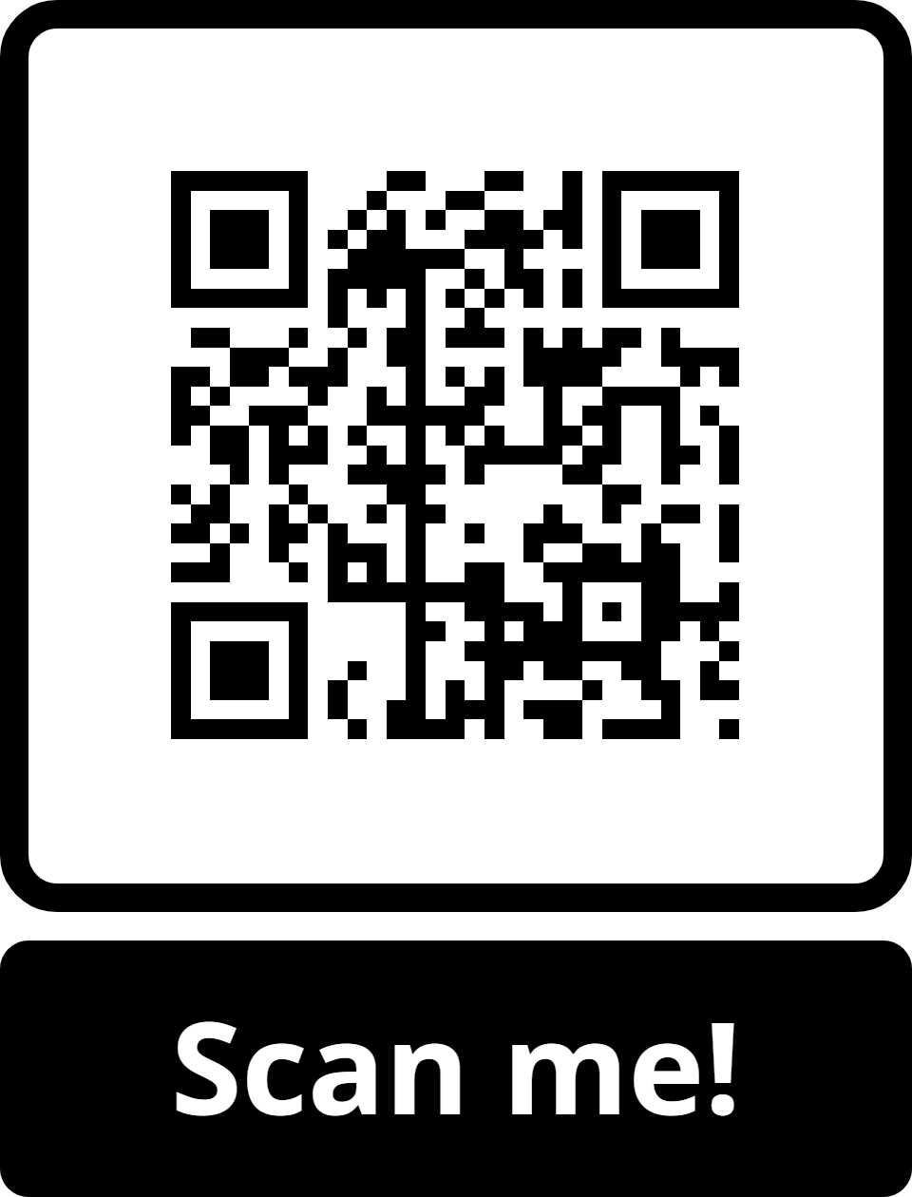

Contact the Speaker
Mariano Gomez Bent
Chief Product & Technology Officer
LinkedIn
linkedin.com/in/marianogomezbent
YouTube
youtube.com/@workbench-blog
Blog
theworkbench.blog
GitHub
github.com/dgpblogster
Scan to save my contact card

Slide 22
Thank you for Attending!

Slide 23
Appendix: Demo Question Script
Demo 1: Connector agent
1. “What is the current release readiness score?”
Expect: 52/100, declining, 3 blockers
2. “What critical bugs are open in GitHub?”
Expect: #25, #26, #27, matched to SQL by issue number
3. “What is blocking the release?”
Expect: #25, #26, #27 (13 pts), #28 stalled, smoke tests and rollback plan not done
4. “What's the main pattern between our GitHub issues and sprint health?”
Expect: Fixes creating regressions (#18 led to #26); velocity 43, 38, 33
5. “At our current pace, will we make the Orion 1.0 release?”
Expect: No forecast tool. It says so
Demo 2: MCP agent
1. “What is the current release readiness score?”
Expect: 52/100, At Risk: same answer, different architecture
2. “What is blocking the release?”
Expect: Same blockers as Demo 1: parity
3. “At our current pace, will we make the Orion 1.0 release?”
Expect: No release forecast available
➜ FLIP THE DASHBOARD SWITCH TO DEPLOYED. DO NOT TOUCH THE AGENT. START A NEW CHAT.
4. “At our current pace, will we make the Orion 1.0 release?”
Expect: Not on track: 56 pts short over 8 sprints; needs 40/sprint vs 33; finishes about 2 Mar 2027

