Slide 1

ENSF 607 - Final Project Software Architecture Assessment for Best Appliances
DILLON PULLANO
TEJPREET BAL
YAAD SRA

Slide 2
Functional vs Non-Functional Requirements
Functional Requirements
User Management:
Admins maintain repair experts
Customer registration through website
User authentication, and profile management
Annual Billing:
Payment linked to user
Credit information stored in user table
Ticket Management:
Customers should be able to enter tickets from the website
Notify and match specialist based on skills and availability
Notify customer when the specialist accepts ticket
Mobile Application Functionality:
Access and update ticket information
Survey Management:
After ticket is marked as complete, customer gets survey link
Non-Functional Requirements
Reliability:
The system should have high availability with minimal downtime
Scalability:
Should handle an increasing number of users and tickets
Maintainability:
Easy to update and maintain without significant downtime
Security:
Secure customer data and comply with data protection laws
Performance:
Quick response times for user interactions and ticket processing

Slide 3
Architectural Characteristics
CHARACTERISTIC WHY
Modularity:
Scalability:
Essential due to the growing number of customers and tickets
Availability:
High availability to minimize downtime and maintain customer satisfaction
Security:
Protect customer data and comply with regulations
Maintainability:
Allow for easy updates and maintenance such as fixing bugs, changing assignment algorithms, and adding new payment methods
Breaking down the monolithic system into microservices allows for easy feature updates through loose coupling

Slide 4
Coupling Considerations
Integrators (Coupling methods)
Disintegrators (Decoupling methods)
API Communication layers:
Centralized ticket generation and distribution
Addresses unit-of-work concern
API layers add standardized communication between components to eliminate any loss in messages
Enterprise Service Bus (ESB Orchestrator):
Routes messages through text or email
Manages updates to ticket history
Addresses re-routing concern
Chosen for reliability
Microservice architecture used for modularity:
Ticket management service and message transfers
Ticket generator and assignment algorithm service
User storage and system administrator service functions
Payment service with extra security layer
Abstraction layers between components where expected changes will occur:
Addresses changing algorithm concern
Allows changes to be made on components without impacting other services
Enables the independent scaling of different services

Slide 5
Service Contracts
Strict Contracts (JSON)
Required Contracts
Ensures that each service adheres to a standardized communication format
Less likely to result in data consistency problems
Since it is a single company, good for maintaining schemas internally
Provide a stable and well-defined interface allowing changes to be made to a service without affecting other services
In the event of a failure of one microservice, strict contracts prevent other microservices from also failing
Allow efficient scaling of individual microservices
Website Ticket generator and Database:
Database responds to ticket generator requests based on the strict predefined schema
Mobile App and Database:
Interaction based on strict database schema ensuring required fields are present and data types are correct
Notification Service and Customer:
Adheres to strict contract to ensure consistent and accurate communication with the customer
Billing Service and Customer:
Communicates with customer to initiate payment
Contract defines required parameters for successful payment
Billing service responds with confirmation or error message, adhering to a predefined schema

Slide 6
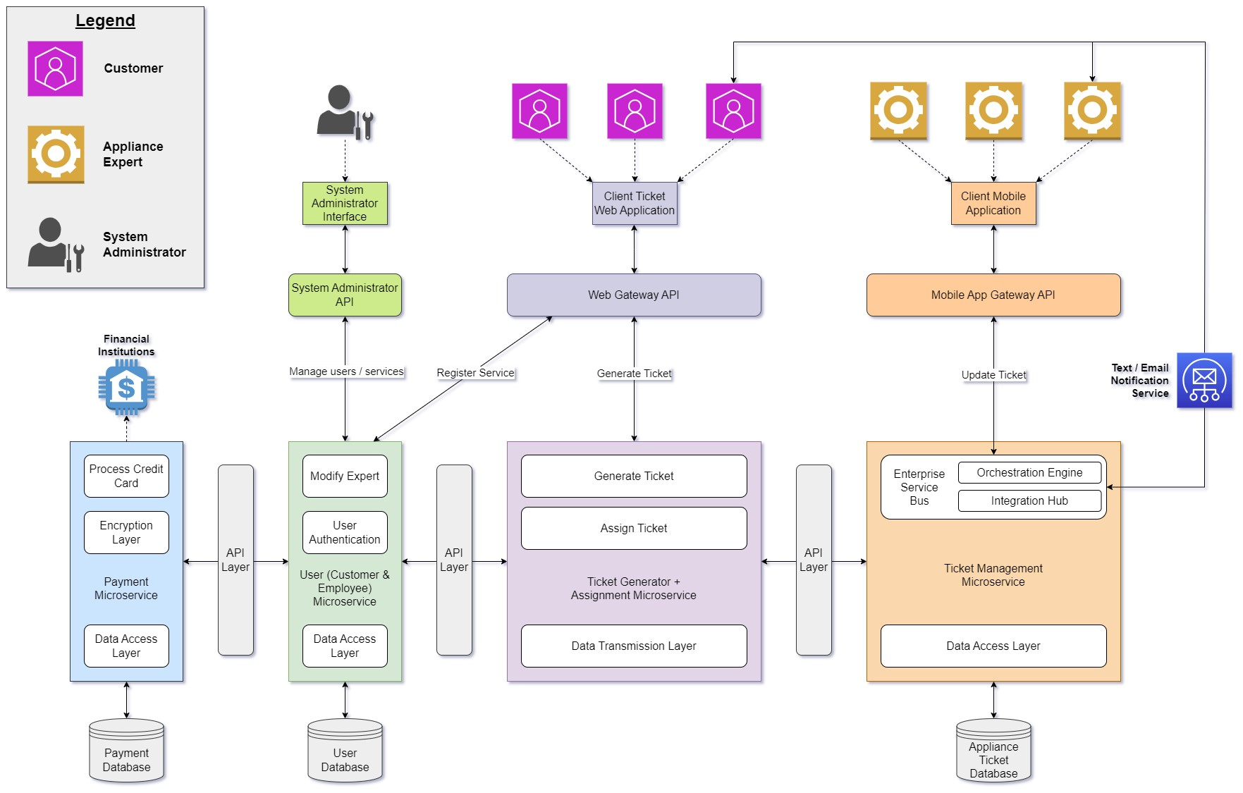
Architecture Diagram

Slide 7
Architecture Diagram Highlights
Microservice architecture splits up components so that they can be modified and scaled individually:
Ticket Generation and Assignment microservice is separate from Ticket Management microservice. Assignment algorithms can be modified without major changes to other system components
Payments are processed through a separate microservice to incorporate added encryption. This also allows for additional payment methods to be added to the system in the future
Orchestration-Driven Architecture ensures that tickets are routed to experts properly:
Assignment service determines correct expert and passes request to ticket management. ESB routes message to text expert
If message is routed successfully, second notification message is sent to customer
If message is not routed successfully, ticket management passes request for new expert to the assignment service
Text / Email Notification service sends out texts and notification emails:
The same service sends and receives the customer survey through email
API gateways are used to connect between client services (web / mobile applications) and the microservice layers
API layers are used internally to communicate between microservices
Strict contracts are maintained between each component and managed through API layers

Slide 8
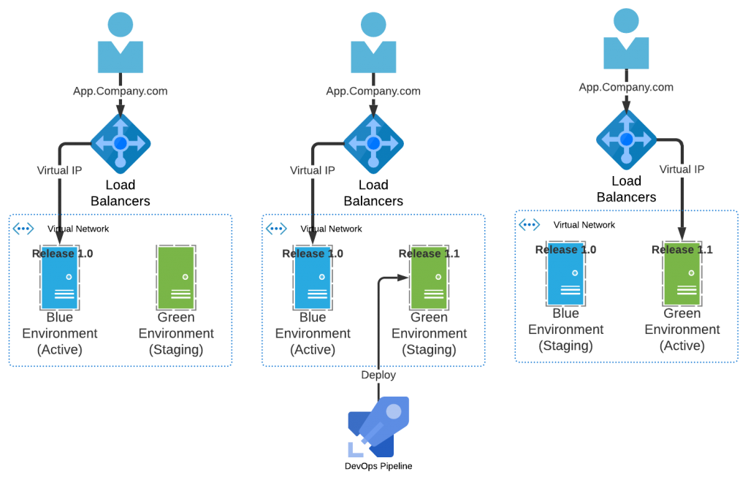
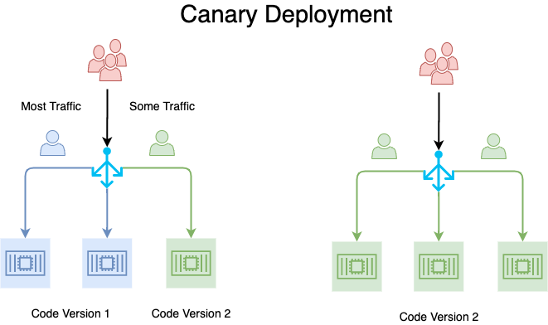
Deployment Strategies
Blue-Green Deployment (Initial Release):
Zero Downtime Updates:
Live traffic switched between environments with no user disruption
Immediate Rollback:
Quick and easy reversion to the stable version in case of any issues with the new release
Production Testing:
Green serves as a live staging area, allowing for testing before going live
Canary Deployment (Subsequent Releases):
Controlled Rollout:
New updates deployed to a small percentage of users initially
Allows for testing and monitoring the subset
Targeted Feedback:
Allows for tweaking and improvements based on user feedback and performance data
Incremental Release Confidence:
Gradually increases the user base for the new release as confidence grows
Full rollout only after successful operation in the canary stage

Slide 9
Fitness Functions
Performance Fitness Function
What Functions Rank This?
Response Time Testing: Measure the time taken to respond to requests.
Throughput Testing: Measure the number of requests processed within a given timeframe
Resource Utilization Testing: Monitor CPU, memory, and I/O usage to ensure they are within optimal ranges
Why is This Effective?
User Satisfaction: Fast and efficient service response is directly linked to user satisfaction
System Health: Indicates the health of the system and helps identify bottlenecks
Cost Management: Efficient resource utilization can reduce operational costs
How Would We Implement This?
Automated Performance Tests: Create scripts that simulate user interactions and measure response times and throughput
Monitoring Tools: Implement tools available for real-time monitoring
Resource Usage Alerts: Set alerts for when usage thresholds are exceeded
Scalability Fitness Function
What Functions Rank This?
Load Testing: Simulate varying loads to test how the system performs when more users or actions are added
Users Volume Testing: Measure the system's ability to handle increased simultaneous users
Data Volume Testing: Test the system's ability to handle large data volumes
Why is This Effective?
Growth Tolerability: Ensures the system can handle growth in user base or data size
Resource Scaling: Verifies that the system resources scale appropriately under load
Reliability Under Stress: Confirms the system's reliability when under stress
How Would We Implement This?
Stress Testing Tools: Implement tools available for stress testing the system
Cloud Auto-Scaling Features: Leverage cloud services that automatically scale resources based on load
Performance Metrics Analysis: Regularly review performance metrics to plan for scaling

Slide 10
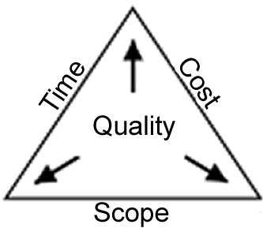
Design Summary
Balancing Trade-Offs:
Microservice architecture with API abstraction layers results in a system that is highly modular
Orchestrator architecture embedded into ticket management microservice ensures messages are routed properly and handles unsuccessful message delivery
System will take longer to build than a monolith system and will cost more money
Why vs. How:
Goal was to create a system that is user-friendly, efficient, and consistent in handling requests, ensuring both operational effectiveness and customer satisfaction.
Long term solution ensures the modular system will be able to handle increased loads and account for changing algorithms
Solution addresses issues presented by the client while preparing for growth

Slide 11
Thank You!
References:
Blue-Green Deployment image: https://blogs.perficient.com/files/Blue-Green-Deployment-Pattern-1024x653.png
Canary Deployment image: https://miro.medium.com/v2/resize:fit:661/0*QMwOW8NdTyoPYCnD.png

