Slide 1

Movie Theater Ticketing System
By: Dalton Graber, Jack Ventura, and Tyler Yocom

Slide 2
Problem Statement
Movie ticket systems are currently outdated, and users are looking for an upgraded and streamlined way to purchase tickets. Upgrading the ticket ordering system to show available movies and their showtimes, select your own seats, and make payments all in one place can lead to higher customer satisfaction and larger profits for movie theaters.

Slide 3
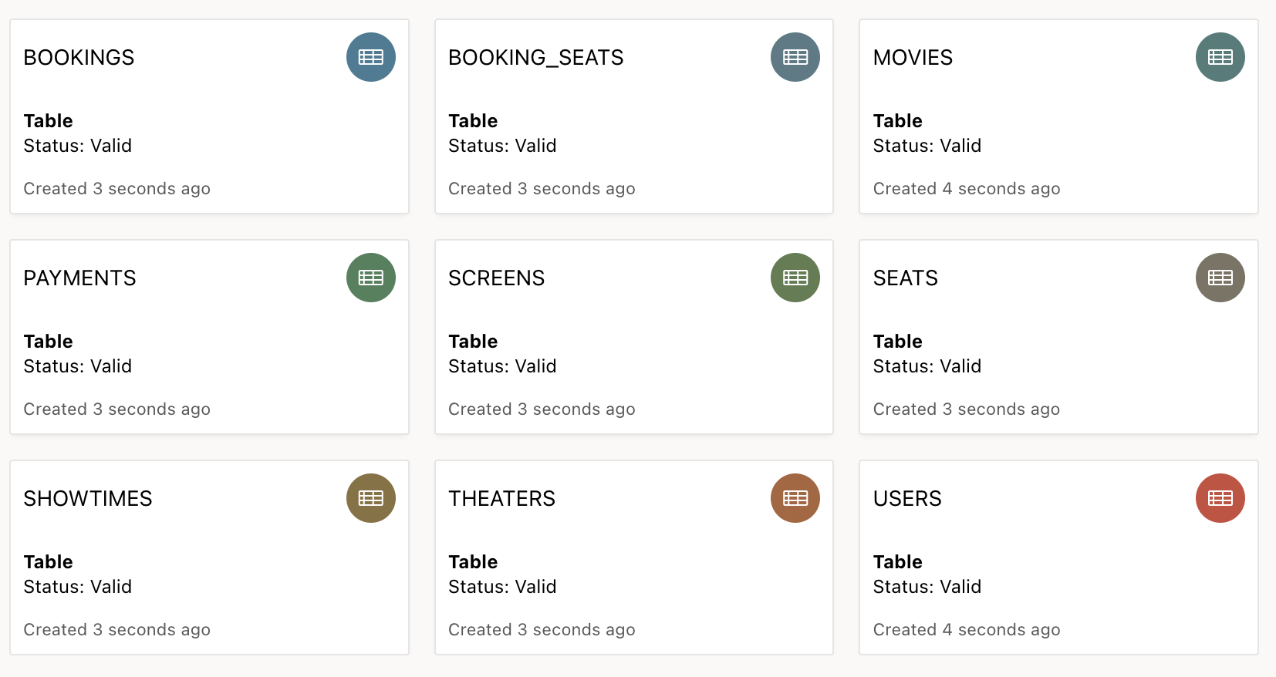
Database Schema

Slide 4
Development Plan
Fill in database with movie and movie theater records.
Implement various data processing tasks within SQL database.
Integrate SQL database with HTML code using PHP.
Improve payment processing functionality and security.
Polish UI functionality and visuals.
Test and debug code.

