Slide 1
HOW TO USE THIS CONTENT AND CONTRIBUTE
NOTE: KEEP THIS SLIDE HIDDEN!
This slide deck is intended for discussions at 300 to 400 levels.
Slides are organized in sections, so you can hide/show entire sections as needed.
Individual slides have the intended level in the notes section (and you should maintain that pattern if you add/change content).
If you make changes add a line item in the change history on the right so we can track what/when changes
CHANGE HISTORY:
V1.0, 2019-??-??, initial release
V2.0, 2019-10-22, content overhaul, leveling

Slide 2
EXAMPLE AURORA IMMERSION DAY AGENDA
Participants Introduction (10 min)
Customer architecture or goals (20 min)
Introduction to Amazon Aurora (L200, 15min)
Aurora Fundamentals: Cluster Architecture, Storage System (L300-400, 1 hr)
HA/DR: HA options, failure recovery, connection management, DR options, Global Database, Multi-Master (L300-400+, 1.5 hrs)
Management and Monitoring: Patching/upgrades, CloudWatch Metrics, Enhanced Monitoring, Performance Insights, Serverless + Data API, Read Replica Auto Scaling, RDS Proxy (L200-400+, 1.5 hrs)
Security and Shared Responsibility Model (L200, 1 hr)
Migration Best Practices (L300, 1 hr)
Performance Features and Optimization: Parallel Query, AKP, Query Cache, Hash Joins, Batch Scans (L300-400+, 1 hr)
Best Practices for Effective Data Models (L300-400+, 0.5 hrs)
Roadmap Review (L200-300, 1 hr)

Slide 3
COMPANION HANDS-ON LABS
Hands-on Labs are hosted at: https://awsauroralabsmysql.com/
All lab code is available at: https://github.com/aws-samples/amazon-aurora-labs-for-mysql
Slide deck contains suggested labs and points in the presentation flow for labs

Slide 4
Amazon Aurora Immersion Day
MySQL Compatible Edition
Team or presenters name
Date

Slide 5
[Example] Table of contents
Introduction to Amazon Aurora
Aurora Fundamentals
HA/DR
Management and Monitoring
Security and Shared Responsibility
Migration Best Practices
Performance Features and Optimization
Best Practices for Effective Data Models
Roadmap Review

Slide 6
HA/DR with Amazon Aurora
Failure recovery, backup/restore, connection management, Global Database, Multi-Master

Slide 7

Tolerating compute failures
Any reader node can be promoted to writer/master.
Failover tier determines preference on failover reader candidates.
Failed instances/nodes are replaced and come online as readers.
Readers reboot on writer failover.
Cluster
Endpoint
Reader
Endpoint
Writer
Writer
Reader
SQL
SQL
SQL
Transactions
Transactions
Transactions
Caching
0
Caching
0
Caching
5
SHARED CLUSTER STORAGE VOLUME
AZ 1
AZ 2
AZ 3
Notes:
Level 300

Slide 8
Near-instant crash recovery
Traditional database
Have to replay logs since the last checkpoint
Typically 5 minutes between checkpoints
Single-threaded in MySQL; requires a large number of disk accesses
Amazon Aurora
Underlying storage replays redo records on demand as part of a disk read
Parallel, distributed, asynchronous
No replay for startup
Crash at T₀ will result in redo logs being applied to each segment on demand, in parallel, asynchronously
Crash at T₀ requires a re-application of the SQL in the redo log since last checkpoint
Checkpointed Data
Redo Log
T₀
T₀
Note: Binlogs (master), undo logs, catalog, FTS indexes, XA still require crash recovery
More: http://blog.symedia.pl/2016/03/crash-recovery-mysql-aurora.html
Notes:
Level 400

Slide 9
When the database fails – recovery is fast <30 seconds
Notes:
Level 400
What matters is that this failover happens quickly.
These charts show you the % of failovers that happen in a given timeframe, say 0-5 seconds or 5-10 seconds. We measured this over 35 days and you have one data point along the x-axis for each day.
In our fleet, we observe 30% of failovers in less than 5 seconds, 70% in less than 10 seconds, 95% in less than 20 seconds, and effectively a 100% in less than 30 seconds

Slide 10
Continuous backup with point-in-time restore
Segment snapshot
Log records
Segment 1
Segment 2
Segment 3
Recovery point
Time
Backup is performed without performance or availability impact by storage nodes
Periodic snapshot of each segment is taken in parallel, and stored in S3
Logs records streamed to Amazon S3 continuously
At restore, appropriate segment snapshots and log records are retrieved by storage nodes
At restore, log records are applied to segment snapshots in parallel and asynchronously
Notes:
Level 300

Slide 11
Aurora backup and restore
Automated backups:
Between 1 and 35 days retention
Recover up to the last ~5 min point in time
Snapshots:
Instantly create user snapshots
No performance impact
Copy snapshots to another region
Share snapshots with other AWS accounts
Restore:
Time depends on cluster volume size
Always creates a new DB cluster
Source Cluster
Restored Cluster
Writer
Reader
Writer
SQL
SQL
SQL
Transactions
Transactions
Transactions
Caching
Caching
Caching
VOLUME
VOLUME
Automated backup
Restore to t₄
t0
1
2
6
t0
5
6
t2
3
Amazon S3
RDS Service Managed
Data changes over time
t₀
t₁
t₂
t₃
t₄
t₅
t₆
Notes:
Level 300

Slide 12
Aurora Backtrack
t₄
Invisible
t₂
t₃
Invisible
t₀
t₁
Rewind to t₃
Rewind to t₁
t₀
t₁
t₂
t₃
t₄
Backtrack brings the database to a point in time without requiring restore from backups
Recover from an unintentional DML or DDL operation
Backtrack is not destructive; you can backtrack multiple times to find the right point in time
Also useful for QA (rewind your DB between test runs)
Notes:
Level 300

Slide 13
HA&DR: from one region to multiple regions…
Cross-region read replicas
Logical, using binary log replication
Up to 5 readable replica clusters
Managed by the RDS service
Aurora Global Database
Physical (redo log) based replication
Up to 1* readable replica cluster
Purpose built replication infrastructure
Notes:
Level 200

Slide 14
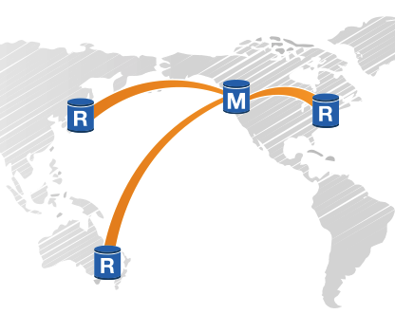
Cross region read replicas (logical)
Promote remote readers to a master for faster recovery in the event of disaster (low RTO/low RPO solution).
Bring data close to your customer’s applications in different regions
Promote to a master for easy migration
Replica clusters are writable unless you set read_only = 1
Writer in replica cluster applies logical changes, lag subject to workload, but isolates the replica
Notes:
Level 400

Slide 15
Aurora Global Database
Faster disaster recovery and enhanced data locality
Northern Virginia
(secondary region)
Oregon
Ohio
Inbound replication
R
R
(secondary region)
(primary region)
M
R
R
Storage
R
R
Inbound replication
Storage
Storage
Ireland
Outbound replication
(secondary region)
High throughput: Up to 200K writes/sec
Low replica lag: < 1 sec cross-region lag
Fast recovery: < 1 min downtime after region unavailability
Support for multiple secondary regions
Support for in-place conversion to Global Database
Inbound replication
R
R
Storage

Slide 16
Performance: logical vs. physical replication
Logical replication MySQL Binary logs (MTS)
Physical replication Global Database
SysBench OLTP (write-only) stepped every 600 seconds on R4.16xlarge
Notes:
Level 300

Slide 17
HA: reducing the impact of downtime/failures
Aurora Multi-Master
Multiple concurrent writer DB instances
When one fails others are still available
Efficient Connection Management
Cluster-aware clients
RDS Proxy
Failover optimization and testing
Notes:
Level 200

Slide 18
Continuous availability with Aurora Multi-Master
Multiple independent DB instances write to shared storage
Continuous Availability
Highly Durable
6 copies, 2 copies per AZ
Support for indexes, constraints, triggers, procedures, functions etc.
SQL Compatible
Write Scaling
Optimistic conflict resolution
Notes:
Level 200

Slide 19
Introduction to Aurora Multi-Master
Every node in the cluster is a writer node that can serve both read and write requests
Shared distributed storage volume
Instances can fail and recover independently
No additional cost
Application1
Application 2
Writer #1
Writer #2
Shared distributed storage volume
Notes:
Level 200

Slide 20
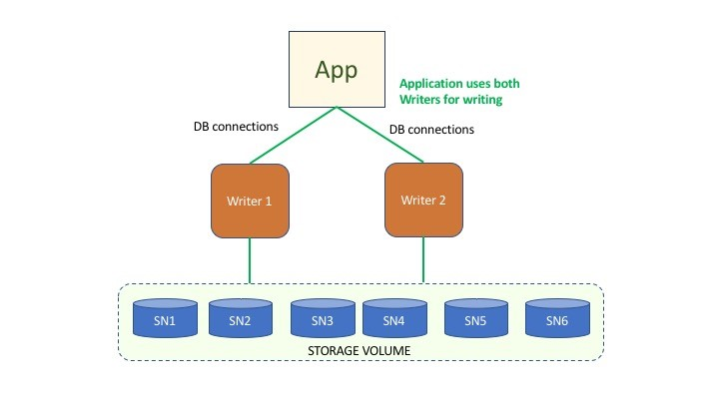
Using Aurora Multi-Master with your applications
Allocate applications to writers
Implement writer node health checks in applications
Re-distribute connections from failed writers to healthy writers
Client side drivers used with Aurora single master will also work with Multi-Master
Notes:
Level 300

Slide 21
Multi-Master: example of transactions with no conflict
Master 1
Master 2
Transactions T1 and T2 from BLUE and RED masters update different tables Table 1 and Table 2
No logical or physical conflicts because data from Table 1 and Table 2 are stored on different pages
No conflict resolution required
Page 1
Page 2
1
1
1
1
1
1
2
2
2
2
2
2
table 1
table 2
Notes:
Level 400

Slide 22
Multi-Master: example of physical conflict (storage arbitration)
Transactions T1 and T2 from BLUE and RED masters update Table 1 at the same time
Data may be on the same page and cause a conflict
Transaction T1 from BLUE master achieves quorum (first to reach storage) – transaction T1 is committed
Transaction T2 from RED master fails to achieves quorum – transaction T2 is rolled back and returns error to client
Storage nodes act as arbitrator for conflict resolution
Master 1
Master 2
Page 1
Page 2
1
1
1
1
2
2
table 1
table 2
Notes:
Level 400

Slide 23
Globally consistent reads with Multi-Master
Client
No waits on the write path
Adds latency ONLY to globally consistent reads
Configurable per session
Globally consistent results
N1
N2
T1
Read
T2
N3
Shared distributed storage volume
T3
Performs the read at vector clock T = (T1, T2, T3)
N1 wait for replication to catch up until T2 AND T3
Notes:
Level 400
(1min 15 sec)
Say we have 3 nodes, N1/N2/N3.
C1 issues a request to N1.
N1 then sends a hello request to N2 and N3. N2 and N3 respond with the timestamp when they saw the hello request from N1.
N1 then waits for replication to catch until T2 and T3 from N2 and N3 respectively. And once its caught up, performs the read and return the results back. This is a very simplified view, there is quite bit of engineering and complexities involved to make it work in practice.
As you can see, there is no wait on the write path. It only adds latency to the reads that needs global consistency. And its configurable per session.

Slide 24

Connection management to minimize disruptions
Up to 16,000 connections per cluster node (readers or writers)
Do read/write splitting (either in application, or proxy)
Use connection pooling, or a proxy if pooling not available
Respect the DNS TTL of the endpoints!
Put a CNAME in front of the endpoints
Avoid long running connections and turning auto_commit = OFF
RDS Proxy is currently in Preview. More: https://d1.awsstatic.com/whitepapers/RDS/amazon-aurora-connection-management-handbook.pdf
Notes:
Level 400

Slide 25
Testing workload fault resilience
OBJECTIVES
Understand app behavior
Understand failure duration
Understand recovery process
TYPES OF DOWNTIME
Scheduled: software updates, instance scaling, non-dynamic parameter changes, hardware maintenance/retirement
Unscheduled: substrate failures (hardware, network, power), workload anomalies, overloads, OOM, unsafe usage
SERVER-SIDE MECHANISMS
Instance reboots (API)
Manual failover (API)
Failure injection queries (SQL)
Promotion of remote replica (API)
Contact Support/Service Team
CLIENT-SIDE MECHANISMS
Networking disruption (NACLs)
Endpoint disruption (CNAME)
Connection pool disruption/reset
Application level fault injection
W
R
W
W
R
S
W
R
W
W
R
W
R
W
R
W
R
W
- Writer
R
- Reader
S
- Storage
More: https://docs.aws.amazon.com/AmazonRDS/latest/AuroraUserGuide/AuroraMySQL.Managing.FaultInjectionQueries.html
Notes:
Level 500

Slide 26


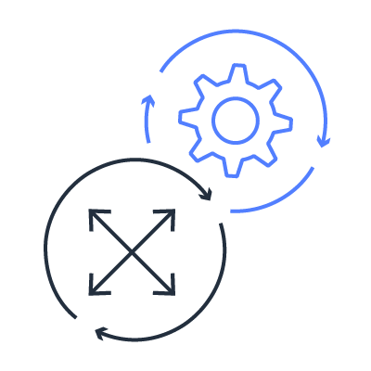
Improving HA with RDS Proxy
Fully managed, highly available database proxy feature for Amazon RDS
Connection Pooling
Minimize Failover Disruptions
Improved Security
Fully Managed and Scalable
Pool and share DB connections for improved app scaling
Consistent endpoint, holds connections open and queue up requests, minimizes failover time
Encryption in transit and improved DB access controls
Delivered as a managed service compatible with RDS databases
In preview, available for Aurora and RDS MySQL
Notes:
Level 200

Slide 27
Connection Pooling with RDS Proxy
Stabilizes and reduces connections against backend DB
Multiplexes client requests at transaction boundaries
Detects session state alterations and pins clients to backend connections
Limit/avoid pinning by setting consistent variables on all sessions
App
DB Cluster
App
RDS Proxy
App
Notes:
Level 300
Session state altering operations that cause pinning: set variables, explicit lock statements, prepared statements/calls, creation of temp tables
Pinning avoidance: excluding variables from pinning filters, avoid statements that cause pinning

Slide 28
Minimize Failover Disruption with RDS Proxy
Idle application connections are preserved by the proxy
Active connections with in-flight transactions will be interrupted to allow for error handling client side
New requests will be queued up by the proxy during the failover
Faster failure recovery, bypassing DNS (up to 66% faster)
Client
Client
RDS Proxy
Client
Notes:
Level 300

Slide 29
Minimizing disruptions during failures/failovers (writers)
 | GOOD | BETTER | BEST
Connectivity | Rely on the Aurora DNS Endpoints for clients, respect DNS TTL (5 sec) | Use a ”smart” driver (e.g. MariaDB Connector/J) that is topology aware Or, build your own topology awareness | Leverage RDS Proxy, connect to proxy endpoint
Failover Behavior | Cluster endpoint unavailable during failover, may initially connect to wrong instance due to stale DNS | Cluster endpoint unavailable during failover, but can avoid stale DNS issues | Existing connections held open subsequent queries queued up, in-flight transactions disconnected with error. New connections may be rejected depending on timing.
Failover Recovery | Monitor server role from clients at connect time and when connections are borrowed from pool (e.g. SELECT @@innodb_read_only;) Flush connection pool when inconsistent connection state detected |  | Connection failures don’t affect the entire pool Retry failed connections
RDS Proxy is currently in Preview. More: https://d1.awsstatic.com/whitepapers/RDS/amazon-aurora-connection-management-handbook.pdf
Notes:
Level 400

Slide 30
Hands-on with Amazon Aurora (MySQL)
Suggested hands-on labs:
Prerequisites (20min, if not completed already, let CloudFormation provision the DB cluster)
Backtrack a DB Cluster (15 min)
Test Fault Tolerance (15-30 min)
Hands-on labs will exercise the following:
Deployment automation via CloudFormation (if not completed already)
Reverting accidental DML operations
Testing, detecting and recovering from failovers
Notes:
Level 300

