Slide 1
HOW TO USE THIS CONTENT AND CONTRIBUTE
NOTE: KEEP THIS SLIDE HIDDEN!
This slide deck is intended for discussions at 300 to 400 levels.
Slides are organized in sections, so you can hide/show entire sections as needed.
Individual slides have the intended level in the notes section (and you should maintain that pattern if you add/change content).
If you make changes add a line item in the change history on the right so we can track what/when changes
CHANGE HISTORY:
V1.0, 2019-??-??, initial release
V2.0, 2019-10-22, content overhaul, leveling

Slide 2
EXAMPLE AURORA IMMERSION DAY AGENDA
Participants Introduction (10 min)
Customer architecture or goals (20 min)
Introduction to Amazon Aurora (L200, 15min)
Aurora Fundamentals: Cluster Architecture, Storage System (L300-400, 1 hr)
HA/DR: HA options, failure recovery, connection management, DR options, Global Database, Multi-Master (L300-400+, 1.5 hrs)
Management and Monitoring: Patching/upgrades, CloudWatch Metrics, Enhanced Monitoring, Performance Insights, Serverless + Data API, Read Replica Auto Scaling, RDS Proxy (L200-400+, 1.5 hrs)
Security and Shared Responsibility Model (L200, 1 hr)
Migration Best Practices (L300, 1 hr)
Performance Features and Optimization: Parallel Query, AKP, Query Cache, Hash Joins, Batch Scans (L300-400+, 1 hr)
Best Practices for Effective Data Models (L300-400+, 0.5 hrs)
Roadmap Review (L200-300, 1 hr)

Slide 3
COMPANION HANDS-ON LABS
Hands-on Labs are hosted at: https://awsauroralabsmysql.com/
All lab code is available at: https://github.com/aws-samples/amazon-aurora-labs-for-mysql
Slide deck contains suggested labs and points in the presentation flow for labs

Slide 4
Amazon Aurora Immersion Day
MySQL Compatible Edition
Team or presenters name
Date

Slide 5
[Example] Table of contents
Introduction to Amazon Aurora
Aurora Fundamentals
HA/DR
Management and Monitoring
Security and Shared Responsibility
Migration Best Practices
Performance Features and Optimization
Best Practices for Effective Data Models
Roadmap Review

Slide 6
Management and Monitoring
Patching and upgrades, monitoring and instrumentation, Serverless, Data API, auto-scaling read replicas

Slide 7
Amazon RDS/Amazon Aurora managed service at a glance
App/schema design
App/schema design
App/schema design
Tuning and config.
Tuning and config.
Tuning and config.
Monitoring
Monitoring
Monitoring
Scaling
Scaling
Scaling
High availability
High availability
High availability
Database backups
Database backups
Database backups
DB software patches
DB software patches
DB software patches
DB software installs
DB software installs
DB software installs
OS patches
OS patches
OS patches
OS installation
OS installation
OS installation
Physical hardware
Physical hardware
Physical hardware
Database on-premises
Database on EC2
Amazon RDS/Aurora
You manage
AWS manages
Shared responsibility
Notes:
Level 300
And while this may seen unglamorous, one of the biggest advantages of moving to a managed database like Aurora is you get to focus on the stuff that drives your business rather than making sure the machines are doing their job correctly. When you’re running your database on premises, you have to do everything by yourself. This is all the stuff in red. As you move to Amazon Aurora on the right, most of the stuff, all the boxes in green, are managed for you. And you only have to focus on optimizing your app

Slide 8
Configuration management
App/schema design
AWS provides:
Centralized parameter configuration using Parameter Groups
Default parameter groups with configurations tuned for Amazon Aurora, suitable for most workloads
Automatically sized parameters based on DB instance class
Workflows to apply parameter changes
Coordination, including deferral to maintenance window
Audit of configuration changes
You are responsible for:
Tuning and customizing parameters, measuring and monitoring their impact
Tuning and config.
Monitoring
Scaling
High availability
Database backups
DB software patches
DB software installs
OS patches
OS installation
Physical hardware
Amazon RDS/Aurora
Notes:
Level 300

Slide 9
Working with parameter groups
From MySQL CE…
File based configuration using my.cnf
Dynamic configuration using SET [GLOBAL] variable = expr;
Lack of built-in centralized auditing of parameter changes
Legacy questionable default values
Exposed to legacy inherited configurations through upgrades
…to RDS/Aurora parameter groups
Centralized management of DB engine parameters
A parameter group is a reusable resource, contains parameters
Parameter group is major version specific (5.6 vs 5.7 compatible)
Auditability of configuration
Aurora tuned defaults apply to most use cases
Ability to create custom parameter groups
Notes:
Level 300

Slide 10
Managing parameters using parameter groups
Dimension | Type | Description
Scope | DB Cluster Parameter Group | Cluster-level parameters affecting shared storage or cluster-wide defaults
 | [DB Instance] Parameter Group | DB instance level scope, override cluster-wide defaults
Apply Type | Dynamic | Always applied immediately, non-disruptive change, but active DB sessions may not recognize the change
 | Static | Always requires a manual reboot
Modifiable | True | Can be customized
 | False | Cannot be changed – informational (usually MySQL parameters that do not apply to Aurora)
Default value | <blank> | Default value inherited from default parameter group, or same as MySQL default
 | {Formula} | Automatically set/sized based on DB instance class
 | Explicit value | Explicit value set for parameter
More: https://docs.aws.amazon.com/AmazonRDS/latest/AuroraUserGuide/USER_WorkingWithParamGroups.html
Notes:
Level 300

Slide 11
Parameters in Aurora vs. traditional MySQL
Many parameters in Aurora MySQL have the same effect as in MySQL
Some do not apply at all (usually filesystem, or InnoDB I/O related)
Aurora specific parameters start with `aurora_` (typically)
Popular Parameter | MySQL CE | Aurora MySQL
max_connections | Theoretically, max. 100,000. Practically much lower due to thread model and memory consumption | Max. 16,000
innodb_flush_log_at_trx_commit | If <> 1, no ACID compliance, ~1 sec. of data loss due to flushing interval | If <> 1, no ACID compliance, no 4 out of 6 write quorum
innodb_change_buffering | Enabled | Removed from Aurora (performance gains generally apply to magnetic block storage)
aurora_read_replica_read_committed | n/a | By default, Aurora readers use Repeatable Read TRX isolation, this switches replicas to Read Committed
More: https://docs.aws.amazon.com/AmazonRDS/latest/AuroraUserGuide/AuroraMySQL.Reference.html#AuroraMySQL.Reference.ParameterGroups
Notes:
Level 400

Slide 12
Monitoring capabilities
App/schema design
AWS provides:
Built-in monitoring and health checks to operate service
Tools to monitor database operational and performance metrics: CloudWatch, Enhanced Monitoring, Performance Insights
Capabilities to alarm, notify based on monitoring metrics
Log collection and publishing capabilities
You are responsible for:
Enabling relevant additional monitoring features
Monitoring and alarming on relevant metrics and setting workload appropriate thresholds
Enabling and configuring desired logs
Tuning and config.
Monitoring
Scaling
High availability
Database backups
DB software patches
DB software installs
OS patches
OS installation
Physical hardware
Amazon RDS/Aurora
Notes:
Level 300

Slide 13

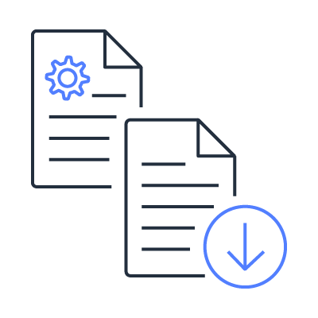


Monitoring capabilities at a glance
Amazon Aurora comes with comprehensive monitoring built-in
Amazon CloudWatch Metrics
Amazon CloudWatch Logs
Enhanced Monitoring
Performance Insights
Monitor core (CPU, memory) and transactional (throughput, latency) metrics
Publishing database logs (errors, audit, and slow queries) to a centralized log store
Additional database-specific metrics at up to 1 second granularity
Query- and wait-level performance data
Notes:
Level 200

Slide 14



What should you monitor in Amazon Aurora?
Do’s
from CloudWatch – core metrics:
CPUUtilization FreeLocalStorage DatabaseConnections
from CloudWatch – engine metrics:
*Throughput *Latency BufferCacheHitRatio AuroraReplicaLag
RollbackSegmentHistoryListLength RowLockTime Deadlocks
from Enhanced Monitoring:
memory.free cpuUtilization.* loadAverageMinute.*
diskIO.avgQueueLen
from Performance Insights – counters:
Innodb_rows* Innodb_row_lock* Created_tmp* Opened_table*
from Performance Insights – waits:
CPU io/aurora_redo_log_flush io/table/sql/handler
synch/mutex/*
Don’ts
Don’t focus on IOPS, Aurora storage IOPS not equivalent to disk IOPS => limited use for perf. monitoring
Avoid synthesizing aggregate network throughput => reference bandwidth is variable except on largest instances
More: https://aws.amazon.com/blogs/apn/key-metrics-for-amazon-aurora/
Notes:
Level 400
Going above and beyond: scheduled capture of innodb engine status and metrics, global status, variables, process list etc via cron

Slide 15
Amazon CloudWatch and Enhanced Monitoring
Amazon CloudWatch Metrics & Alarms
Free metric collection built into the platform
Granularity of 1 minute or higher
(metric specific)
Leading indicators,
configure alarms for abnormal conditions
Amazon RDS Enhanced Monitoring
Collection of metrics at configurable
granularity down to 1 second
Stored in CloudWatch Logs (addl. cost)
More granular and precise metrics
useful for further investigation
Notes:
Level 200

Slide 16
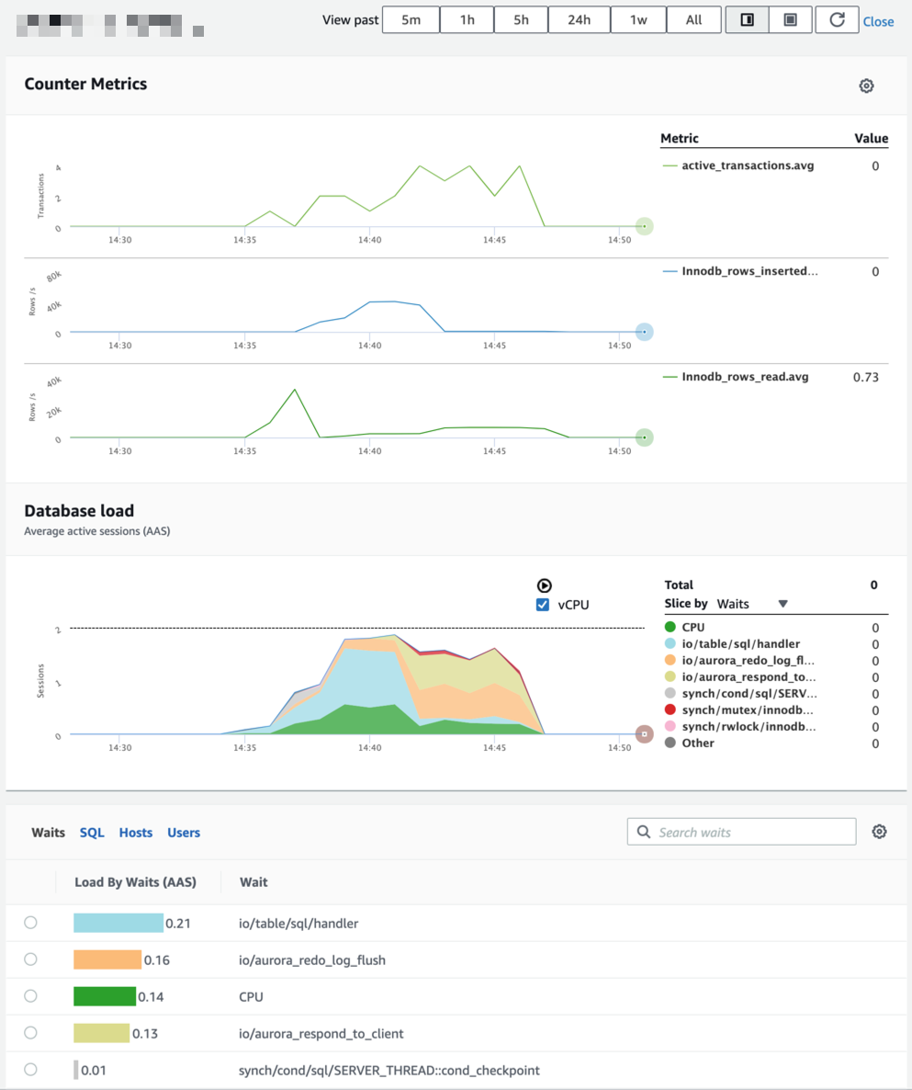
Amazon RDS Performance Insights
Easy and powerful dashboard showing load on your database
Uses Average Active Session (AAS) as a load aggregation method over time
Helps you identify source of bottlenecks: top SQL queries, wait statistics, DB engine counters
Adjustable time frame (hour, day week, month)
7 days of performance data history free – perfect for developers; up to 2 years of long term retention for production use cases
Notes:
Level 300

Slide 17
Using Performance Insights with Aurora MySQL
Enabling Performance Insights (PI):
PI requires enabling MySQL’s performance_schema (p_s)
If p_s not enabled, you see process states from SHOW PROCESSLIST;
p_s has a (usually) small performance impact, so test in pre-prod first
Working with Performance Insights:
Find bottlenecks: correlate engine counters with wait events
Drill down to specific query patterns and individual queries
Most wait events are inherited from MySQL CE, some are Aurora specific
See Aurora documentation for common ones (e.g. io/aurora_redo_log_flush)
More: https://aws.amazon.com/blogs/database/analyze-amazon-aurora-mysql-workloads-with-performance-insights/
Notes:
Level 300

Slide 18
Activity logging
 | Error Log | Slow Query Log | General Log | Audit Log
State: | Enabled by default | Enable using parameter group (dynamic) | Enable using parameter group (dynamic) | Enable using cluster parameter group (dynamic, cluster-wide)
Centralization: | Enable publishing of logs to CloudWatch Logs (separate from enabling the logs) Recommended to persist logs past DB instance replacement (addl. cost)
Contents: | Engine errors and messages | Information about slow statements (incl. runtime) | Information about all statements (incl. runtime) | Audit trail of statements
Performance impact: | Minimal | Usually minimal | Potentially severe due to log access contention | Usually minimal due to purpose build audit feature
Configuration: |  | Long query threshold; Other statements to log |  | Events to capture; Users to include or exclude
More: https://docs.aws.amazon.com/AmazonRDS/latest/AuroraUserGuide/AuroraMySQL.Auditing.html
Notes:
Level 300

Slide 19
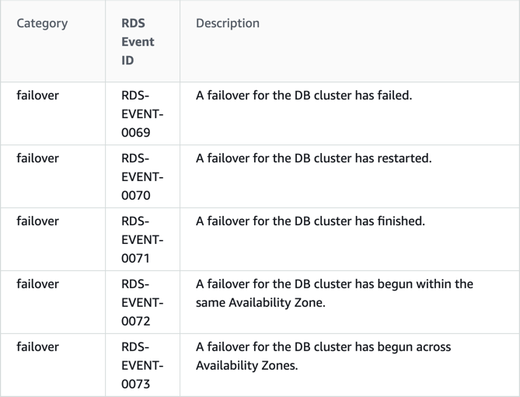
RDS event notifications
Provide notifications when RDS events occur
Built-in API to list events (adhoc delivery)
Leverage an Amazon SNS topic as the delivery target (push delivery)
Create subscription for specific RDS resource types (DB instances, DB clusters, snapshots, parameter groups…) and event categories
Add desired RDS resources to subscription
Near real-time notifications
More: https://docs.aws.amazon.com/AmazonRDS/latest/UserGuide/USER_Events.html
Notes:
Level 200

Slide 20
Scaling capabilities
App/schema design
AWS provides:
Automatic Aurora storage scaling up to 64TB
Capabilities to change compute node sizes
Read-replica auto-scaling capability
Aurora Serverless on-demand compute scaling model
You are responsible for:
Scaling compute nodes in workload efficient manner
Enabling, configuring read-replica auto-scaling
Setting appropriate scaling thresholds for Aurora Serverless
Tuning and config.
Monitoring
Scaling
High availability
Database backups
DB software patches
DB software installs
OS patches
OS installation
Physical hardware
Amazon RDS/Aurora
Notes:
Level 300

Slide 21
Automatically scalable storage
Storage volume size up to 64TiB – auto-incremented in 10GiB units
Storage scaling has no performance impact
Storage volume size does not shrink when the logical data set decreases
Available space is subsequently reused, if feasible
Physical volume topology does not change as a result of cloning or backup and restore operations
up to 64 TiB
Notes:
Level 300

Slide 22
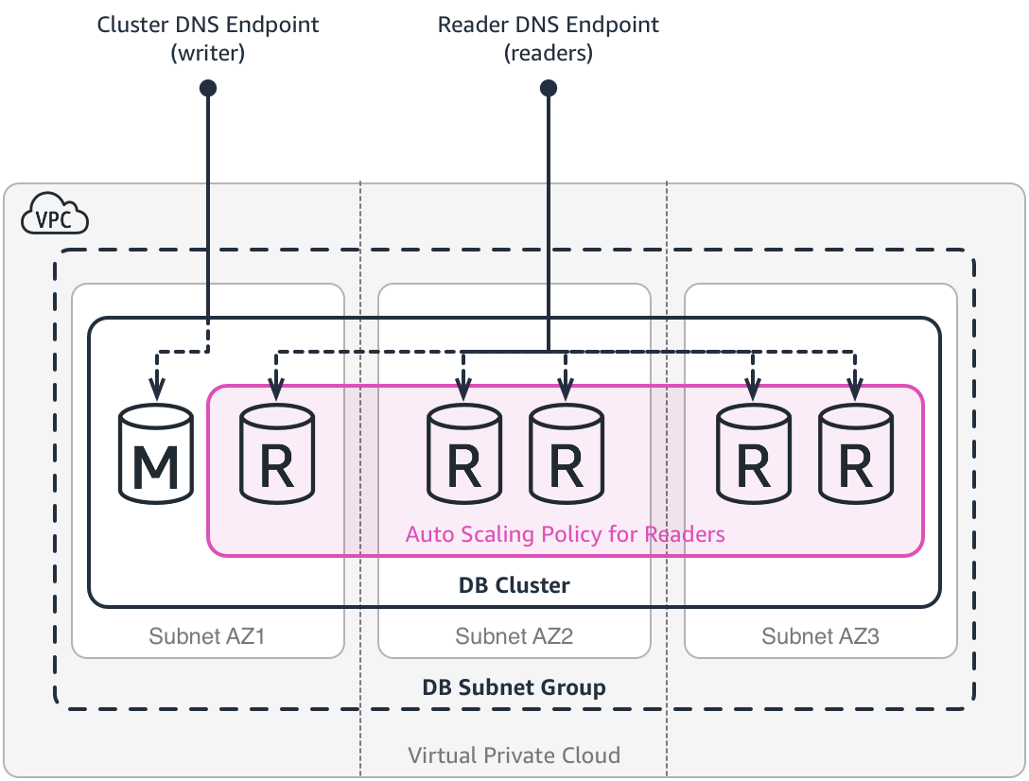
Aurora provisioned DB clusters: read replica auto scaling (in/out)
Automatically add or remove readers based on workload demand
Leverages an AWS Application Auto Scaling target tracking policy
Concepts:
Scalable Target (DB Cluster, Min/Max Readers)
Scaling Policy (Target, Metric, Value, Cooldown)
Scaling Metric (Avg. CPU Utilization or Avg. DB Connections)
Using Auto Scaling:
Same DB instance class as writer
Some configuration differences apply
Only removes readers it added
Readers get assigned the lowest priority failover tier (15)
Readers are created outside CloudFormation stack resources
Use case pattern: treat all readers the same
Notes:
Level 300

Slide 23
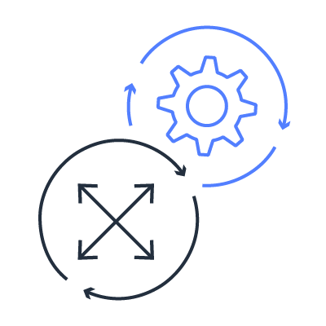
Aurora provisioned DB clusters: scaling compute nodes
Not seamless!
Changing DB instance class requires DB instance replacement
Reduce disruption using manual failover: add or change reader, adjust failover tier, failover manually to it
Manual failover reboots all readers
Notes:
Level 300

Slide 24
Amazon Aurora Serverless
What it is:
DB clusters with automatically scalable compute (up/down)
Fit for purpose:
Development and test databases:
Cost savings when DBs are not in use
Simplify dev/test pipelines
Multi-tenant apps with single tenant data stores
Cost savings due to automated capacity management
Applications with variable or infrequent load - peaks of activity that are hard to predict (e.g., news site)
Automated scaling in a short time duration
Cost savings due to variability
Notes:
Level 200

Slide 25
Aurora Serverless architecture
Application talks to engine compatible endpoint
Fleet of routers manage queue, client connections and route DB traffic
Single tenant DB Instance handles database operations
Data kept durable and highly available on Aurora storage volume
When scaling thresholds are reached we scale the instance substituting with capacity from warm pool
Scaling operations are transparent to applications
You configure min. and max. capacity, whether and when to pause DB if there’s no activity
Application
Request routers
Scalable DB capacity
Warm pool of instances
DB storage
Notes:
Level 300

Slide 26
Using Aurora Serverless in practice
HA considerations:
Equivalent of single node provisioned DB cluster
Compute failure recovery time undefined (best case: substitute from warm pool)
Scaling considerations:
Scaling point: point in time between 2 transactions to substitute compute node
Timeout action (force scaling/cancel scaling) vs. long running transactions
Connections are kept open (unless active when forced) during scaling => 3-5 sec response lag
Other considerations:
Lack of CDC support, custom parameters, feature parity, patching model
Notes:
Level 400

Slide 27
Aurora Serverless: scale up and down with load
TPS
ACU
Scales down more gradually
Scales up quickly as load increases
Notes:
Level 300

Slide 28
Amazon RDS Data API
REST API endpoint
Millions of IOT/ mobile devices
Data API fleet
Amazon Aurora Serverless
Serverless apps often have restrictions
Limited network connectivity to the DB
No persistent connection to the DB
Small client (e.g., IoT) with limited resources
RDS Data API provides:
Public endpoint accessible via HTTP
Access without any client configuration
Notes:
Level 300
Public HTTP API endpoint, integrated with AWS Authentication
Automated server side connection pooling
Ideal for AWS Lambda or serverless apps reusing connections across multiple invocations
Fully Integrated with AWS Secrets Manager and AWS AppSync
Optional session construct for efficient prepared statement executions
Interactive Query Editor in the console for ad-hoc queries
Available for Aurora Serverless DB clusters

Slide 29
Database backups
App/schema design
AWS provides:
Continuous automated backups
Automated snapshots during backup retention period
Ability to take manual snapshots
Ability to copy snapshots (e.g. to other regions)
Ability to share snapshots with other accounts
Fast database cloning
You are responsible for:
Setting appropriate BC/DR plan
Configuring backups to meet RPO/RTO requirements
Leveraging the right features for the use case
Protecting access to backups
Tuning and config.
Monitoring
Scaling
High availability
Database backups
DB software patches
DB software installs
OS patches
OS installation
Physical hardware
Amazon RDS/Aurora
Notes:
Level 300

Slide 30
Fast database cloning
Create a copy of a DB cluster (storage volume) without duplicate storage cost
Creation is fast – we don’t physically copy data
Source Database
Cloned Database
Page 1 | Page 2 | Page 3 | Page 4
Page 1 | Page 2 | Page 3 | Page 4
Page 1 | Page 2
Page 3 | Page 4
State: Created a clone, made no storage changes
Both databases reference same pages on the shared distributed storage system
Notes:
Level 300

Slide 31
Fast database cloning (continued)
Isolation: Activity on the clone doesn’t impact performance of the source (and vice-versa)
Source Database
Cloned Database
Page 1 | Page 2 | Page 3 | Page 4
Page 1 | Page 2 | Page 3 | Page 4 | Page 5
Page 1 | Page 2 | Page3 | Page 4
Page 3 | Page 4 | Page5
State: Created a clone, made storage changes on both source & clone
Both databases reference common pages on the shared distributed storage system
Notes:
Level 300

Slide 32
Using fast database clones
Benchmarks
Use cases:
Test changes in pre-prod on relevant data sets
Reorganize a DB with minimal impact (clone + CDC)
Save a point in time snapshot for reporting/analytics with no impact on prod/OLTP
Failback for maintenance activities
Using clones:
Up to 15 clones from same source
2 step process: clone cluster + add instances (optional)
Clone starts with same DB engine version as source
Clone across AWS accounts with resource sharing
Dev/test
applications
Clone
Clone
Clone
Production
applications
Production
applications
Production database
Notes:
Level 300

Slide 33
Patching and DB engine updates
App/schema design
AWS provides:
Regular DB engine updates
LTS versions of the DB engine
Automated engine update workflow
Zero Downtime Patching (ZDP) capability
Maintenance window customization
You are responsible for:
Keep DB engine up-to-date
Monitoring for PHD or email based notification for forced patches or other out-of-band maintenance
Tuning and config.
Monitoring
Scaling
High availability
Database backups
DB software patches
DB software installs
OS patches
OS installation
Physical hardware
Amazon RDS/Aurora
Notes:
Level 300

Slide 34
Aurora DB engine versions
AWS releases engine updates regularly, multiple times per year
Certain engine versions are designated as “long-term supported” (LTS) for min. 1 year
Version Numbering Convention:
1.[Version].[Patch Level] – for 5.6 compatible
2.[Version].[Patch Level] – for 5.7 compatible
Version numbering does not follow MySQL CE, the reported MySQL version is static: 5.6.10a and 5.7.12
What is included in a new DB engine update?
New Aurora features (typically in a new version)
Features ported from MySQL CE
Fixes (general, security, stability, …)
Integration of bug fixes from MySQL CE
For LTS, patch levels do not include new features, only important fixes
Which support model should I use?
Use the latest release – recommended for most use cases
Use LTS when qualification/testing is time-consuming and you need to reduce patch frequency
More, incl. current LTS versions: https://docs.aws.amazon.com/AmazonRDS/latest/AuroraUserGuide/AuroraMySQL.Updates.html
Notes:
Level 300

Slide 35

Performing DB engine updates
Update DB engine, when a new release becomes available (recommended)
When an old version is no longer supported, an engine update is required
Required updates are scheduled automatically during a maintenance window
Required LTS releases get updated to next LTS patch level
Engine updates are applied to all DB instances in the cluster at the same time
Cannot undo/rollback engine update natively (use clone + binlog)
Zero Downtime Patching (ZDP) available for the writer only, subject to limitations (long running trx, binlog, TLS connections, locks, DDL)
Test engine update process in a representative pre-prod environment (use a clone)
Patch disruption duration similar to failover disruption
More, incl. current LTS versions: https://docs.aws.amazon.com/AmazonRDS/latest/AuroraUserGuide/AuroraMySQL.Updates.html
Notes:
Level 400

Slide 36

Zero Downtime Patching (ZDP)
Net state
App state
Old DB
Engine
Before ZDP
Net state
App state
New DB
Engine
User sessions terminate during patching
Storage Service
Old DB
Engine
With ZDP
Networking
state
Application
state
User sessions remain active through patching
New DB
Engine
Storage Service
Notes:
Level 400

Slide 37
Hands-on with Amazon Aurora (MySQL)
Suggested hands-on labs:
Prerequisites (20min, if not completed already, let CloudFormation provision the DB cluster)
Clone a DB Cluster (15 min)
Use Performance Insights (15 min)
Create an Aurora Serverless DB Cluster (10 min)
Use Aurora Serverless with AWS Lambda Functions (10 min)
Hands-on labs will exercise the following:
Deployment automation via CloudFormation (if not completed already)
Creating a clone DB cluster and verifying data divergence upon changes
Performing a load test and interpreting the Performance Insights metrics
Creating a Serverless DB cluster and accessing it via the RDS Data API from a Lambda function
Notes:
Level 300

