Slide 1
Deadlocks in Operating Systems
By Sameer Gupta, Issac Helms, David Grant, Anthony Hernandez

Slide 2
About Deadlocks

Slide 3
What is a Deadlock?
A deadlock occurs when a process needs EXCLUSIVE access to multiple resources. When multiple processed are blocked and in standstill, the situation is a deadlock.

Slide 4
Conditions for Deadlock to occur
Mutual Exclusion
Non Preemptive resource allocation
Hold and Wait
Cyclic Wait

Slide 5
First Type of Deadlocks
Resource Deadlock
A problem from competition synchronization and occurs when multiple processes are trying to get exclusive access to the same resources

Slide 6
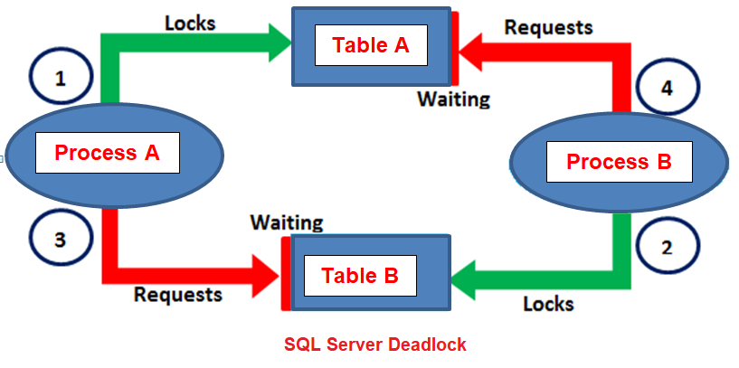
Example (1) of Resource Deadlocks
Two Process and Two Tables
Here Process A aquires Table A and Process B acquires Table B
The problem arises due to Process A also needing access to Table B while Process B also needs access to Table A
This causes a deadlock due to both processes needing access to both tables at the same time.
Notes:
Here is a basic example of a dead lock

Slide 7
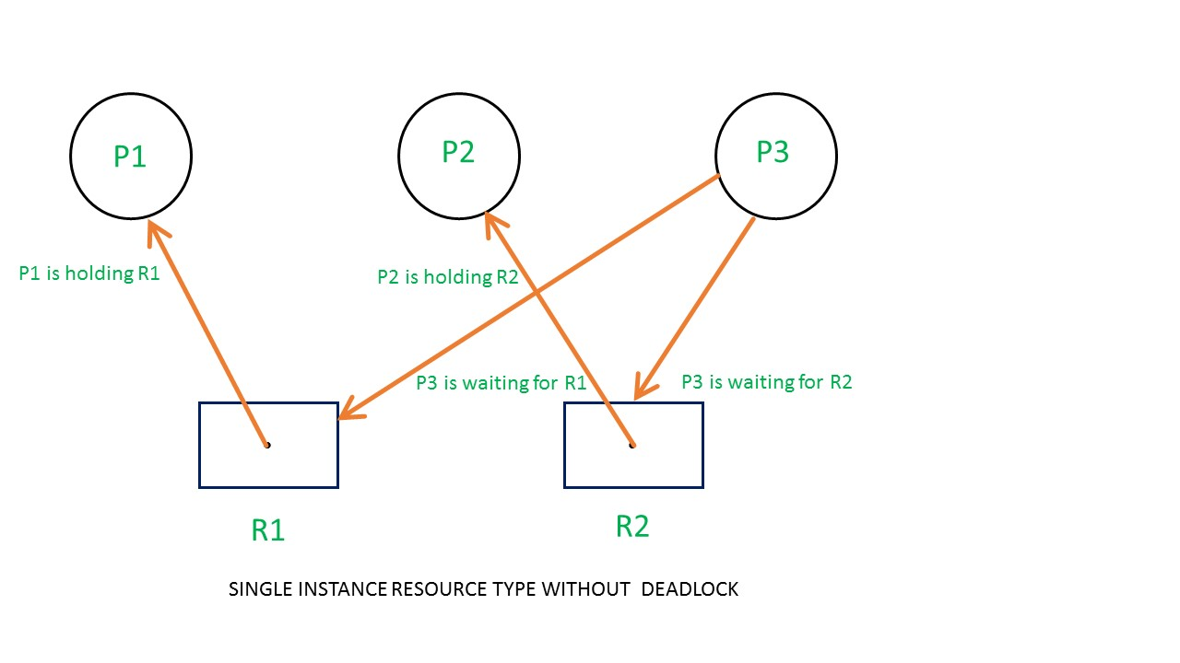
Example (2) of Resource Deadlocks
Process 1 holds Resource 1
Process 2 holds Resource 2
Process 3 waits to acquire both Resource 1 and 2
A deadlock does NOT occur here because there are no circular dependencies
Circular Dependencies: Each process heading in the same direction towards opposite resources
Notes:
Here a third process is added and a deadlock does not occur

Slide 8
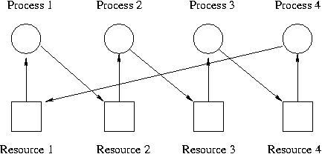
Example (3) of Resource Deadlocks
Same concept with more processes
Each process controls one resource
Each process waits for the next resource to become available
No resource will be available as they will all be waiting for each other
Notes:
More processes and resources

Slide 9
Second Type of Deadlocks
Communication Deadlock
Communication Deadlocks are a type of distributed deadlock and occurs when multiple processes are trying to send messages to each other

Slide 10
Example (1) of a Communication Deadlock
B replies but message is lost
A sends a message request to process B
B Replies to A, but the reply is lost
A never gets B’s message so A is blocked
B gets blocked waiting for A to send a task
A
A sends request message
B

Slide 11
Example (2) of a Communication Deadlock
B replies but message is lost
A sends request message
A sends a message request to process B
A sends a message request to process C
B Replies to A, but the reply is lost
C Replies to A and A sends a task to C
A never gets B’s message so A is blocked
B gets blocked waiting for A to send a task
C proceeds as normal
A
C
A sends request message
B
C replies and A can send the task to C

Slide 12
Solving Deadlocks

Slide 13
Different ways to resolve deadlocks
Preemption
Rollback
Killing Processes

Slide 14
Recovery Through Preemption
Recovery through Preemption involves taking a resource away from the current owner and giving it to another owner.
Ex. Taking paper out of a printer while printing to stop the current job and cancel. Then putting paper back in for the next job.

Slide 15
Recovery through Rollback
Recovery through Rollback involves, periodically checkpoint a process when a deadlock is thought to potentially occur. This saves a current image of what has already been run so in the event of a deadlock, the process that owns a needed resource can rollback to a previous checkpoint before it acquired that resource to reevaluate the potential deadlock.

Slide 16
Recovery through Killing Processes
Recovery through Killing a process involves physically stopping the processing form running in the hope it will allow the next process to begin running.

Slide 17
Sempahores

Slide 18
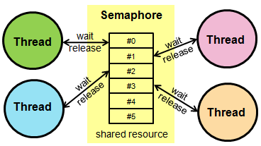
What is a Semaphore?
Semaphores are a variable used for counting the number of wakeups and is saved for a future use.

Slide 19
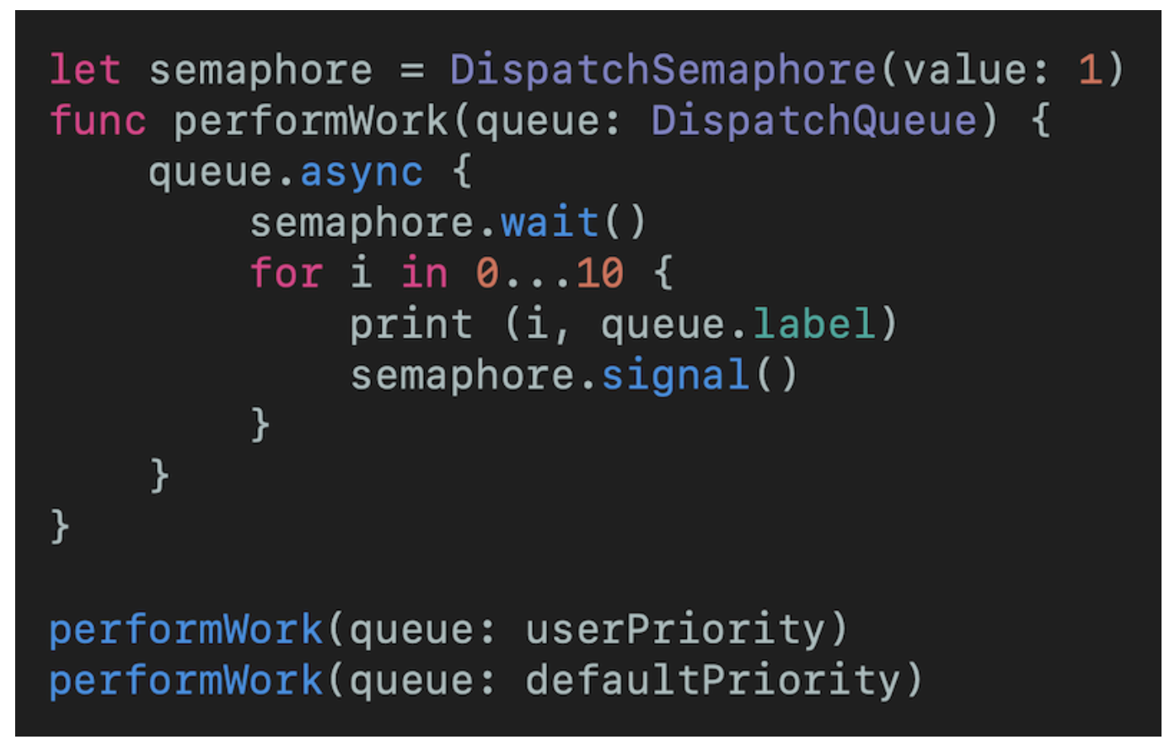
How can Semaphores help prevent deadlocks?
Semaphores can help prevent deadlocks by limiting the amount of work that can concurrently occur at any time. Using a counter and incrementing and decrementing as necessary, deadlocks can be detected and taken action upon.

Slide 20
How to Detect a Deadlock

Slide 21
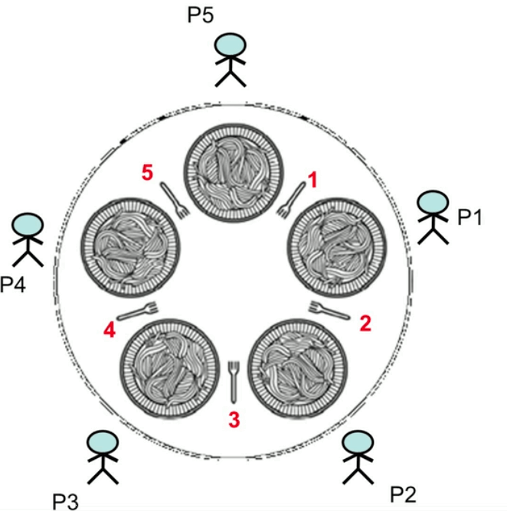
Deadlock Detection
Deadlock detection is the process of determining whether a deadlock exists and identifying the process and resources involved in resolving the deadlock.

Slide 22
Determining whether system is deadlocked or not
To determine whether a system is deadlocked or not is to check allocation against resource availability for all allocation abilities to determine if the system is in a deadlocked state. Action is taken based on this determination.

Slide 23
Identifying if machine is in Deadlock
There are a few signs a computer will show if it is experiencing a deadlock:
Frozen Computer
Blue screen of death
Infinite loop of running program

Slide 24
What to do once deadlock has been detected
Once a deadlock has been detected, it must be solved using a method which was pre discussed in this presentation.
Preemption
Rollback
Killing Processes

Slide 25
The Dining Philosophers Problem

Slide 26
Deadlock in Dining Philosophy
The five philosophers sitting around a table can only use the fork on their immediate left or right. The philosophers never speak to each other, which creates a dangerous possibility of a deadlock. This deadlock has the possibility to occur if every philosopher holds a left fork and waits perpetually for a right chopstick.

Slide 27
Problem with a Deadlock in Dining Philosophers
The problem occurs when all philosophers pick up the same fork making it so that no philosopher has two forks and therefore cannot eat. In the image it is clear that if all philosophers pick up the same fork on either their right or left then no one will have two forks and they will eventually starve. The technical term for their starvation is a deadlock.

Slide 28
Solution for Deadlock in Dining Philosophers
In order to prevent a Deadlock it must be ensured that one philosopher picks up the left fork before the right. Then all other philosophers will need to pick up the right fork as the first Philosopher fork before the left fork which avoids the deadlock condition. If even one philosopher picks up the wrong fork then a deadlock occurs.
In order to avoid a deadlock in the image if P1 picks up fork 2 then all the other Ps must pick up the fork to their right. This way P1 has two forks and can eat. When he finishes then there will be another two forks available so on and so forth until all have eaten.

Slide 29
Deadlocks: Conclusion

Slide 30
Summary
In conclusion, it is mandatory that when two or more processes are waiting on the same asset that there is a deadlock detection algorithm to break the ensuing deadlock. If no algorithm exists deadlocks can severely hurt an applications performance and ultimately users will undergo a poor experience. For developers the threat of deadlocks must always be considered and proper code must always be implemented to avoid them.

