Slide 1

A Brief Introduction into Python
Week 2 of 3

Slide 2

Recap from last week
Different data types in Python
How store data in variables
How to index ordered/unordered data
How to create and manipulate numpy array
Mathematical Numpy Functions
How to create a plot/subplots with Matplotlib

Slide 3
Overview for week 2
Pandas and Data Frames
Reading/Writing Data Files & NumPy Logical Operators
Looping
While Loops
For Loops
If, elif, & else statements

Slide 4


Open-sourced library for data analysis and manipulation tool for Python
Commonly used for Data Visualization
Able to import data from csv, excel, text files, HDF5, and SQL data bases
Introduces a new type of ordered data type known as the DataFrame
import pandas as pd

Slide 5
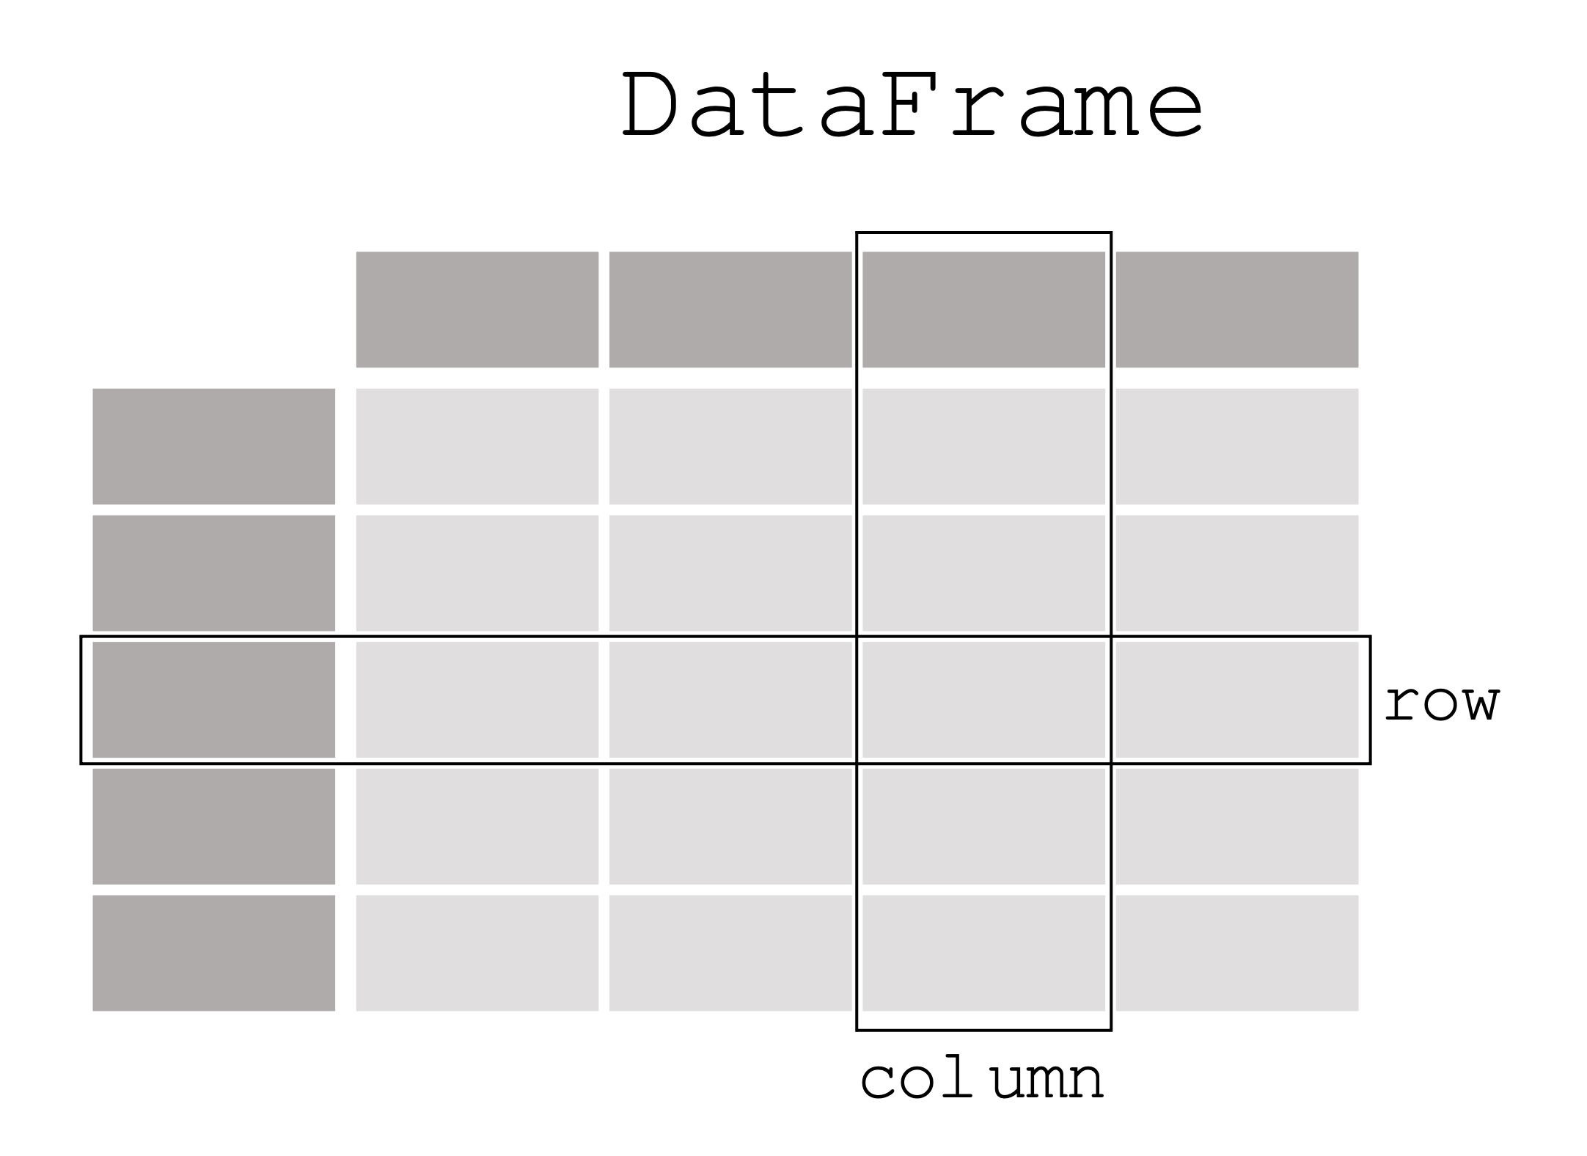
DataFrame
What is a DataFrame? A DataFrame is a two-dimensional comprised of rows and columns
DataFrames can be made from a dictionary of numpy arrays, lists, other dicts, or DataSeries
Series : is a one- dimensional organized array from pandas

Slide 6
DataFrame Manipulation
With a DataFrame you can

Slide 7
let’s try opening a csv into a dataframe

Slide 8
Looping in Python

