Slide 1
Modeling 911 Calls as a Poisson Process
Daniel Garcia

Slide 2
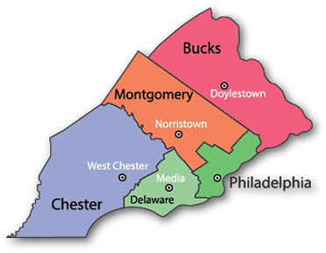
Description
This project models 911 calls in specific towns in the county of Montgomery, Pennsylvania as a Homogeneous and Non-homogeneous Poisson process.
We compare two different towns in Montgomery County to see the difference in emergencies per town.
We will also compare wait times of calls when modeled as a homogenous Poisson process.

Slide 3
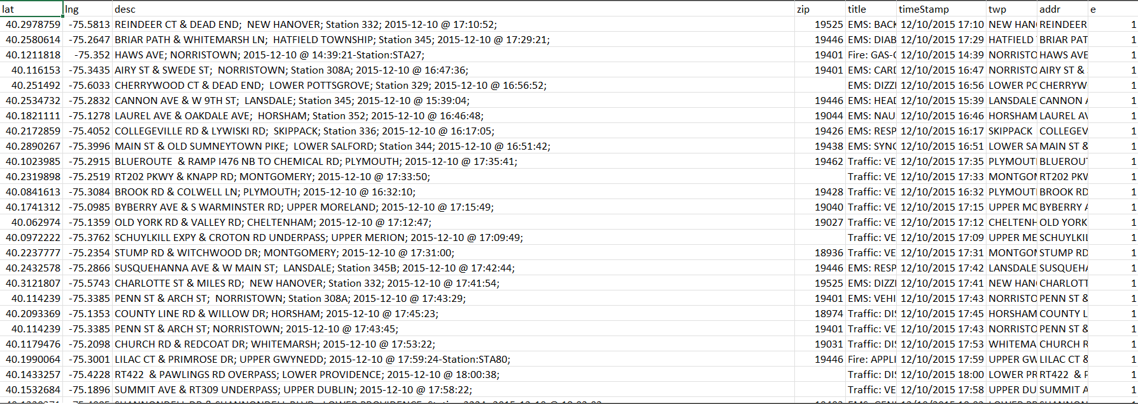
Data
Data was gathered from Kaggle, https://www.kaggle.com/datasets/mchirico/montcoalert
Original dataset: 663,522 observations spanning from 12/10/2015 to 7/29/2020.
I specifically focus on two towns—Lower Merion and East Greenville—since they have some of the highest and lowest 911 calls of all towns, respectively.
Dataset only including Lower Merion: 55,490 observations.
Dataset only including East Greenville: 1,316 observations.

Slide 4
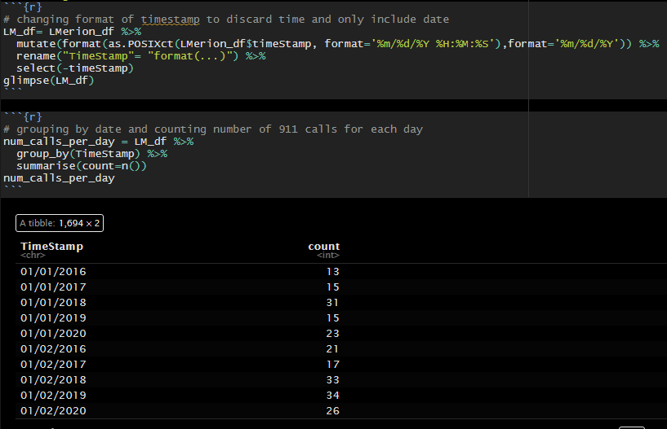
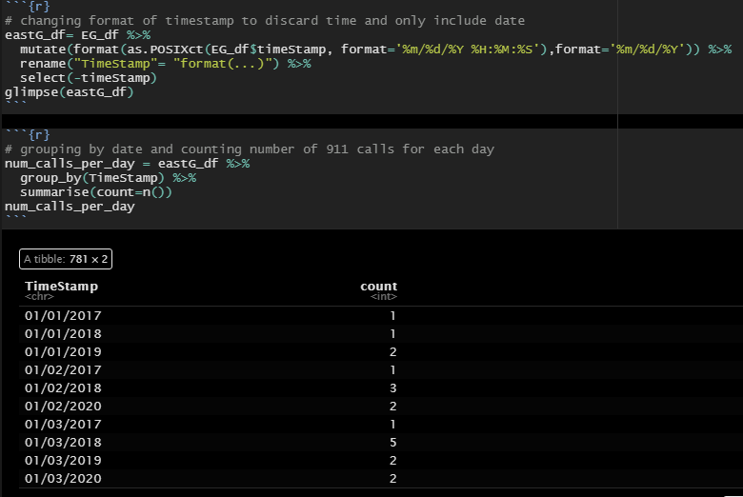
Cleaning the Data
Count of number of calls in Lower Merion by day
Count of number of calls in E. Greenville by day

Slide 5
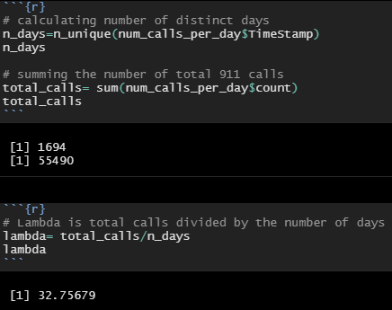
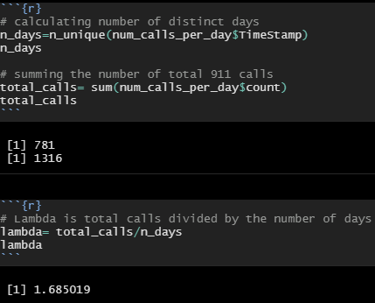
Lambda For Homogeneous Poisson
Lambda for Lower Merion
Lambda for E. Greeenville

Slide 6
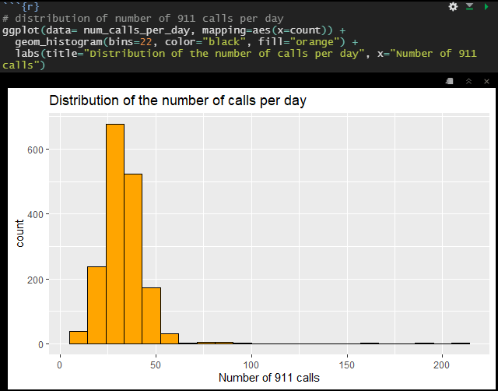
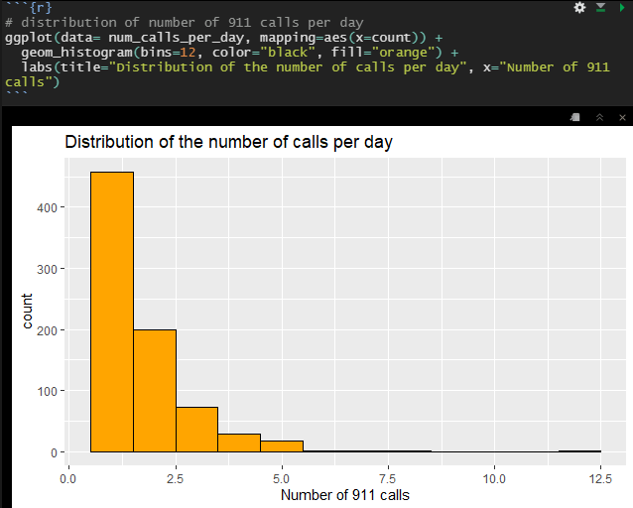
Histogram of Distribution
Histogram of calls in Lower Merion
Histogram of calls in E. Greenville

Slide 7
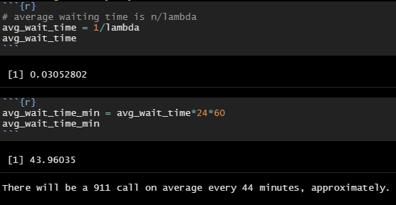
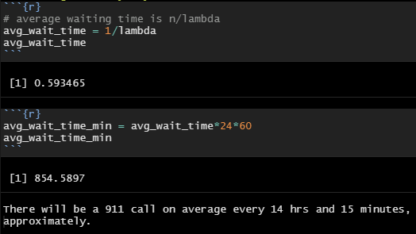
Wait Times
Lower Merion Waiting Time
E. Greenville Waiting Time

Slide 8
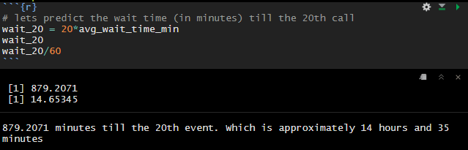
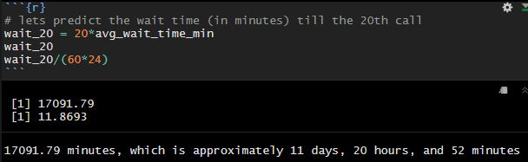
Wait Time till 20th call
Lower Merion
E. Greenville

Slide 9

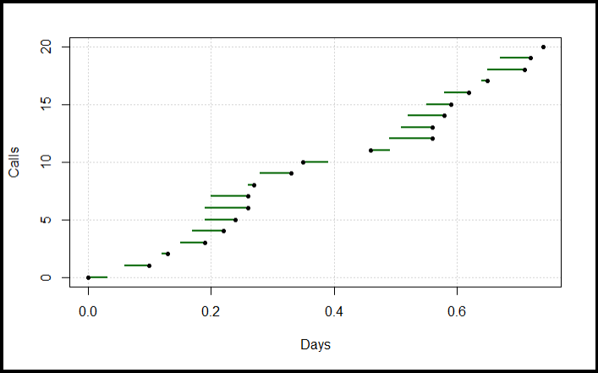
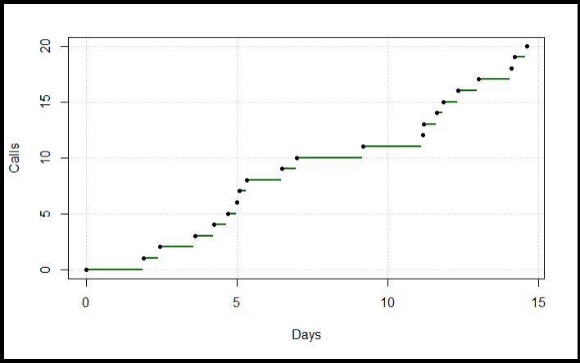
Simulating Wait time till 20th call
Simulation for Lower Merion
Simulation for E. Greenville

Slide 10
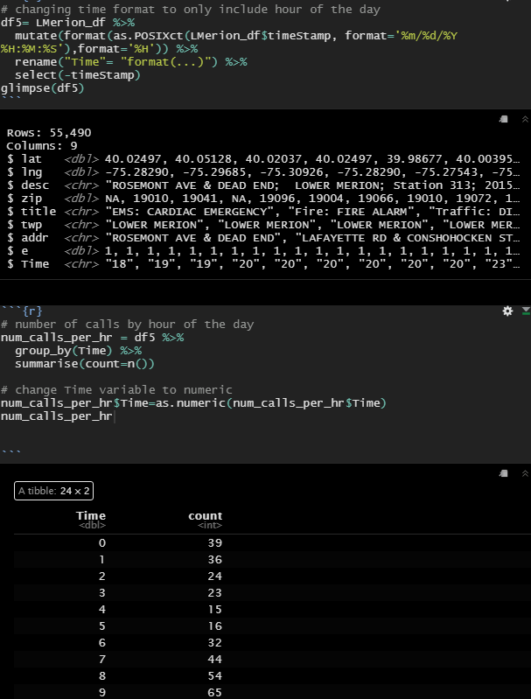
Non-Homogeneous Poisson Process
Split the data to only consider occurrences by the hour of the day
Next, I group the data by hour of the day and count the number of calls by such
This gives me the total calls in Lower Merion by hour of the day where 0 is 12AM and 23 is 11PM

Slide 11
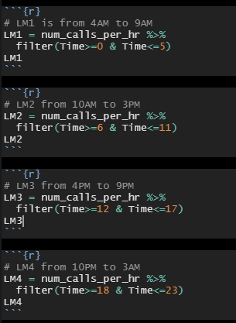
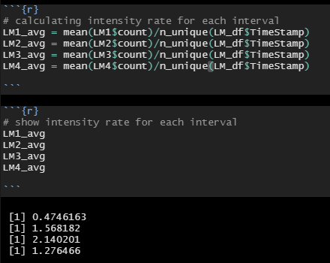
Non-Homogeneous Poisson Process
We divide the hours of the day into 4 equal intervals. Then calculate the average rate per interval, which is our intensity rate function
12 AM to 5 AM
6 AM to 11 AM
12 PM to 5 PM
6 PM to 11 PM
Number of days: 1694 days

Slide 12
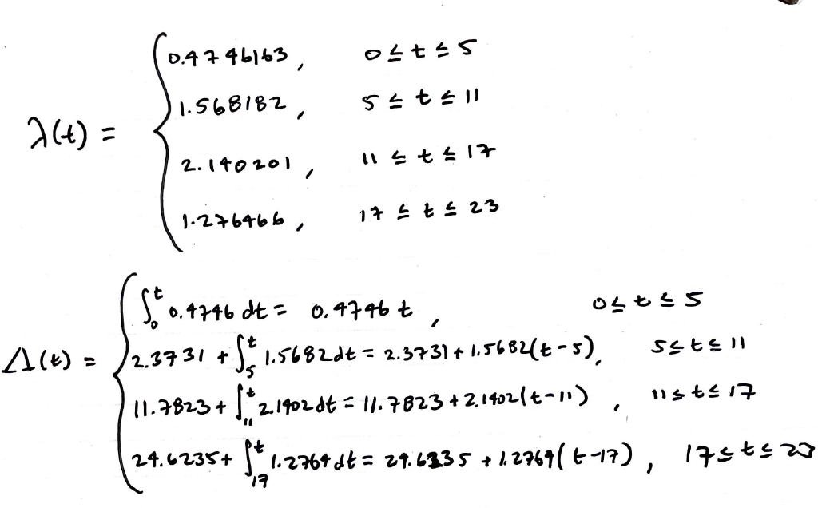
Intensity rate function and Integrated Rate Function

Slide 13
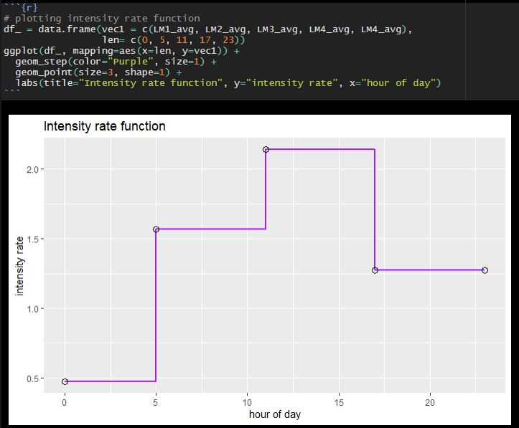
Graph of Intensity rate Function

Slide 14
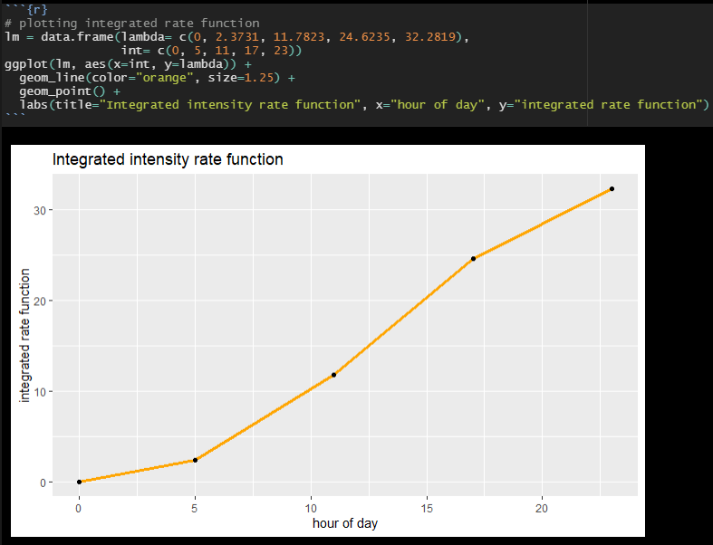
Graph of Integrated Intensity Rate Function

Slide 15
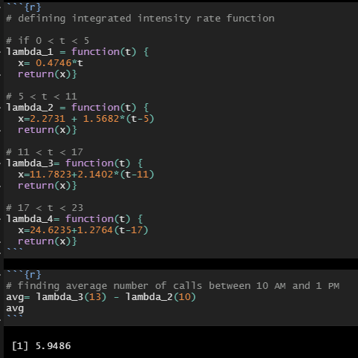
Average 911 Calls
Expected number of calls within 10 AM and 1 PM
First, we define 4 functions to represent the integrated intensity rate function
Next, we calculate the difference, given time.
Expected number of calls between 10 AM and 1 PM on any given day is approximately 6

Slide 16
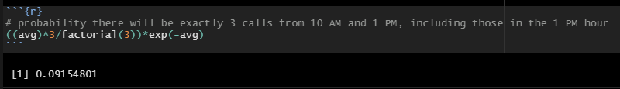

Probability
Finding the probability that there will be exactly 3 calls from 10 AM 2 PM
Using the same integrated intensity function, but using the probability mass function for a non-homogeneous Poisson process

Slide 17
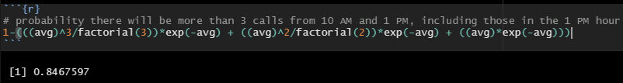
Probability
Probability there will be more than 3 calls between 10 AM and 1 PM
Equal to the complement of the sum of probabilities that there will be 1, 2, or 3 calls
84.68% chance there will be more than 3 calls between 10 AM and 1 PM on any given day

Slide 18
Conclusions/Future Work
Emergencies in Lower Merion far exceed that of east Greenville
11 am to 5 pm showed the highest rate of 911 calls in lower Merion
this data can be used to accordingly staff 911 operators and first responders based off of expected calls per time segment.
I hope to expand on this work to include more towns and model based off of specific types of emergencies using text mining techniques.

Slide 19
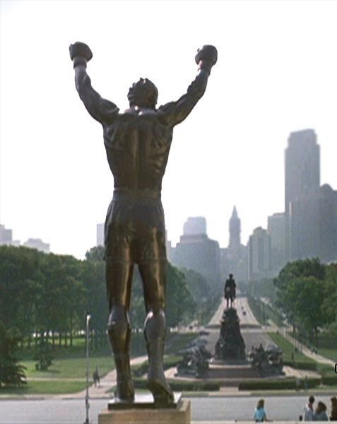
Thank you, Dr. Olga and 482 classmates

