Slide 1
DWDM project part II
An implementation of K-Means and DBSCAN algorithms
Daniel Hanspeter
Daniel Graziotin
Thomas Schievenin

Slide 2
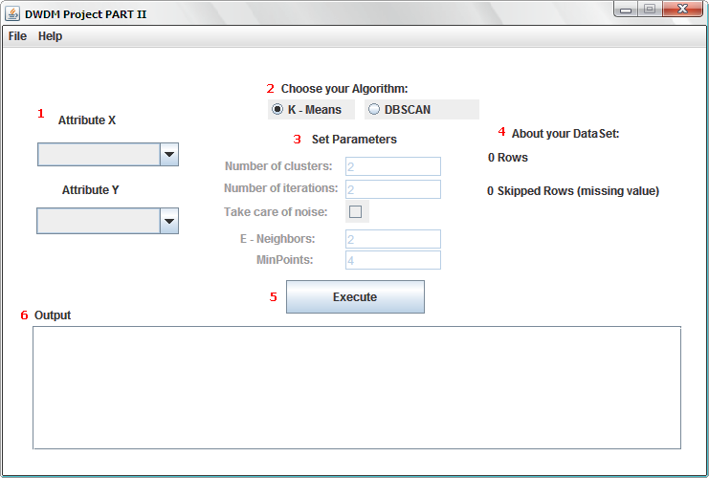
Description of the work
Java Graphical
Simplicity
Modularity
Single window
Selection
Algorithm
Attribute
Parameters
Info
Output

Slide 3
Description of the work
K-Means
# Clusters
# Iterations
Noise care
DBSCAN
# E-neighbors
# MinPoints

Slide 4
Problems encountered
Datasets loaded entirely in memory
Actual PC Ram is enough
Modularization, extendibility
Software Engineering approaches
Noise removal for K-Means
Adaption of specific solution for Optical Data
Missing values
Ignore or refuse
Nominal data
Transform into ordinal

Slide 5
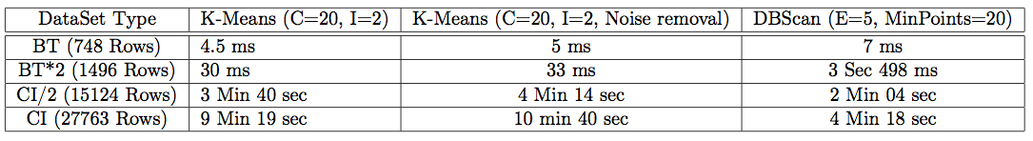
Lessons learned
Loading non-trivial amount of data
Data interpretation, not manipulation
DBSCAN > K-Means
Automated Cluster Size
Automated Noise Care
Performance

