Slide 1
Pomotux
Team 8
Riccardo Buttarelli
Daniel Graziotin
Massimiliano Pergher

Slide 2
Summary
Mission Statement
The Pomodoro Technique
Use Cases
Technologies Involved
Activity Facing
Problems Encountered
Conclusions

Slide 3
Mission Statement
Implementation of an activity manager using the Pomodoro Technique by Francesco Cirillo
Focus on basic features of the technique.
Statistics and Multi-User

Slide 4

The Pomodoro Technique
A time management method that can be used for any kind of task.
Anxiety triggered by deadlines, time seen as enemy
Turn time as a valuable ally, improve efficiency and productivity
http://www.pomodorotechnique.com/

Slide 5
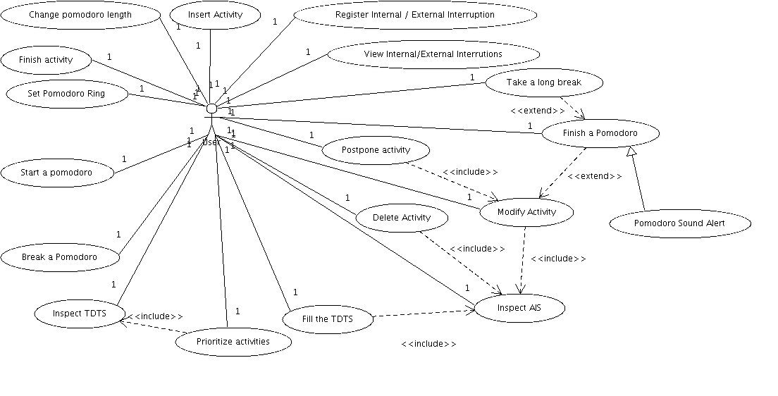
Use Cases

Slide 6
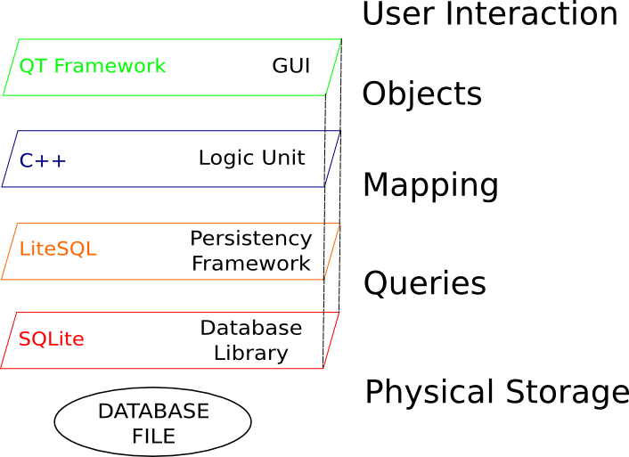
Technologies Involved

Slide 7
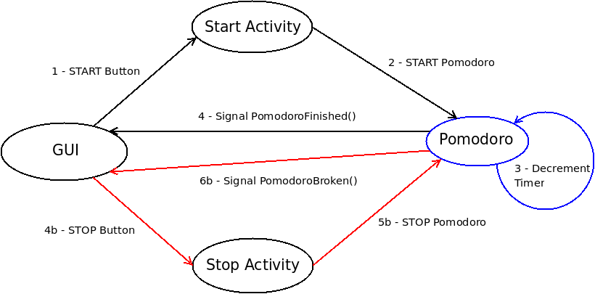
Activity Facing
Go to: Detailed Sequence Diagram

Slide 8
Problems Encountered
LiteSQL immaturity => Unstable and Buggy
Lack of Documentation => Wrong implementation strategy
Unit-Testing (CXXTEST) discovered a bug in the retrieval of dates from the database.
Bug fix set for next LiteSQL version.
However, the community of LiteSQL wrote for us a patch for fixing the bug in 0.3.3

Slide 9
Conclusions
Must have: 16/16, Ought to Have: 5/5, Nice to Have: 2/3
Unit Testing works
Fruitful use of Frameworks
Collaboration with external opensource community
Huge Knowledge Expansion
Scrum Method Appreciated

Slide 10
End of Presentation
Thank you very much for your attention
Questions?
More information and diagrams follow

Slide 11
More Information
Logic Unit Class Diagram
E/R Diagram of the Database Structure
Sequence Diagram of ”Facing an Activity”
LiteSQL details

Slide 12
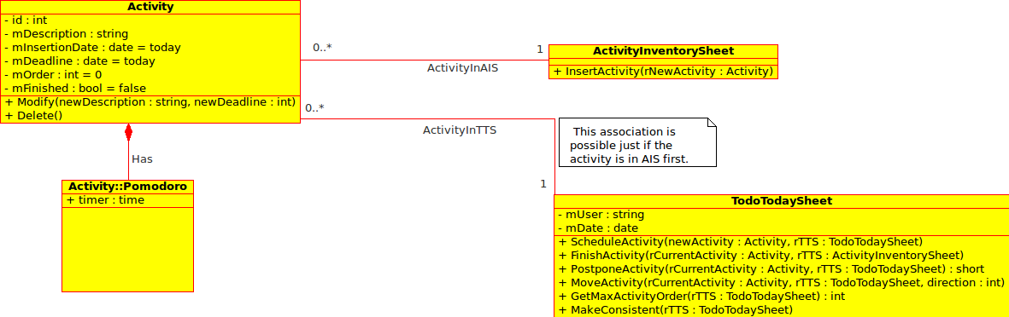
Logic Unit Class Diagram

Slide 13
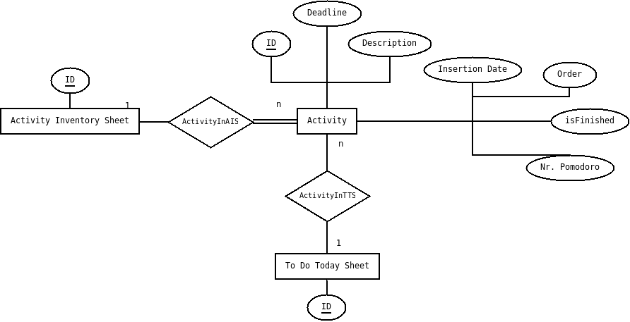
E/R Diagram: Database Structure

Slide 14
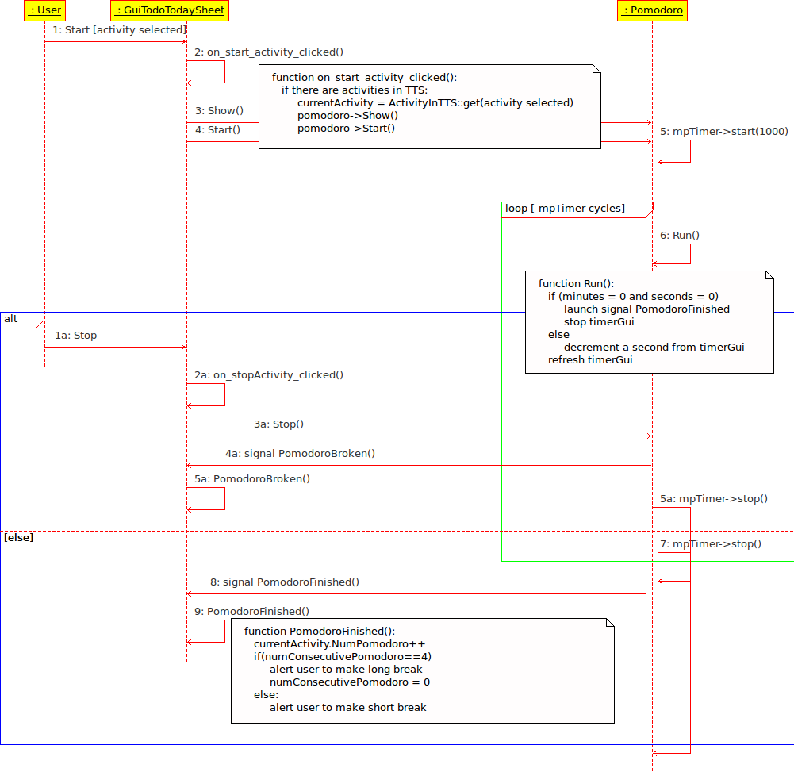
Sequence Diagram – Activity Facing
Go to:
Simplified Diagram

Slide 15
LiteSQL details
Entity/Relation Definition Phase
Code Generation Phase
Implementation Phase
http://apps.sourceforge.net/trac/litesql/

Slide 16
Entity/Relation Definition Phase
<?xml version="1.0"?>
<!DOCTYPE database SYSTEM "litesql.dtd">
<database name="PomotuxDatabase" namespace="pomotuxdatabase">
<!-- maps Activity objects into database -->
<object name="Activity">
<field name="mDescription" type="string"></field>
<field name="mInsertionDate" type="date"></field>
<field name="mDeadLine" type="date"></field>
<field name="mNumPomodoro" type="integer" default="0"></field>
<field name="mIsFinished" type="boolean" default="true"></field>
</object>
<!-- maps Activity Inventory Sheet objects into database -->
<object name="ActivityInventorySheet"></object>
<!-- creates a many-to-one relationship between Activity and AIS -->
<relation name="InsertActivity">
<relate object="Activity" limit="many"></relate>
<relate object="ActivityInventorySheet" limit="one"></relate>
</relation>
</database>

Slide 17
Code Generation Phase
Utility litesql-gen parses pomotuxdatabase.xml file and generates:
pomotuxdatabase.hpp - Class declarations for persistent objects and relations
pomotuxdatabase.cpp - implementation of methods and lots of static data.
One table for each class
One table for each class - relation

Slide 18
Implementation Phase
Creation/Maintenance of the database
PomotuxDatabase db("sqlite3", "database=pomotux.db");
// create tables, sequences and indexes
if(db.needsUpgrade())
db.upgrade();
Creation of Activity/ActivityInventorySheet objects
// creation of one Activity Inventory Sheet
ActivityInventorySheet ais(db);
// make it persistent
ais.update();
Creation of one Activity
Activity at(db);
at.mDescription = "A dummy Activity";
time_t today = time (NULL);
at.mInsertionDate = (int) today;
at.mDeadLine = today;
at.mIsFinished = true;
at.mNumPomodoro = 0;
at.update();
Perform relations between objects
// activity linked in AIS
InsertActivity::link(db,at,ais);

