Slide 1


Free University of Bolzano/Bozen
Dycapo: On the creation of an open-source Server
and a Protocol for Dynamic Carpooling
Daniel Graziotin
08 October 2010
Notes:
Good afternoon ladies and gentlemen. Welcome to my presentation. I know that it is late afternoon and some of you are working from this morning. So thank you for coming here to listen.
Today I will present about a Dynamic Carpooling project that I am working on as thesis project. My name is Daniel Graziotin, currently under internship for FBK, in the Social Networking research group.
With the information contained in my presentation you will have the chance to learn something about a very hot topic in Computer Science and Sociology, as well as the change to join this experience.
Due to time constraint I would please you to keep your questions up to the end of my presentation. Thank you

Slide 2
Content
Dynamic Carpooling
Dycapo Project
Conclusions

Slide 3
1. Dynamic Carpooling
Definition
“A system that facilitates the ability of drivers and passengers to make one-time ride matches close to their departure time, with sufficient convenience and flexibility to be used on a daily basis"
Kirshner, D. - http://dynamicridesharing.org

Slide 4
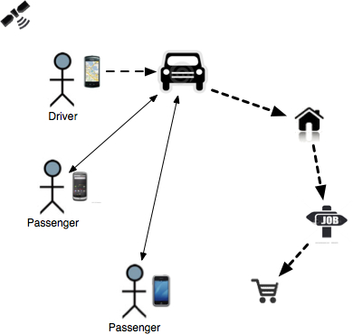
1. Dynamic Carpooling
Overview
Exploitation of geo-aware,
internet-enabled technologies: smart-phones
Benefits, same as Carpooling:
  Environmental
  Economical
  Social
Dynamic approach:
  Instant share of empty seats
  More tolerance to variable schedules
  More safety
Notes:
Carpooling can be defined with a one single sentence: to have a vehicle shared between persons
The idea of Carpooling is not recent, as it has its roots in Hitchhiking.
First real carpooling experiences were made during the second World War in the U.S.A., to save fuel for the Army. On the right side you may see a typical poster of that time.
In the 70s we had the first formal projects, created by Universities, always in the U.S.A.
Regarding the Present: Carpooling is a consolidated reality in America, where there are several street lanes dedicated to carpoolers. Talking about Europe, there is a project in Germany called MFG that counts thousand rides every week. The situation in Italy is unstable: there are several projects with a scarse number of users
Why did I write the “static” keyword? It means that Carpooling has a static approach. There is an announcement system of the Ride offered, in a forum, a mailing list or a specialized website, and people answer to this announcements. So what will “dynamic” be about?

Slide 5
1. Dynamic Carpooling
State of the art: papers and systems
Exploration of Domain of interest
  Nouns
  Actions
  Requirements
Comparative analysis of issues
  Focus on technical problematics
Decision on our contribution
  The creation of a basic building block: an open and extendable technological infrastructure.
The Dycapo Project.
Notes:
Carpooling can be defined with a one single sentence: to have a vehicle shared between persons
The idea of Carpooling is not recent, as it has its roots in Hitchhiking.
First real carpooling experiences were made during the second World War in the U.S.A., to save fuel for the Army. On the right side you may see a typical poster of that time.
In the 70s we had the first formal projects, created by Universities, always in the U.S.A.
Regarding the Present: Carpooling is a consolidated reality in America, where there are several street lanes dedicated to carpoolers. Talking about Europe, there is a project in Germany called MFG that counts thousand rides every week. The situation in Italy is unstable: there are several projects with a scarse number of users
Why did I write the “static” keyword? It means that Carpooling has a static approach. There is an announcement system of the Ride offered, in a forum, a mailing list or a specialized website, and people answer to this announcements. So what will “dynamic” be about?

Slide 6
Content
Dynamic Carpooling
Dycapo Project
Conclusions

Slide 7
2. Dycapo Project
Mission, Aim
Project aims: to share knowledge and technological products on dynamic carpooling
  Research
  Protocol
  Server
  Client
Enclosed in an open-collaborative Wiki
  http://dycapo.org
Mission: to become a world standard for dynamic carpooling
Notes:
Dycapo Project is and will be an Open Architecture for Dynamic Carpooling systems. We aim to create a Standard Protocol for communications in Carpooling, as well as a universal server system implementing the protocol, and mobile clients using the service. That is, a complete stack implementing Dynamic ridesharing.
We decided to follow three formal phases to accomplish our goals, that I will describe right now

Slide 8
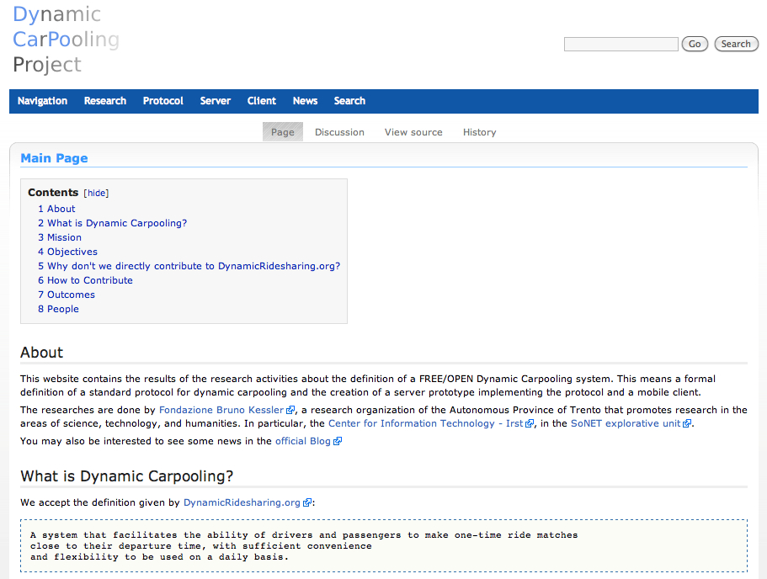

Slide 9
2. Dycapo Project
Protocol
An open application-level protocol
JSON (JavaScript Object Notation) as data exchange format
Built on top of REST architecture
  Elements as HTTP resources
  Each resource has a unique URI for identification (and referencing)
  Exploitation of HTTP methods for operations
  Status of operations using HTTP status codes
Notes:
Dycapo Project is and will be an Open Architecture for Dynamic Carpooling systems. We aim to create a Standard Protocol for communications in Carpooling, as well as a universal server system implementing the protocol, and mobile clients using the service. That is, a complete stack implementing Dynamic ridesharing.
We decided to follow three formal phases to accomplish our goals, that I will describe right now

Slide 10
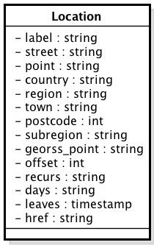
2. Dycapo Project
Protocol Elements
Complex, detailed and non-trivial relations
Current elements: Location, Person, Trip, Modality, Preferences, Participation, Search
Encoded using JSON format
{
"label": "Work",
"street": "Rom Strasse",
"point": "posi",
"country": "",
"region": "",
"town": "Bolzano",
"postcode": 39100,
"subregion": "",
"georss_point": "46.490200 11.342294"
"offset": 150,
"recurs": "",
"days": "",
"leaves": "2010-09-02 13:32:34",
"href" : "https://test.dycapo.org/api/persons/angela/location/"
}

Slide 11
2. Dycapo Project
Protocol Operations
Performed by using verbs defined in HTTP methods: GET, POST, PUT, DELETE
e.g. The creation of a Trip is a POST operation of a Trip element against the URI of the trip collection
  POST /api/trips/ HTTP/1.1 with a Trip element in JSON format as message-body
  A HTTP response with a HTTP 201 Created status code is returned, with the Trip element as message-body and a href attribute containing the URI

Slide 12
2. Dycapo Project
Server
An open-source server prototype
  Developed using Python programming language and Django web-framework
Implements Dycapo Protocol
  Empirical outcomes on the rules of the protocol
Provides an essential set of dynamic carpooling functionalities
  To become a solid base or an inspiration for the creation of full dynamic carpooling services
Notes:
Dycapo Project is and will be an Open Architecture for Dynamic Carpooling systems. We aim to create a Standard Protocol for communications in Carpooling, as well as a universal server system implementing the protocol, and mobile clients using the service. That is, a complete stack implementing Dynamic ridesharing.
We decided to follow three formal phases to accomplish our goals, that I will describe right now

Slide 13
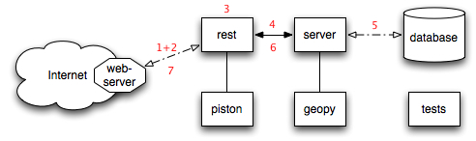
2. Dycapo Project
Server Components
HTTP request wrapped as a Python object, JSON included
Request URI evaluated and passed to rest package
Resource mapped to a Python object from the server module.
Resource is involved in computation a call in the server module.
The server module keeps states by using the database
Results converted by the rest package in JSON format
Results returned to the web server.

Slide 14
Content
Dynamic Carpooling
Dycapo Project
Conclusions

Slide 15
3. Conclusions
Future Improvements
Dycapo is a contribution to a better understanding and a technological solution to the open problem of dynamic carpooling.
A quite complex domain of interest
Becoming a world standard
Real-world usage

