Slide 1
Pomodroid
Team 2
Daniel Graziotin
Thomas Schievenin

Slide 2
Summary
The Pomodoro Technique
Mission Statement
Pomodroid in 4 points
System Architecture in terms of workflow
db4o
Problems Encountered

Slide 3

The Pomodoro Technique
A time management method that can be used for any kind of task.
Anxiety triggered by deadlines, time seen as enemy
Turn time as a valuable ally, improve efficiency and productivity
Pomodoro
http://www.pomodorotechnique.com/

Slide 4
Mission Statement
Implementation of a mobile activity manager using the Pomodoro Technique
Focus on basic features of the technique.
Simplicity

Slide 5
Pomodroid in 4 points
Retrieval of Trac tickets
Conversion/organization of tickets into Pomodroid Activities
Facing Activities according to the Pomodoro Technique
Sending Metrics gathered to PROM

Slide 6
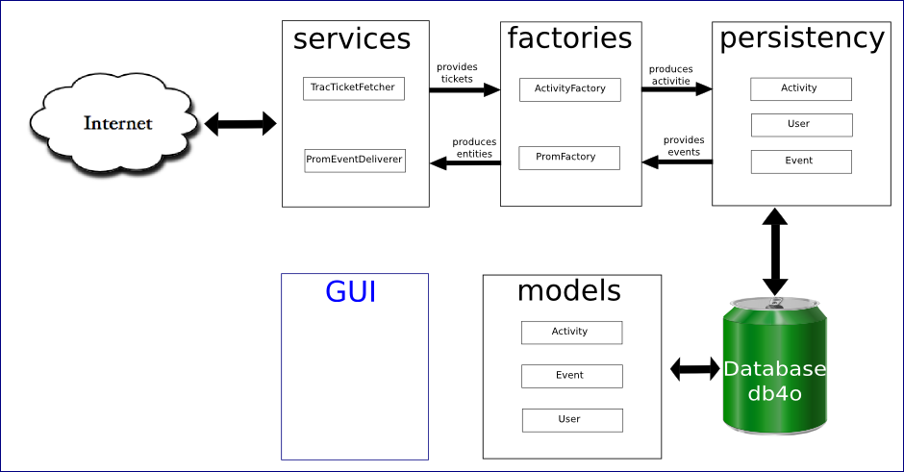
System Architecture: workflow

Slide 7
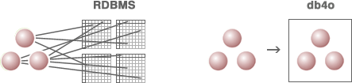
db4o
Open source object-oriented database
Enables developers to store and retrieve any complex object with only few lines of code
Eliminates the need to predefine or maintain a separate, rigid data model.
Fully works under Android

Slide 8
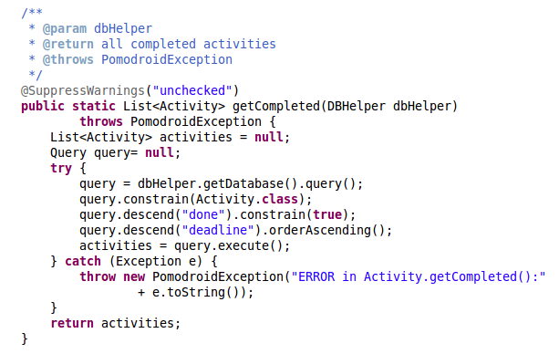
db4o code snippet

Slide 9
Problems Encountered
Android-xmlrpc library
Trac XML-RPC plugin
PROM
Android Limitations
Pomodoro Timer

Slide 10
End of Presentation
Thank you very much for your attention
Demo Run
Questions?

