Slide 1
Team 2
Presented By:
Dylan Dalton, Schauber Gbalou, Matthew Manuel, Joey Richardson, Darrin Wang

Slide 2
NetBeans Configuration Tool
Takes care of the initial setup of the NetBeans Templates for class, exception, interface, etc files
Initial setup currently has to be done in a series of complicated and confusing steps
Current steps are given in a blog post linked in the canvas module 1b

Slide 3
Audience
Our target audience is EE333 Java students
Potential to be adapted for other courses that use NetBeans

Slide 4
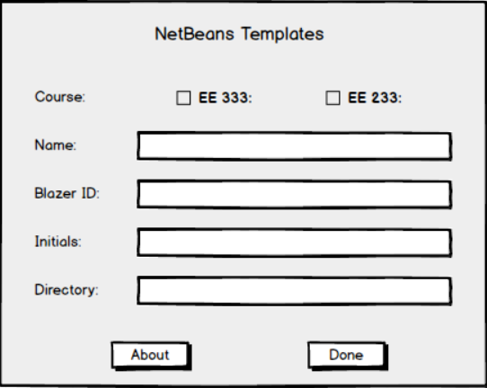
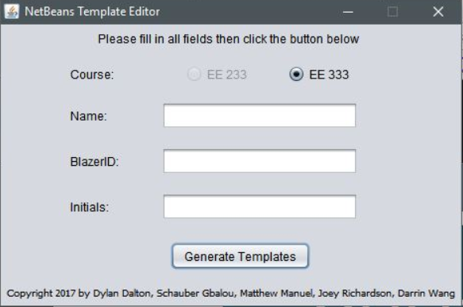
GUI Design Changes

Slide 5
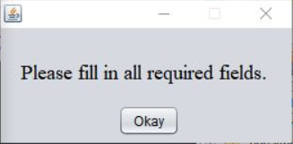
GUI Design Changes

Slide 6
Questions?

