Slide 1

Modeling fluid dynamics through a simplified artery
Nina Martinez Diers

Slide 2
Clinical applications for the fluid dynamics of blood flow
Identifying regions of pressure exerted on blood vessels helps assess risk of aneurysm rupture or thrombosis formation [1]
Pressure drop from an arterial blockage can be used to determine cardiovascular stress [2]
Turbulent blood flow is often clinically significant (ex. aorta ) [3]
Models of cardiovascular fluid dynamics can improve the diagnostic capabilities of existing diagnostic imaging techniques or minimally invasive procedures

Slide 3
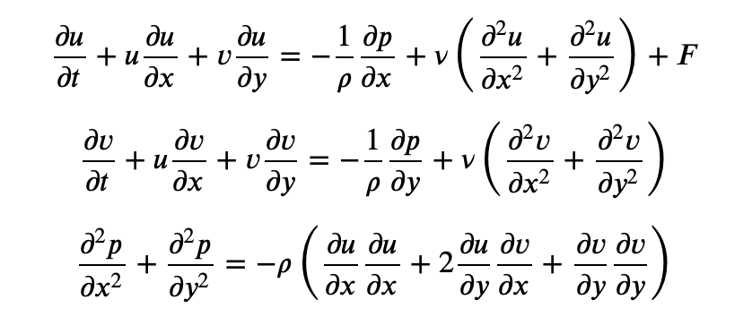
Navier-Stokes Equations
For incompressible viscous fluids
Blood is not an incompressible fluid, but in large arteries incompressibility is an appropriate approximation
2 vector equations: momentum and continuity
For 2D flow, this gives us the equations on the right
To apply to an initial-value problem, we take this set of equations and discretize it so that we can make arrays representative of the fields and perform array operations over time to observe the flow evolution

Slide 4
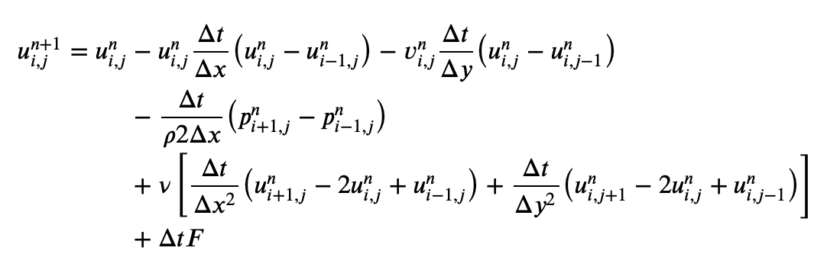
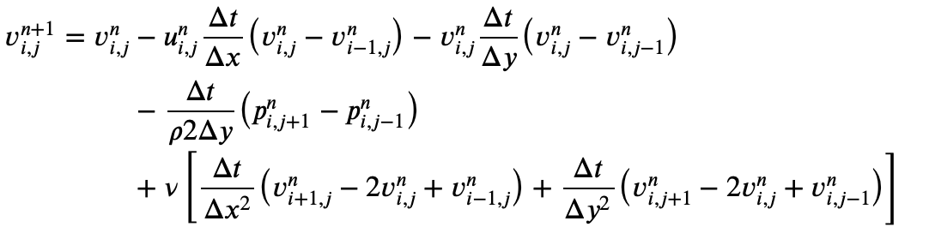
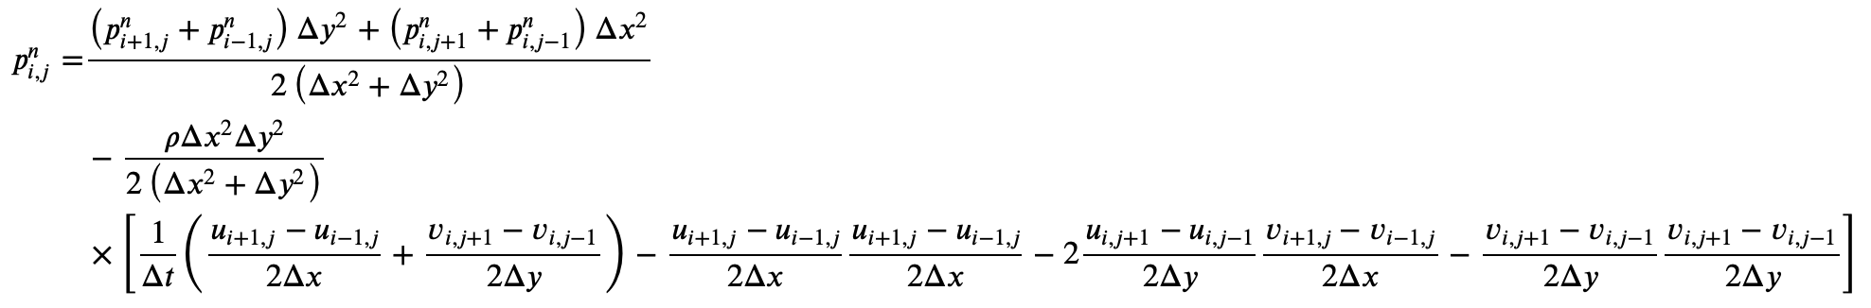
Solving Partial Differential Equations

Slide 5
Setting up simplified arterial model
Boundary Conditions
Initial conditions
Variables
Constant pressures exiting model of arterial segment
Constant velocity entering model
No-slip on arterial walls
Laminar flow through the arterial segment
Set pressure field through arterial segment using Bernoulli’s equation
Reynolds number:
Re = ρuD/𝜈
ρ = blood density
u = axial component of velocity
D = vessel diameter
𝜈 = blood viscosity
Arterial size

Slide 6
For large artery dimensions, flow evolves more slowly even for extremely high Reynolds numbers
t = 100 t = 1100 t = 2100

Slide 7
Turbulent flow emerges rapidly at realistic artery widths and Reynolds numbers
t = 2 t = 6 t = 10

Slide 8
Citations
[1] Lipp SN, Niedert EE, Cebull HL, Diorio TC, Ma JL, Rothenberger SM, Stevens Boster KA, Goergen CJ. Computational Hemodynamic Modeling of Arterial Aneurysms: A Mini-Review. Front Physiol. 2020 May 12;11:454. doi: 10.3389/fphys.2020.00454. PMID: 32477163; PMCID: PMC7235429.
[2] Farajtabar, M., Larimi, M.M., Biglarian, M. et al. Machine Learning Identification Framework of Hemodynamics of Blood Flow in Patient-Specific Coronary Arteries with Abnormality. J. of Cardiovasc. Trans. Res. 16, 722–737 (2023). https://doi.org/10.1007/s12265-022-10339-5
[3] A. Quarteroni, L. Dede’, A. Manzoni, and C. Vergara, “Basic facts about quantitative physiology,” in Mathematical Modelling of the Human Cardiovascular System: Data, Numerical Approximation, Clinical Applications, Cambridge: Cambridge University Press, 2019, pp. 3–9
[4] L. Barba and G. Forsyth, Journal of Open Source Education 2, 21 (2018).

