Slide 1
Topics to be covered
Boolean variables and classical circuit model
Universal logic gates
Logical identities
DeMorgan’s laws

Slide 2
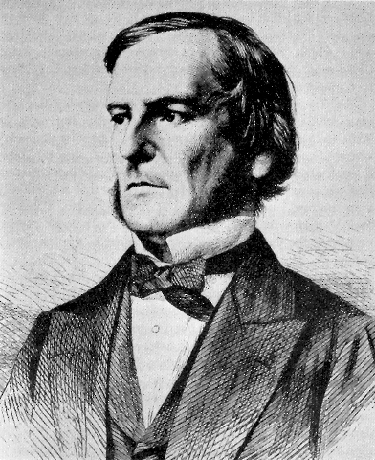
Boolean expressions
Evaluate to one of two values: True or False
Named after George Boole
(1815-1864)
In hindsight, he is regarded
as a founder of comp sci

Slide 3
Boolean operators
Lets start with the identity gate
A truth table shows all possible inputs and outputs.
a | a
F | F
T | T
a | a
0 | 0
1 | 1
or
a
a
A truth table with n inputs has n + 1 columns

Slide 4
Boolean operators
Example unary: not, and binary: and and or.
A truth table shows all possible inputs and outputs.
a | Not a
F | T
T | F
a | Not a
0 | 1
1 | 0
or
a
Not a
A truth table with n inputs has n + 1 columns

Slide 5
Boolean operations and and or
P | Q | P and Q
T | T | T
T | F | F
F | T | F
F | F | F
With 0, 1 =
false, true,
and acts like
multiplication *
P | Q | P or Q
T | T | T
T | F | T
F | T | T
F | F | F
or acts like
addition +
P + Q - PQ

Slide 6
Boolean operations and and or
P
With 0, 1 =
false, true,
and acts like
multiplication *
P  Q
Q
P
or acts like
addition +
P + Q - PQ
P  Q
Q
Is either of these logic gates reversible?

Slide 7
Boolean operation nand
P
With 0, 1 =
false, true,
NOT(a) corresponds
to 1 - a
NOT(P  Q)
Q
P | Q | P nand Q
T | T | F
T | F | T
F | T | T
F | F | T

Slide 8
Boolean operation XOR = exclusive or
P | Q | P XOR Q
T | T | F
T | F | T
F | T | T
F | F | F
With 0, 1 =
false, true,
XOR acts like
addition mod 2
Can use the logical identity
A XOR B = (A OR B) AND (NOT A OR NOT B),
Could be verified as a HW exercise.

Slide 9
Other important classical gates
FANOUT (COPY), COPY: a  (a,a)
CROSSOVER (SWAP), CROSSOVER: (a,b)  (b,a)
a
a
b
a
a
b
a
Universal gates. Any function f: {0,1}^{n}  {0,1}^{n}
can be constructed from the elementary gates AND, OR, NOT,
and FANOUT. Therefore, we say that these constitute a
universal set of gates for classical computation.

Slide 10
Short example
Obtaining NOT from NAND and FANOUT:
a NAND a = NOT(a AND a) = 1 – a² = 1 – a = NOT a.
Homework Hint
Consider
(a NAND b) NAND (a NAND b)

Slide 11
Example Boolean expressions
Condition that a raquetball game is over:
scoreA == 15 or scoreB ==15
A simulation loop that continues as long as the game is not
over:
while not (scoreA == 15 or scoreB ==15):
# continue playing
some players play shutouts (= skunks)
Now the game-over condition is:
a==15 or b==15 or (a==7 and b==0) or (b==7 and a==0)

Slide 12
Example Boolean expressions for raquetball
Enforce winning by two points
Condition that a raquetball game is over:
(a >= 15 and a-b >=2) or (b >= 15 and b-a>=2)
Alternatively:
(a >= 15 or b >= 15) and abs(a-b) >=2

Slide 13
Properties of Boolean expressions (1 of 2)
a and true == a
a and false == false # anything anded with false is false
a or true == true # anything ored with true is true
a or false == a
a and not a == false
a or not a == true

Slide 14
Properties of Boolean expressions (2 of 2)
commutativity: a and b == b and a, a or b == b or a
Both and and or distribute over each other:
a or(b and c) == (a or b) and (a or c)
a and (b or c) == (a and b) or (a and c)
not (not a) == a
These two identites are DeMorgan’s laws:
not (a or b) == (not a) and (not b)
not (a and b) == (not a) or (not b)
Go through the
truth table of a
couple of these

Slide 15
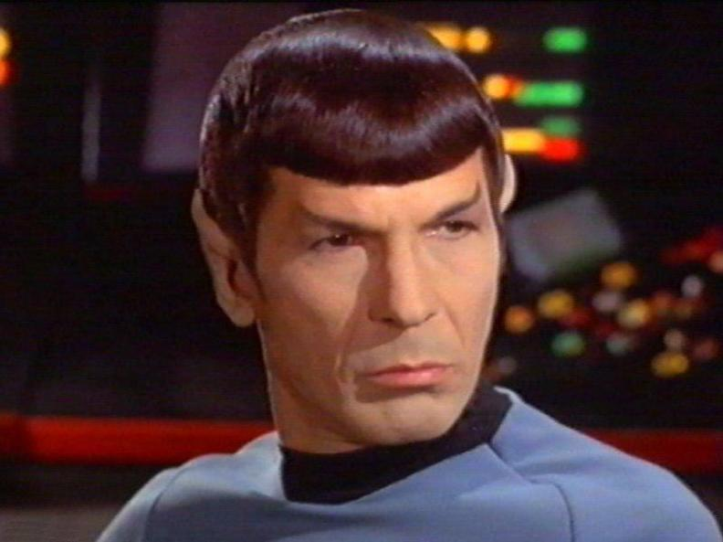
It is satisfyingly
logical, Captain.

Slide 16
Transformation of logical expressions
while not (scoreA == 15 or scoreB ==15):
# continue playing
With DeMorgan’s law, the condition may be transformed to:
(not scoreA ==15) and (not scoreB ==15).
A further step:
while scoreA != 15 and score B !=15:
# continue playing

Slide 17
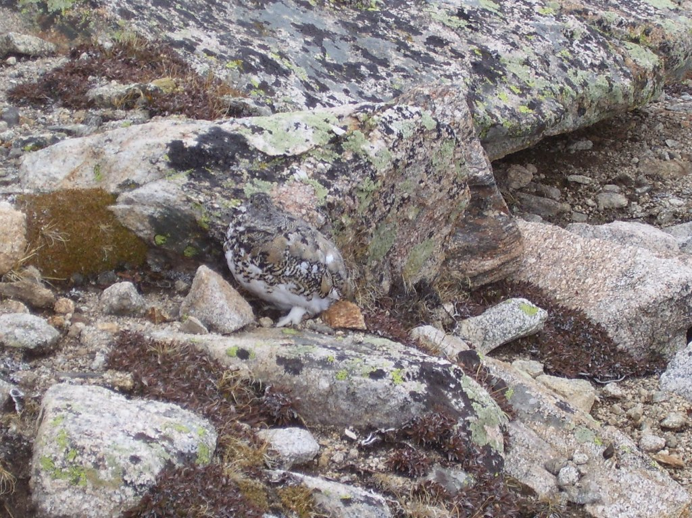
Next up
Circuit model of computation, tensor products, …

