Slide 1
MATH 4810/5810
Introduction to Quantum Computing
Turing machines and computability
Mark W. Coffey
Colorado School of Mines
Department of Physics
mcoffey@mines.edu
13 January 2016

Slide 2
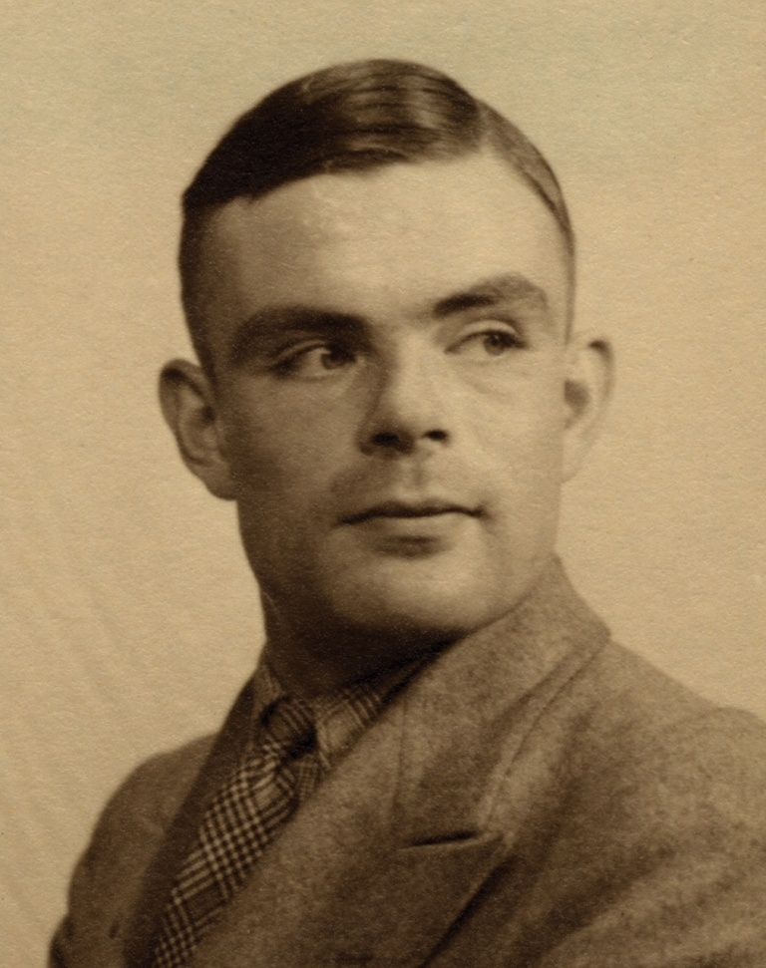
High-Level Outline
Alan Turing
Turing machine concepts
Abstract model of a computer
and program
Church-Turing thesis
Aspects of computability
Recommended textbook reading this week: Ch. 1

Slide 3
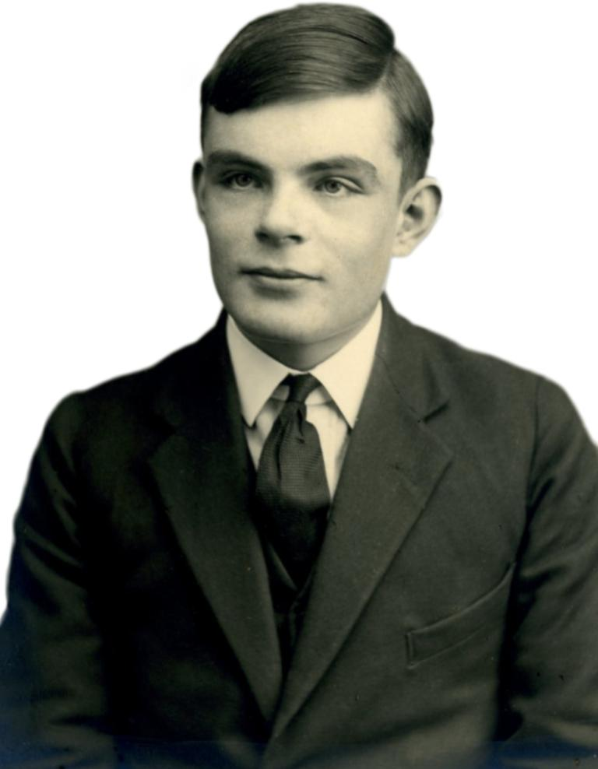
Alan M. Turing
1912-1954
English mathematician, logician, cryptanalyst, computer
scientist
Father of computer science and artificial intelligence
During WWII, worked at Bletchley Park, breaking German codes
After the war, at Manchester University, early computer
development
Math bio interest lead to a paper, and prediction of oscillating
chemical reactions that were first observed in the 1960’s
UK government public apology Sept. 2009 for its treatment of AMT

Slide 4
Turing machine (1)
Alan Turing, 1930’s
essential elements: tape, control unit, read/write head
b
0
1
0
0
b
1
0
0
0
1
b
0
1
b for a blank cell
S_{i}
Instructions:
i. Transition of control unit from state s to s_
ii. Transition of the cell addressed from
letter a to a_
iii. Displacement of the head one cell left or
right

Slide 5
Turing machine (2)
An instruction is given by 3 functions,
s_ = f_{S}(s,a)
a_ = f_{A}(s,a)
d = f_{D}(s,a), where d = l (for left) or d = r (for right)
So there’s some mapping
(s, a) (s_, a_, d).

Slide 6
Turing machine addition (1)
Using unary repr. E.g., 1 = 1, 2 = 11, 3 = 111, 4 = 1111, …
b
b
b
1
1
b
1
1
1
b
b
b
b
b
big computation: the
sum 2 + 3
s₁
s | a | s_ | a_ | d
s₁ s₂ s₂ s₃ s₃ s₄ | b b 1 b 1 b | s₂ s₃ s₂ H s₄ s₂ | b b 1 b b 1 | l l l 0 r l
6-line program
s = internal state
a = letter being read
s_= new state
a_= letter overwritten
H = halt

Slide 7
Example addition
1
b
b
1
/
b
/
/
b
b
1
1
b
1
1
1
b
b
b
b
b
/
s₁
s₂
s₂
s₂
s₂
s₃
s₄
s₂
s₃
s₄
s₂
s₃
H

Slide 8
Turing machine addition (2)
Using unary repr. E.g., 1 = 1, 2 = 11, 3 = 111, 4 = 1111, …
Running the program results in:
b
b
1
1
1
1
1
b
b
b
b
b
b
b
big computation:
the sum 2 + 3
H
How to set the machine more generally to add m + n:
b
b
1
1
…
1
b
1
1
1
…
1
b
…
m cells
n cells
s₁

Slide 9
The Church-Turing thesis
Thesis.
The class of all functions computable by a Turing
machine is equivalent to the class of all functions
computable by means of an algorithm.
For class to ponder:
Does an algorithm exist, in principle, for all possible
mathematical problems?

Slide 10
PTM Probabilistic Turing machine
PTM
--where the mapping (s,a) → (s,a,d) is probabilistic
--can have coin-tossing states to decide the output
--may solve some problems faster than a deterministic TM.
However, a PTM does not enlarge the class of computable
functions.
--A deterministic TM could always march through all
possible paths corresponding to different values of the
coin tosses.

Slide 11
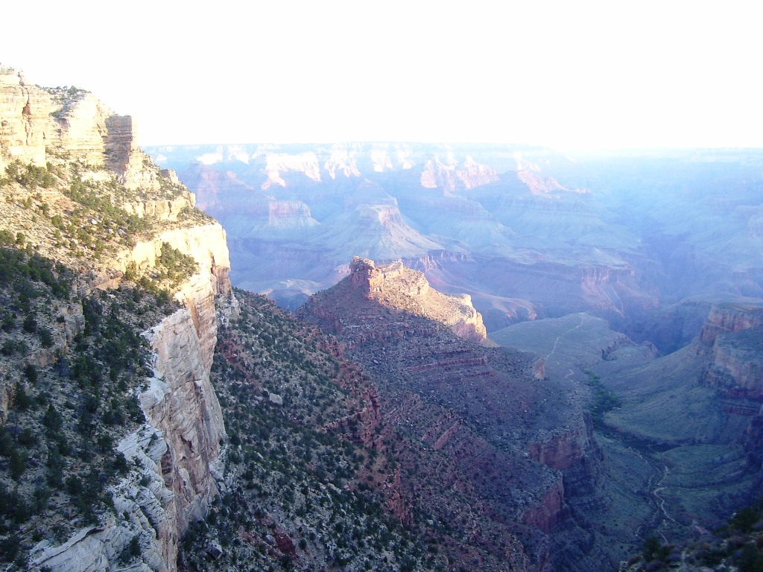
Next up:
Computability
Halting problem

Slide 12
Computability
A puzzle: Post’s correspondence problem
Given a set of cards:
--N card types (can use as many copies of each type as
needed)
--Each card has a top and bottom string
Emil Post 1946
Example 1
BAB
A
AB
BA
N = 4
A
ABA
B
B
Puzzle:
Is it possible to arrange the cards so that the top and
bottom strings match?

Slide 13
Post’s correspondence problem
Given a set of cards:
--N card types (can use as many copies of each type as
needed)
--Each card has a top and bottom string
Example 1
BAB
A
AB
BA
N = 4
A
ABA
B
B
Puzzle:
Is it possible to arrange the cards so that the top and
bottom strings match?
Solution 1
Yes
A
BA
BAB
AB
A
ABA
B
A
B
ABA

Slide 14
Computability
A puzzle: Post’s correspondence problem
Given a set of cards:
--N card types (can use as many copies of each type as
needed)
--Each card has a top and bottom string
Emil Post 1946
Example 2
A
ABA
B
A
N = 4
BAB
B
A
B
Puzzle:
Is it possible to arrange the cards so that the top and
bottom strings match?

Slide 15
Post’s correspondence problem
Given a set of cards:
--N card types (can use as many copies of each type as
needed)
--Each card has a top and bottom string
Example 2
A
ABA
B
A
N = 4
BAB
B
A
B
Puzzle:
Is it possible to arrange the cards so that the top and
bottom strings match?
Solution 2. No. First card in solution must contain same
letter in leftmost position.

Slide 16
Post’s correspondence problem
Given a set of cards:
--N card types (can use as many copies of each type as
needed)
--Each card has a top and bottom string
Puzzle:
Is it possible to arrange the cards so that the top and
bottom strings match?
Challenge. Write a program to take cards as input and
solve the puzzle.
Surprising fact. It is NOT possible to write such a
program!

Slide 17
Halting problem
Problem. Write a Python program that reads in a Python
program f and its input x, and decides whether f(x) results
in an infinite loop.
Easy for some functions, not so easy for others.
E.g., Does f(x) terminate?
def f(x):
while x != 1:
if x%2 ==0: x = x/2
else: x = 3*x +1
f(6): 6 3 10 5 16 8 4 2 1
f(27): 27 82 41 124 62 31 94 47 142 71 214 107 322 …
4 2 1

Slide 18
Undecidable problem
A yes-no problem is undecidable if no Turing machine
exists to solve it.
Theorem. (Turing 1937) The halting problem is
undecidable.
Proof intuition: lying paradox.
--Divide all statements into two categories: truths and lies
--How do we classify the statement: “I am lying”
Key element of lying paradox and halting proof: self-reference.
and, by universality, no program

Slide 19
Consequences
Q. Why is debugging hard?
A. All problems below are undecidable.
Halting problem. Give a function f, does it halt on a given input x?
Totality problem. Give a function f, does it halt on every input x?
No-input halting problem. Give a function f with no input, does it halt?
Program equivalence. Do two functions f and always return same value?
Uninitialized variables. Is the variable x initialized before it's used?
Dead-code elimination. Does this statement ever get executed?

Slide 20
Post’s correspondence problem
Given a set of cards:
--N card types (can use as many copies of each type as
needed)
--Each card has a top and bottom string
Puzzle:
Is it possible to arrange the cards so that the top and
bottom strings match?
Challenge. Write a program to take cards as input and
solve the puzzle.
Is Undecidable

Slide 21
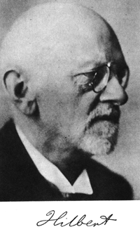
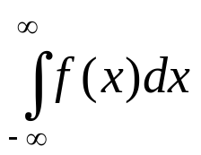
More undecidable problems
Hilbert’s 10th problem.
Devise a process according according to which it can be
determined in a finite number of operations whether a
given multivariate polynomial has an integer root.
f(x,y,z) = 6x³yz² + 3xy² – x³ -10 yes. f(5,3,0) = 0.
f(x,y) = x² + y² – 3
Definite integration.
Given a rational function f(x) composed of polynomial and
trig functions. Does exist?
g(x) = cos x (1 + x²)⁻¹ yes, value is π/e
h(x) = cos x (1 – x²)⁻¹ no, integral is undefined

Slide 22

More undecidable problems
Optimal data compression.
Find the shortest program to produce a given string or picture
Mandelbrot set (40 lines of code)

Slide 23
More undecidable problems
Virus identification.
Is this program a virus?
Exploited vulnerability in
MS Word
Private Sub Document_Open()
On Error Resume Next
If System.PrivateProfileString("",
"HKEY_CURRENT_USER\Software\Microsoft\Office\9.0\Word\Security", "Level") <> ""
Then
CommandBars("Macro").Controls("Security...").Enabled = False
System.PrivateProfileString("",
"HKEY_CURRENT_USER\Software\Microsoft\Office\9.0\Word\Security", "Level") = 1&
Else
CommandBars("Tools").Controls("Macro").Enabled = False
Options.ConfirmConversions = (1 - 1): Options.VirusProtection = (1 - 1):
Options.SaveNormalPrompt = (1 - 1)
End If
…
disables
security
Melissa virus
March 28, 1999

Slide 24
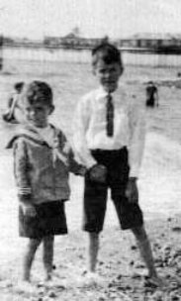
Turing’s contributions to CS
Turing machine
formal model of computation
Program and data
encode program and data as a sequence of symbols
Universality
concept of general-purpose, programmable computers
Church-Turing thesis
computable at all is synonomous with computable with a
Turing machine
Computability
inherent limits to computation
Alan Turing (left)
Elder brother (right)

Slide 25
Postscript: 2012 The Alan Turing Year
June 23, 2012, was the Centenary of Alan Turing’s birth in
London.
During his relatively brief life, Turing made a unique impact on the
history of computing, computer science, artificial intelligence,
developmental biology, and the mathematical theory of computability.
2012 was celebration of Turing’s life and scientific impact,
with a number of major events taking place throughout the year. Most
of these were linked to places with special significance in Turing’s life,
such as Cambridge, Manchester and Bletchley Park.
The Turing Year was coordinated by the Turing Centenary
Advisory Committee (TCAC),

