Slide 1
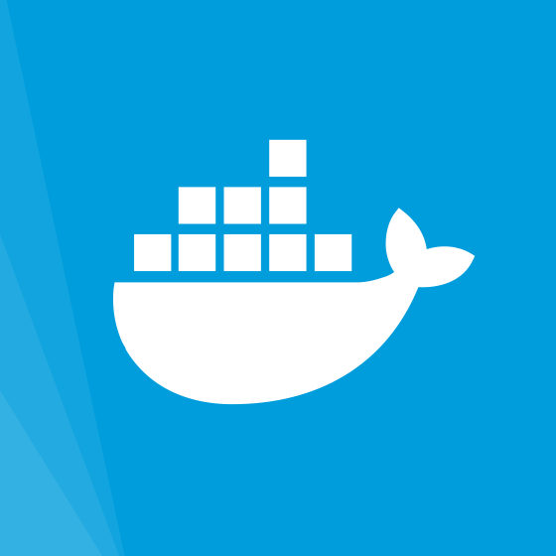
Docker

Slide 2
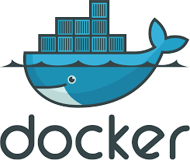
What is Docker
One of the most widely used technologies for containers
The ability to run an image in an isolated environment on
your computer

Slide 3
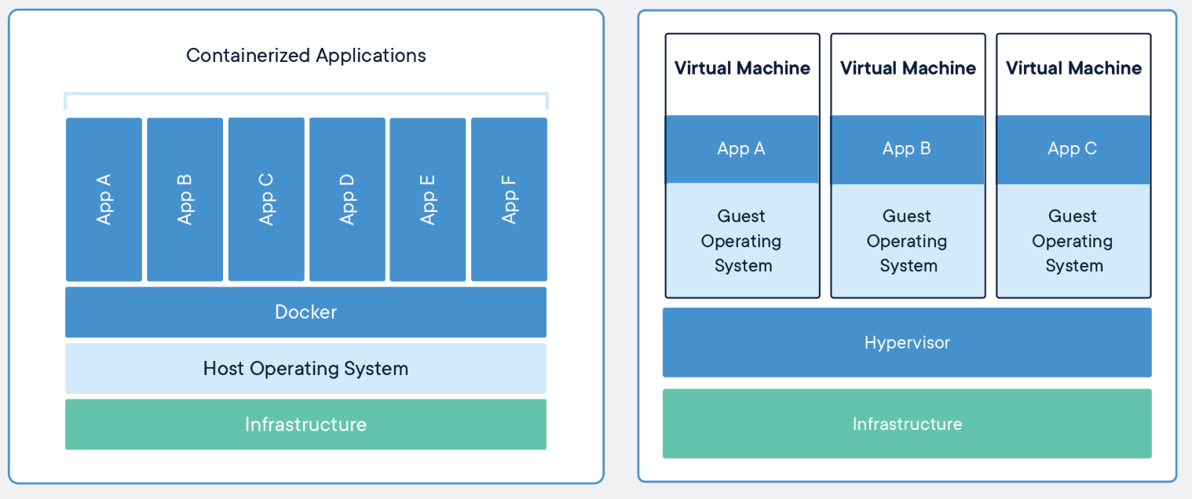
Containers
Notes:
Virtual machines are a way for us to run an operating system on top of another os. For example we can run a Linux vm on a Windows machine. This allows us to allocate some amount of processing power, RAM, and other resources to the virtual machine.

Slide 4
Why is Docker used?
Easily ship images, guaranteed to work anywhere with minimal resource usage
Install only what is needed to run an application
Build images on one distro and run on another

Slide 5
Why should you care?
Companies use Docker to deploy applications
DevOps
Still an emerging technology

