Slide 1
On the new threats of social engineering exploiting social networks
Daniel Siegel
27. Mai 2009

Slide 2
Inhalt
Social Engineering
Soziale Netzwerke
Motivation & Problemstellung
Ein konkretes SN: Twitter
Prototyp
Related Work

Slide 3
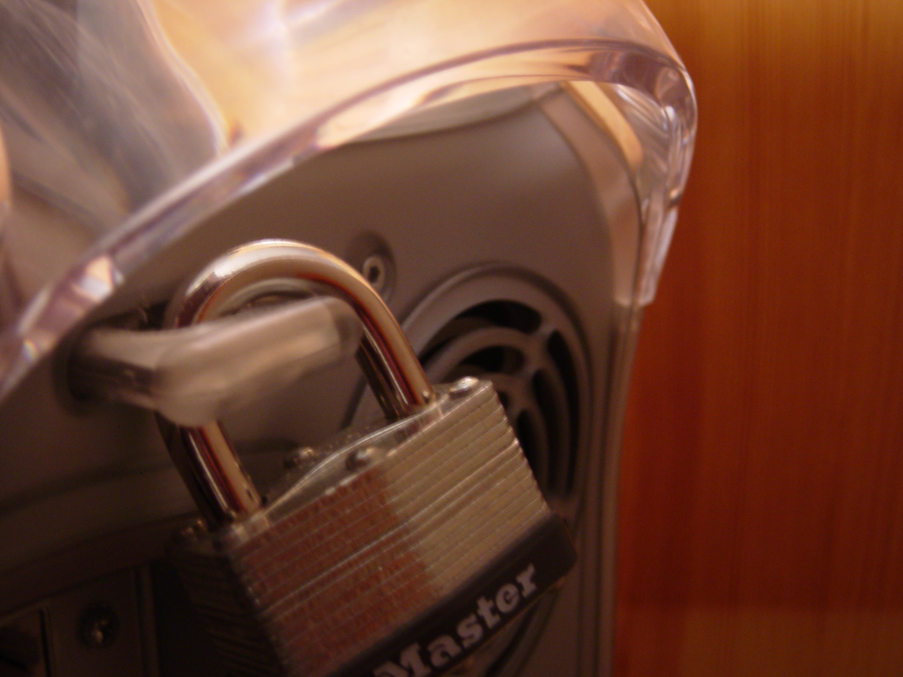

Slide 4


Slide 5
Social Engineering
A Term for cracking techniques that rely on weaknesses in wetware rather than software; the aim is to trick people into revealing passwords or other information that compromises a target system's security.
"Social Engineering", The Jargon Dictionary

Slide 6
Stanley Mark Rifkin
vs.
Security Pacific National Bank
Los Angeles

Slide 7
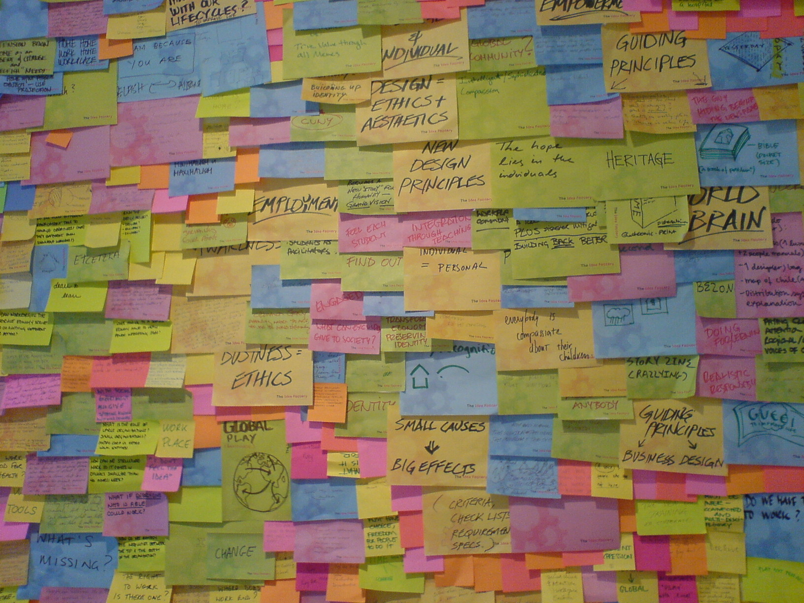

Slide 8
“Hi, this is Mike Hansen in International.”
“Whats your office number, please?”
“286”
“Okay, what's the code?”
“4789”

Slide 9
“Ten million, two-hundred
thousand dollars.“
“Okay, I got that. Now I need the
Interoffice settlement number.”
“Let me check, I'll call you right back.”

Slide 10
+10.000.000 $

Slide 11
4 easy steps...

Slide 12
1. Informationen

Slide 13
1. Informationen
2. Vertrauen

Slide 14
1. Informationen
2. Vertrauen
3. Manipulation

Slide 15
1. Informationen
2. Vertrauen
3. Manipulation
4. Angriff

Slide 16
1. Informationen
2. Vertrauen
3. Manipulation
4. Angriff

Slide 17
Soziale Netzwerke

Slide 18
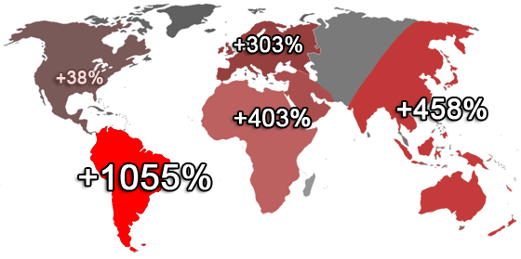
http://www.techcrunch.com/2008/08/12/facebook-is-not-only-the-worlds-largest-social-network-it-is-also-the-fastest-growing/

Slide 19
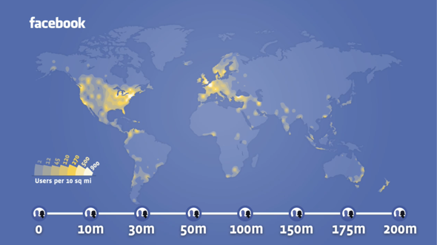
http://venturebeat.com/2009/04/08/trying-to-analyze-facebooks-latest-statistics-more-status-updates-more-content-sharing/

Slide 20
Social Networks
+
Social Engineering
=
Profit

Slide 21
Problemstellung
“Wie können Daten bestimmter
Individuen bzw. Unternehmen über Soziale Plattformen automatisch extrahiert und so dargestellt werden, dass sie für einen Social Engineering Angriff benutzt werden können. Zudem sollen Gegenmaßnahmen zu diesen Angriffen erarbeitet werden.”

Slide 22


Slide 23
Micro-blogging
140c

Slide 24
http://twitter.com/[username]

Slide 25
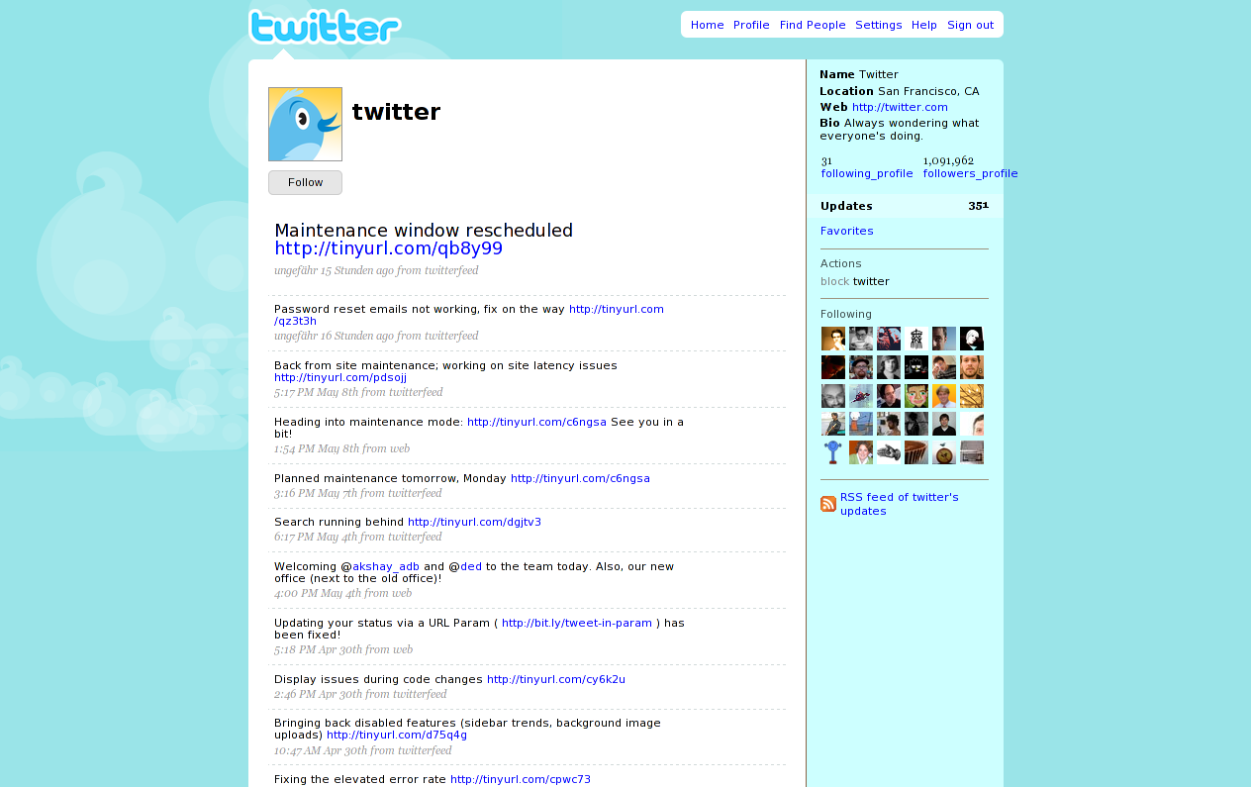

Slide 26
“@max you should check the weather
forecast, see http://tinyurl.com/plmr3m”
9:34 AM May 28th from web in reply to max

Slide 27
API
(http://apiwiki.twitter.com/Twitter-API-Documentation)

Slide 28
GET http://twitter.com/users/show/barackobama.json

Slide 29
created_at: "Mon Mar 05 22:08:25 +0000 2007"
description: "The president of the United States of America"
favourites_count: 0
followers_count: 1221122
friends_count: 776706
Id: 813286
location: "Chicago, IL"
name: "Barack Obama"
profile_image_url: "http://s3.amazonaws.com/twitter_production/
profile_images/219314140/
obama_4color_omark_normal.jpg"
protected: false
screen_name: "BarackObama"
statuses_count: 272
time_zone: "Central Time (US & Canada)"
url: "http://www.barackobama.com"

Slide 30
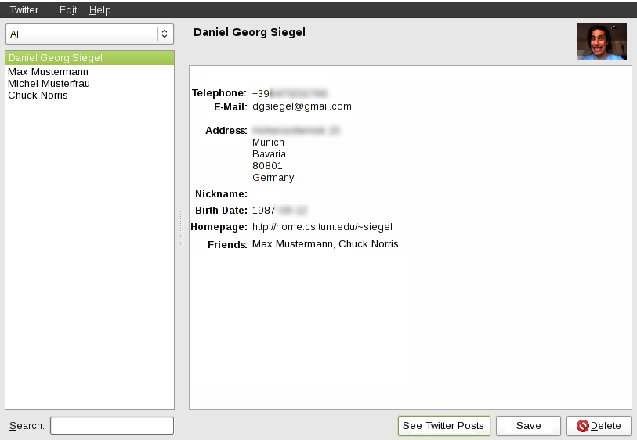
Prototyp

Slide 31
Szenarien
Zeit- und Nutzungsverhalten
Arbeitgeber, Mitarbeiter, Kollegen
Abwesenheit/Urlaube
Telefonnummern, E-Mail Adressen
Geburtstage, Hochzeiten, etc.
...

Slide 32
GET http://search.twitter.com/search.json?q=password

Slide 33
“@MattBrewer your nerddinner.com
password is "imadork"”
22 minutes ago from Tweetie in reply to MattBrewer
(http://twitter.com/matt2hews/status/1893008221)
“@MattBrewer your nerddinner.com
password is "imadork"”
22 minutes ago from Tweetie in reply to MattBrewer
(http://twitter.com/matt2hews/status/1893008221)

Slide 34
“You've been sent a picture message
by 447983397493 open it at
http://www.vodafone.co.uk/g...
your password is bnh24bfu”
40 minutes ago from Ping.fm
(http://twitter.com/markiemarkify/statuses/1892911013
“You've been sent a picture message
by 447983397493 open it at
http://www.vodafone.co.uk/g... your
password is bnh24bfu”
40 minutes ago from Ping.fm
(http://twitter.com/markiemarkify/statuses/1892911013

Slide 35
“@MarkLittlewood Hi Mark, great
entry! Google photobucket,
login:summerpudding2009
password: summerpudding upload
shots with name on”
about 1 hour ago from web NickiePhilbin
(http://twitter.com/NickiePhilbin/status/1892736072)
“@MarkLittlewood Hi Mark, great
entry! Google photobucket,
login:summerpudding2009
password: summerpudding upload
shots with name on”
about 1 hour ago from web NickiePhilbin
(http://twitter.com/NickiePhilbin/status/1892736072)

Slide 36
Related Work / Social Engineering
The Art of Deception
K. Mitnick, W. Simon
ISBN 076454280X
Social Phishing
T. Jagatic, N. Johnson, M. Jakobsson, F. Menczer
http://doi.acm.org/10.1145/1290958.1290968
Social Engineering: The “Dark Art”
T. Thornburgh
http://doi.acm.org/10.1145/1059524.1059554

Slide 37
Related Work / Social Networks
Social networks and context-aware spam
G. Brown, T. Howe, M. Ihbe, A. Prakash, K. Borders
http://doi.acm.org/10.1145/1460563.1460628
Information revelation and privacy in online social networks
R. Gross, A. Acquisti, H. John
http://doi.acm.org/10.1145/1102199.1102214

Slide 38
Related Work / Twitter
A few chirps about twitter
B. Krishnamurthy , P. Gill, M. Arlitt
http://doi.acm.org/10.1145/1397735.1397741
Why we Twitter
A. Java, X. Song, T. Finin, B. Tseng
http://doi.acm.org/10.1145/1348549.1348556

Slide 39
Fragen?
Tipps?
Hinweise?

Slide 40
Thanks
Image: 'Secure.'
www.flickr.com/photos/15301434@N00/44830826
Image: 'breathtaking'
www.flickr.com/photos/31429864@N00/217896072
Image: 'Brainstorms at INDEX: Views'
www.flickr.com/photos/47854931@N00/49915119

