Slide 1
MUMT-307/501 Final Project
A study in dynamic range controllers and compressor verification techniques
David “Graham” Smith
04/22/2019

Slide 2
Intro
Why study dynamic range controllers?
  - They are complex and non-intuitive
  - Most other audio effects are more straight-forward
Initial Goal
  - Explore all possible types of dynamic range controllers
  - Too Ambitious = Fail!
  - Restrict scope to compressors
Audio Engineers/Musicians
  - What do they look for?

Slide 3
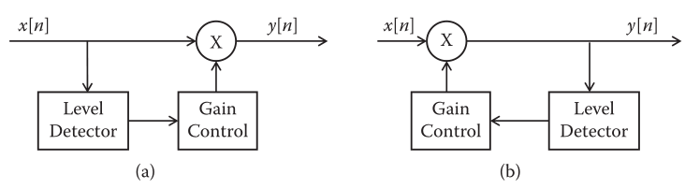
Theory
Basic theory covered in MUMT-307 earlier in semester
Different topologies:
  - Feedback
  - Feed-foward
More possibilities:
  - Where to put smoothing?
  - Multi-band compressors

Slide 4
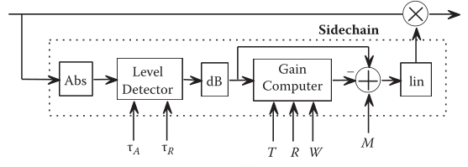
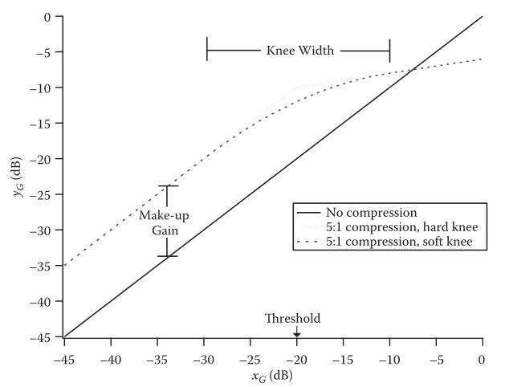
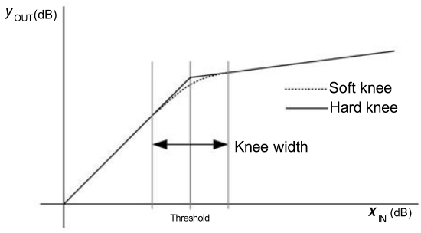
Theory
New Parameters
  - Attack/Release Time
  - Knee Width
  - Make Up Gain

Slide 5
System Characteristics
Linearity
  - Nope! Consider two signals right below the threshold.
Memory
  - Requires memory to do smoothing w/ filters
Causality
  - Causal as no future inputs required
Stability
  - Yes! The gain function is memory-less and attenuation is only applied.
Time-Varying
  - Yes! Consider if new signal is applied before full release time.

Slide 6
Design Considerations
Which level detection to use?
  - Peak
  - RMS
  - RMS approximation
Gain Function
  - Quantization?
    Cap input values @ -floor(20*log10(2^Q )) where Q is bit depth
  - Interpolation method for knee
Focus on testability

Slide 7
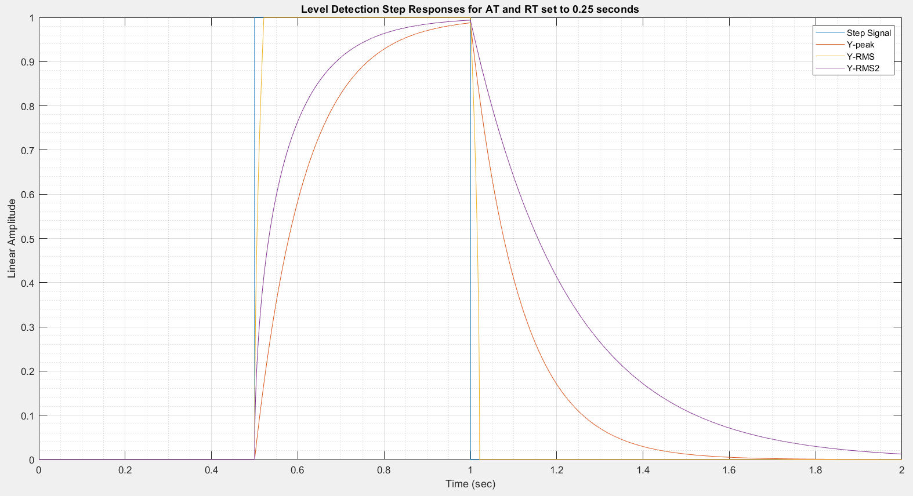
Level Detection Comparisons

Slide 8
Testing Strategy - How do I know it actually does what I “told” it to do?
Strategy
  - Unit test smaller components first on a larger range of parameters
  - Test assembled product as a “black-box” on a smaller range of values
Motivations
  - Unit testing develops through familiarity with constituent parts (a.k.a. I’ll actually know what I’m doing)
  - Unit vs. Integration failure becomes easier to diagnose
  - Simulates realistic scenarios: “Cloning” or being an Audio Validation Engineer
  - Original plan was to develop a modular suite of functions and leverage function handles to reconfigure a general DRC model and compare different configs

Slide 9
Order of Parameter Testing
Parameter behaviour is coupled together
  - Ratio only applies after threshold is passed
  - Knee width also depends on threshold working correctly
Attack and Release times
  - Separate functional block
  - Unit testing order doesn’t matter relative to gain functions
Test Signal
  - Use a level sweep since everything is so gain dependent
  - Use step signals for timing

Slide 10
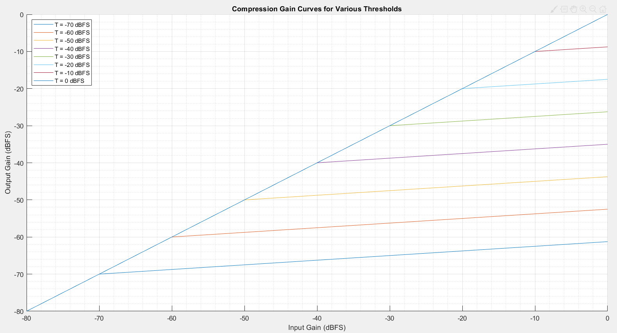
Threshold Test Results

Slide 11
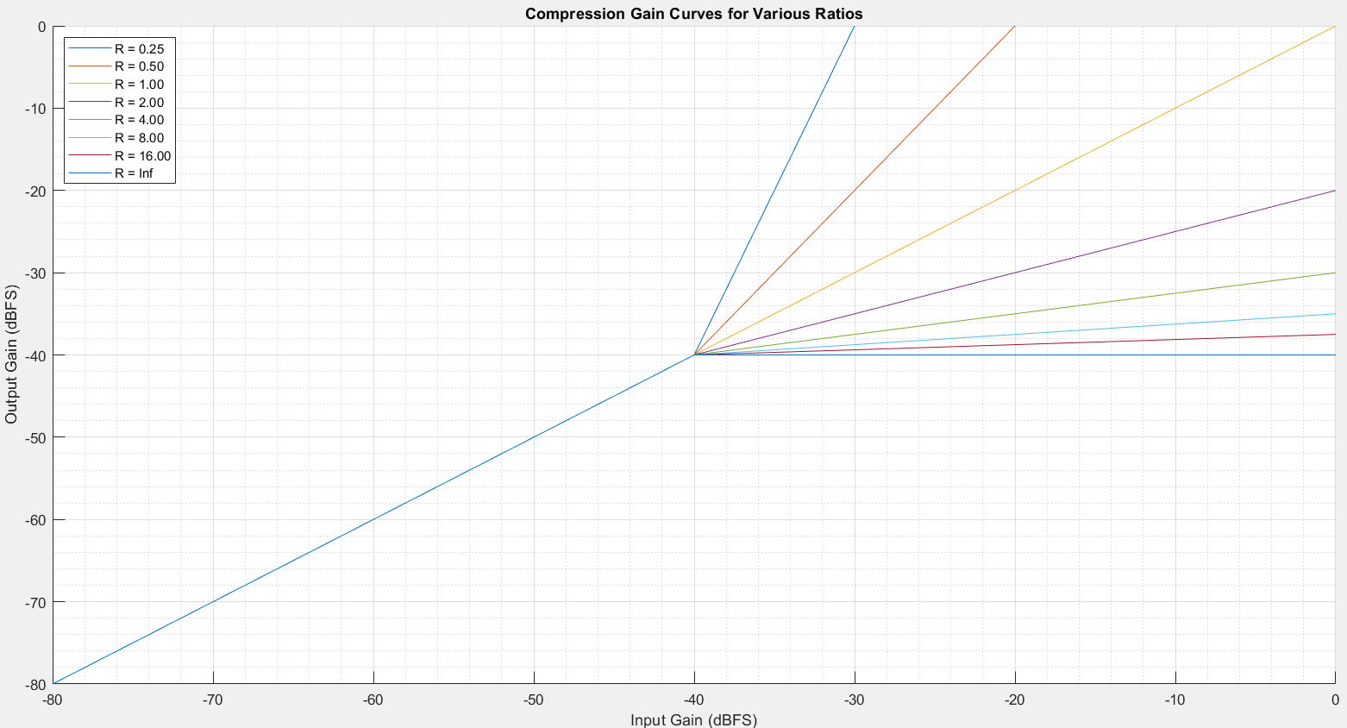
Ratio Test Results

Slide 12
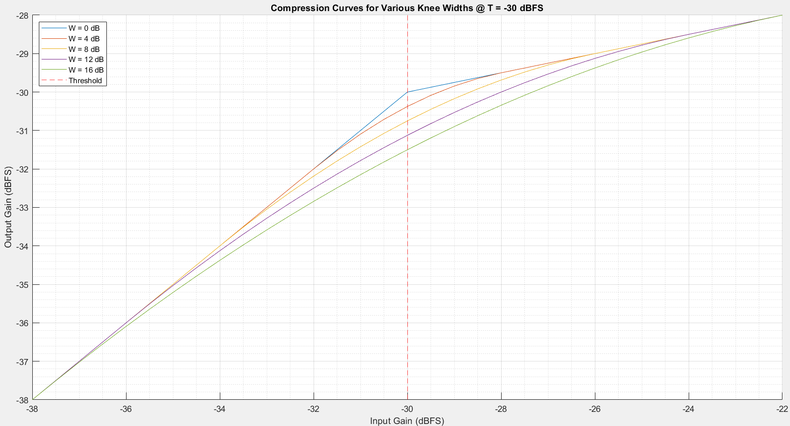
Knee Width Results

Slide 13
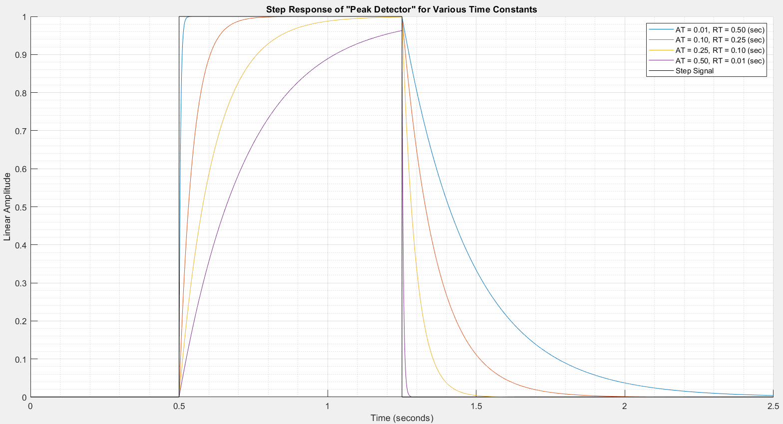
Attack and Release Time Results

Slide 14
Measuring Complete System Behaviour
Strategy
  - Similar approach as before but now timing becomes crucial
    - Same order
    - Try to isolate the effects of each parameter on the controller’s behaviour
Attack and Release times
  - Can be set to 0 here but that isn’t always the case
  - Delay from non-zero attack time causes difficulty in verifying the threshold
  - Verifying the attack time is extremely difficult (“Plateauing Effect”)

Slide 15
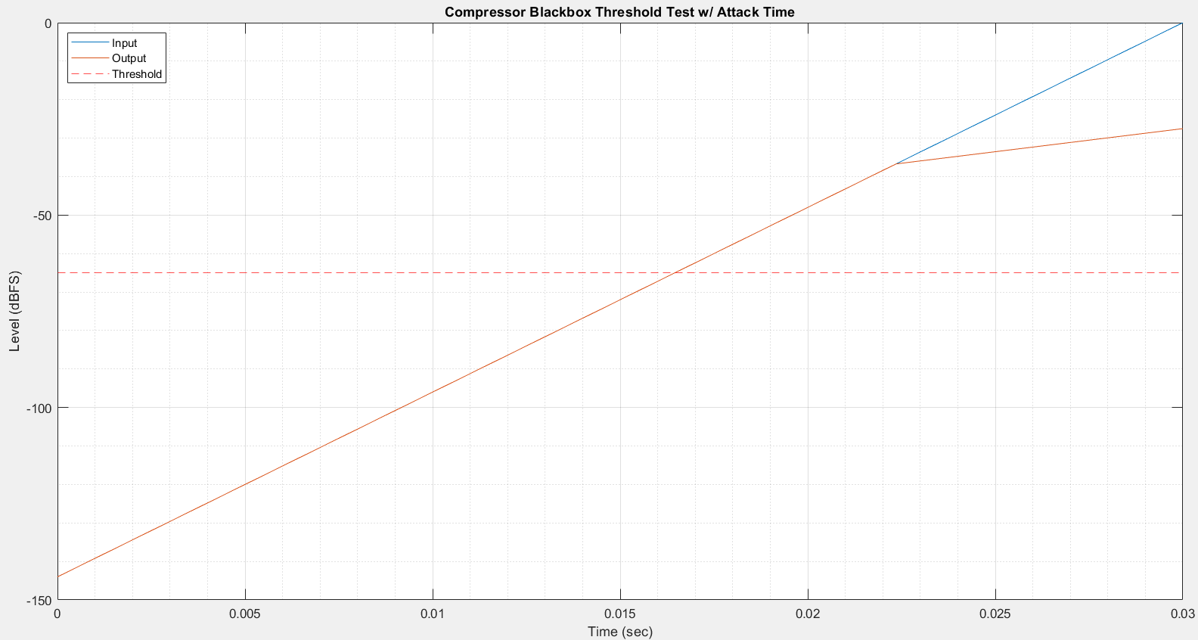
Delay from Attack Time

Slide 16
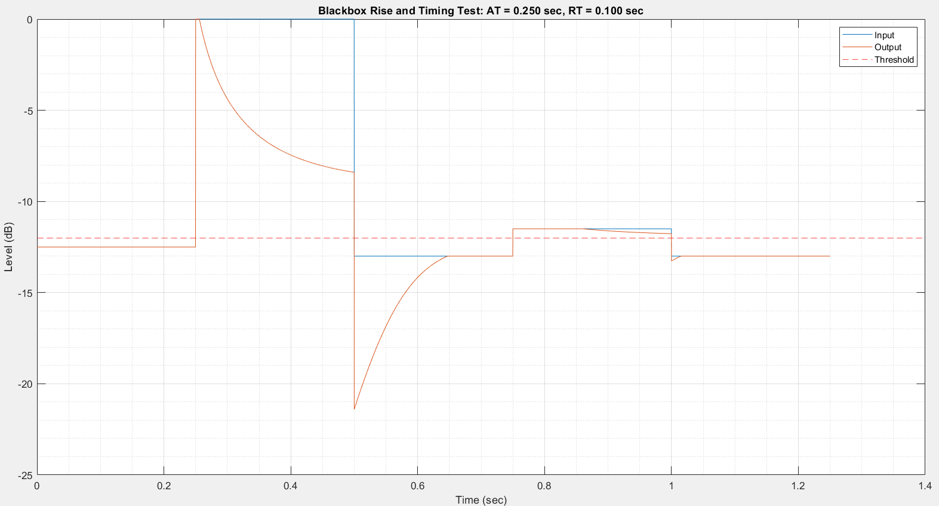
“Plateau”ing Issue

Slide 17
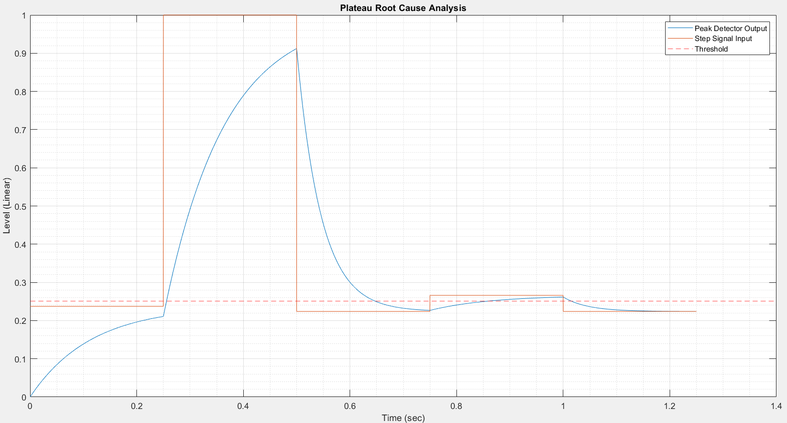
Plateau Root Cause

Slide 18
What is “correct”?
Engineer’s vs. Audio Engineers/Musicians
  - All these graphs are fine and dandy for verifying behaviour
  - What behaviour is “correct”?
  - Ultimately if an audio engineer/musician doesn’t want to use it = FAIL!
What do audio engineers/musicians want?
  - I asked a few and got conflicting results
  - One wanted it to be “transparent” and “keep a signal under control”
    - Plateau bad?
  - One didn’t care about the utility of DRC at all and only used it for the colouring effect
    - Plateau good?
  - How to translate their wants into a design?

