Slide 1
MUMT-605 Final Project
Time/pitch shifting via PSOLA Algorithm
Graham Smith

Slide 2
PSOLA – Overview
PSOLA – Pitch Synchronous Overlap and Add
Method for time-stretching and pitch-shifting in the time-domain
Computationally efficient (especially compared to frequency domain approaches) depending on F0 estimation algorithm
Works best for harmonic monophonic sounds
Time-stretching – adjusting the rate of acoustic events without modifying the frequency/pitch
Pitch-shifting – modifying the perceived pitch of a sound without adjusting the rate of acoustic events

Slide 3
F0 Estimate – YIN Algorithm
Quite a wide variety of approaches to F0 estimation exist
Computationally efficient time-domain method
Published in 2002 by Alain de Cheveingé and Hideki Kawahara
Similar to autocorrelation method
  Relies on a harmonic/periodic model for signal analysis
  Takes an analysis frame of the signal and measures similarity to delayed versions of the signal
  The amount of delay corresponding to the maximum similarity measure is considered the fundamental frequency

Slide 4
PSOLA – Analysis Stage
Step 1 – Determine the pitch period and pitch marks
  Pitch period requires F0 estimation
  Pitch marks defined to occur where maximum value is
  Unvoiced sections have pitch period of previous frame
Step 2 – Extract a segment centered at each pitch mark using a Hanning window with a length of 2 pitch periods
  Two pitch periods ensures capturing enough data as the underlying signal is harmonic
  Hanning allows for nice cross-fading and has other properties

Slide 5
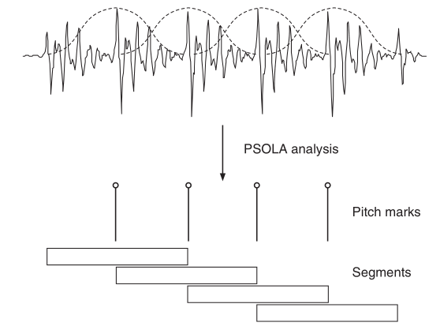
PSOLA Analysis Illustration

Slide 6
PSOLA – Time-Scaling Synthesis
α = time-scaling parameter
Steps:
  For every synthesis pitch-mark tk, choose the analysis segment which minimizes |α*ti – tk|
  Extract the windowed segment centered around the pitch mark ti
  Overlap and add the extracted segment at tk
  Determine tk+1 = tk + P(ti) for next iteration

Slide 7
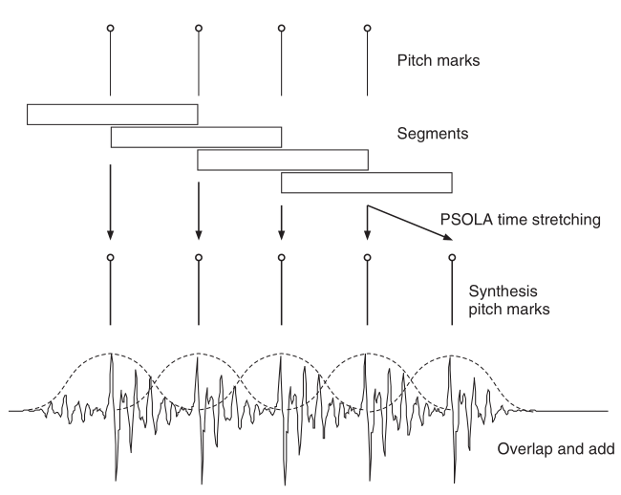
Time-scaling Illustration

Slide 8
PSOLA – Pitch Scaling Synthesis
β = pitch scaling parameter
Steps:
  Determine analysis segment which minimizes |ti – tk|
  Overlap and add the windowed segment at tk
  Determine next tk+1 = tk + P(ti)/β
Similar to time-scaling but pitch period changes
Intuitively this makes sense as we’re adjusting F0
Destroys nice windowing property we had before

Slide 9
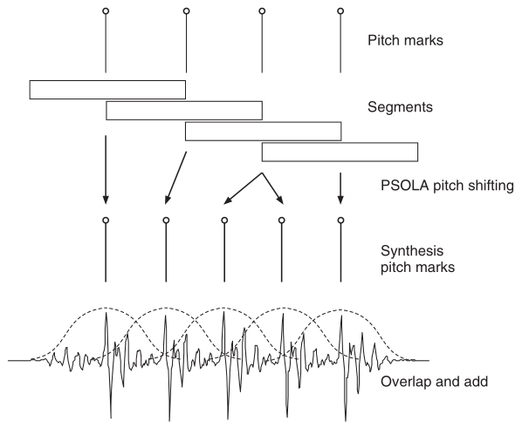
Pitch shifting illustration

Slide 10
Issues with Pitch Marks
F0 estimates are useful but there are limitations
Smallest unit of discretization in time being a sample has ramifications on pitch periods you can’t represent
  @Fs = 44100 Hz, A440 has a P0 = 44100/440 = 100.22 samples
  We can only operate in integer samples…
Use F0 to make an educated guess as to pitch mark location based on P0
Refine by searching over local range for the max
Which analysis frame to choose?

Slide 11
Pitch Mark Finding Algorithm
First frame
  Find the max value and its corresponding sample index
  Use F0 estimate for frame to guess where all the other pitch marks for the frame are based on a constant P0
  Examine an area of P0/2 centered around PM guesses to find the max and set this as the corrected pitch mark
Subsequent frames
  Use location of last pitch mark from previous frame to estimate PM locations based on current frame’s F0 estimate
  Revise using the same method of searching for a local maximum

Slide 12
Pitch Mark Finding Illustration

Slide 13
Pitch-Shifting Verification - I
Fs = 44.1 kHz, β = 1.5
Use sine wave stimuli at 441 Hz
  Ensures signal is periodic given sampling frequency
  P0 = 100 samples
  Use sine wave over cosine so signal doesn’t start on a discontinuity
Theoretically we should see a signal at 1.5*441 = 661.5 Hz at output

Slide 14
Pitch Shifting Verification - II
YIN measured F0 on output signal = 658.2090 Hz
Measured ratio = 658.2090 / 441 = 1.4925
Error is introduced from rounding when calculating the synthesis pitch mark
  Recall for pitch shifting: tk+1 = tk + P(ti)/β
  P(ti)/β = 100/1.5 = 66.67 samples
  Rounds to 67 in code
  β = (P0 input / P0 output) = 100 / 67 = 1.4925
Integer values for samples impose limitations on the algorithm

Slide 15
Time-Scaling Verification - I
Fs = 44100, α = 1.5
Stimuli
  Sine wave at 441 Hz for 3 seconds
  Pad beginning and end with 10*P0 samples of silence
Expect duration of each “event” to be scaled by 1.5
  Silence sections are 1.5*10*100 = 1,500 samples
  Sine wave is 1.5*3*44100 = 198,450 samples

Slide 16
Time-Scaling Verification - II
Not the case…
  First silence at 1475 (or 25 samples under)
  Tone duration measured at 198,475 (or 25 samples over)
  25 samples = P0/4
Root cause unknown
  Error likely introduced by pitch marks in unvoiced sections during the first frame
  Corrected marks moved 25 samples from initial guess

Slide 17
Time-Shifting Likely Error Culprit

Slide 18
Perceptual Evaluations
Algorithm performs quite well for slight adjustments
Limited to monophonic harmonic signals based on design
Masking from original sources can help hide artifacts when harmonized
Combining both pitch/time scaling made the artifacts more present
Extreme pitch shifting down is interesting timbrally
  Flute becomes bassoon
  Vocals sound like smokers

Slide 19
Limitations of Algorithm
F0 estimations can affect things
Integer limitations on sample values
Pyschoacoustic aspects of speech intelligibility and pitch perception affect parameter limits
  Pitch-shifting limits
    Lower limits on pitch shifting generated by lack of overlap between segments
    Upper limits on pitch shifting generated by too much overlap
  Time-shifting limits
    Upper limit based on discarded segments
    Lower limit based on artifacts introduce by repeititon

Slide 20
Window Length/Spacing and P0

Slide 21
Audio Examples
Flute
  Original
  Major third
  Bassoon (down 4 octaves)
Voice
  Original
  Played at 1.5x speed
  Smoker (down 4 octaves)

