Slide 1
EGR 106 Foundations of Engineering II
Final Lecture Meeting – 5/2/22

Slide 2
Today’s Topics
Design Project
Project Files Submission
Final Presentation Schedule
Student IDEA Course Evaluation
Course Survey
Optional, submit by 5/4, 11:59 PM for quiz extra credit

Slide 3
Project Files Submission (one per team)
Matlab code (.m file). Be sure to include team member names in comment lines in .m file
Output and color/texture files, including: .gif, .obj, colors.mtl, and .jpg files
No need to include .p files
Upload all files to the Brightspace Monday section site (look under Assignments)
Submit Project files by 11:30 PM, Tuesday 5/10 to the Brightspace Lecture site (to be submitted by one member per team)

Slide 4
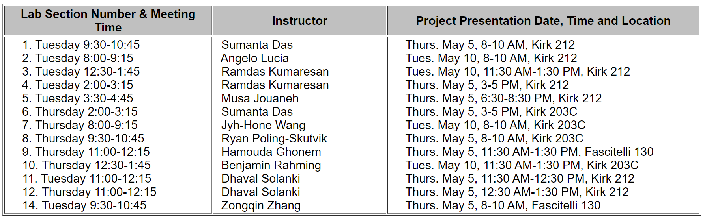
Design Project Presentation Schedule

Slide 5
Project Presentations
Presentation can include combination of Powerpoint slides, Matlab and/or MeshLab demonstration of final result
Possible things to include in presentation:
Project title
Team member names
Description of objectives
Show Matlab code and functions used to create geometry
Discussion of aesthetics / custom colors / textures used (if any)
Demonstration of the code running
Matlab generated animation (insert animated .gif in Powerpoint)
Show result in MeshLab

Slide 6
Student IDEA Course Evaluation
IDEA Course Evaluation
https://uri.campuslabs.com/eval-home/
Available now through May 4th at 11:59 PM
Evaluation is based on Monday class sessions only (not Tuesday/Thursday instructors)

Slide 7
Course Survey (Optional)
For future course planning purposes, please complete the Course Survey
Participation is optional
Survey is posted on Brightspace (look for link under Calendar)
Extra credit toward quiz grade will be given (if submitted by Wednesday, 5/4 @ 11:59 PM)

Slide 8
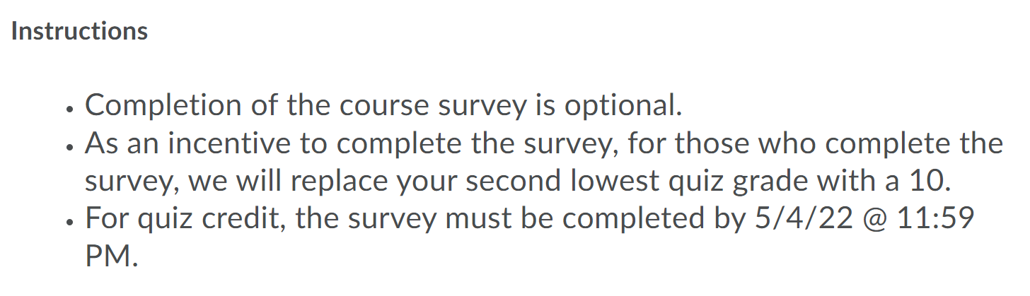
Survey Questions

Slide 9
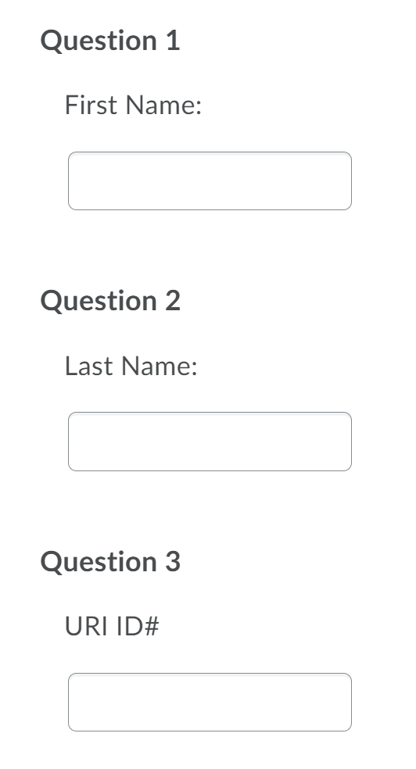
Survey Questions (cont.)
Questions 1-3 (optional but required for quiz credit):

Slide 10
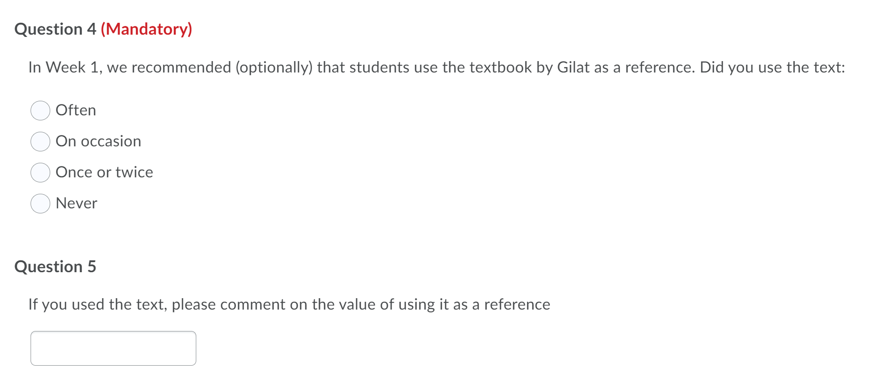
Survey Questions (cont.)
Questions 4-5

Slide 11
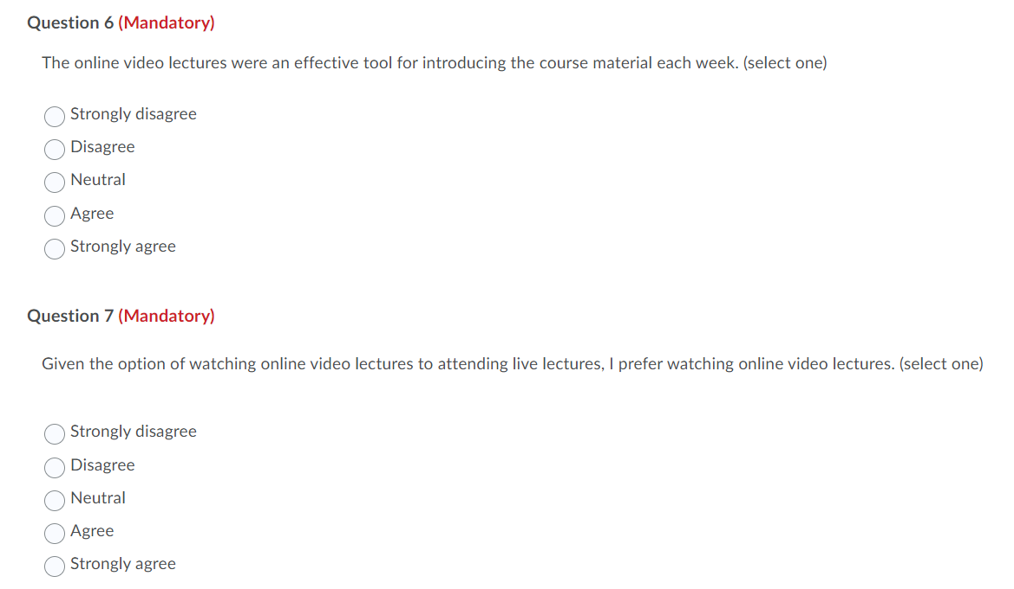
Survey Questions (cont.)
Questions 6-7

Slide 12
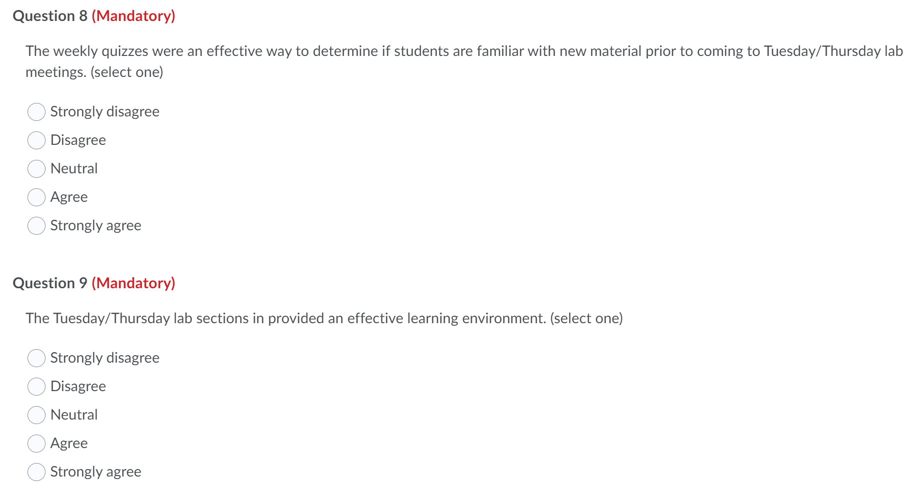
Survey Questions (cont.)
Questions 8-9

Slide 13
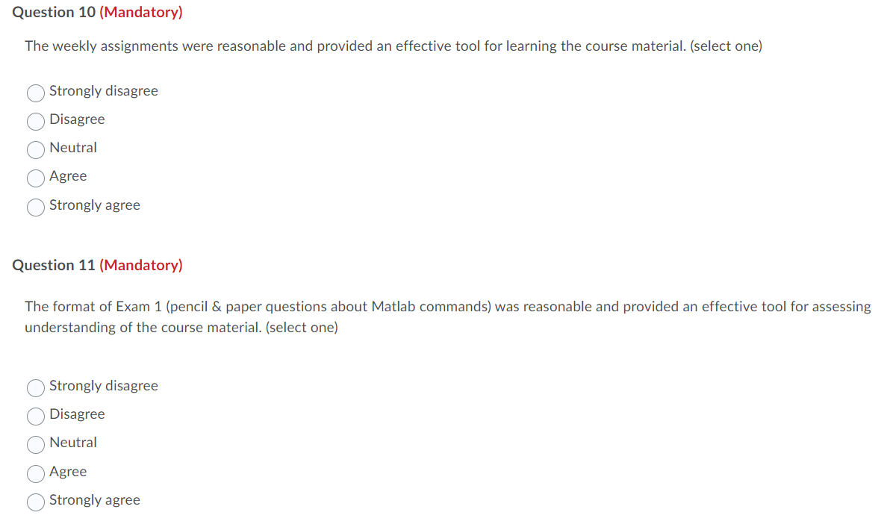
Survey Questions (cont.)
Questions 10-11

Slide 14
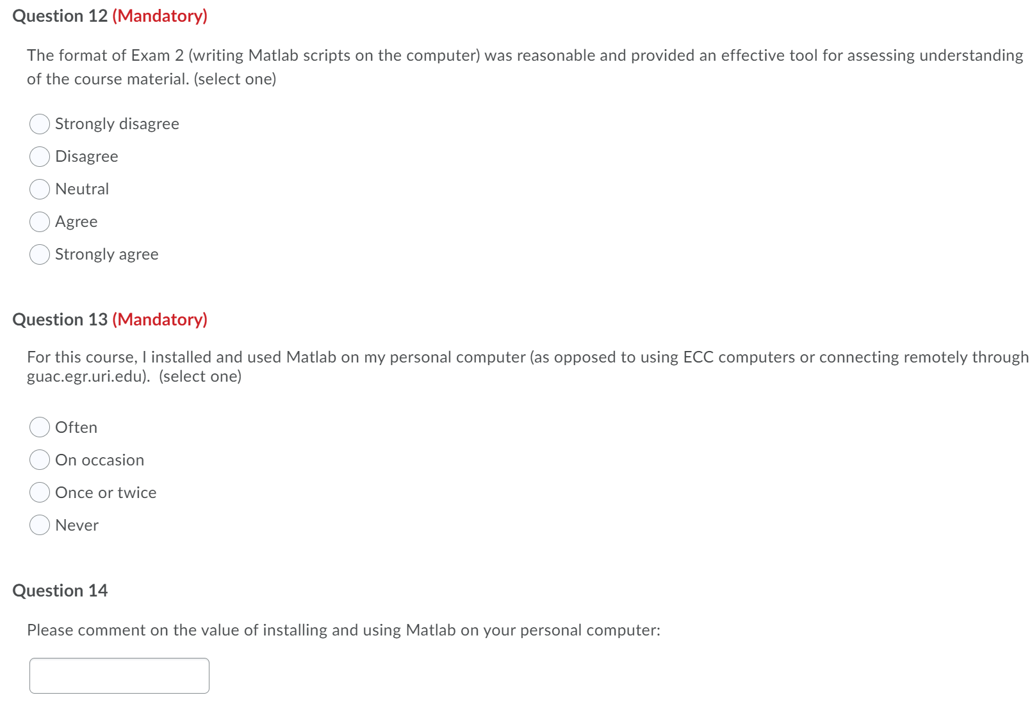
Survey Questions (cont.)
Questions 12-14

Slide 15
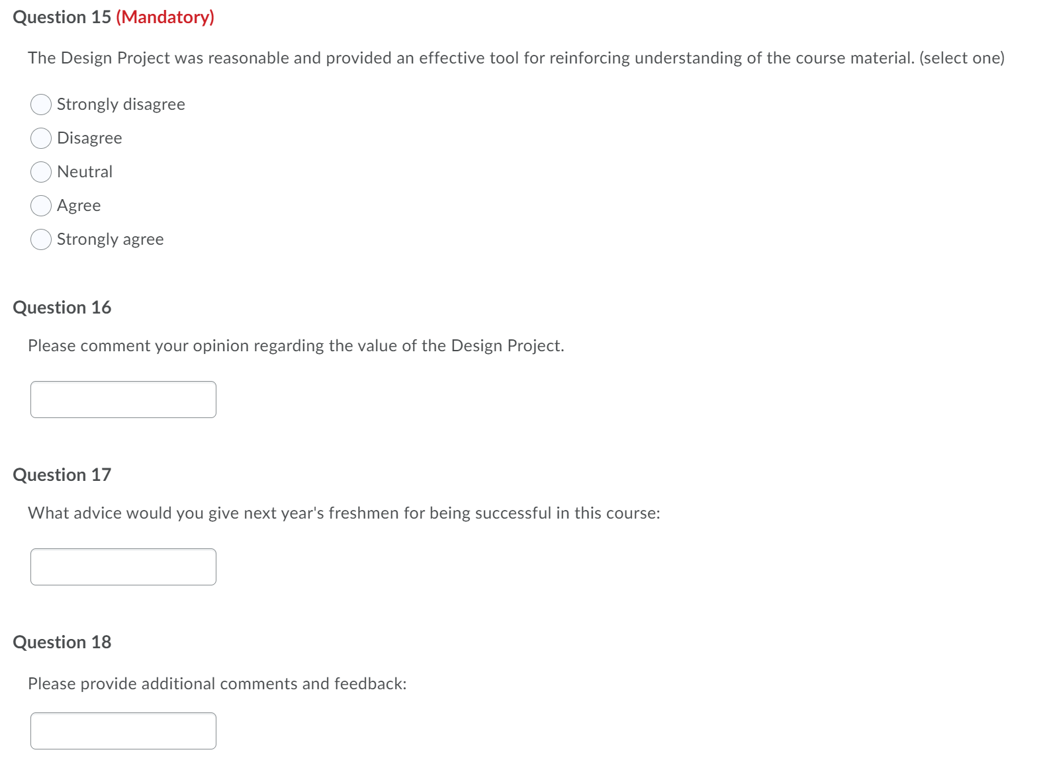
Survey Questions (cont.)
Questions 15-18

Slide 16

Have a Great Summer!

