Slide 1
EGR 106 Foundations of Engineering II
Lecture 3 – Part A
Announcements

Slide 2
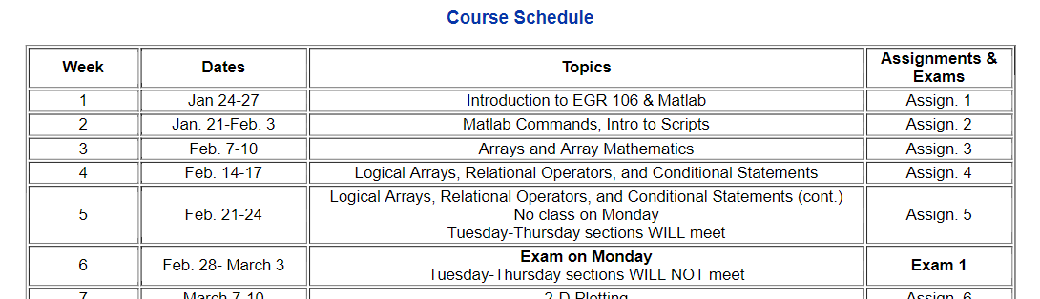
Week 3 Announcements
Week 2 quiz results
Week 3 quiz (must be submitted by 8 AM on Tuesday, Feb. 8)
Exam 1 – Monday February 28 @ 4 PM, 5 PM and 6 PM (Locations: TBA)

Slide 3
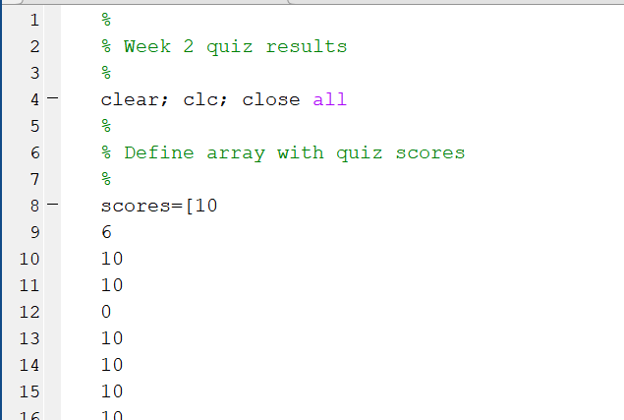
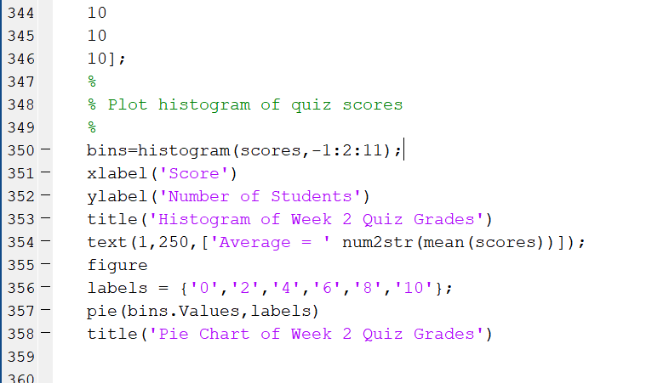
Week 2 Quiz Results
Matlab script:

Slide 4
Week 2 Quiz (cont.) Figure window output

Slide 5
Quiz Grading
In computing final quiz averages, I will drop your lowest quiz grade

Slide 6
Week 3 Quiz
Be sure to take the Week 3 Quiz by 8 AM Tuesday February 8th.
Don’t wait to the last minute
You may take it up to 10 times (check score in Grades)
Your highest score will be recorded
Correct answers will be released after due date

