Slide 1
EGR 106 Foundations of Engineering II
Lecture 3 – Part B
Arrays and Array Mathematics

Slide 2
This Week’s Topics
Review of last week’s topics
Today’s topics:
Array addressing
Special arrays
Some array operators
Character arrays
Array mathematics
Vector operations
Element by element operations
- addition, subtraction, multiplication, division
Matrix multiplication
Solving systems of equations

Slide 3
Review of Last Week
Arrays are the fundamental data units in MATLAB
Rectangular collection of data
All variables are considered to be arrays
Data values organized into rows and columns

Slide 4
Review of Last Week (cont.)
Size of an array (R x C)
Array Construction:
Brute force using brackets
Concatenation of other arrays – side-by-side and top-to-bottom
The colon operator
The linspace command
MATLAB scripts
File editor
Useful commands: clc, clear, close, %, pause, disp

Slide 5
Array Addressing
We indicate a particular element within an array by it’s row/column position:
use parentheses after the array name
e.g.
yield(2,4)

Slide 6
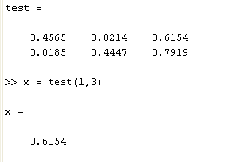
Array Addressing (cont.)
Used to read a value from an array

Slide 7
Array Addressing (cont.)
How about more than one entry?
Can specify a rectangular sub-array
again, use parenthesis after the array name
list desired rows, comma, desired columns
as separate vectors, typically in brackets
e.g.
yield([1 2],[3 4])

Slide 8
Special Arrays
Square versions
Special predefined arrays:
all zeros zeros(R,C) zeros(N)
all ones ones(R,C) ones(N)
zeros with ones on the diagonal
eye(R,C) eye(N)
random numbers (within [ 0 1 ])
rand(R,C) rand(N)

Slide 9
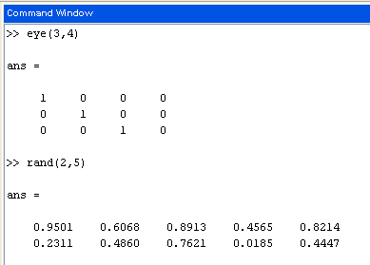
Examples
random on [ 0, 1 ]

Slide 10
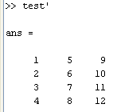

Transpose Operation
Transpose (single quote symbol ' )
switches rows and columns

Slide 11
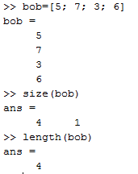
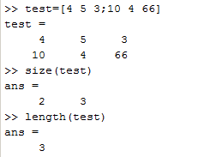
Array Size and Length
Size – the number of rows and columns
Length – the larger of these two

Slide 12
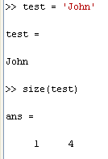
Character Arrays
Rows of the array are strings of alphanumeric characters, one array entry per character
Enter using a single quotation mark ( ' ) at each end of the string

Slide 13
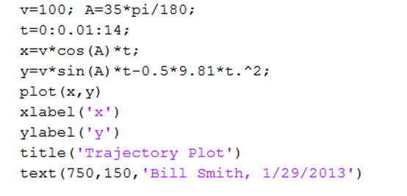
Character Arrays (cont.)
For multi-row alphanumeric arrays, each row must have the same number of characters
name = [ 'Marty' ; 'James' ; 'Bob ' ]
Note that we have already used character arrays in plotting functions – recall Week 1 homework:
Note – need 2 spaces

Slide 14
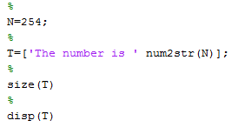

“num2str” command
The built-in function, num2str(N), takes a number, N, and
converts it to a character string.
Useful in displaying results
Ex.
Concatenates the strings ‘The number is ‘ and ‘254’

Slide 15
Demonstration Problem
Create a script which:
1. Creates the following array of characters:
This is a Matlab demo of
a character string array
2. Determines and displays the size of the array
3. Adds a row with the characters:
which has 24 columns
4. Determines and displays the new size of the array

Slide 16
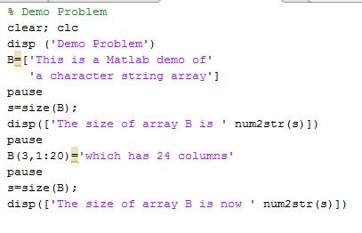
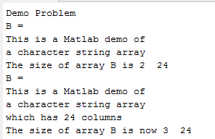
Demonstration Problem (cont.)
Script
Command Window Output

Slide 17
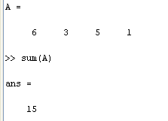
Vector Based Operations
Some operations analyze a vector to yield a single value.
For example:
sums the elements

Slide 18
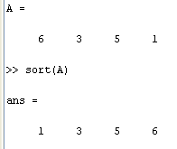
Vector Operations (cont.)
Some operators yield vector results
size(A) we’ve already seen – gives rows and columns
sort (A)

Slide 19
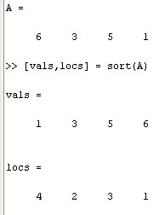
Vector Operations (cont.)
Some operators give multiple vectors

Slide 20
Other Vector Operations
Minimum: min(A)
Maximum: max(A)
Median: median(A)
Mean or average: mean(A)
Standard deviation: std(A)
Product of the elements: prod(A)

Slide 21
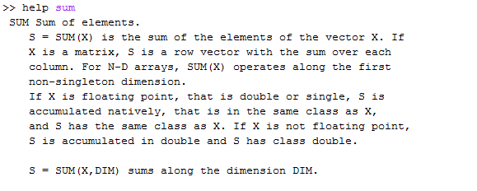
Vector Operations (cont.)
Use help to discover how to use these work

Slide 22
Element by Element Math Operations
For arrays of identical sizes, addition and subtraction is defined term by term:
the command F = A + B means
F(r,c) = A(r,c) + B(r,c)
for all row and column pairs r,c
“element-by-element” addition

Slide 23
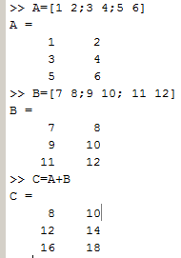
Array Addition and Subtraction
Arrays must be of identical size
Term by term (or element by element) operation:

Slide 24
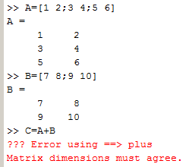
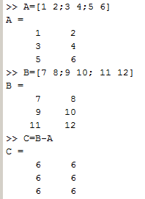
Addition and Subtraction of Arrays (cont.)
Sizes must match:
Array subtraction is identical:

Slide 25
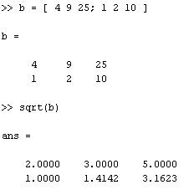
Built in Functions
Built-in functions also work element-by-element:
(sqrt, log, exp, sin, cos, etc. )
Example:

Slide 26
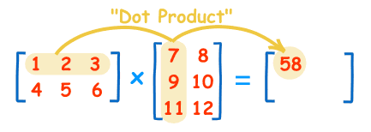
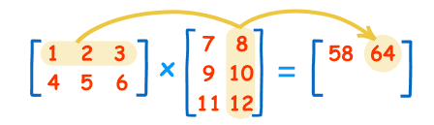
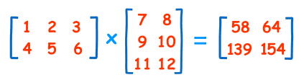
Matrix Multiplication
In linear algebra:
Matrix multiplication of an M x N matrix times an N X P matrix yields an M X P matrix
Each term is found by taking the dot product of rows of the first matrix with columns of the second
2 x 3 3 x 2 2 x 2

Slide 27
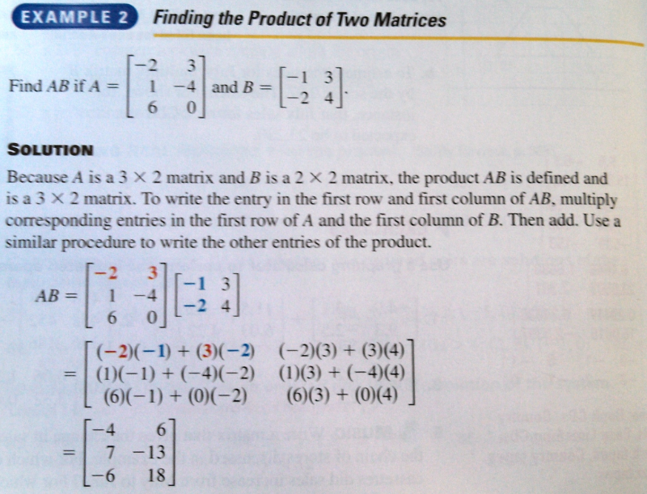
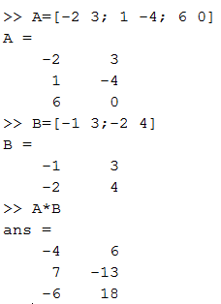
Matrix Multiplication (cont.)
Example from high school algebra text
MATLAB

Slide 28
Array Multiplication (cont.)
The number of columns of the 1st must match the number of rows of the 2nd
= *
n by m
n by k
k by m

Slide 29
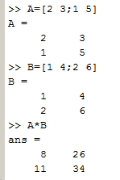
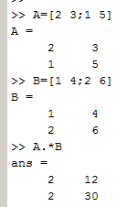
Array Multiplication vs. Element by Element Multiplication
Array Multiplication Element by Element Multiplication

Slide 30
Other Element by Element Operations
The other basic math operations work element by element using the dot notation (with A,B the same sizes):
multiplication
F = A .* B → F(r,c) = A(r,c) * B(r,c)
division
F = A ./ B → F(r,c) = A(r,c) / B(r,c)
exponentiation:
F = A .^ B → F(r,c) = A(r,c) ^ B(r,c)
note periods!

Slide 31
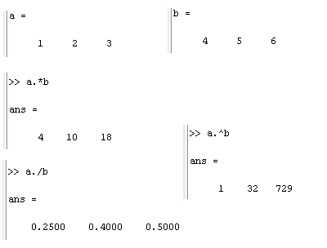
Element by Element Operations - Examples

Slide 32
Solving System of Equations - Example
In matrix form this is
A * x = b
where

Slide 33
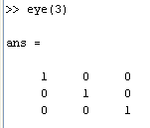
Solving Systems of Equations – Array Division
Recall the command eye(n)
This result is the array
multiplication identity matrix I
For any array A
A * I = I * A = A
must be properly sized!

Slide 34
Solving Systems of Equations – Array Division (cont.)
Imagine that for square arrays A and B we have
A * B = B * A = I
then we call them inverses
A = B^{–1} B = A^{–1}
In MATLAB: A ^ -1 or inv(A)
When does A^{–1} exist?
A is square
A has a non-zero determinant (det(A) ≠ 0)

Slide 35
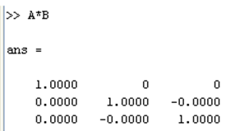
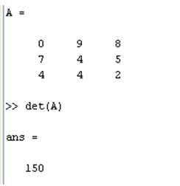
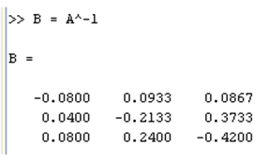
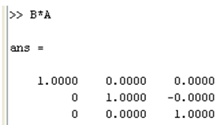
Solving Systems of Equations – Array Division (cont.)
Example:

Slide 36
Solving Systems of Equations – Array Division (cont.)
Solving A * x = b
Assume that A is square and det(A) ≠ 0
Multiply both sides by A^{–1} on the left
A^{–1 *}A * x = A^{–1}* b
so x = A^{–1}* b
In MATLAB, x = A^-1*b, x = A \ b or x = inv(A)*b
= I
= x
backwards slash

Slide 37
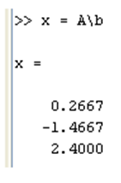
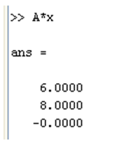
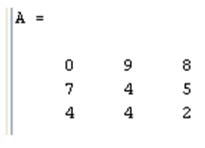
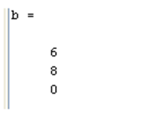
Solving Systems of Equations – Array Division (cont.)
Example:

