Slide 1
EGR 106 Foundations of Engineering II
Lecture 1 – Introduction to MATLAB
David G. Taggart
Dept. of Mechanical, Industrial and Systems Engineering

Slide 2
Introduction to MATLAB
What is MATLAB?
Name is from matrix laboratory
Powerful tool for
Computation and visualization for engineering, science and mathematics
Communication of ideas
Programming:
Built-in editor, debugger, and help
Many predefined functions
Interpreted or compiled programs

Slide 3
MATLAB Environment
Data represented in arrays:
Organized by row and column indices
Use variable names for them
User interface - multi-paned desktop:
Command window
Workspace browser
Current directory
Other windows: Figure, File Editor, Help, …..
More next week

Slide 4
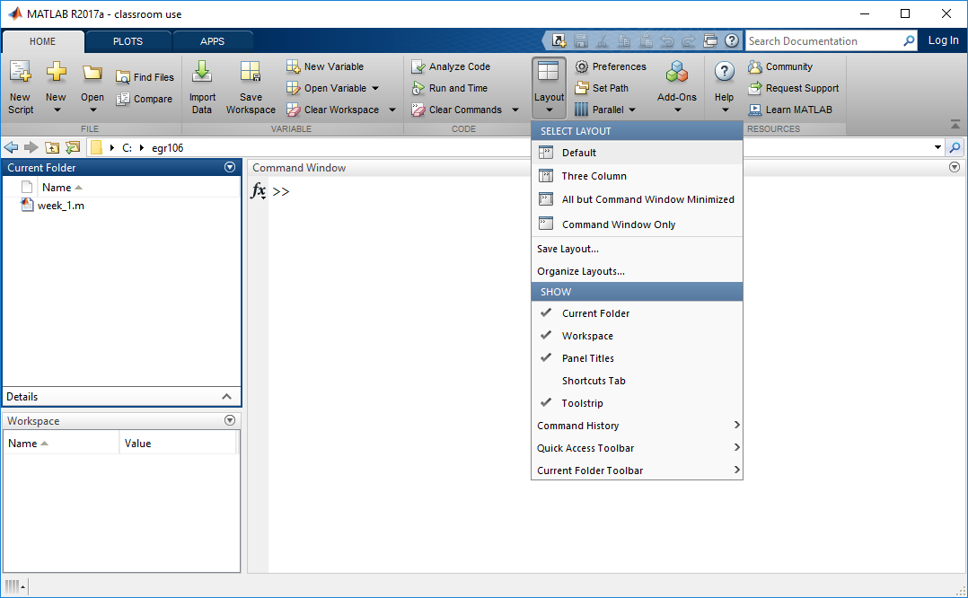
MATLAB Graphical User Interface (GUI)
Default layout:
For now, turn off everything but Command window
(Layout => Command Window Only)

Slide 5
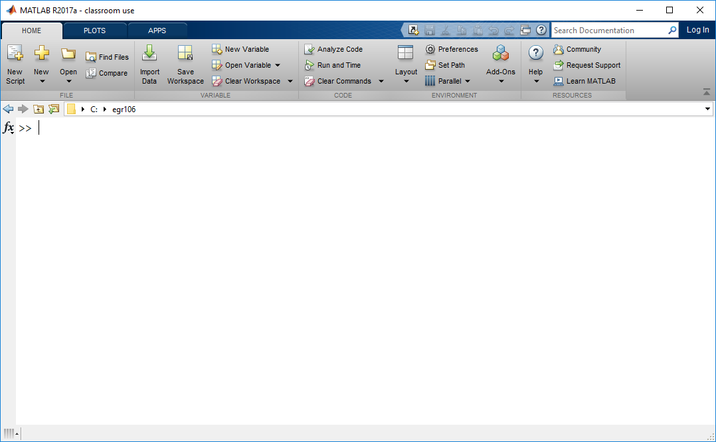
Command Window Only

Slide 6
Command Window Operations
Command prompt >>
Basic math operations are available:
addition + subtraction – division /
multiplication * exponentiation ^
“enter” key “executes” or “runs” or “invokes” the operation
Operator precedence: PEMDAS
5 – 4 + 3 ^ 4 / ( 3 – 1 ) = ?
= 41.5

Slide 7
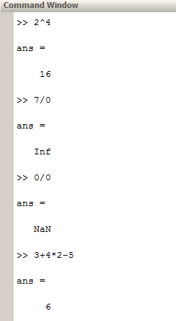
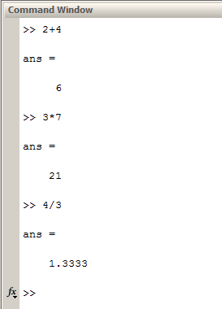
Examples

Slide 8
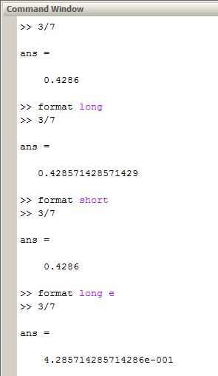
Examples (cont.)
Format command – controls display output format

Slide 9
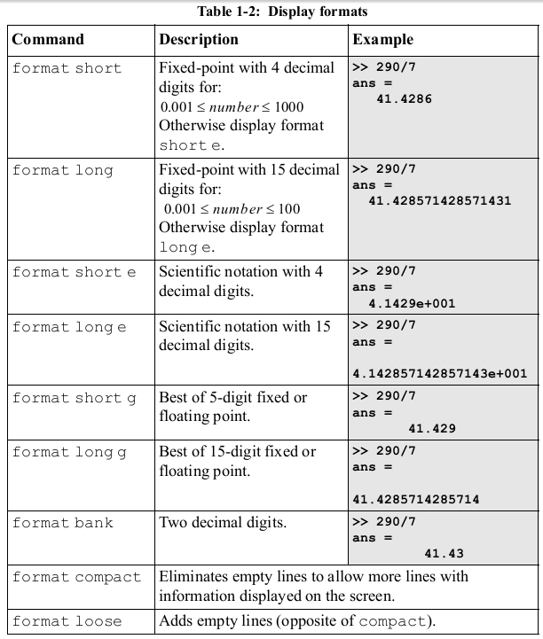
Display Formats (source: Gilat’s text)

Slide 10

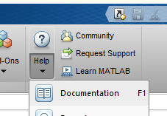

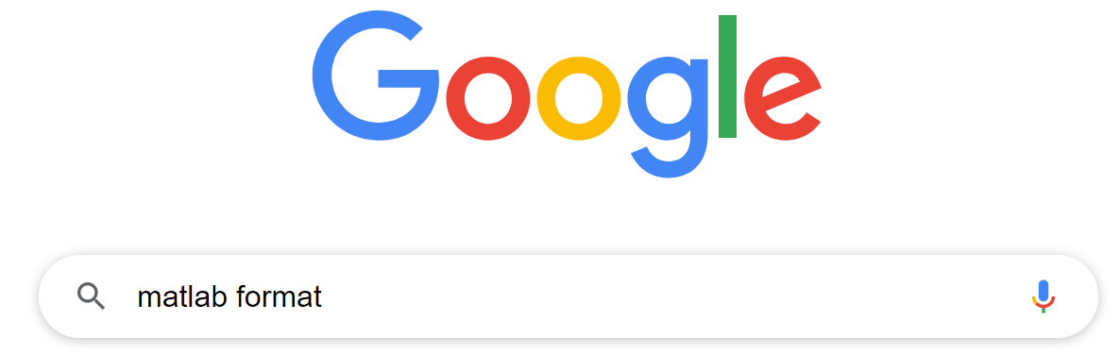
Options for Getting Help
Built in help command:
Built in documentation (F1):
Mathworks web site:
Google:

Slide 11
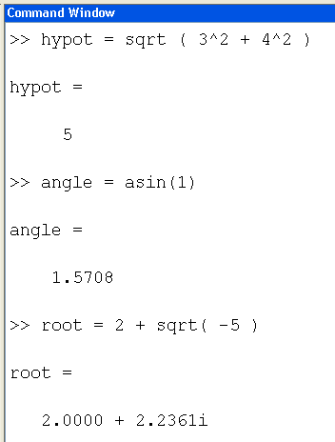
More Examples
Square roots
Note that trig functions generally work in radians, not degrees
In general, all variables are complex numbers

Slide 12
Assigning Variables
The equal sign is an assignment operator
c = 7.5 bob3 = 3.7789
There are naming restrictions:
Connected symbols, starting with a letter
Make them unique
Some are predefined for special values or uses:
pi inf i j ans
(note: if you assign a new value,
the predefined value is lost)

Slide 13
Built in Functions
Matlab has a large library of built-in functions:
abs(x) ceil(x) exp(x) fix(x)
sign(x) floor(x) log(x) round(x)
sqrt(x) conj(x) log10(x) rem(x,y)
sin(x) sinh(x) tan(x) atan2(x,y)
asin(x) acosh(x) atan(x) sec(x)
sind(x) and many more !!

Slide 14
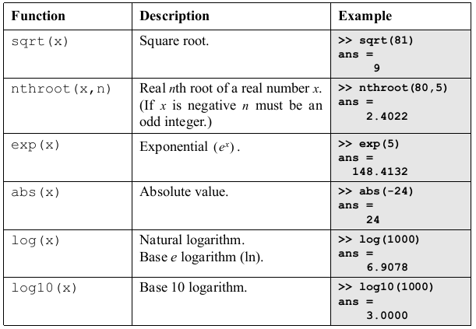
Elementary Math Functions

Slide 15
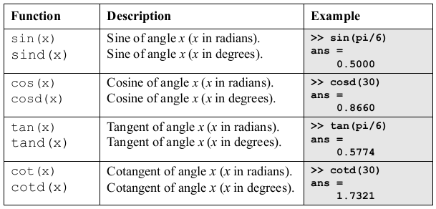
Trigonometric Functions

Slide 16
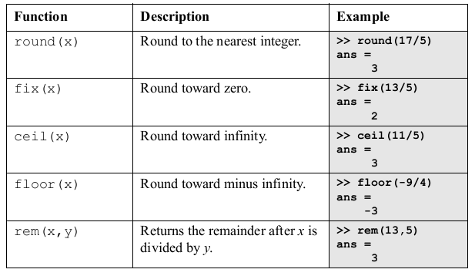

Rounding Functions

Slide 17
Misc. Commands and Features
Other useful system commands:
clear, clc diary
help, lookfor who, whos
Semicolon (;) suppresses the displaying of the result of a computation
Arrow keys allow for editing of prior commands

Slide 18
Introduction to Plotting (more later)
Figure window commands:
figure, figure(3), clf, close
plot(x,y) in which x and y are “arrays”
Annotation commands:
title('the title goes here')
xlabel('the x axis label goes here')
ylabel('the y axis label goes here')

