Slide 1
EGR 106 Foundations of Engineering II
Week 7 Lecture - Part A
Announcements

Slide 2

New Opportunity for URI Undergraduates

Slide 3


Slide 4
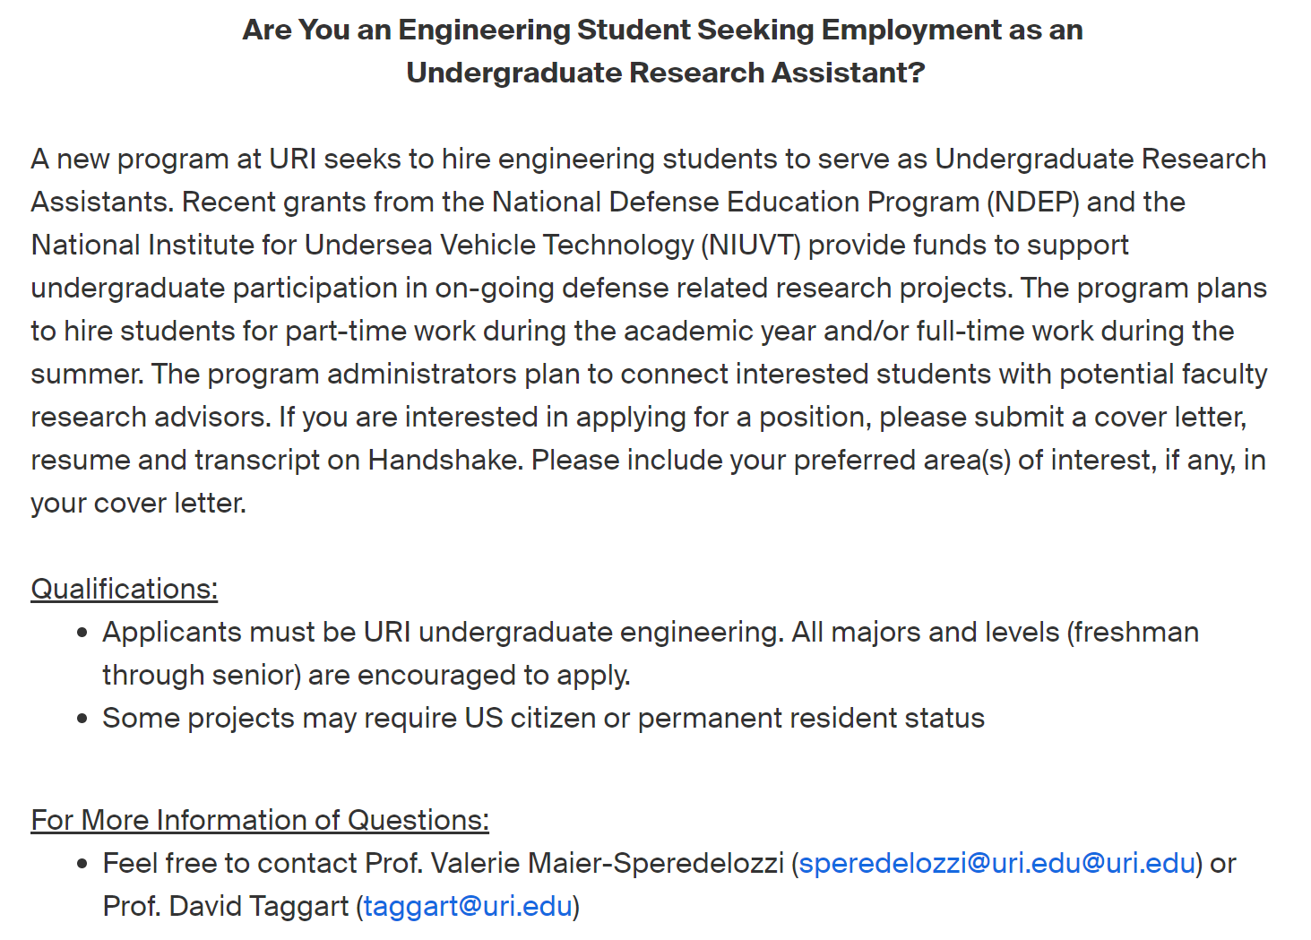
Undergraduate Research Assistant
Funds are available to support undergraduate research projects in defense related areas and can provide hourly pay during both the academic year and summers
We will seek to match interested students with faculty researchers
To apply, go to: https://web.uri.edu/career/handshake/

Slide 5
Exam 1 / Grading
Exam 1 is being graded and will be returned during Tuesday-Thursday sections after Spring Break
Final grade distribution
Quizzes – 10%
Exams – 35% (17.5% each)
Assignments – 25%
T-Th attendance – 10%
Project – 20%
Final letter grades determined by T-Th instructors

Slide 6
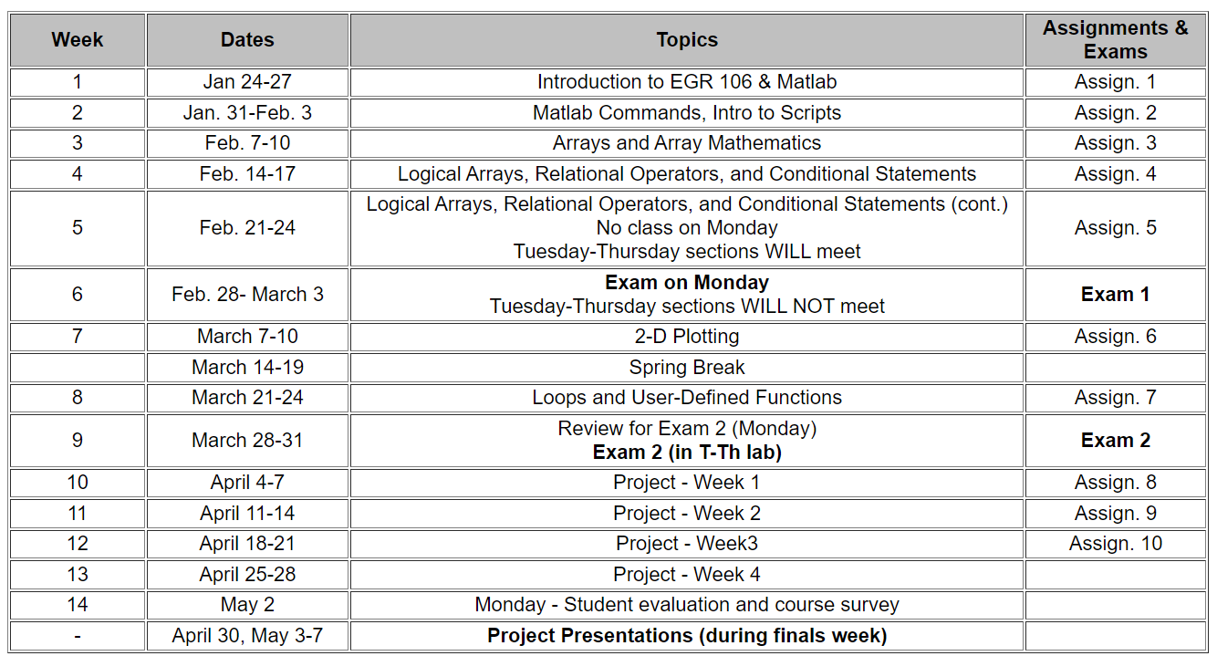
Plans for Weeks 7 - 9

Slide 7
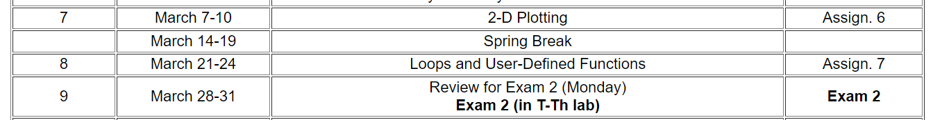
Plans for Weeks 7 - 9 (cont.)
Week 7 (March 7-10): 2D Plotting
Spring Break (March 14-18)
Week 8 (March 21-24): Loops and User Defined Functions
Week 9 (March 28-31):
Lecture - Project Introduction / Exam 2 Review
T-Th Labs – Exam 2 (on computer using Matlab)

Slide 8
Week 7 Quiz
Must be completed by 8 AM, Tuesday, March 8
Don’t wait to the last minute
You may take it up to 10 times
Your highest score will be recorded in Brightspace Grades

