Slide 1
EGR 106 Foundations of Engineering II
Week 7 Lecture – Part B
2D Plotting

Slide 2
This Week’s Topics
2D Plotting
plot command
line specifiers and properties
multiple graphs
formatting a plot
logarithmic axes
special graphs - histograms, pie charts, polar plots, etc.
3D plotting (brief intro)

Slide 3
2D Plotting
Graphical presentation has become the standard method to show technical information. Engineers use plots to analyze, visualize, and present their work.
Matlab provides many powerful plotting tools.
We’ll review some of them today.

Slide 4
A Simple Example
colon and dot
notation for
arrays
x = –3:0.1:3;
y = x.^3 – 5*x.^2 + 4;
plot(x,y)
xlabel('value of x')
ylabel('value of y')
title(‘A Simple Plotting Example')
text(0,-30, ‘EGR106 example')
standard form
for plot
annotation tools

Slide 5
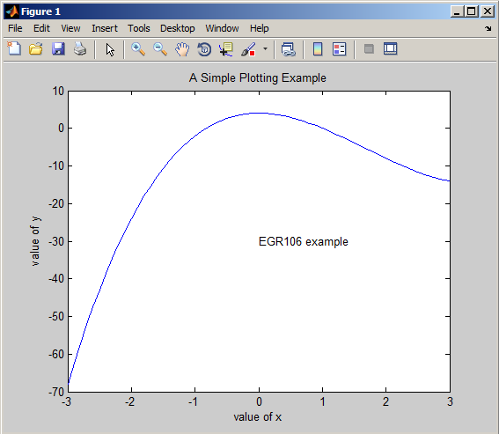
Resulting Plot
By default:
Figure is “Figure 1”,
Lines are blue
Scales are automatic
note axis labels & text

Slide 6
Figure Formatting
Two Approaches:
Interactive figure editing
Command line formatting (recommended)

Slide 7
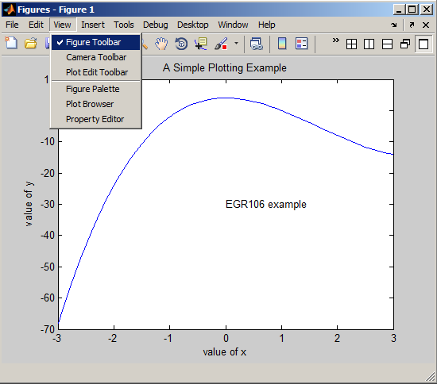
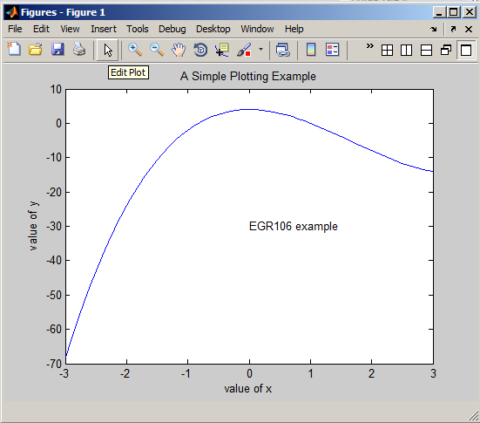
Interactive Figure Editing
Select View => Figure Toolbar
Select “Edit Plot”
Double click on object you’d
like to edit – opens
“Property Editor”

Slide 8
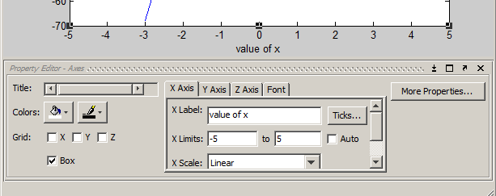
Property Editor
Provides interactive editing of text, axes, line
properties, marker properties
Example – axis editor:

Slide 9
Property Editor vs. Command Line Formatting
Property editor is like a spreadsheet’s tools, but ...
is limited to a single figure
is tedious to repeat for other plots
Often more efficient to use command line plot formatting: plot(x,y, 'linespec' , 'Propname' , PropValue )
line specifiers: color, line type, markers for data
property name and value: thickness, size, etc

Slide 10
Line Specifiers
plot(x,y, '￼ ￼ ￼')
Color:
k black
r red
b blue
g green
y yellow
c cyan
w white
m magenta
Symbol (Marker):
. point
o circle
x x-mark
s square
d diamond
etc.
Line Style:
- solid
: dotted
-- dashed
-. dash-dot
Note: The order is not important !

Slide 11
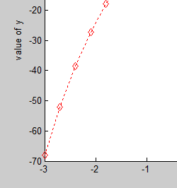
Line Specifiers - Example
plot(x,y, ' r : d ' )
red
dotted line
diamonds

Slide 12
Line Properties
plot(x,y,’ ￼ ’,value)
Properties:
linewidth
markersize
markeredgecolor
markerfacecolor
Value:
varies with each property
sizes in points
colors as strings
Note: Can have multiple properties in one command

Slide 13
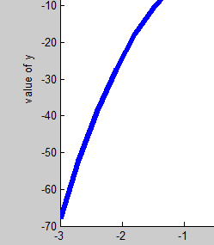
Line Properties - Example
plot(x,y, 'linewidth',5 )
line width is 5 “points”

Slide 14
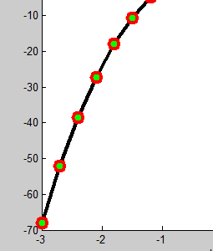
Line Properties – Another Example
plot(x,y, '- k o' , 'LineWidth' , 3, 'MarkerSize', 10,…
'MarkerEdgeColor','red','MarkerFaceColor','green')

Slide 15

Multiple Graphs on Same Plot
Note: Default is solid line with ‘rotating’ colors

Slide 16

Multiple Graphs (cont.)
Each line can have its own specification

Slide 17
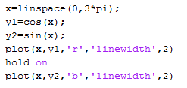
Multiple Graphs using ‘hold’
By default, each plot command will erase previous plots.
The ‘hold on’ command will add plots to existing plots.
Example:

Slide 18
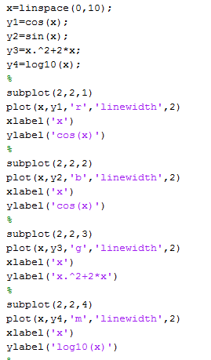
Multiple Graphs in Single Window - Subplot
Argument list is:
rows, columns, subplot number

Slide 19
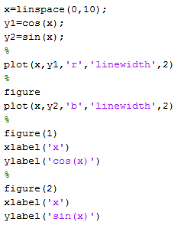
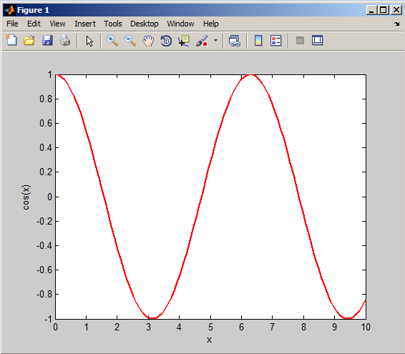
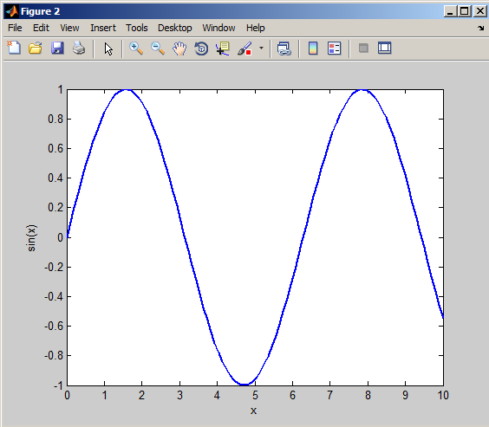
Multiple Figure Windows

Slide 20
Other Useful Commands
figure
opens a new figure window, by default Figure number 1
figure(n) creates new figure window (Figure n), or if Figure n exists, takes you to existing figure window n
text(x,y,’string‘)
used to print text in the figure at location (x,y)
gtext(‘string‘)
used to print text in the figure at location specified by mouse click
ginput(1)
creates crosshairs on the screen
returns (x,y) location of cursor at mouse click
ginput(n) returns n pairs of locations

Slide 21
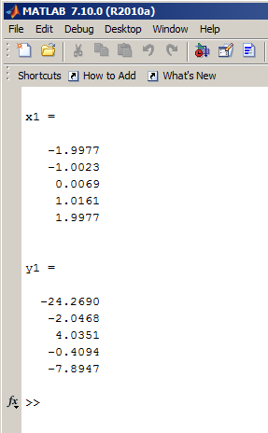
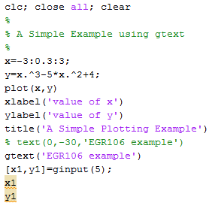
gtext and ginput example
Figure Window
Command Window

Slide 22
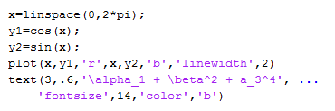
Adding Text with Greek Letters, Subscripts and Superscripts, Color

Slide 23
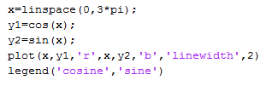
Adding a Legend

Slide 24
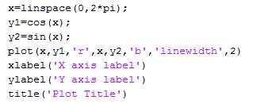
Adding Axis Labels

Slide 25
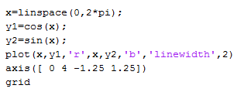
Formatting Axes and Adding a Grid
Adding a grid:
grid
Setting the axis limits:
axis( [ xmin xmax ymin ymax ] )
Example:

Slide 26
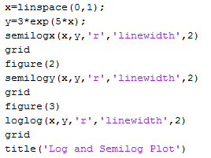
Log and Semilog Plots
semilogx(x,y) semilogy(x,y) loglog(x,y)

Slide 27
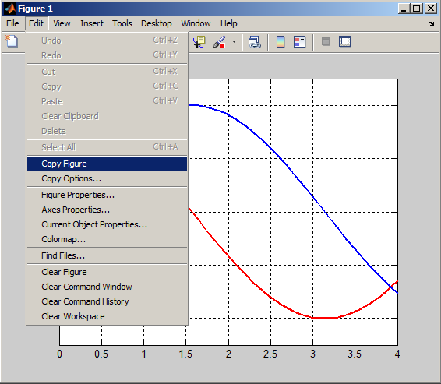
Copying Figures to Other Applications
In Figure window => Edit => Copy
Other application (MS Word, Powerpoint, etc. ) => Paste

Slide 28

Histograms

Slide 29

Pie Charts

Slide 30

Polar Plots
magnitude
angle in radians

Slide 31
Other Plot Types
Vertical bar plot - bar
Horizontal bar plot - barh
Stem plot - stem
Stair plot – stairs
(see text for details)

Slide 32
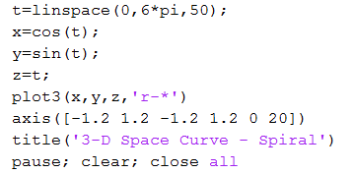
3D Space Curve Plot

Slide 33

3D Surface and Contour Plots

