Slide 1
EGR 106 Foundations of Engineering II
Week 11 Lecture - Part A
Announcements

Slide 2
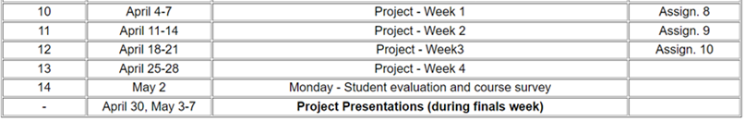
Design Project Schedule
Week 10 (4/4-7)
Introduction to creating shapes
Week 11 (4/11-14)
More shape tools
Creating and viewing 3D models
Week 12 (4/18-21)
Adding color/texture
Week 13 (4/25-28)
Preparing your final presentation

Slide 3
Design Project (cont.)
Deliverables (due last week of classes):
Matlab code
Graphic files (.obj, animated .gif and color/texture definition files)
Project Presentation
Dates & Time: Finals Week
(based on lab section meeting time)
Location: Varies with section (see next slide)

Slide 4
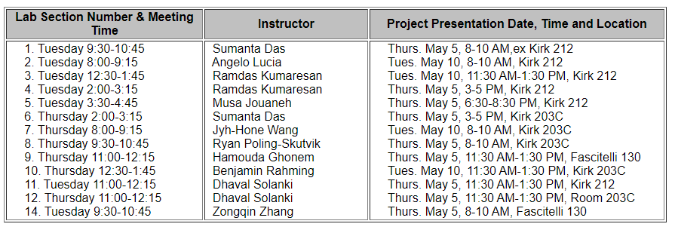
Design Project Presentation Schedule (tentative)

Slide 5
Week 11 Quiz
Must be completed by 8 AM, Tuesday, April 12
Don’t wait to the last minute
You may take it up to 10 times
Your highest score will be recorded in Brightspace Grades

