Slide 1
EGR 106 Foundations of Engineering II
Week 8 Lecture - Part A
Announcements

Slide 2
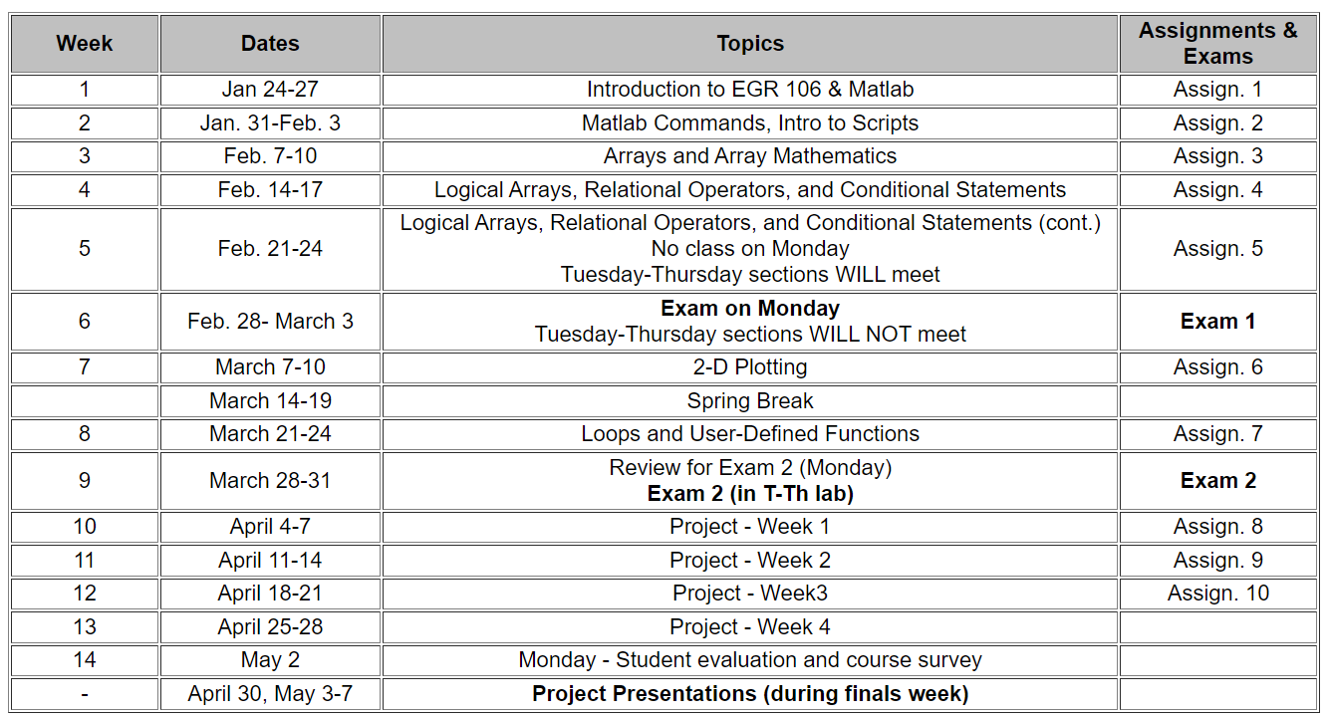
Plans for Upcoming Weeks

Slide 3
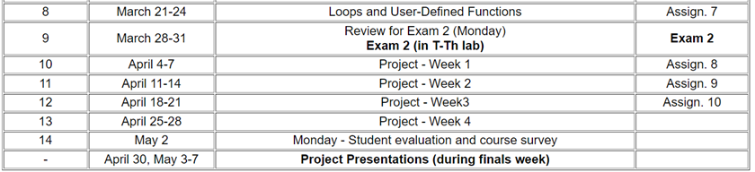
Plans for Upcoming Weeks (cont.)
Week 8 - March 21-24
Loops and User Defined Functions
Week 9 - March 28-31
Lecture – Design Project Introduction / Exam 2 Review
T-Th Labs – Exam 2 (on computer using Matlab)
Weeks 10-13
Design project
Final Exam week
Design project presentations
Schedule to be announced

Slide 4
Week 8 Quiz
Must be completed by 8 AM, Tuesday, March 22
Don’t wait to the last minute
You may take it up to 10 times
Your highest score will be recorded in Brightspace Grades

