Slide 1
EGR 106 Foundations of Engineering II
Lecture 8 – Part B
Loops and User Defined Functions

Slide 2
This Week’s Topics
Programming in MATLAB (cont.)
“for-end” loops (cont.)
“while-end” loops
“break” and “continue” commands
Nested loops
User defined functions

Slide 3
This Week’s Examples – Lecture_8.m
Compound interest using ‘for’ loop
Compound interest using ‘while’ loop
Compound interest using break
Constant acceleration problem
Taylor/Maclaurin series summation
Computing Fourier series with nested loops
User function to convert degrees to radians
User function to estimate sine

Slide 4
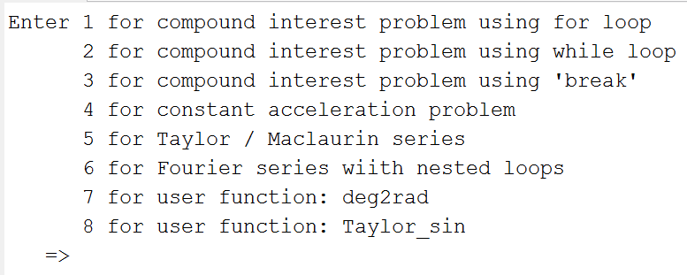
This Week’s Examples (cont.)
Lecture_8.m

Slide 5
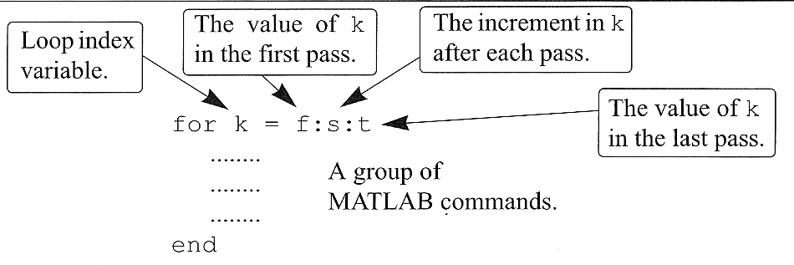
The “for-end” Loop

Slide 6
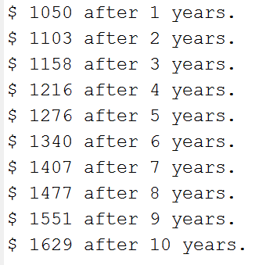
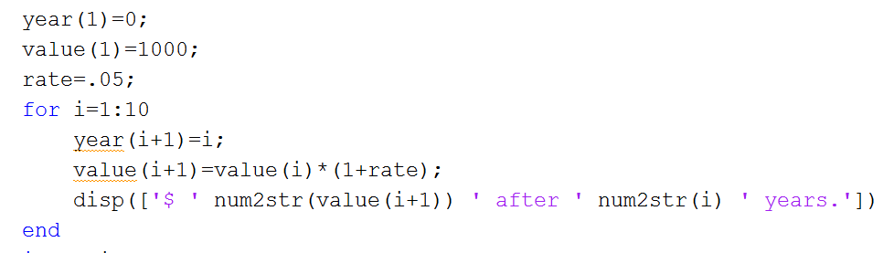
Example 1 – Compound Interest
Calculating 5% interest compounded annually for 10 years:

Slide 7
while – end Command
while conditional expression
. . .
. . .
. . .
end
Loop will continue until as long as conditional expression is true
Be careful to avoid infinite loop
Group of MATLAB commands

Slide 8
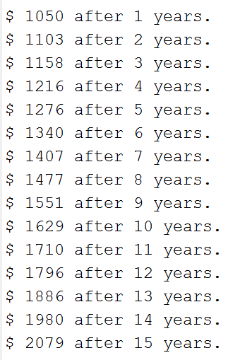
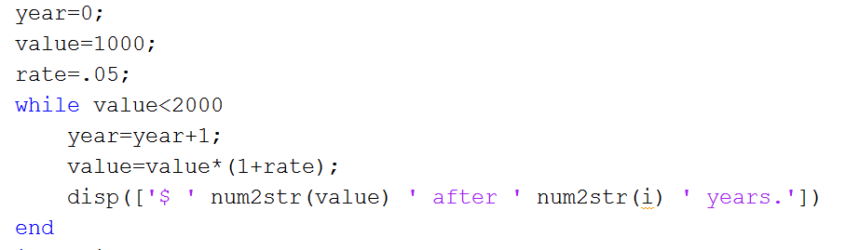
Example 2 – Compound Interest with while loop
Interest (5%) compounded until investment doubles:

Slide 9
Loop Controls
Loops contain sets of commands that you want to do repeatedly.
But you might want to:
Skip commands in the current iteration
Stop the loop itself
Why continue once you’ve found what you’re looking for !!

Slide 10
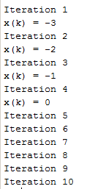
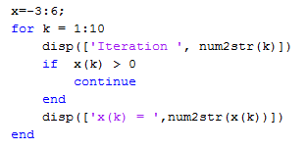
Skipping Ahead: Continue
Continue – jumps to next loop iteration:
skip to end & continue loop

Slide 11
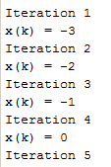
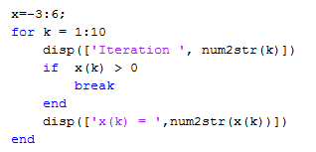
Early Termination: Break Command
Break ends the loop:
go to commands beyond end

Slide 12
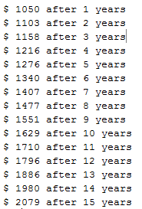
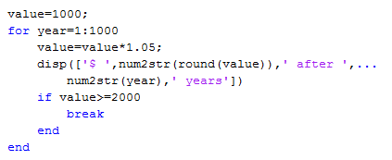
Example 3 – using the Break command
Calculate interest until the amount doubles:
will calculate up to 1000
years, if necessary
if condition decides
when to terminate loop

Slide 13
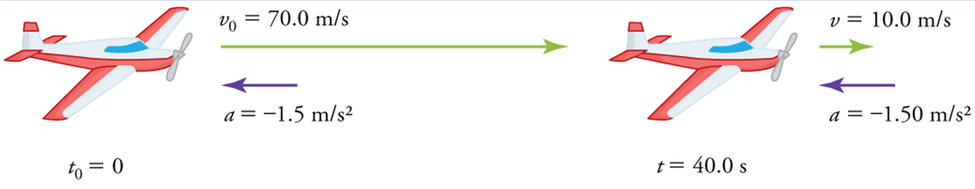
Example 4 – Constant Acceleration
Consider the deceleration a plane after landing:
Landing speed: 70 m/s
Acceleration: a=-1.5 m/s²
Exact solution after 40 seconds:
v(40)=v₀+a t = 70 m/s – 1.5 m/s² (40 s) = 10 m/s
s(40)=s₀+v₀ t + ½ a t² = 0 m +70 m/s (40 s) + ½ (-1.5 m/s²)(40 s)²
= 1600 m

Slide 14



Example 4 – Constant Acceleration (cont.)
Numerical (approximate) solution:
Given
where
solving for s(t+dt) gives
with
determine

Slide 15
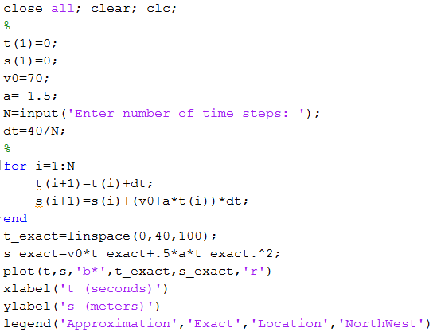

Example 4 – Constant Acceleration (cont.)
Matlab solution:

Slide 16
Example 4 – Constant Acceleration (cont.)
N = 10 steps
N = 50 steps

Slide 17

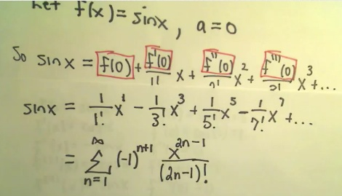
Example 5 – Taylor /Maclaurin Series for sin(x)
Express sin(x) in a Taylor/Maclaurin series expansion
Aside – video on how to find Taylor/Maclaurin series expansion:
http://www.youtube.com/watch?v=dp2ovDuWhro

Slide 18
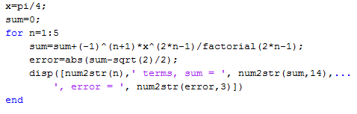
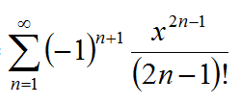

Example 5 – Taylor /Maclaurin Series for sin(x) (cont.)
Sum the series at x=pi/4:
Note:
Important – must first initialize sum

Slide 19
Nested Loops – loops within loops
for index1 = array1
{outer loop commands}
for index2 = array2
{inner loop commands}
end
{more outer loop commands}
end
Note each “for” must have its own “end”
Can be more than 2 levels deep

Slide 20
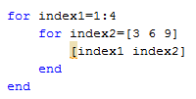
Nested Loops - Example
index1
index2
1 3
1 6
1 9
2 3
2 6
2 9
3 3
3 6
3 9
4 3
4 6
4 9

Slide 21
Example 6 - Computing Fourier Series with Nested Loops
Fourier Series:
any periodic function can be expressed as an infinite series of sines and cosines.
Example:
Sawtooth Wave

Slide 22
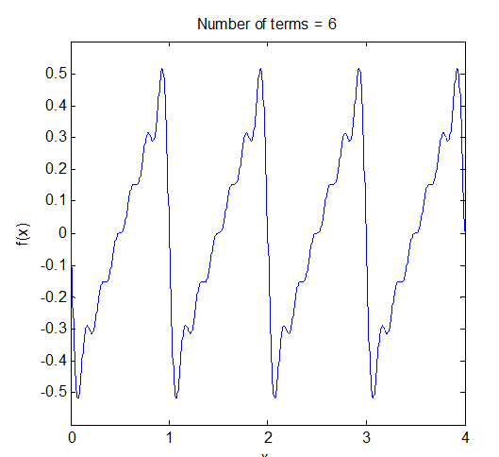
Example 6 - Fourier Series – Sawtooth Function
Fourier Series expansion
Sum of first six terms:

Slide 23
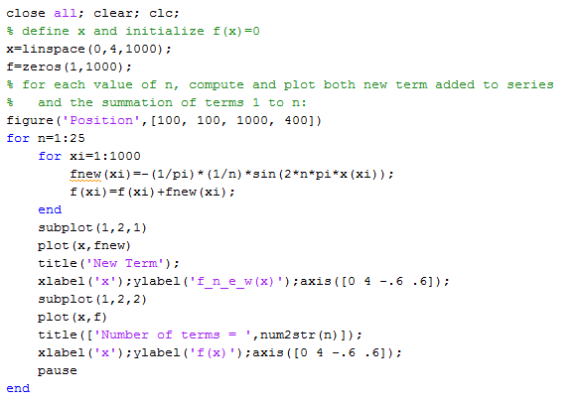
Example 6 - Fourier Series Example (cont)

Slide 24
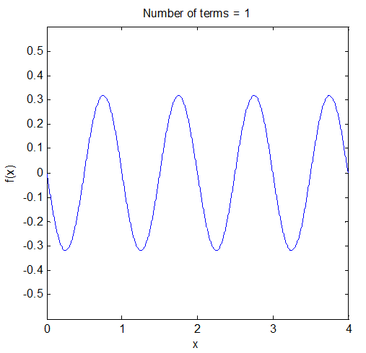
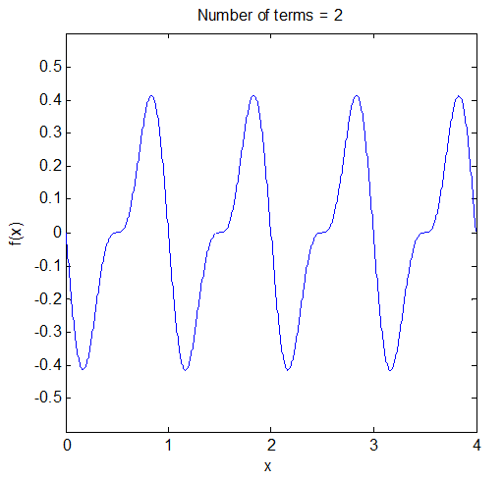
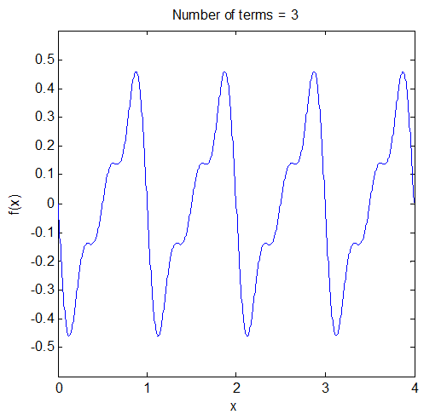
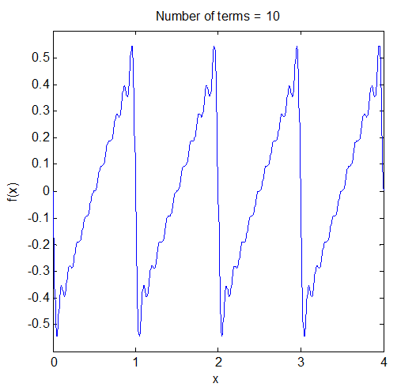
Fourier Series Example (cont)
One term:
Two terms:
Three terms:
Ten terms:

Slide 25
Function Concept
So far:
Have used MATLAB’s built-in functions; for example
sin(x), exp(x), abs(x), . . .
Function:
Reusable script
Sometimes called “user-defined function” or subprogram
Can be used just like built-in MATLAB functions
Useful as a building block for larger programs
Computes an output from an input

Slide 26
Building Block Concept
% Main Program
function
------
------
------
function #1
------
------
------
function #2
------
------
------
------
------
function #3
------
------
------
------
------
------
------
function #1
------
------
------
Functions can be in separate files with filename: “function_name.m” or can be in the same file as main program
function #2
------
------
------
function #3
------
------
------

Slide 27
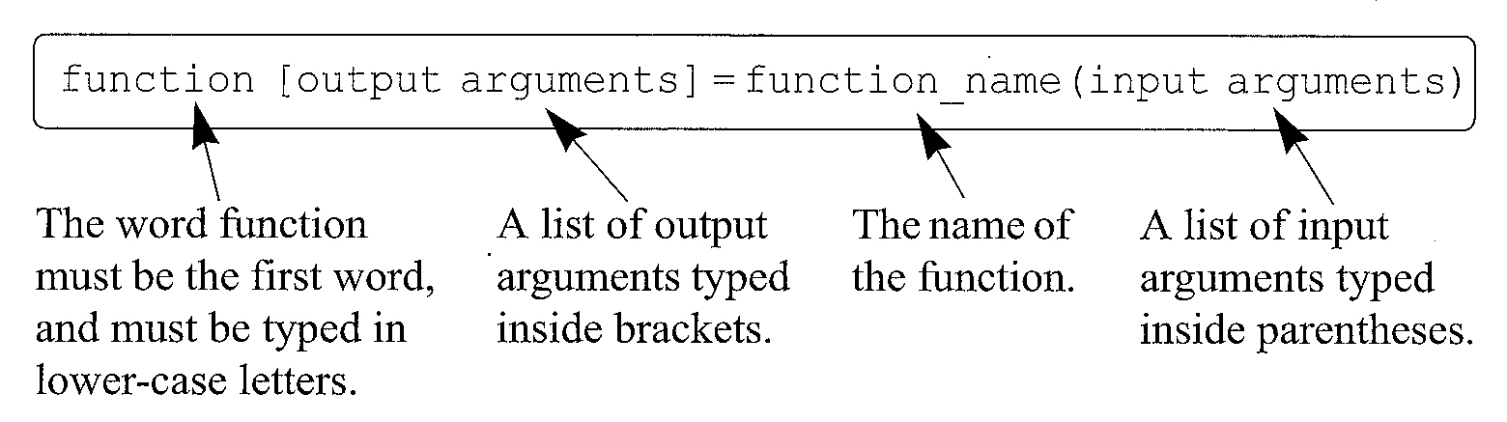
Function File Format
First line of the file must be of the form:
If no input or output arguments are needed:
function function_name

Slide 28
Input to Functions
Used to transfer data into the function from the workspace
Workspace variables are unavailable within the function
Any necessary variables must be brought in
For multiple inputs:
Separate them by commas
Order is important
Examples of built-in functions with inputs:
sum(x) plot(x,y)

Slide 29
Output from Functions
Used to transfer results back into the workspace from the function
For multiple outputs:
Separate them by commas in brackets
Order is important
Output variables must be assigned
Examples of built-in functions with outputs:
y = sum(x)
[value,location] = max(x)

Slide 30
Saving & Using Function Files
Function files must be saved before they can be used.
Files are saved with the same extension “.m” as used for script files.
If saved separately, it is recommend that the file be saved with the same name as the function name.
The function file can be called from: the Command Window, or a script file, or another function.
To use a saved function, it must be in the current folder

Slide 31
Function File Structure
Each function can be a single file
Convenient for large programs where tasks are broken into smaller building blocks that are tested independently
Or, can stack functions in one file (as done in Lecture_7.m)
All blocks in file must be functions (including main program)
Useful for mailing and testing

Slide 32
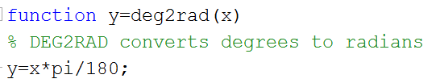
Example 7 – Convert Degrees to Radians
Functions are “called” just like a built-in functions
Application is independent of the variable
names within the function (x,y)
Executed by typing function_name (input)

Slide 33
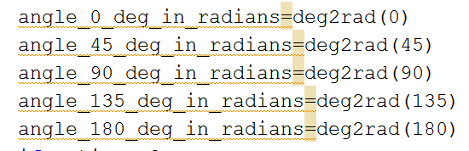
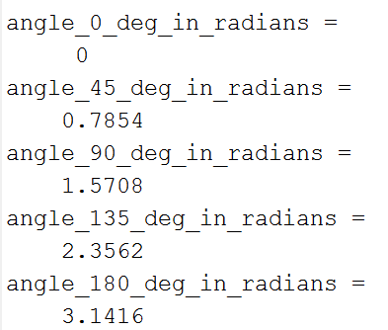
Example 7 – Convert Degrees to Radians (cont)
“Main” program Command Window

Slide 34
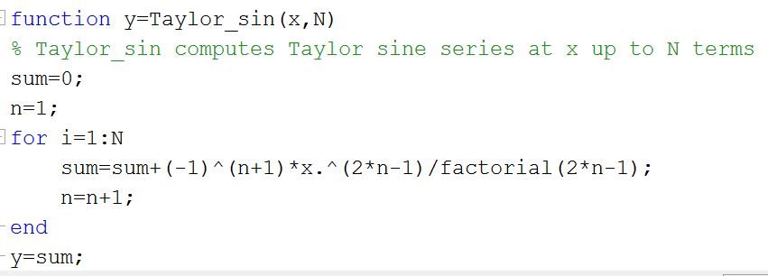
Example 8 – User function to approximate sin(x)
Truncated Taylor series (replace ∞ with N)
User function

Slide 35
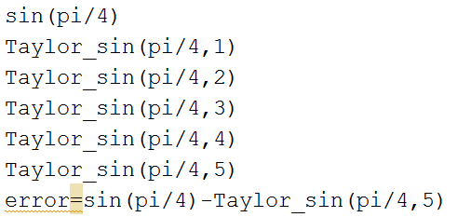
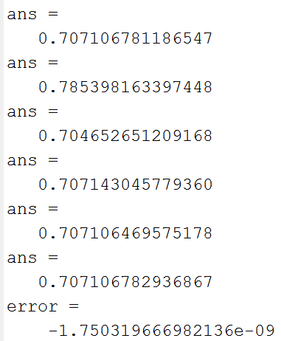
Example 8 – User function to approximate sin(x) (cont)
“Main” program Command Window

