Slide 1
EGR 106 Foundations of Engineering II
Lecture 1 – Course Introduction
David G. Taggart
Dept. of Mechanical, Industrial and Systems Engineering

Slide 2



Program Announcement: Concentration in Naval Science and Technology
Academic program (9 credits):
Seminar course, Navy-related research, Navy-related senior design
Seminar course (1 credit):
“EGR 201 - Seminar in Naval Science and Technology”
Wednesdays 5 PM, Fascitelli 025C
Open to public, All students are welcome to attend
For more details, see program web site:
http://web.uri.edu/naval-science-technology

Slide 3
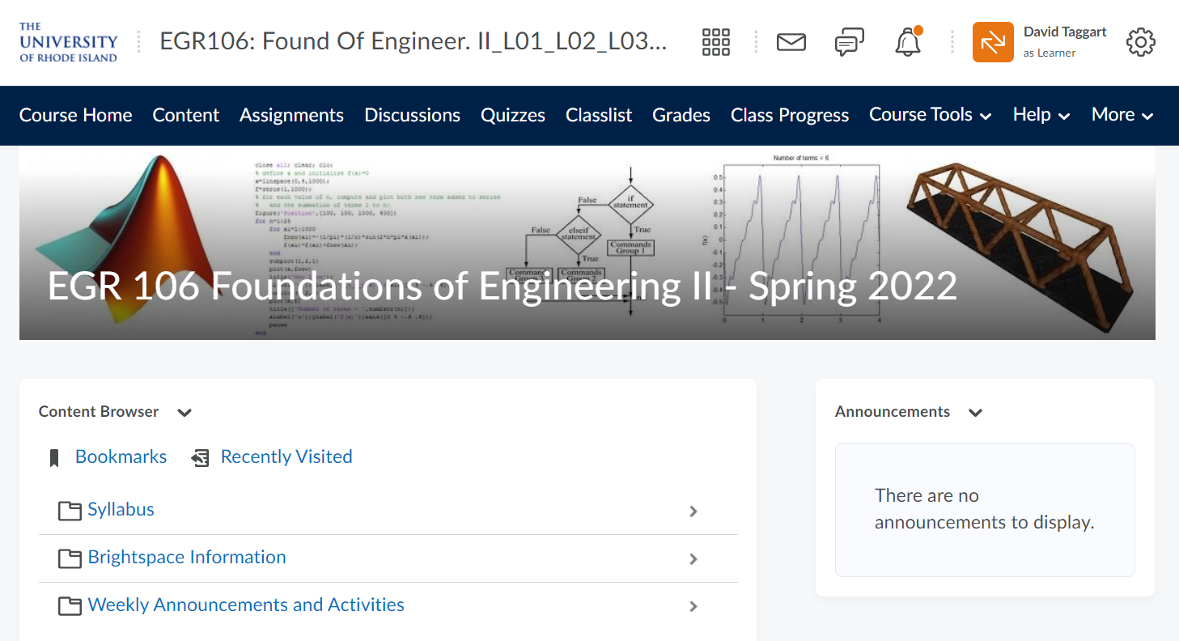
EGR 106 – Course Information
Course Brightspace Site:
Note:
Some Tuesday/Thursday instructors may setup separate Brightspace sites
Weekly assignment grading will be done by Tuesday/Thursday instructors

Slide 4
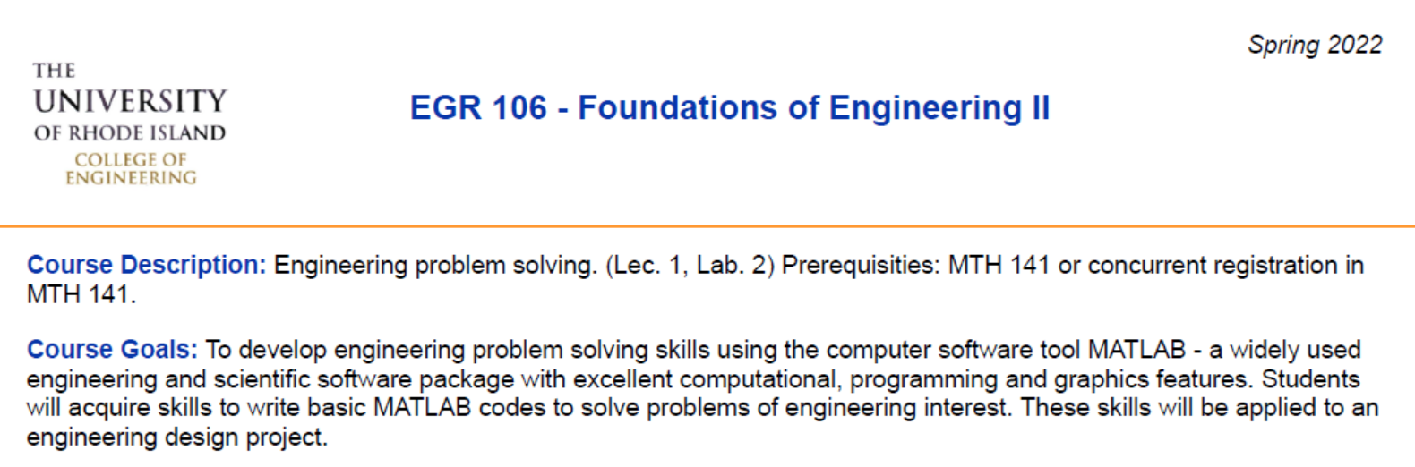
Syllabus
See Brightspace for full syllabus, weekly activities and course materials

Slide 5
Course Objectives
To introduce engineering problem solving methods using the computer software tool MATLAB - a widely used engineering and scientific software package with excellent computational, programmable and graphics features. Students will acquire skills to write basic MATLAB codes to solve problems of engineering interest.

Slide 6

Text
Matlab - An Introduction with Applications, 6th edition, A. Gilat, John Wiley & Sons, 2015 (Online access - under institution, select "Not Listed, click here" and enter URI login credentials.)

Slide 7
Software - Matlab
Options for running Matlab:
Engineering Computing Center (requires ECC account)
Matlab installed on all PC’s in ECC (Kirk & Fascitelli)
Remote access to ECC computers (guac.egr.uri.edu)
Other Devices - free access for URI students
Create Mathworks account with URI credentials
Install on personal computer or run Matlab Online in browser (matlab.mathworks.com)

Slide 8
Course Operation
Monday evening lectures
Week 1: Online Zoom meeting at 4 PM (Week 1 only)
Remaining weeks: Live in-person lectures every week at 4 PM in Pastore Auditorium (attendance optional, open to everyone)
Online video lectures posted each week
Online Quiz (starting week 2) must be taken by 8 AM on Tuesday
Small class sessions (Tues. or Thurs.) - Attendance Required
First Semester Exam – 2/28 (Monday) at 4, 5 or 6 PM (Online)
Second Semester Exam – 3/29 (Tues.) or 3/31 (Thurs.)
Project Presentations– Finals Week (locations and times – TBA)
Grading – Quizzes-10%, HW - 25%, Semester Exams - 35%,
Project - 20%, T/Th Section Attendance - 10%.

Slide 9
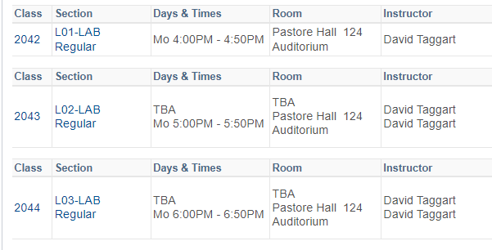
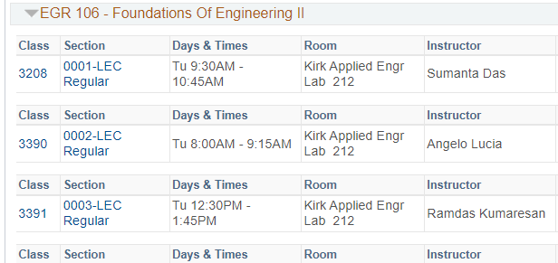
Clarification: Lecture vs. Lab
e-Campus:
In practice (opposite):

Slide 10
Monday Lectures
All Monday lecture materials will be posted online on Brightspace
Weekly materials include:
Powerpoint slides
Videos of narrated presentations and demonstrations
Multiple choice quizzes - Deadline is 8 AM every Tuesdays (before 1st lab session)
Quiz grade (10%) based on online quizzes
Lowest quiz grade will be dropped
Can be taken up to 10 times (highest score is recorded)
Allow time for technical problems

Slide 11
Tuesday / Thursday Sessions
Time: Tuesdays and Thursdays
Location: Sections 12 & 14 – 203C Kirk, all others Kirk 212
Attendance: Required (10%)
Purpose: Weekly assignments - some due at end of class, others due the following week. (25%)

Slide 12
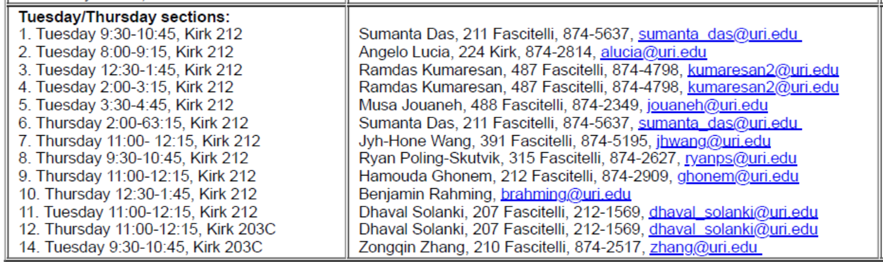
Tuesday/Thursday Sections (cont)

Slide 13
Exams
First Semester Exam (17.5%)
Date: Monday, February 28
Time: Section L01 – 4 PM, Section L02 – 5 PM , Section L03 – 6 PM
Location: TBD
Second Semester Exam (17.5%)
Date: March 29 (Tues.) or March 31 (Thurs.)
Time: During T/Th meeting time
Location: Kirk 212 or 203C

Slide 14
Design Project (20%)
Working in teams, write a Matlab code that creates a three dimensional object
Design considerations:
functionality
aesthetics
use of color and texture

Slide 15
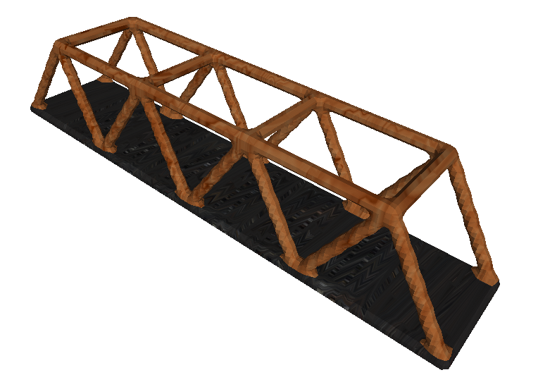
Example – Truss Bridge

Slide 16
Design Project (cont.)
Deliverables (due last week of classes):
Matlab code
Graphic files (.obj and animated .gif)
Project Presentation
Dates & Time: Finals Week
(based on lab section meeting time)
Location: TBD

Slide 17
Student comments about EGR 106
This was an interesting course and I learned alot
This was a very useful and productive class
Definitely a fun course for learning software like this
Was a fun class!
This class was extremely useful when it came to doing my physics homework. Knowing how to use Matlab made calculations for it a whole lot easier.
I loved having the lecture online and it proved to be a good tool in learning the material.
I would have preferred a mandatory in class lecture … I did not feel encouraged to master the material

Slide 18
Student comments about the Design Project
The design project was the best part of the course, I felt it was the best way to learn anything in the course
Loved it! / I think the project is fun. / Very effective way to wrap up the course.
I like the creativity and openness to the project.
Helpful in exploring the capabilities of Matlab
I believe it's a good way to make us use the skills learned in this class
It was an interesting project. It gave the ability to work as a team which gave experience as many engineering jobs you will work as a team. Also it was fun to see the different ideas people came up with.
Matlab not the best tool for the project, other CAD programs would have been better for this type of assignment

Slide 19
Why MATLAB?
Student comment: “I am still unclear of the situations in which Matlab would be useful as opposed to other programming options such as Mathematica, Python, Java, or C.”
Many programming languages are commonly used: Python, Java, C++, Ruby, Javascript, Matlab, Mathematica, VBA, R, Perl and many more.
Advantages of MATLAB:
Widely used in industry and research labs for technical computing
Provides user-friendly programming environment and help system
Extensive library of built-in functions
Powerful graphics capabilities for visualization and image processing
At URI, MATLAB is used in numerous upper level engineering courses
Disadvantages of MATLAB:
Slower execution times
Commercial product (many programming languages are free to use)

Slide 20
Prior to attending T/Th class this week
For ECC computer access, be sure to have your ECC login name and password (same as account used in EGR 105, for assistance – see Help desk in ECC (203 Kirk) or e-mail eccmanager@egr.uri.edu with student ID number.

