Slide 1
EGR 106 Foundations of Engineering II
Lecture 2
Announcements

Slide 2
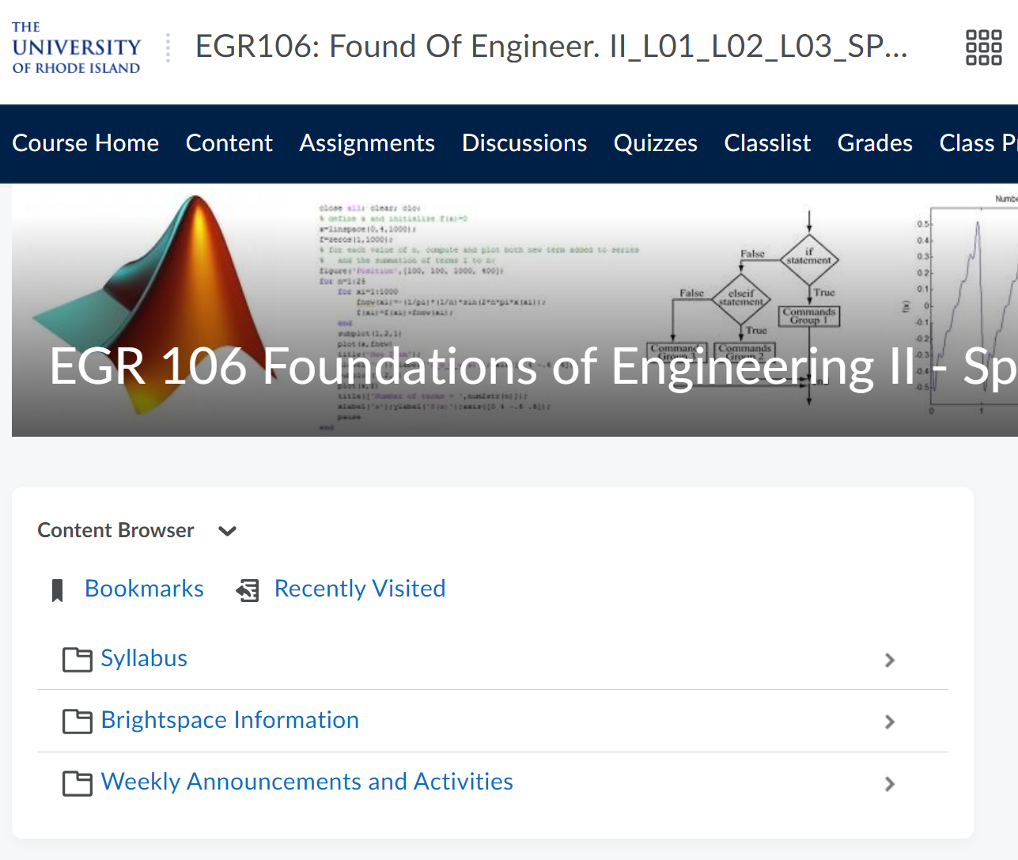
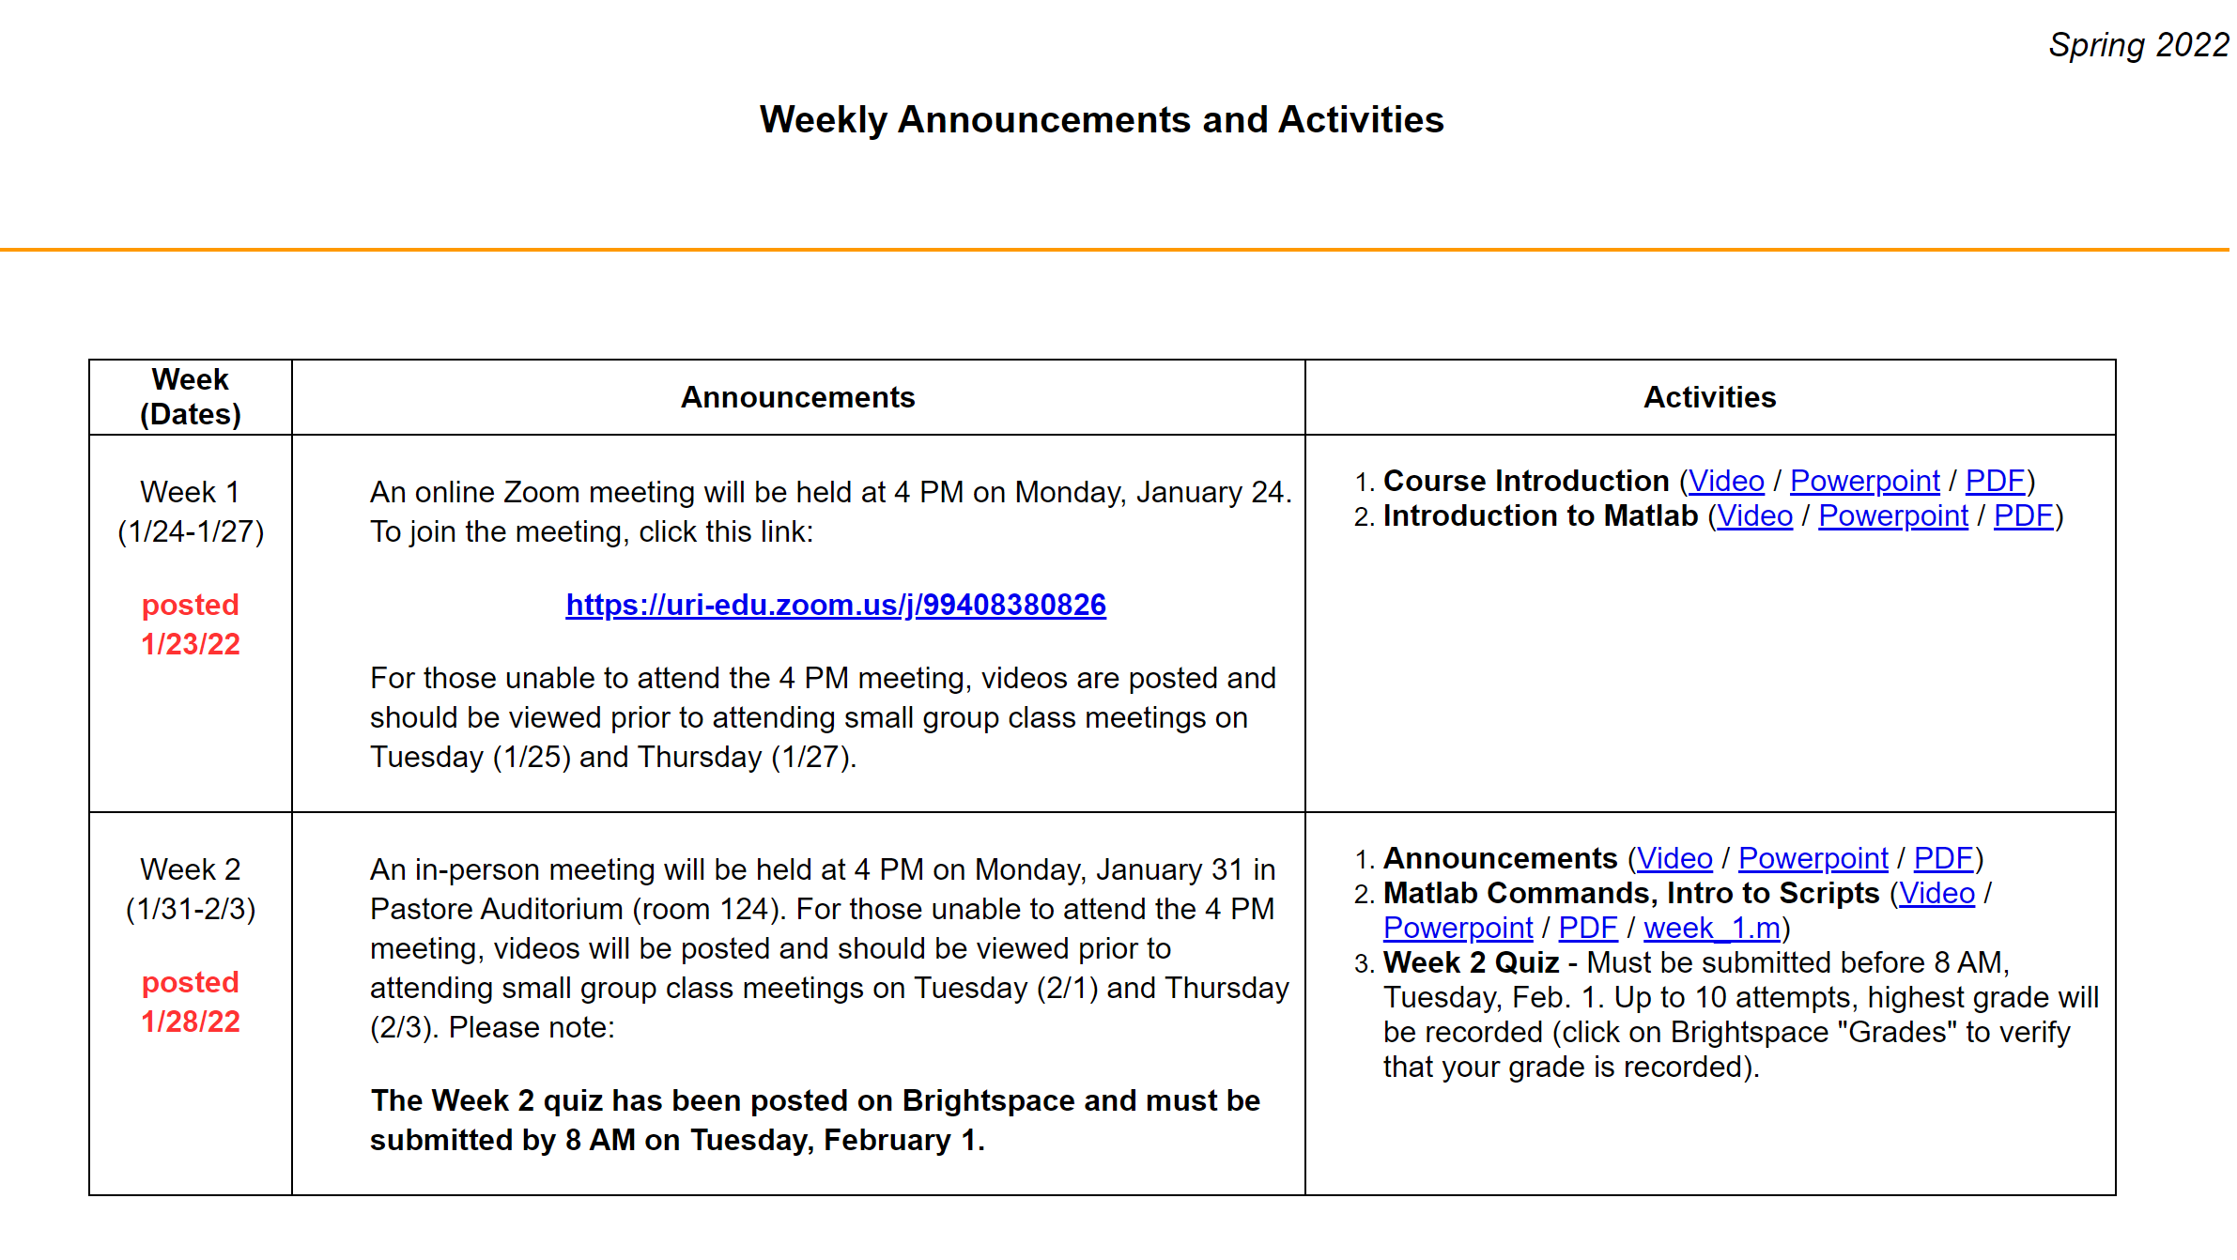
This Week’s Activities
Go to Brightspace => Course Home > Weekly Announcements and Activities > Week 2

Slide 3
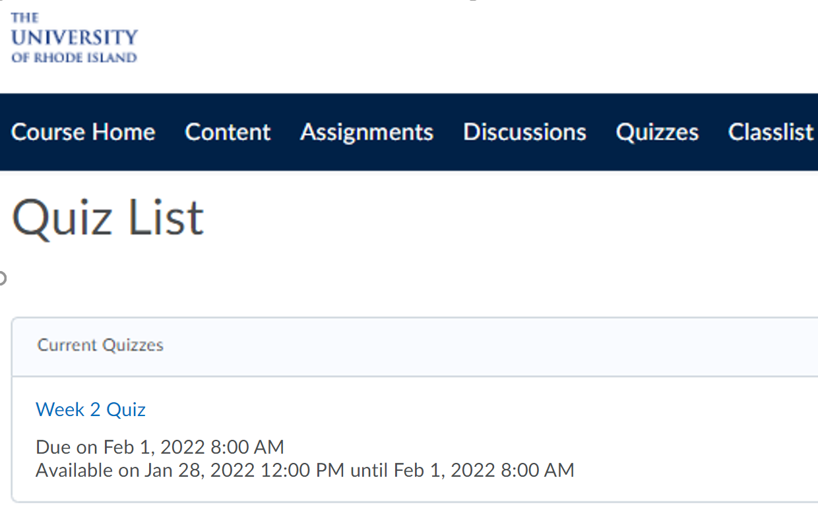
Instructions for Week 2 Quiz
Go to Brightspace => Quizzes > Week 2 Quiz

Slide 4
Online Quizzes
You have up to 10 attempts. Your highest score will be recorded under Brightspace => Grades
Quizzes must be completed by 8 AM on Tuesday (before 1st lab meeting).
Be sure to take the quiz by 8 AM, Tuesday 2/1
Recall that we will drop your lowest quiz grade to allow for forgotten quizzes, illness, etc.
If you miss a quiz, the missed quiz is the one to be dropped

