Slide 1
EGR 106 Foundations of Engineering II
Lecture 2
Scripts and Arrays

Slide 2
This Week’s Topics
Scripts
Script concept and useful script commands
Matlab file editor
Example: Week 1 Assignment
Arrays
Arrays & array size
Creating Arrays in Matlab
Concatenation, the “Colon” Operator and the linspace command

Slide 3
Scripts – Simple Programs
Last week, commands have been typed in the command window:
Executed by pressing “enter”
Edited using the arrow keys or the history window
This is a very tedious method to use MATLAB
Much better to save the commands in a script file

Slide 4
Script Concept
A file (called ‘m-file’) containing MATLAB commands
Can be re-executed
Is easily changed/modified
Is savable and can be e-mailed to someone else
Commands are executed one by one, sequentially
File is executed by typing its name (without .m)
Results appear in the command window
(or use ; to suppress output to the command window)
Can be created using any text editor
.m extension
Listed in Current Directory window

Slide 5
Useful Script Commands
clc – clears the command window
clear – clears variables from workspace
close all – closes all figure windows
% - creates comment, everything to the right of % is ignored
pause – stops operation and waits for a key press
pause(n) – stops operation and waits for n seconds
disp – a simple way to display text or arrays in the Command Window
format compact – removes spaces between lines in the command window output
Good to use at beginning of code

Slide 6
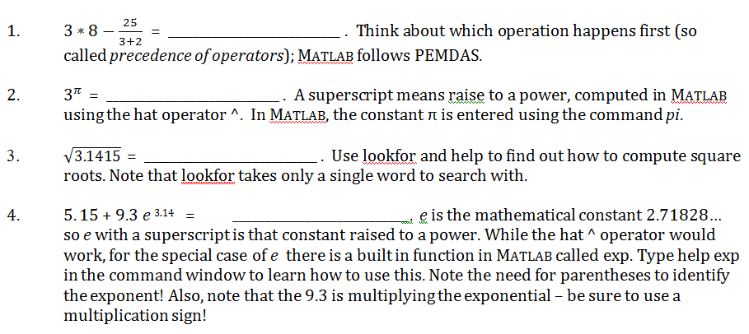
Example: Week 1 Assignment

Slide 7
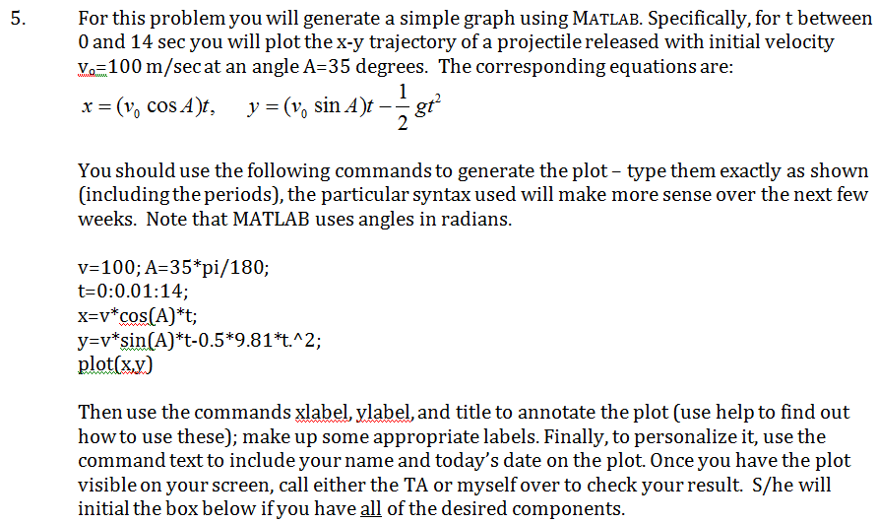
Example: Week 1 Assignment (cont.)

Slide 8
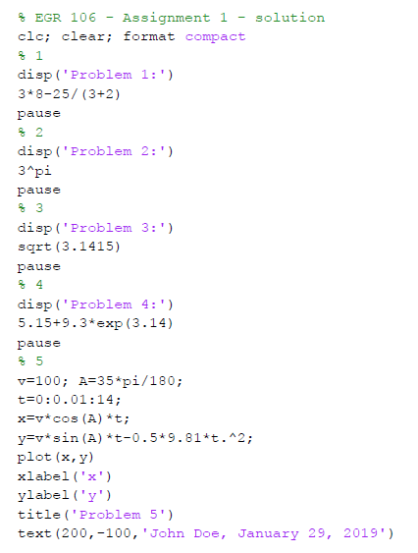
Example: Week 1 Assignment (cont.)
Matlab script (week_1.m):

Slide 9
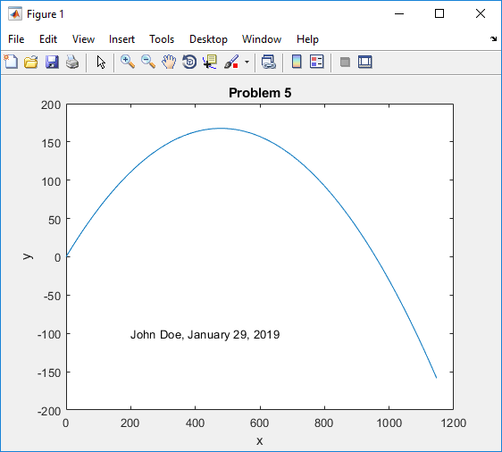
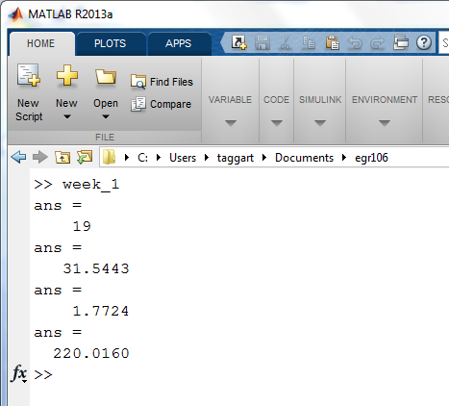
Example: Week 1 Assignment
Type script name in Command Window
Figure window created by plot command
Script output displayed in Command Window

Slide 10
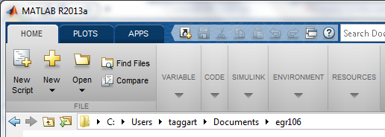
Matlab’s Built-in, Color Editor:
Can create a new file or open an existing M-file (icons or click on file name)
Color used to aid in file creation (command types, typos, etc.)
Opens an Existing File in Editor Window to Edit & Save
Opens Editor Window to Create New M-File

Slide 11
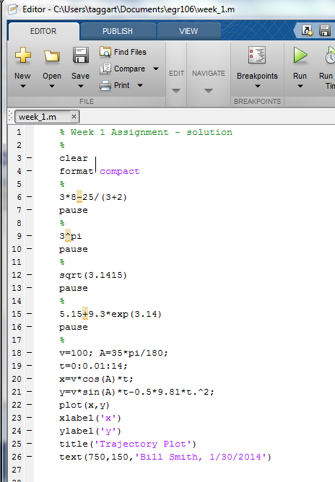
Editor Window
In this window: - type & edit commands - run program - save work when finished

Slide 12
Features of MATLAB Editor
Familiar Windows menus
Line numbers
“Run” button or F5
Comment lines (begin with ‘%’)
Note use of semicolons to suppress output
Note use of colors

Slide 13
Array Concept
Arrays are the fundamental data units in MATLAB
Rectangular collection of data
All variables are considered to be arrays
Data values organized into rows and columns

Slide 14
Array Size
Size or dimension of an array:
number of rows and columns
written as R by C or R x C
where R = number of rows
C = number of columns
e.g.
yield is 3 by 4
test is 1 by 5

Slide 15
Special Size Arrays
scalar: 1 x 1 array 4 or [4]
row vector: 1 x C array
[ 9 7 5 4 2 ] is a 1 x 5 row vector
column vector: R x 1 array
is a 3 x 1 column vector

Slide 16
Special Size Arrays (cont.)
If R = C => square matrix
If R = C = 0 => null matrix [ ] (a pair of empty brackets)

Slide 17
Creating Arrays
Direct specification:
Name followed by an equal sign ( = ), just like variables
List values within a pair of brackets ( [ ] )
Enter data one row at a time
left to right, top to bottom order
space or comma between the values
rows separated by semicolons or the enter key

Slide 18
Creating Arrays - Examples
To get
type
b = [ 4,5,3,9; 10,4,66,20; 18,-3,2,0 ]
or
b = [ 4, 5, 3, 9
10, 4, 66, 20
18, -3, 2, 0 ]
Press Enter to start new lines

Slide 19
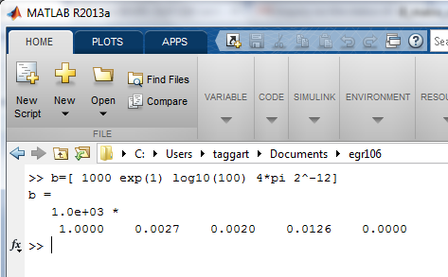
Creating Arrays (cont.)
Can use simple math operations as well as numbers as the entries:
Note the common format of all entries in the response
(exp(1) = e = 2.71828, log₁₀(100) = 2, 2⁻¹² = 0.00024414)
MATLAB scales the exponent to the largest entry !!

Slide 20
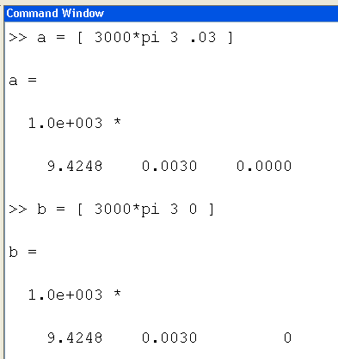
Creating Arrays (cont.)
Scaling is sometimes deceptive:
Not really zero
Really zero

Slide 21
Concatenation
Concatenation – “gluing arrays together”
if a = [ 1 2 3 ] & b = [ 4 5 6 ]
Attaching left to right – use a comma
[ a, b ]
Attaching top to bottom – use a semicolon
[ a; b ]

Slide 22
Concatenation (cont.)
Note that sizes must match for this to work:
if a = [ 1 2 3 ]
then
[ a, b ] = ?? [ a; b ] = ??
Size needs for concatenation:
# of rows the same for side by side (comma)
# of columns the same for top to bottom (semicolon)

Slide 23
The Colon Operator
The colon operator
first : increment : maximum
yields a row vector of equally spaced values
Examples: 0 : 2 : 10 => [ 0 2 4 6 8 10 ]
1 : 5 => [ 1 2 3 4 5 ]
7 : -2 : -3 => [ 7 5 3 1 -1 -3 ]
1 : 2 : 8 => [ 1 3 5 7 ]
Note: default for increment is 1
Note – does not hit 8!!

Slide 24
The linspace Command
linspace – like the colon operator, but definitely gets the last number on the list
linspace ( start, last, number of values)
Examples:
linspace(0,10,6) => [ 0 2 4 6 8 10 ]
linspace(0,1,4) => [ 0 0.333 0.667 1 ]
Default for number of values is 100
linspace(0,10) => [ 0 0.101 0.202 … 10 ]
100 points, 99 intervals

