Slide 1
EGR 106 Foundations of Engineering II
Lecture 4 - Part A
Announcements

Slide 2
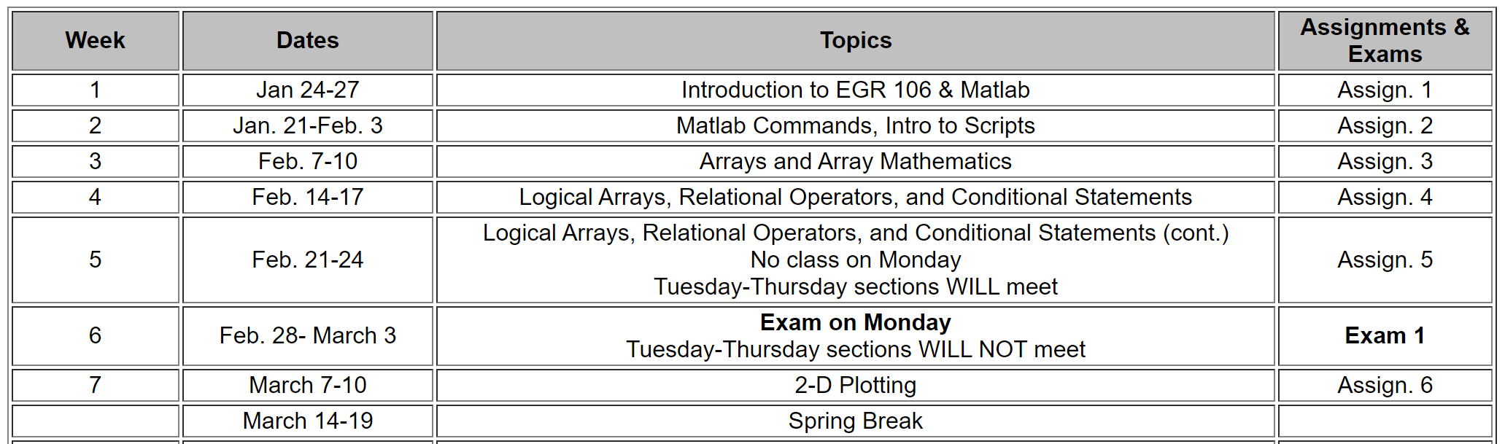
Next Few Weeks

Slide 3
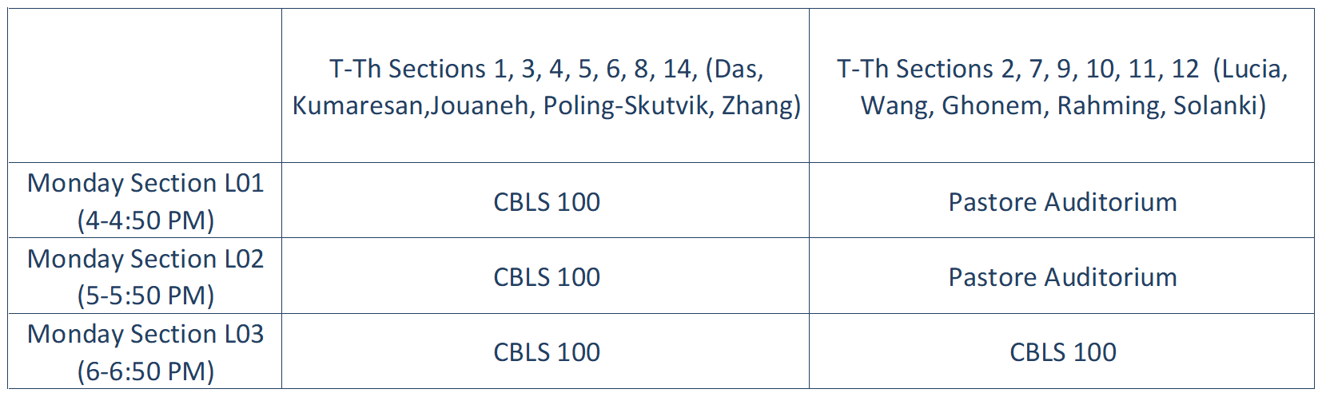
Exam 1
Monday, February 28
Monday Section L01: 4 - 5 PM
Monday Section L02: 5 - 6 PM
Monday Section L03: 6 - 7 PM
Locations (based on lab section):

Slide 4
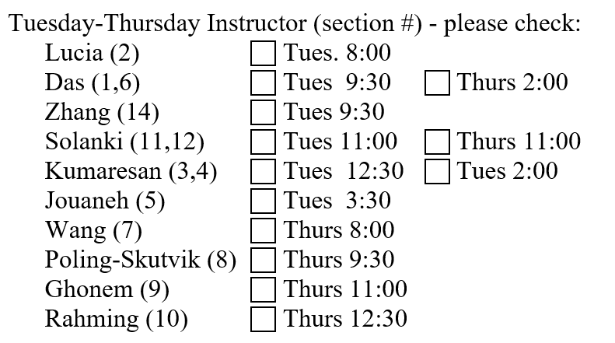
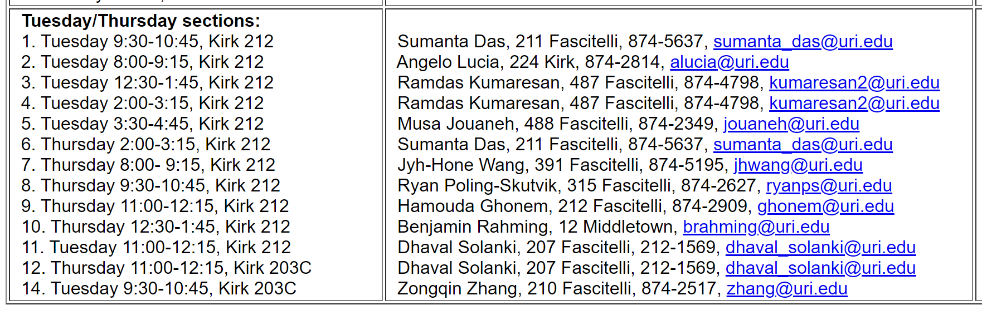
Exam 1 (cont.) Be sure to know your T-Th instructor & section number

Slide 5
Exam 1 ( cont.)
Topics (Weeks 1-3):
Basic MATLAB Commands
Scripts
Arrays and Array Mathematics
Closed book, closed notes, no calculators
See Brightspace for Sample Exam and Review Sheet (look under ‘Week 4 Announcements and Activities’)
Time Conflicts and/or Accommodation Requests - See me (or send e-mail) ASAP

Slide 6
Today’s Lecture
Logical Arrays
Relational Operators
Conditional Statements
Brief Introduction to Loops

Slide 7
Online Quiz
Be sure to take the Week 4 Quiz by 8 AM Tuesday February 15th.
Don’t wait to the last minute
You may take it up to 10 times
Your highest score will be recorded

