Slide 1
EGR 106 Foundations of Engineering II
Lecture 4 – Part B
Logical Arrays, Relational Operators, Conditional Statements and Loops

Slide 2
This Week’s Topics
Programming in MATLAB
More on scripts
Input / output
Logical Arrays
Relational Operators
Conditional Statements
“for-end” loops

Slide 3
Recall - Useful Script Commands
clc – clears the command window
clear – clears variables from memory
close all – closes all figure windows
% - creates comment, everything to the right of % is ignored
pause – stops operation and waits for a key press
pause(n) – stops operation and waits for n seconds
Good to use at beginning of code

Slide 4

Other “Tips” for MATLAB Scripts
To continue a long line of code use three periods at end (…), hit enter and continue typing the remainder of text on next line
Typing “Ctrl-c” in command window will interrupt the current computation

Slide 5
Input – Allowing Users to Enter Data
Using the “input” command:
Numeric:
x = input(‘Please enter a number: ')
String:
x = input(' Please enter a string of characters: ', 's')

Slide 6
Output - How scripts show or output data:
Simply type array name – will show in Command Window
Use of disp command to display results:
- Existing array (a single array only – if necessary, use concatenation)
disp(x) or disp([x,y])
- Text
disp(' The task is done ')
- Concatenate text strings with numerical results using ‘num2str’
(see last week’s lecture)
Formatted output - use of fprintf command (we’ll skip for now)

Slide 7
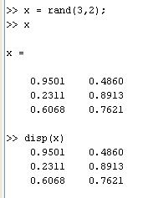
Example – disp command
Note that disp shortens the resulting output by dropping the array name and removing blank lines

Slide 8
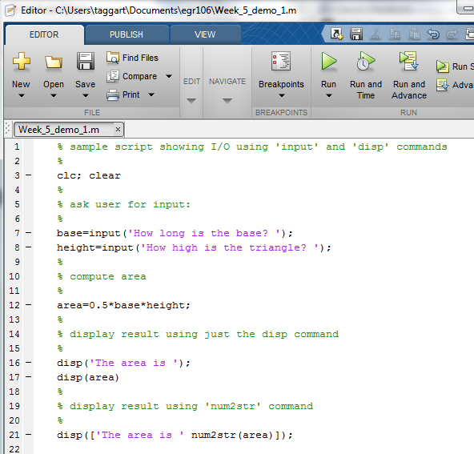
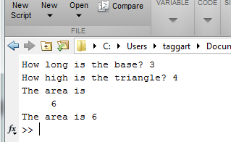
Example – Input/Output (I/O)
Command Window Output
input
disp
num2str (see last week’s lecture)

Slide 9
Programming in MATLAB
So far, we’ve looked at simple programming using scripts of sequentially evaluated commands
In more advanced programs, commands are not always executed in order. Examples:
Decision-making within the program controls program flow
Repeated sequence of commands (loops)
Calls to separate subprograms (user-defined functions)

Slide 10
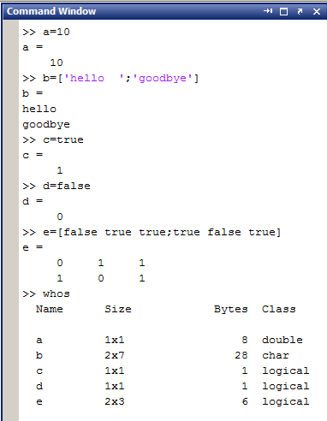
Logical Variables / Arrays
Matlab variable types:
numbers
character strings
logical (0=false, 1=true)

Slide 11
Relational Operators
Compares two numbers or arrays and decides if relation is true (1) or false (0).
Relational Operator | Description
< | Less than
> | Greater than
<= | Less than or equal to
>= | Greater than or equal to
== | Equal to
~= | Not equal to

Slide 12

Relational Operators (cont.)
Examples:
Is 3 less than 4 ? - true
Is 3 greater than 4 ? - false
Is 3 equal to 4 ? - false
Is 3 equal to 3 ? - true
Is 3 not equal to 4 ? - true

Slide 13
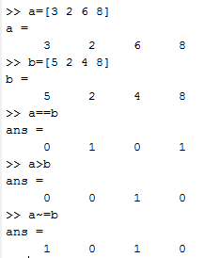
Relational Operators – Applied to Arrays
For arrays, relational operations are applied term-by-term
Examples:

Slide 14
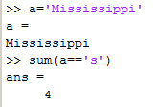

Relational Operators – More Examples
Combining math and relational
operations:
How many s’s in Mississippi?

Slide 15
Logical Operators
AND, OR, XOR and NOT:
Logical Operator | Name | Description
& Example A&B | AND | True if A and B is true
| Example A|B | OR | True if A or B is true
xor Example A xor B | XOR | Exclusive OR – true if A or B is true but not both A and B are true
~ Example: ~A | NOT | If A is true, ~A is false If A is false, ~A is true

Slide 16
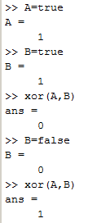
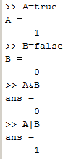
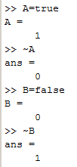
Logical Operators - Examples

Slide 17
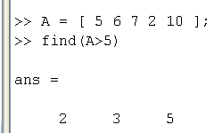
Other Logical Operators
Logical Operator | Description
all Example: all(A) | True if all elements of A are true
any Example: any(A) | True if any elements of A are true
find Example: find(A) | Returns the indices of nonzero (true) elements of A
Example:

Slide 18

Logical Operators Applied to Numbers
A and B are interpreted as logical (binary):
Numeric 0 is interpreted as false
All else is interpreted as true (equal to 1)
Example:
When logical operators are applied, A is false, B is true

Slide 19
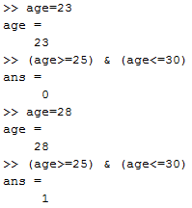
Logical Operators – Examples
“Are you between 25 and 30 years old?”
(age>=25) & (age<=30)

Slide 20
Order of Precedence
Parentheses ( )
Transpose(') and exponentiation (.^)
Negation (-) and logical negation (~)
Multiplication (.*) and division (./),
Addition (+) and subtraction (-)
Relational operators (<, <=, >, >=, = =, ~=)
Logical AND (&)
Logical OR (|)

Slide 21
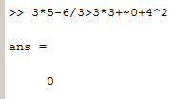
Order of Precedence - Examples
Consider:
3*5-6/3>3*3+~0+4²
15-2>9+1+16
13>26
0

Slide 22
Branches and Conditional Statements
Commands to select and execute certain blocks of code, skipping other blocks.
Common types in MATLAB include:
if / else
switch
try / catch
We will only discuss and use “if / else”

Slide 23
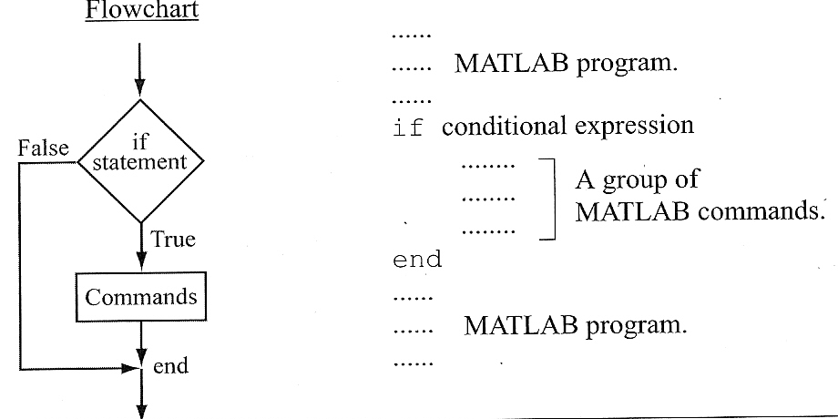
if – end command

Slide 24

if – end (cont.)
Another example: Ask if a plot should be drawn
in editor, blue color & auto indent

Slide 25
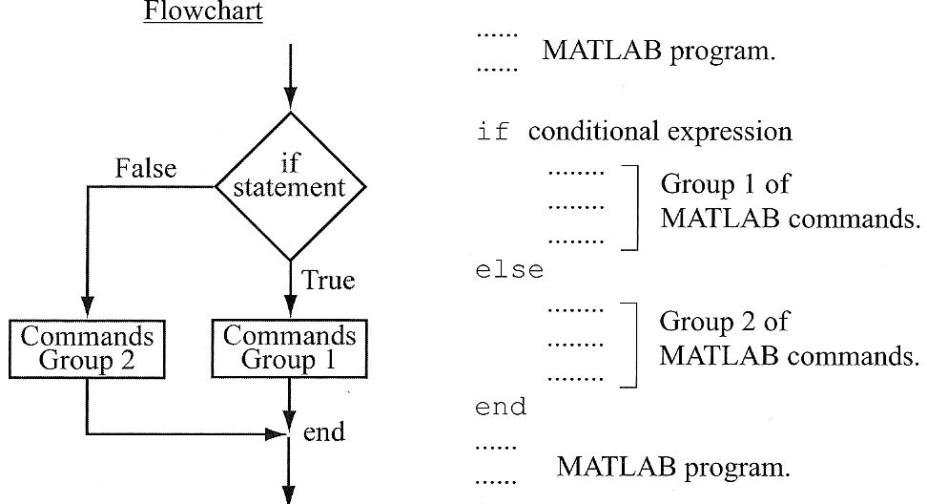
“if – else – end” Command

Slide 26
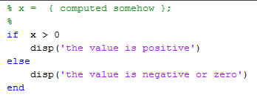
“if – else – end” (cont.)
Example – output whether a variable x is positive or not:

Slide 27
“if – else – end” (cont.)
What if there are more than 2 pieces of code to make a choice on? For example:
Example - 4 choices:
convert a compass angle to a direction
0° → east
90° → north
180° → west
270° → south

Slide 28
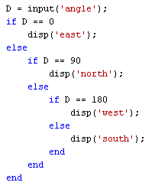
“if – else – end” (cont.)
Using “nested” if-else-end:
Better to use if-elseif-else-end
Example: Convert a compass angle to a direction:
0° → east
90° → north
180° → west
270° → south

Slide 29
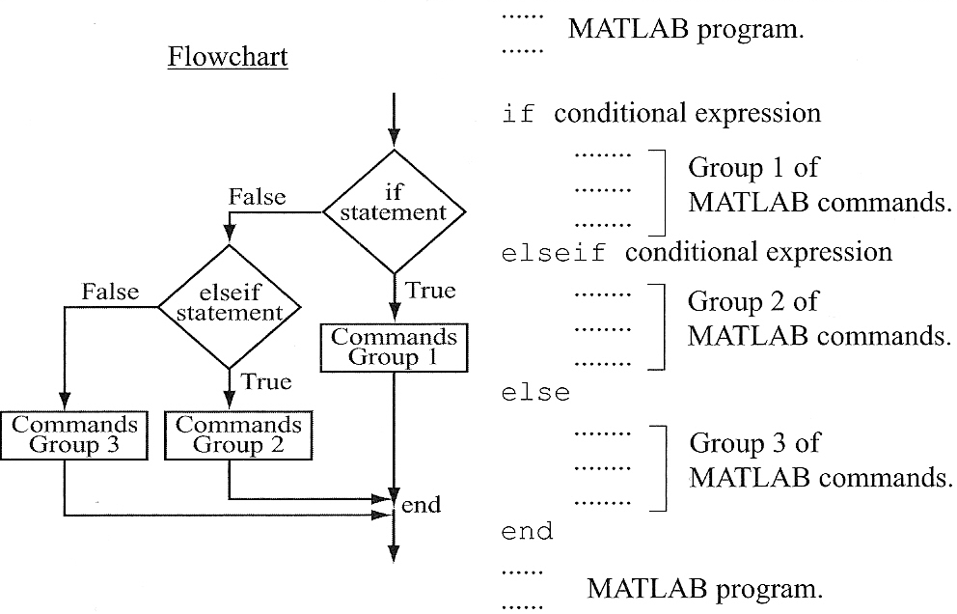
“if-elseif-else-end” Command

Slide 30
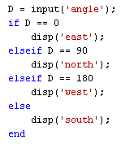
“if-elseif-else-end” (cont.)
Previous example
Note – many “elseifs” are allowed, but only 1 “else”

Slide 31
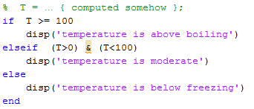
“if-elseif-else-end” (cont.)
Another example :
Output temperature in three different ranges:

Slide 32
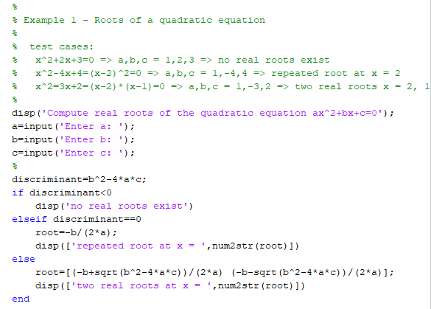
Example – Real Roots of Quadratic Equation (see Lecture_4.m – Example 1)

Slide 33
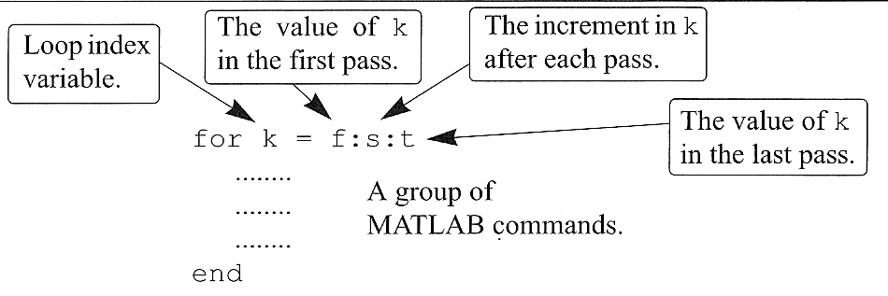
The “for-end” Loop (more on this later)

Slide 34
Example – Hi-Lo guessing game
select number between 1 and 25
no
yes
input guess
5 tries?
lose
no
correct?
provide hi/lo feedback
yes
win

Slide 35
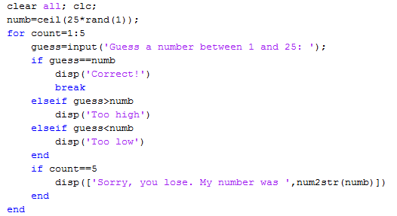
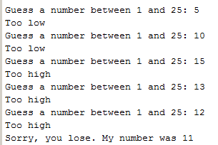
Example – Hi-Lo guessing game (see Lecture_4.m – Example 2)
Note: “break” will be discussed later

