Slide 1
EGR 106 Foundations of Engineering II
Week 12 Lecture - Part A
Announcements

Slide 2
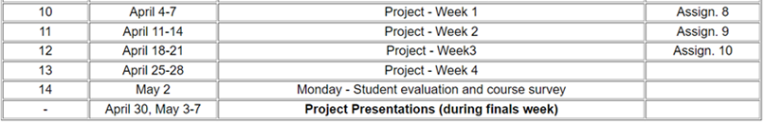
Design Project Schedule
Week 10 (4/4-7)
Introduction to creating shapes
Week 11 (4/11-14)
More shape tools
Creating and viewing 3D models
Week 12 (4/18-21)
Adding color/texture
Week 13 (4/25-28)
Preparing your final presentation

Slide 3
Design Project (cont.)
Deliverables (due last week of classes):
Matlab code
Graphic files (.obj, animated .gif and color/texture definition files)
Project Presentation
Dates & Time: Finals Week
(based on lab section meeting time)
Location: Varies with section (see next slide)

Slide 4
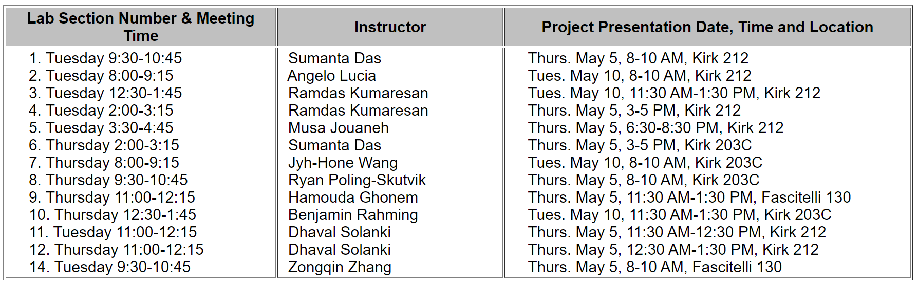
Design Project Presentation Schedule (updated)

Slide 5
Project Assignment
Working in teams of approximately 3 members*:
Select a unique 3D component that you would like to design
Submit a proposal to your lab instructor
Develop a design, taking into consideration available shapes, component functionality and aesthetic appeal
Write a Matlab program that generates your design
Submit Matlab program (.m) and output files (.obj, .gif, .mtl and .jpg) to the Brightspace (lecture) site
Prepare a Powerpoint presentation and give presentation to your lab section during finals week
* Team selection / assignments will be coordinated by lab instructors

Slide 6
Design Project Presentation Rubric
Your team presentation will be graded based on the following components:
Recognition and comprehension of the design process
Creative and/or functional aspects of your design
Aesthetic principles and use of texture
Ability to use Matlab tools
Overall quality of presentation

Slide 7
Aesthetics
“designing is the act of making things that are intended to be both sensible and beautiful”
Paola Antonelli, curator, Dept. of Architecture and Design, Museum of Modern Art
“design is a process for making things right, shaping what people need”
Ralph Caplan, Cooper Hewitt Award, “Design Mind” 2010
“objects are aesthetically valuable if they have the capacity to produce pleasure in those who experience or appreciate them”
https://www.academia.edu/6325207/Eight_Aesthetic_Principles

Slide 8
Use of Texture
“texture is the element of art that refers to the way things feel ... visual texture is an illusion of texture created by an artist
http://visualartspdsf.blogspot.com/2012/04/textures.html
“designers ... understand that texture ... can have a strong visual and tactile impact. The visual aesthetics of a particular material and the surface texture ... contributes to how the user perceives the material”
Zuo et al. "Sensory perception of material texture in consumer products." The Design Journal 19.3 (2016): 405-42

Slide 9
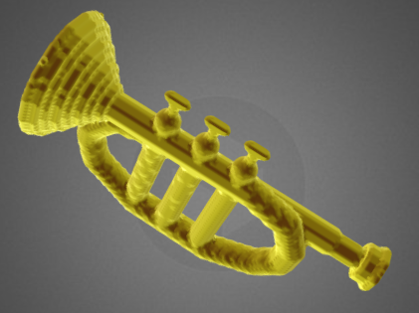
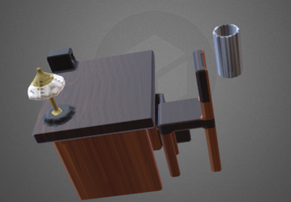
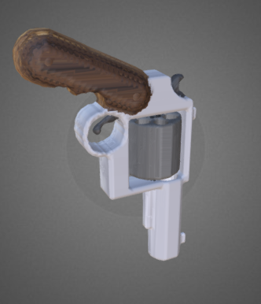
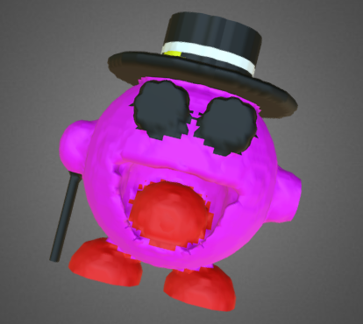
Samples from Previous Years

Slide 10
Week 12 Activities
In Tuesday / Thursday classes
Form design teams (instructors to coordinate)
Develop a project proposal (Assignment # 10)
Begin work on Design Project

Slide 11
Week 12 Quiz
Must be completed by 8 AM, Tuesday, April 19.
Don’t wait to the last minute
You may take it up to 10 times
Your highest score will be recorded in Brightspace Grades

